Slide 1
Speech signal processing

Slide 2
Application: Speech
Speech is a wave traveling through space
at any given point in space it is a signal in time
The speech values are pressure differences (or molecule velocities)
There are many reasons to process speech, for example
speech storage / communications
speech compression (coding)
speed changing, lip sync
text to speech (speech synthesis)
speech to text (speech recognition)
translating telephone
speech control (commands)
speaker recognition (forensic, access control, spotting, …)
language recognition, speech polygraph, …
voice fonts

Slide 3
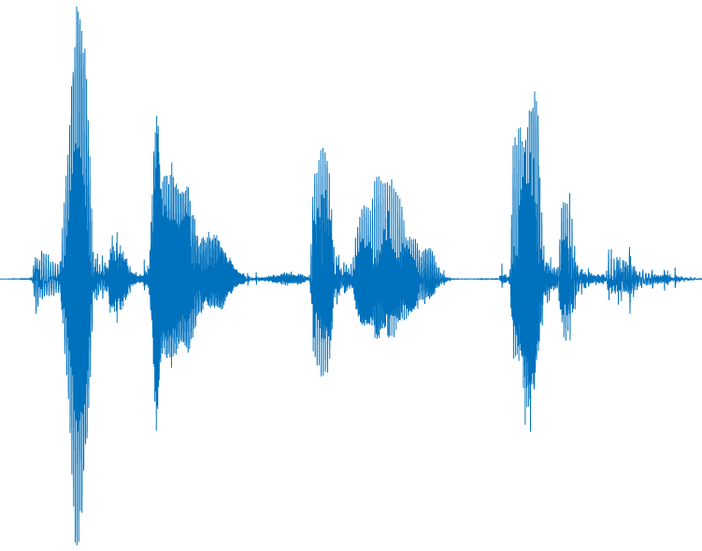
Speech in the time domain
D IGI T A L S I GNA L PROCESSING
Why don’t we see the letters?

Slide 4
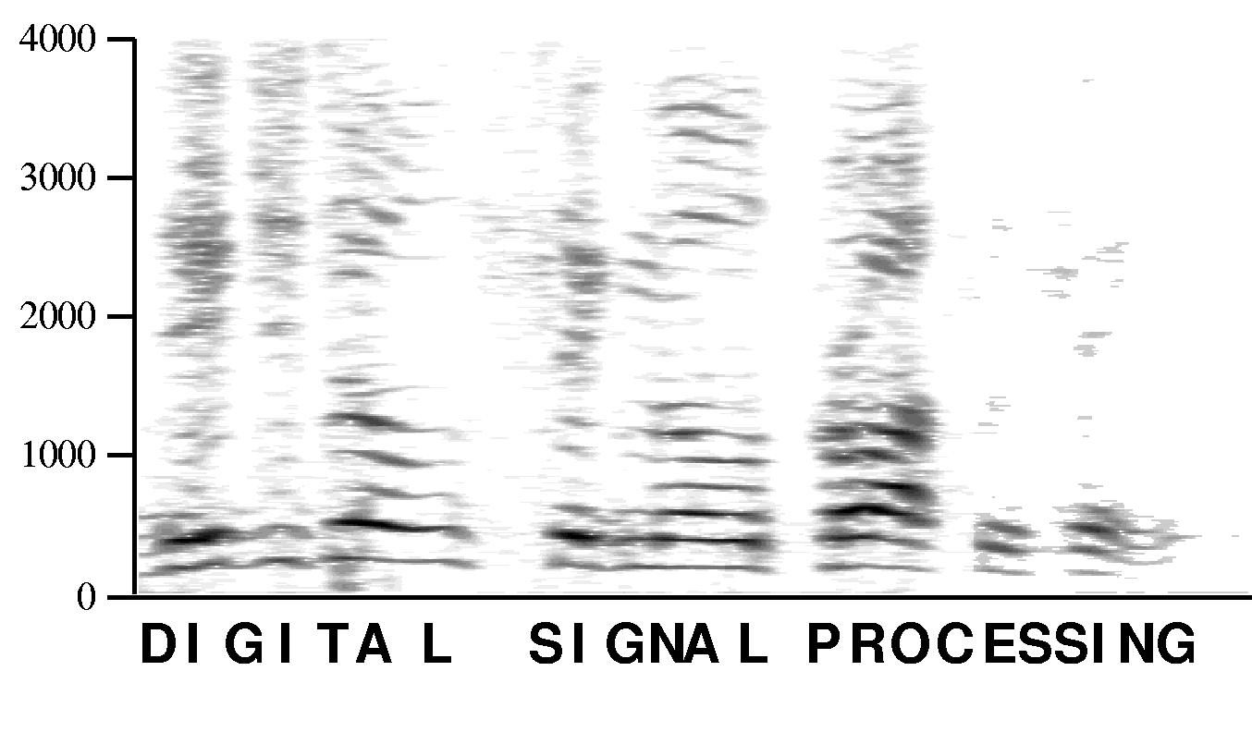
Speech in the frequency domain
Why don’t we see the letters?

Slide 5
Phonemes
A phoneme is defined to be the smallest acoustic unit
that can change meaning
Different languages have different phoneme sets
and their speakers hear sounds differently
in Hebrew there is no TH phoneme, so speakers substitute Z
in Arabic there is no P phoneme, so speakers substitute B
in English there is no כ phoneme, so speakers substitute K
in Japanese there is a single phoneme
somewhere between English R and L
Some languages have many phonemes
Danish has 25 different vowels
Taa has over 150 consonants
Xhosa has 3 different click sounds
Some have very few
Piraha has 3 vowels and 8 consonants
Hawaiian has only 3 consonants

Slide 6
Some phoneme types
Vowels front (heed, hid, head, hat) mid (hot, heard, hut, thought) back (boot, book, boat) dipthongs (buy, boy, down, date) Semivowels liquids (w, l) glides (r, y) | Consonants nasals (murmurs) (n, m, ng) stops (plosives) voiced (b,d,g) unvoiced (p, t, k) fricatives voiced (v, that, z, zh) unvoiced (f, think, s, sh) affricatives (j, ch) whispers (h, what) gutturals ( ח ,ע ) clicks etc. etc. etc.

Slide 7
Speech sampling
Telephony speech is from 200 to 4000 Hz
this is not enough for all sounds we can hear
not really even enough for speech (e.g., S - F)
high quality audio is from 20 Hz to over 20 kHz
By the sampling theorem we need 8000 samples per second
high quality audio typically sampled at 44.1 / 44 / 48 kHz
If we sample at 8 bits per sample
we perceive significant quantization noise (see next slide)
So, let’s assume we should sample at 16 bits per sample
actually 13-14 bits is enough
So we need 8000 samples/sec * 16 bits/sample = 128 kbits/sec
to faithfully capture telephony quality speech
Information theory tells us that speech actually only carries
a few bits per second
So we should be able to improve this
but we need to learn more about the speech signal!

Slide 8
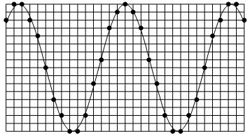
What’s quantization noise?
When we quantize a signal value s_{n} to the closest integer (or rational)
we add an error value x_{n} = s_{n} + q_{n}
Assuming the q_{n} samples are uncorrelated
the quantization noise is white noise
We hear white noise as a hiss
q_{n} ε [-½ 2^{-n}, ½ 2^{-n}]
(or [-½ 2^{-n}, ½ 2^{-n}] if we assume the signal is in [-1 , 1])
So the more bits we use the better the Signal to Noise Ratio
Each additional bit reduces the SNR by a factor of 2 (3 dB)

Slide 9
Speech biology
To understand the speech signal
we need to learn some biological signal processing
There are two separate systems of interest
speech generation system
  lungs
  windpipe
  vocal folds (cords)
  vocal tract (mouth cavity, tongue, teeth, lips, uvula)
  Broca’s area (in left hemisphere)
speech recognition system
  outer ear
  ear drum and hammer
  cochlea, organ of Corti (cilia)
  auditory nerve
  medial geniculate nucleus (in thalamus)
  auditory cortex and Wernicke’s area (in superior temporal gyrus)
These two systems are not well matched

Slide 10
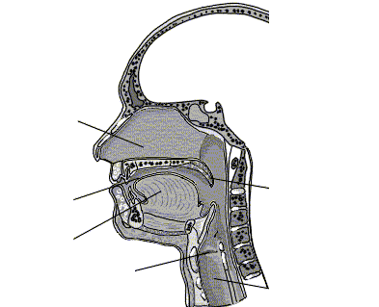
Speech Production Organs
Brain
Hard Palate
Nasal
cavity
Velum
Teeth
Lips
Uvula
Mouth
cavity
Pharynx
Tongue
Esophagus
Larynx
Trachea
Lungs

Slide 11
Speech Production
Air from lungs is exhaled into trachea (windpipe)
Vocal cords (folds) in larynx can produce periodic pulses of air
by opening and closing (glottis)
Throat (pharynx), mouth, tongue and nasal cavity modify air flow
Teeth and lips can introduce turbulence
Basic function – filter an excitation signal
(we will see that the filter can be modeled as an AR filter)

Slide 12
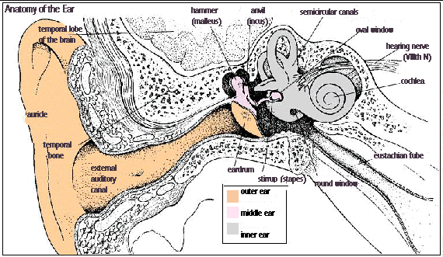
Hearing Organs

Slide 13

Hearing Organs
Sound is air pressure changing over time (and propagating through space)
Sound enters the external ears which
collect as much sound energy as possible (like a satellite dish)
differentiate between right/left and front/back
even differentiate between up and down
Sound waves impinge on outer ear enter auditory canal
Amplified waves cause eardrum to vibrate
Eardrum separates outer ear from middle ear
The Eustachian tube equalizes air pressure of middle ear
Ossicles (hammer, anvil, stirrup) amplify vibrations
Oval window separates middle ear from inner ear
Stirrup excites oval window which excites liquid in the cochlea
The cochlea is curled up like a snail
The basilar membrane runs along middle of cochlea
The organ of Corti transduces vibrations to electric pulses
Pulses are carried by the auditory nerve to the brain

Slide 14
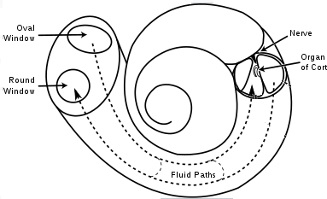
Cochlea
Cochlea has 2 1/2 to 3 turns (for miniaturization)
were it straightened out it would be 3 cm in length
The basilar membrane runs down the center of the cochlea
as does the organ of Corti
15,000 cilia (hairs) contact the vibrating basilar membrane
and when it vibrates they release neurotransmitters
stimulating 30,000 auditory neurons
Cochlea is wide (1/2 cm) near oval window and tapers towards apex
and is stiff near oval window and flexible near apex
hence high frequencies cause vibrations near the oval window
while low frequencies cause section near apex to vibrate
Basic function – Fourier Transform
(by overlapping bank of bandpass filters)

Slide 15
Voiced vs. Unvoiced Speech
We saw that air from the lungs passes through the vocal cords
When open the air passes through unimpeded
When laryngeal muscles close them glottal flow is in bursts
When glottal flow is periodic we have voiced speech
basic interval/frequency called the pitch (f₀)
pitch frequency is between 50 and 400 Hz
You can feel the vocal cord vibration
by placing your fingers on your larynx
A laryngeal microphone directly perceives the sound at this point
even opening you mouth very wide doesn’t work very well
Vowels are always voiced (unless whispered)
Consonants come in voiced/unvoiced pairs

Slide 16
Exercise
Which are voiced and which are unvoiced ?
B, D, F, G, J, K, P, S, T, V, W, Z,
Ch, Sh, Th (the), Th (theater), Wh, Zh
Which unvoiced phoneme matches the voiced one?
B
D
G
V
J
Th (the)
W
Z
Zh

Slide 17
Excitation spectra
Voiced speech is periodic and so has line spectrum
Pulse train is not sinusoidal due to short pulses of air
and is rich in harmonics (amplitude decreases about 12 dB per octave)
Unvoiced speech is not periodic
Common assumption : white noise (turbulent air)
f
pitch
f

Slide 18

Effect of vocal tract
So what is the difference between all the (un)voiced sounds?
The sound exiting the larynx enters the mouth cavity and is filtered
Mouth and nasal cavities have resonances (poles)
similar to blowing air over a bottle
Thus the sound exiting the mouth is periodic (due to periodic excitation)
but with some harmonics strong and some weak
Resonant frequencies depend on geometry
in particular mouth opening, tongue position, lip position

Slide 19
Effect of vocal tract - cont.
Sound energy at resonant frequencies is amplified
Frequencies of peak amplification are called formants
F1
F2
frequency response
F3
F4
frequency
voiced speech
unvoiced speech
F0

Slide 20
Cylinder model(s)
Rough model of throat and mouth cavity (without naval pathway)
With nasal pathway
destructive
interference
Voice
Excitation
Voice
Excitation

Slide 21
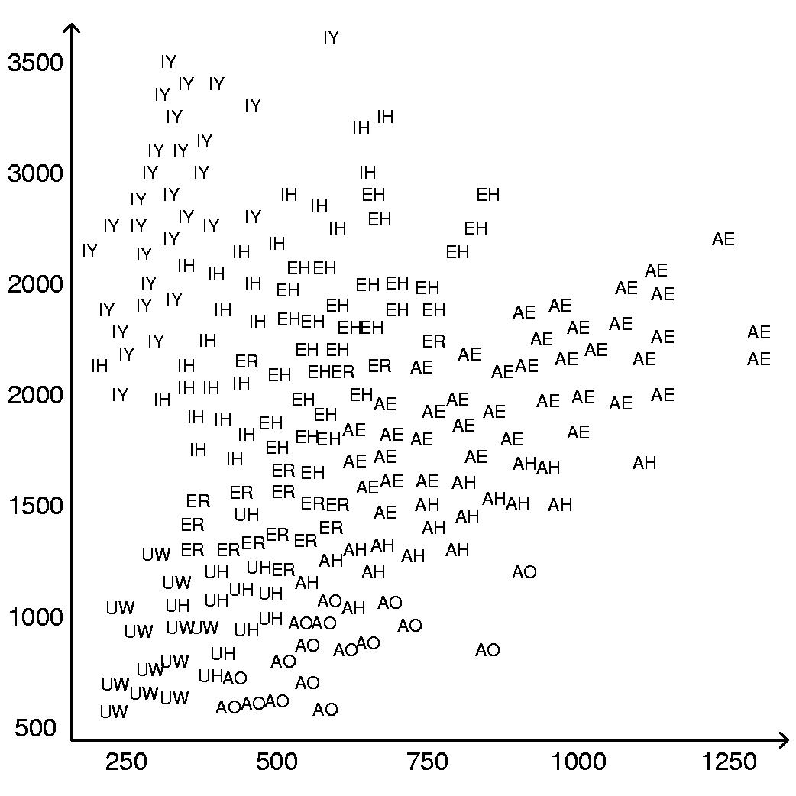
Formant frequencies
Peterson - Barney data (note the “vowel triangle”)
f₂
AE = hat
AH = hut
AO = ought
EH = head
ER = hurt
IH = hit
IY = heat
UH = hood
UW = who
f₁

Slide 22
Sonograms
Which sounds are voiced?
Where is the pitch?
Where are the formants?

Slide 23
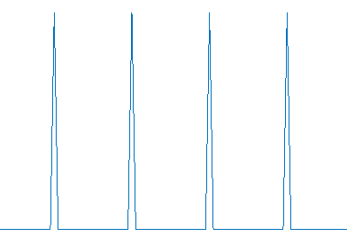
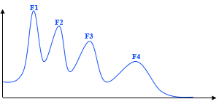
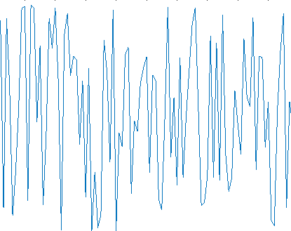
Simple model for speech generation
Pulse
Generator
U/V
switch
G
synthesis
filter
s
White Noise
Generator

Slide 24
LPC Model
This model was invented by Bishnu Atal (Bell Labs) in 1960s
pulse generator produces a harmonic rich periodic impulse train
white noise generator produces a random signal
U/V switch chooses between voiced and unvoiced excitation
varying gain allows to speak loudly or softly
(typically placed before the filter)
LPC filter amplifies formant frequencies
(no zeros but peaks - all-pole or AR IIR filter)
Note: standard LPC doesn’t work well for nasals
destructive interference creates zeros in the frequency response
output resembles true speech to within modeling error

Slide 25
Can LPC compress speech?
Let’s estimate the number of bits/second required to
capture speech (for transmission or storage) using the LPC model
we need to model several times per phoneme
  no-one can produce more than a few phonemes per second
  20-100 frames per second is reasonable, let’s assume 25
we need to specify the pitch (between 50 and 400) in Hz
  1 byte is more than enough (no-one hears the difference of 1 Hz!)
we need 1 bit for the U/V switch
  but don’t have to waste a bit
  since we can encode as pitch with zero frequency
we need to capture the gain
  1 byte is enough (our ear is not that sensitive to small gain changes)
the AR filter has 4 formants
  so we need 8 values (4 frequencies and 4 amplitudes or 8 poles)
  and once again will assume 1 byte for each
Altogether we need 25 * (10 bytes * 8 bits/byte) = 2000 bits/sec
much better than 128,000 bits/sec

Slide 26
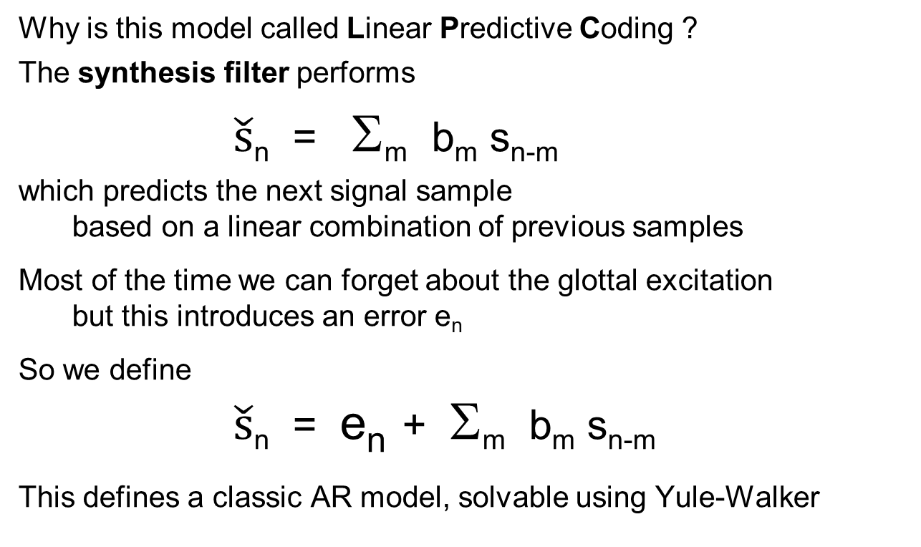
LPC ?
Why is this model called Linear Predictive Coding ?
The synthesis filter performs
$\check{s}$_{n} = Σ_{m} b_{m} s_{n-m}
which predicts the next signal sample
based on a linear combination of previous samples
Most of the time we can forget about the glottal excitation
but this introduces an error e_{n}
So we define
$\check{s}$_{n} = e_{n} + Σ_{m} b_{m} s_{n-m}
This defines a classic AR model, solvable using Yule-Walker

Slide 27
How do we do it?
Given a frame of speech samples (x₀, x₁, x₂, ... x_{N-1})
how do we find the LPC parameters?
the gain is easy to find – it requires calculating the energy
U/V can be found by observing the spectrum
if lines then voiced, if continuous then unvoiced
the pitch can be determined by
  lowest spectral peak or frequency difference between peaks
  autocorrelation
since the input to the AR filter can now be created
and the output is the speech samples
we now have an AR filter system identification problem
so the filter can be found by solving the Yule-Walker equations

Slide 28
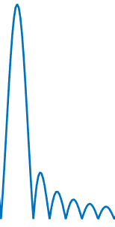
Does it work?
An early commercial use of LPC
was the Texas Instruments Speak & Spell chip
which used LPC-10 (10 AR coefficients)
An early software implementation was Klattalk
Pure LPC speech sounds robotic (Steven Hawking speech) because
we need to add prosodic modeling
we need to post process to clean up estimation errors
e.g., pitch doubling
we need to add frame-to-frame processing
e.g., pitch needs to change smoothly
but most importantly
pitch pulses are not deltas or on-off rectangles
they have waveforms that influence the sound

Slide 29
Better speech compression
Compressing telephony quality speech
was once a tremendously important problem
The International Telecommunications Union set goals
to reduce speech transmission rates by factors of 2
We can thus compare:
128 kbit/sec – linearly quantized speech
64 kbit/sec – Pulse Code Modulation (logarithmic quantization)
32 kbit/sec – Adaptive Delta PCM
16 kbit/sec was never standardized
8 kbit/sec – Code Excited LPC
But we now need to understand some psychophysics

Slide 30
Psychophysics
Psychophysics is the subject that combines psychology and physics
Its fundamental question is the connection between
external physical values (light, sound, etc.)
internal psychological perception
Ernst Weber was one of the first to investigate of the senses
In a typical experiment
a subject is asked in which hand there are more coins
1 coin in 1 hand and 2 coins in the other is easily noticeable
10 coins in 1 hand and 11 coins in the other is just noticeable
41 coins in 1 hand and 42 in the other is not noticeable
But how could this be?
Can one notice the difference of 1 coin or not?

Slide 31
Weber
Weber defined the concept of the Just Noticeable Difference (JND) the minimal change produces a noticeable difference
Weber’s important discovery was that JND varied with signal strength
In fact, Weber found
the sensitivity of a subject to X is in direct proportion to the X itself
that is
one notices adding a specific percentage not an absolute value
Δ I = k I
Thus
the number of noticeable additional coins
is proportional to the number of coins
and the same is true for
saltiness of salty water
length of lines
strength of sound

Slide 32
Fechner’s law
Gustav Theodor Fechner was a student of Weber
While viewing the sun in order to discover JNDs he was blinded
He later regained his sight and took this as a sign
that he would solve the psychophysical problem
Simplest assumption: JND is single internal unit
Weber’s law says we perceive external values multiplicatively
Fechner concluded that internal unit is the log of the external one:
Y = A log I + B
People celebrate the day he discovered this
as Fechner Day (October 22 1850)

Slide 33
Dynamic range
Logarithms are compressive
Fechner’s law explains the fantastic ranges of our senses
Sight (retinal excitation)
minimum: single photon
maximum (harm threshold): direct sunlight
ratio: 10¹⁵
Hearing (eardrum movement)
minimum: < 1 Angstrom 10⁻¹⁰ meters
maximum (harm threshold): >1 mm (behind a jet plane)
ratio: 10⁸
Alexander Graham Bel defined to be log₁₀ of power ratio
A decibel (dB) one tenth of a Bel
d(dB) = 10 log₁₀ P₁ / P₂

Slide 34
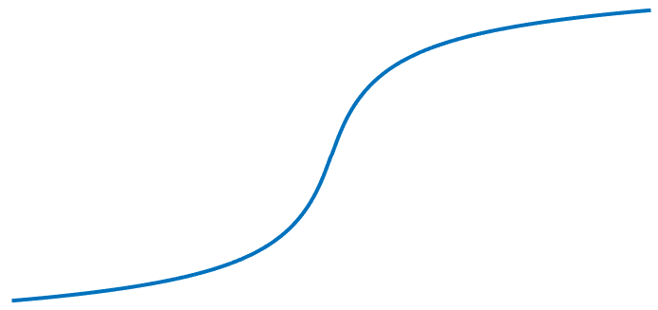
Fechner’s law for sound amplitudes
According to Fechner’s law, we are more sensitive at lower amplitudes
We perceive small differences when the sound is weak
but only perceive large differences for strong sounds
Companding is the compensation
for the logarithmic nature of speech perception
We need to adapt the logarithm function
to handle positive/negative signal values
If we could sample non-evenly
then this can be exploited for speech compression

Slide 35
Fechner’s law for sound frequencies
octaves, well tempered scale
Critical bands
Frequency warping
Melody 1 KHz = 1000, JND afterwards M ~ 1000 log₂ ( 1 + f_{KHz} )
Barkhausen can be simultaneously heard B ~ 25 + 75 ( 1 + 1.4 f²_{KHz} )^{0.69}
excite different basilar membrane regions
¹² 2
f

Slide 36

2 more psychological laws
Respond to changes
Our senses respond to changes – not to constant values
Masking
Strong tones block weaker ones at nearby frequencies
f

Slide 37
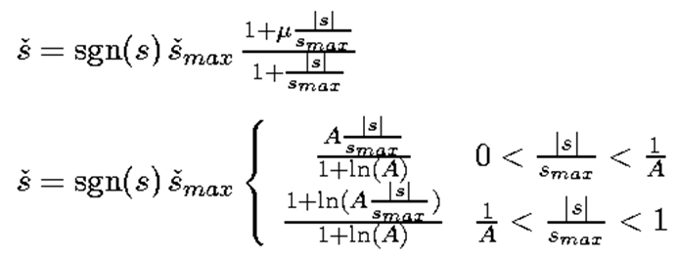
PCM
8 bit linear sampling (256 levels) is noticeably noisy
But due to
  prevalence of low amplitudes in generated speech
  logarithmic response of ear
we can use 8-bit logarithmic sampling ( with sgn(s) * log(|s|) )
G.711 gives 2 different logarithmic approximations
μ-law
A-law
Although very different looking they are nearly identical
G.711 standard further approximates these expressions
by 16 staircase straight-line segments (8 negative and 8 positive)
Note that μ-law has horizontal segment through the origin (plus and minus zero)
while A-law has a vertical segment
North America μ = 255
Rest Of World
Α = 87.56

Slide 38
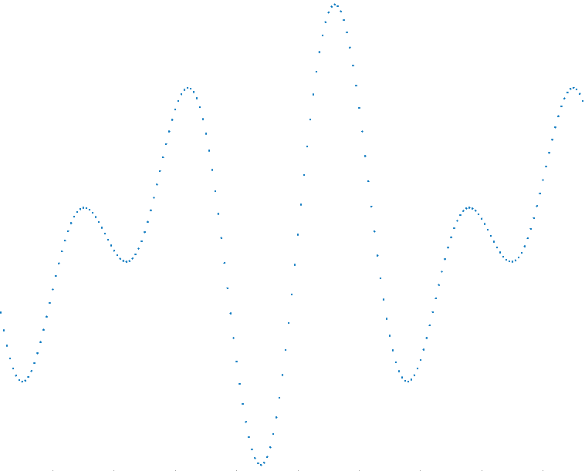
Logarithmic sampling

Slide 39
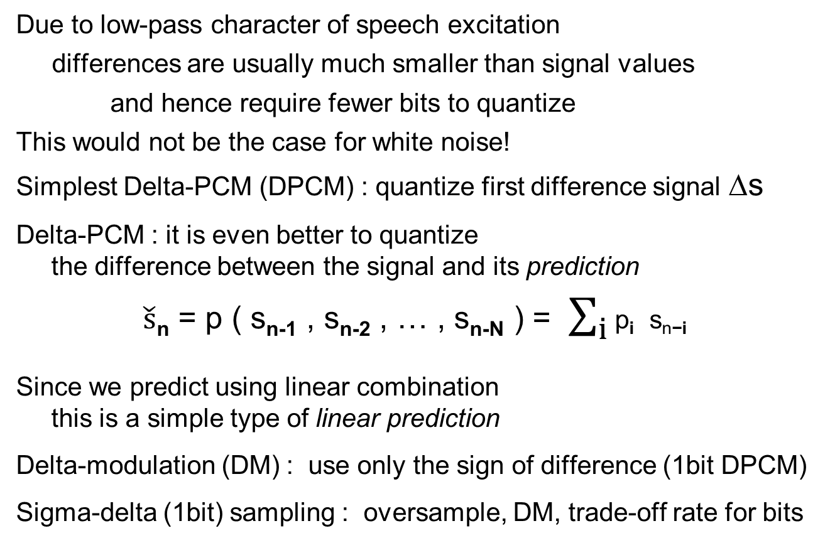
DPCM
Due to low-pass character of speech excitation
differences are usually much smaller than signal values
and hence require fewer bits to quantize
This would not be the case for white noise!
Simplest Delta-PCM (DPCM) : quantize first difference signal Δs
Delta-PCM : it is even better to quantize
the difference between the signal and its prediction
$\check{s}$_{n} = p ( s_{n-1} , s_{n-2} , … , s_{n-N} ) = $\sum_{i}{\text{p}\text{i} \text{sn}\text{−}\text{i}}$
Since we predict using linear combination
this is a simple type of linear prediction
Delta-modulation (DM) : use only the sign of difference (1bit DPCM)
Sigma-delta (1bit) sampling : oversample, DM, trade-off rate for bits

Slide 40
Deltas are usually small
The first difference requires fewer bits
if 4 bits is enough then we need 32 kb/s

Slide 41
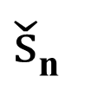
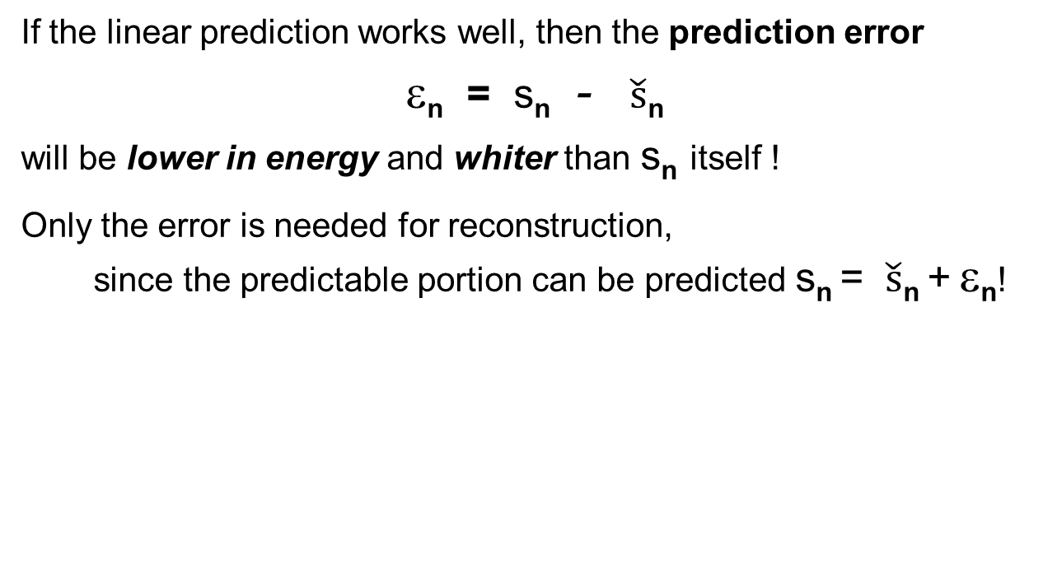
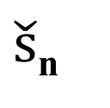
DPCM with prediction
If the linear prediction works well, then the prediction error
ε_{n} = s_{n} - $\check{s}$_{n}
will be lower in energy and whiter than s_{n} itself !
Only the error is needed for reconstruction,
  since the predictable portion can be predicted s_{n} = $\check{s}$_{n} + ε_{n}!
s_{n}
-
ε_{n}
s_{n}
prediction
filter
prediction
filter
$\check{s}$_{n}
$\check{s}$_{n}

Slide 42
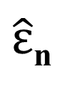
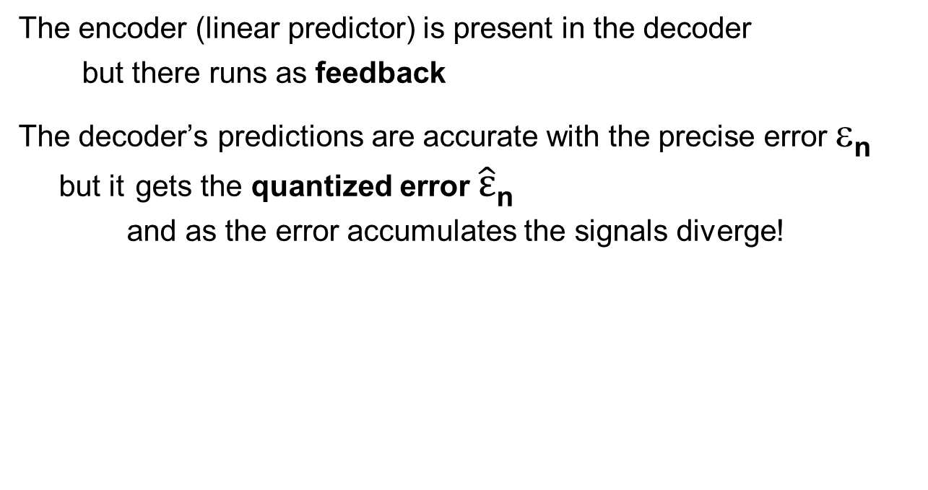
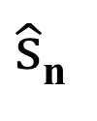
Open loop prediction
The encoder (linear predictor) is present in the decoder
  but there runs as feedback
The decoder’s predictions are accurate with the precise error ε_{n}
but it gets the quantized error $\hat{ε}$_{n}
and as the error accumulates the signals diverge!
s_{n}
Q
$\hat{ε}$_{n}
IQ
$\hat{s}$_{n}
-
PF
PF

Slide 43
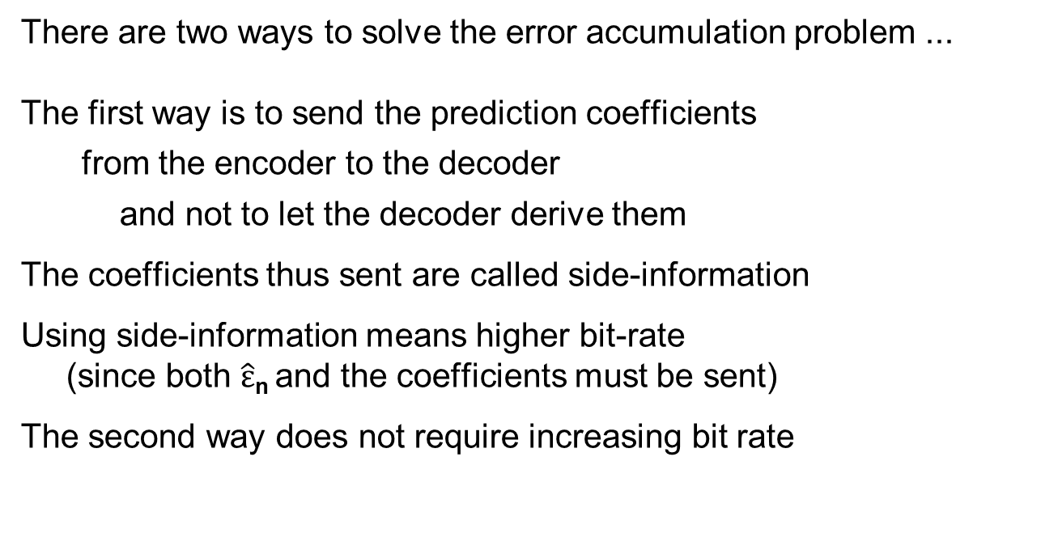
Side information
There are two ways to solve the error accumulation problem ...
The first way is to send the prediction coefficients
  from the encoder to the decoder
  and not to let the decoder derive them
The coefficients thus sent are called side-information
Using side-information means higher bit-rate
(since both $\hat{ε}$_{n} and the coefficients must be sent)
The second way does not require increasing bit rate

Slide 44
Closed loop prediction
To ensure that the encoder and decoder stay “in-sync”
  we put the entire decoder
  including quantization and inverse quantization
  into the encoder
Thus the encoder’s predictions are identical to the decoder’s
  and no model difference accumulates
ε_{n}
s_{n}
Q
ε_{n}
IQ
s_{n}
-
IQ
PF
PF

Slide 45
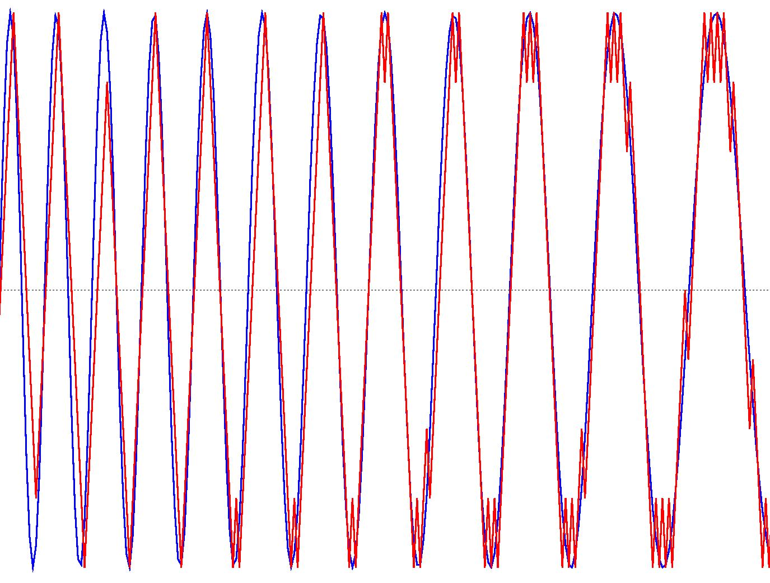
Two more forms of error
For DM there is another source of error (that depends on step size)
Δ too small
Δ ΟΚ
Δ too large
Δ much too large

Slide 46
Adaptive DPCM
Speech signals are very nonstationary
We need to adapt the step size to match signal behavior
  increase Δ when signal changes rapidly
  decrease Δ when signal is relatively constant
Simplest method (for DM only):
  if present bit is the same as previous multiply Δ by K (K=1.5)
  if present bit is different, divide Δ by K
  constrain Δ to a predefined range
More general method :
  collect N samples in buffer (N = 128 … 512)
  compute standard deviation in buffer
  set Δ to a fraction of standard deviation
    send Δ to decoder as side-information or
    use backward adaptation (closed-loop Δ computation)

Slide 47
G.726
G.726 (standard for international telephony) has
  adaptive predictor
  adaptive quantizer and inverse quantizer
  adaptation speed control
  tone and transition detector
  mechanism to prevent loss from tandeming
computational complexity relatively high (10 MIPS)
32 kbps toll quality
24 and 16 Kbps modes defined, but not toll quality
G.727 same rates but embedded for packet networks
ADPCM only exploited general low-pass characteristic of speech
What is the next step?

Slide 48
AVQSBC
A good quality 16 kb/s speech encoder is obtained
by exploiting Fechner’s law for sound frequencies
The idea is to use Sub-Band Coding
We divide the signal in the frequency domain
using perfect-reconstruction band-pass filters
The frequency widths are small at low frequencies
but large at high frequencies
Each subband is separate quantized using Vector Quantization
This technique was never standardized for speech
but SBC was standardized for music as MP3 audio
0 Hz
4000 Hz

Slide 49
LPC10
For military-quality voice
180 sample frame (44.4 frames per second)
are encoded into 54 bits as follows:
Pitch + U/V (found using AMDF) 7 bits
Gain 5 bits
10 reflection coefficients
  first two coefficients converted to log area ratios
  L₁, L₂, a₃, a₄ 5 bits each
  a₅, a₆, a₇, a₈ 4 bits each
  a₉ 3 bits a₁₀ 2 bits 41 bits
1 sync bit 1 bit
54 bits 44.44 times per second results in 2400 bps
By using VQ one could reduce bit rate to under 1 Kbps!
LPC-10 speech is intelligible, but synthetic sounding
  and much of the speaker identity is lost !

Slide 50
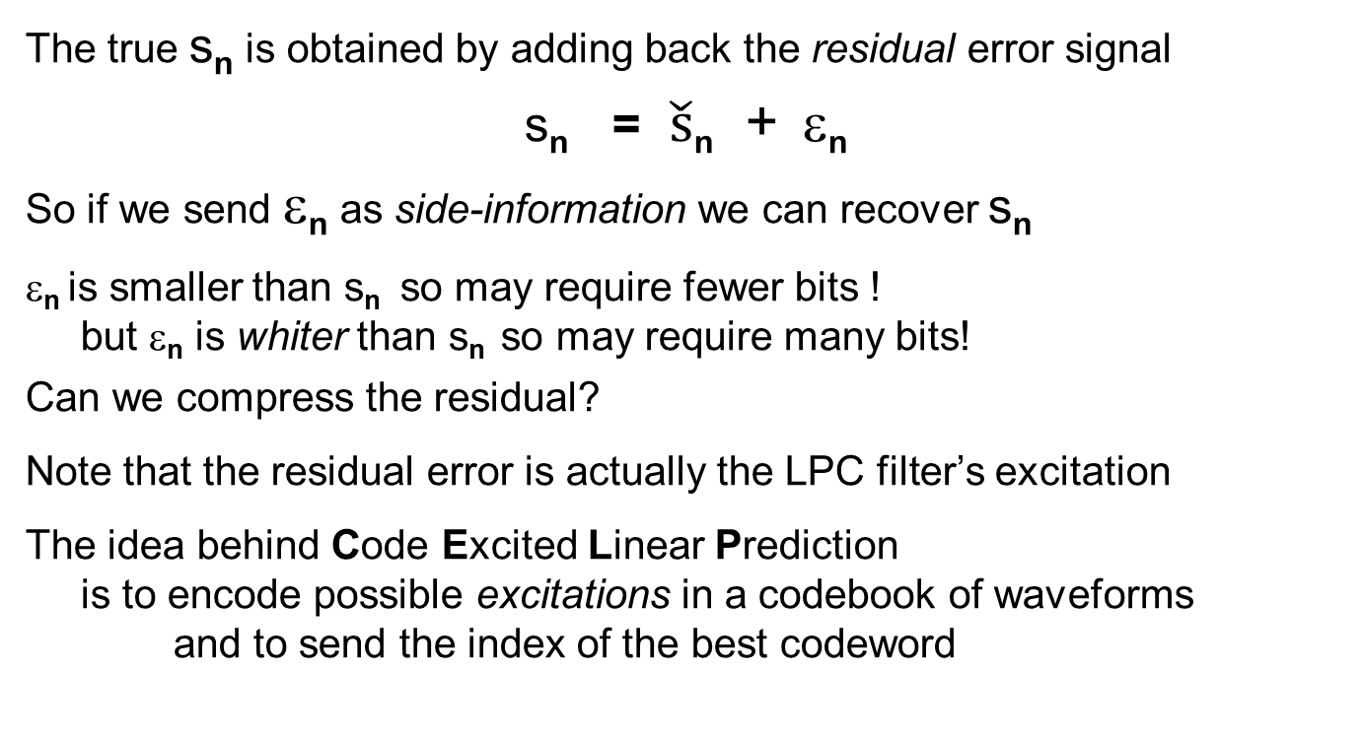
CELP
The true s_{n} is obtained by adding back the residual error signal
s_{n} = $\check{s}$_{n} + ε_{n}
So if we send ε_{n} as side-information we can recover s_{n}
ε_{n} is smaller than s_{n} so may require fewer bits !
but ε_{n} is whiter than s_{n} so may require many bits!
Can we compress the residual?
Note that the residual error is actually the LPC filter’s excitation
The idea behind Code Excited Linear Prediction
is to encode possible excitations in a codebook of waveforms
and to send the index of the best codeword

Slide 51
Analysis By Synthesis
To find the best code word we try them all (exhaustive enumeration)
although algebraic tricks save computation
We choose the code word with the least error
s_{n}
Compute
energy
-
CB
LPC
.
.
.
find
minimum

Slide 52
Perceptual weighting
But we don’t want the approximation
that looks the most like the real signal
We want the approximation
that sounds the most like the real signal
Now is the time to use psychophysics
Instead of computing the energy of the difference
we use a perceptual measure of similarity
that takes masking, etc. into account

Slide 53
G.729
The standard speech compression in cellular
and very popular in Internet and other applications
Encodes 10 ms frames (100 frames per second) into 80 bits
resulting in 8000 bits per second
filter coefficients 18 bits pitch 8 bits
gain CB 14 bits adaptive CB 5 bits
pulse positions 26 bits pulse signs 8 bits parity check 1 bit

Slide 54
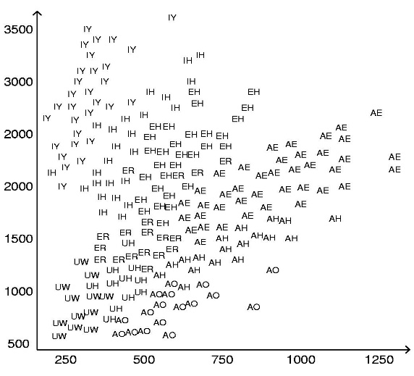
Speech recognition
You might think that speech recognition could be performed thus:
extract speech features (e.g., LPC, Cepstrum) for speech frames
classify several successive frames into phonemes
combine phonemes into words
Unfortunately, that doesn’t work for many reasons
phonemes are pronounced differently depending on context
phonemes are pronounced differently depending on accent
phonemes may not be pronounced at all in rapid speech
nonlinear time warping

Slide 55
Backtracking
The lower levels of the human auditory tentatively identify
the most probable phoneme
But as we continue listening
the higher levels continuously backtrack
and select lower probability ones if needed
To understand this backtracking we can use an analogy
from even higher levels of speech understanding
What does the word FIRE mean in the following sentence?
THE MAN SHOUTED
FIRE !
FIRE THE GUN !
FIRE THE GUN MAKER !

Slide 56
Why don’t we notice this?
All of this happens unconsciously in the background
but involves higher levels of the cortex
Example 1
People who do not understand a language
can not reliably transcript phonemes in that language
Example 2
People who understand a language well
can successfully understand in very low SNR
Example 3
What am I saying?
HOW TO RECOGNIZE SPEECH
HOW TO WRECK A NICE BEACH

Slide 57
Levenshtein distance
Automatic typing correction mechanisms and spelling correction
find the closest known word to an unknown one
How do we define closeness?
The Levenshtein distance between 2 strings (not necessarily equal length)
is defined as the minimal cost to transform 1 string to the other
Where each of the following has a defined cost
deletion digital → digtal
insertion signal → signall
substitution processing → prosessing
  in typing the cost may depend on how close the keys are
  in spelling correction the cost may depend on the sounds
What is the unity weighted Levenshtein distance
between digital and dijtal?
How do we find the minimum cost?

Slide 58
Levenshtein distance (unity weighting)
What is the Levenshtein distance between prossesing and processing ?
Rules:
1 enter square
from left (deletion) cost = 1
2 enter square
from under (insertion) cost = 1
3a enter square
from diagonal
and same letter cost = 0
3b enter square
from diagonal
and different letter
(substitution) cost = 1
4 Always use minimal cost
p r o s s e s i n g
p r o c e s s i n g

Slide 59
Levenshtein distance - cont.
Start with 0 in the bottom left corner
9
8
7
6
5
4
3
2
1
0 1 2 3 4 5 6 7 8 9
p r o s s e s i n g
0
p r o c e s s i n g

Slide 60
Levenshtein distance - cont.
Continue filling in table
9
8
7
6
5
4 3 2 2 2
3 2 1 1 2
2 1 0 1 2
1 0 1 2 3
0 1 2 3 4 5 6 7 8 9
Note that only local computations and decisions are made
p r o s s e s i n g
0
p r o c e s s i n g

Slide 61
Levenshtein distance - cont.
Finish filling in table
9 8 7 7 6 5 5 5 4 3
8 7 6 6 5 4 4 4 3 4
7 6 5 5 4 3 3 3 5 5
6 5 4 4 3 2 3 4 4 5
5 4 3 3 2 3 3 3 4 5
4 3 2 2 2 2 2 3 4 5
3 2 1 1 2 2 3 4 5 6
2 1 0 1 2 3 4 5 6 7
1 0 1 2 3 4 5 6 7 8
0 1 2 3 4 5 6 7 8 9
The global result is 3 !
So the Levenshtein distance is 3
p r o s s e s i n g
0
p r o c e s s i n g

Slide 62
Levenshtein distance - end
Backtrack to find path actually taken
9 8 7 7 6 5 5 5 4 3
8 7 6 6 5 4 4 4 3 4
7 6 5 5 4 3 3 3 5 5
6 5 4 4 3 2 3 4 4 5
5 4 3 3 2 3 3 3 4 5
4 3 2 2 2 2 2 3 4 5
3 2 1 1 2 2 3 4 5 6
2 1 0 1 2 3 4 5 6 7
1 0 1 2 3 4 5 6 7 8
0 1 2 3 4 5 6 7 8 9
Remember:
The question is always how we got to a square
We see that the distance is 3
Since, e.g.,
substitution
insertion
deletion
p r o s s e s i n g
p r o c e s s i n g

Slide 63
Generalization to DP
If not all substitutions are equally probable
  then we add the cost function instead of 1
We can also have costs for insertions and deletions
D_{i j} = min ( D_{i-1 j} + C_{i-1 j; I j} ; D_{i-1 j-1} + C_{i-1 j-1; I j} ; D_{i j-1} + C_{i-1 j; I j} )
And even more general rules are often used
This algorithm is called Dynamic Programming
and many other names
  Viterbi algorithm
  Levenshtein distance
  Dynamic Time Warping
but they are all basically the same thing!
The algorithm(s) are computationally efficient
  since they find a global minimum based on local decisions

Slide 64
DTW
DTW uses the Dynamic Programming technique
for matching spoken words
The input is a feature vector (e.g., LPC, cepstrum)
and is separately matched to each dictionary word feature vector
  and the closest word is the winner!
The cost for each substitution needs to represent
how similar the two sounds sound
In isolated word recognition systems
  energy contours are used first to isolate the words
  linear time warping is then used to normalize the duration
  but special mechanisms are used for endpoint location flexibility
In connected word recognition systems
  the endpoint of each recognized utterance is used
  as a starting point for searching for the next word
In speaker-independent recognition systems
  multiple templates are used for each reference word

Slide 65
Markov Models
An alternative to DTW is based on Markov Models
A discrete-time left-to-right first order Markov model
A DT LR second order Markov model
In Markov models future states depend only on the current state
What is the probability of remaining stuck in a state?
a₁₁
a₂₂
a₃₃
a₄₄
probabilities
a₁₂
a₁₂
a₂₃
a₃₄
a₁₁ + a₁₂ = 1,
a₂₂ + a₂₃ = 1,
etc.
State 1 2 3 4
a₁₁
a₂₂
a₃₃
a₄₄
a₁₁ + a₁₂ + a₁₃ = 1,
a₂₂ + a₂₃ + a₂₄ = 1,
etc.
a₁₂
a₂₃
a₃₄
a₁₃
a₂₄

Slide 66
Example
State A B C D
0.5
0.5
1
0.5
0.5
Which strings are possible? What are their probabilities?
ABCD p = 0.5*0.5*1 = 0.25
ABD p = 0.5 * 0.5 = 0.25
ACD p = 0.5 = 0.5
Note that the probabilities sum to 1 (of course!)

Slide 67
Example
0.5
0.5
0.5
0.5
0.5
0.5
0.5
0.5
State A B C D
Which strings are possible?
ABCD
AABBCCDD
ABBBBBBBCD
ACBD
ABBCDCCD
AAAAA....
Which string is most probable?
What is its probability?
Which strings are 2nd most probable?
What are their probability?
What is the probability of an infinite string?

Slide 68
Markov Models - cont.
3
General DT Markov Model
Model jumps from state to state with given probabilities
e.g. 1 1 1 1 2 2 3 3 3 3 3 3 3 3 4 4 4
or 1 1 2 2 2 2 2 2 2 2 2 4 4 4
1
2
4

Slide 69
Markov Models - cont.
Why use Markov models for speech recognition?
  states can represent phonemes (or whatever)
  different phoneme durations (but exponentially decaying)
  phoneme deletions using 2nd or higher order
So time warping is automatic !
How do we use it?
We first build a Markov model for each word
Then, given an utterance
we select the most probable word

Slide 70
HMM
But the same phoneme can be said in different ways
  so we need a Hidden Markov Model
a₁₁
a₂₂
a₃₃
a₄₄
a₁₂
a₂₃
a₃₄
b₁₁
b₁₄
b₁₃
b₁₂
4
1
2
3
a_{ij} are transition probabilities
b_{ik} are observation (output) probabilities
acoustic
phenomenon
b₁₁ + b₁₂ + b₁₃ + b₁₄ = 1,
b₂₁ + b₂₂ + b₂₃ + b₂₄ = 1,
etc.

Slide 71
HMM - cont.
For a given state sequence S₁ S₂ S₃ … S_{T}
the probability of an observation sequence O₁ O₂ O₃ … O_{T}
is P(O|S) = bS₁O₁ bS₂O₂ bS₃O₃ … bS_{T}O_{T}
For a given hidden Markov model M = { states, a, b }
the probability of the state sequence S₁ S₂ S₃ … S_{T}
is (the initial probability of S₁ is taken to be pS₁)
P(S|M) = pS₁ aS₁S₂ aS₂S₃ aS₃S₄ … aS_{T-1}S_{T}
So, for a given hidden Markov model M
the probability of an observation sequence O₁ O₂ O₃ … O_{T}
is obtained by summing over all possible state sequences

Slide 72
HMM - cont.
P(O| M) = Σ P(O|S) P(S|M)
= Σ πS₁ bS₁O₁ aS₁S₂ bS₂O₂ aS₂S₃ bS₂O₂ …
So for an observation sequence we can find
  the probability of any word model
(but this can be made more efficient using the forward-backward algorithm)
How do we train HMM models?
The full algorithm (Baum-Welch) is an EM algorithm
An approximate algorithm is based on the Viterbi (DP) algorithm
(Sorry, but beyond our scope here)

Slide 73
The new world
DTWs and HMMs were the state of the art until recently
DTWs have little training time but long run times
HMM have long training times but short run times
Recently Deep Neural Networks have taken over many applications
DNNs
use essentially no knowledge about the speech signal
require astronomical amounts of data to train
have very long training times
provide no reasoning as to their decisions
can frequently outperform classical methods
but can also fail catastrophically
and can be subject to adversarial attacks

