Slide 1
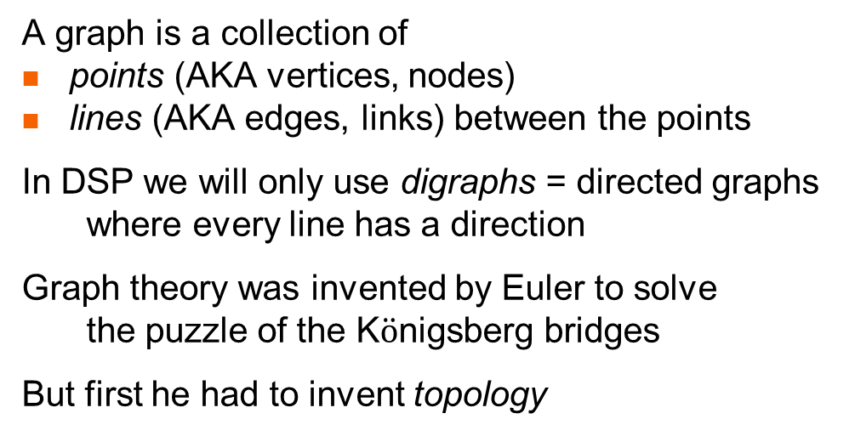
What is a graph?
A graph is a collection of
points (AKA vertices, nodes)
lines (AKA edges, links) between the points
In DSP we will only use digraphs = directed graphs
where every line has a direction
Graph theory was invented by Euler to solve
the puzzle of the K$\ddot{o}$nigsberg bridges
But first he had to invent topology
Is it possible to leave your home for a walk, cross all the bridges exactly once,
and return home? (an Euler cycle)
There is an Euler cycle
iff every point has even degree
Pregel river
graph
map
topologically equivalent map

Slide 2

Topology?
Topology is a generalization of geometry
in geometry congruence allows translation and rotation
in affine geometry we also allow scale changes (zoom)
in projective geometry we allow
any transformation from lines to lines (maintains collinearity)
here all triangles are equivalent, but squares are different
in topology we allow any transformation
that doesn’t tear or glue together space
(think of drawing on a rubber sheet)
Side Side Side
Side Angle Side
Angle Side Angle
but not
Angle Angle Angle
Side Side Side
Side Angle Side
Angle Side Angle
Angle Angle Angle

Slide 3
Some more topology
Topology’s equivalence relationship is called homeomorphism
A homeomorphism is a continuous function from space to space
with a continuous inverse function
In topology distance, angle, and linearity are meaningless
triangle = square = polygon = circle
all curves that don’t cross themselves are equivalent
a figure 8 is not the same as a circle (would require a tear)
(the number of holes is preserved)
in 3D topology a sphere is equivalent to a cube
but not to a donut
What Euler realized is that the existence of a Euler cycle
is independent of the bridge location and orientation
The bridge puzzle is truly a topological problem

Slide 4

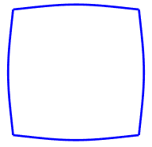
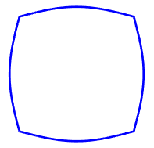

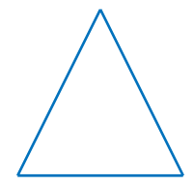
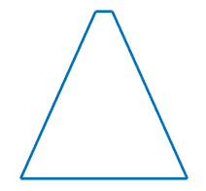
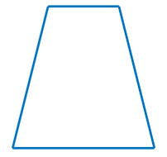

Continuous transformations
Continuously morph a square into a circle (and back again)
Continuously triangle into a square (and back again)

Slide 5
Topology and graph theory
In graph theory all we care about is connectivity
which point is connected to which point
We don’t care about the length or angle of the line
or even if it is a line
The meaning of a graph is purely topological
So all the following digraphs are equivalent:
But not or
y
x
y
x
y
x
y
x
x
y
y
x
x
w
y

Slide 6
Graph theory in CS
In the early days of computer science
programs were represented by block diagrams
which are a kind of graph
This representation has been mostly abandoned
for several reasons:
block diagrams are actually a programming language
so using them in addition to code
means maintaining 2 code different sets
block diagrams are tightly coupled to
imperative program with goto statements
which has been disparaged
block diagrams are purely documentation
and add nothing positive to the programming process
block diagrams only describe algorithms
Wirth’s Law
programs = algorithms + data structures
But in DSP we still use signal flow graphs!
processing
false
if
true
Goto A

Slide 7
Signal flow graphs
Shannon introduced signal flow graphs in which
the points represent signals
the lines (and things on lines) represent signal processing functions
These graphs capture both
algorithms and
data structures
In addition to their purely documentary function
signal flow graphs are useful because of graphical mechanisms
for simplifying graphs
lowering computational power or memory requirements

Slide 8
The simplest graph
The simplest signal flow graph has 1 point and represents a signal
When we write a letter next to a point (below, left, right, above)
it represents the name of the signal (here: x !)
When interpreting signal flow graphs
it is often useful to ask – what is the value of the signals at time n ?
So we sometime draw
But don’t be confused!
The point represents the signal x_{n} Ɐn= -∞ … +∞
not a particular value
x
x_{n}

Slide 9
The next simplest graph
The simplest nontrivial signal flow graph has 2 points and one line
and it represents signal identity (y = x, i.e., Ɐn= -∞ … +∞ y_{n} = x_{n})
Of course, due to the topological nature of graphs
we could have drawn this graph in many other ways
And in this case only we can also reverse the line direction
Note that we will often neglect to draw the point when it is obvious
(i.e., at the end of a line)
(we will later only draw points in specific places …)
identity = assignment
x
y
y = x
x
y
y
x
x
y
y
x
x
y

Slide 10
What does this mean?
y
x
z
y
x
We can figure this out by naming the unlabeled point w
and breaking the graph down into three parts
So w = x and y = w = x and also z = w = x
WARNING! Do not think of this as electrical currents
in which case y=x/2 and z=x/2 !
This graph is called the splitter
Note that the splitter always has
1 signal going in and 2 signals coming out
w
z
x
w
w
y
w
z
y
y = x
and
z = x
x
splitter = tee connector
z

Slide 11
Gain
The simplest signal processing is the gain y = g x (Ɐn= -∞ … +∞ y_{n} = g x_{n})
We draw this by putting the letter g next to the arrow
Note that (for g ≠1) this is very different from
but the same as
Be careful!
A letter near a point tells you the signal’s name
but a letter near an arrow represents a gain
g
x
y
y = g x
gain
g
y
x
x = g y
x
y
g
g
g
g
etc.
y
x
x
y
y
x

Slide 12

Delay
We have seen that the unit delay is very important in DSP
and so it deserves its own graphical symbol
and as usual we can draw this in various orientations, such as
is the same as ?
x
z⁻¹
y
$y= {\hat{z}}^{−1} x$ (Ɐn= -∞ … +∞ y_{n} = x_{n-1} )
unit delay
x
y
z⁻¹
x
z⁻¹
y
g
g
x
z⁻¹
y
x
z⁻¹
y

Slide 13
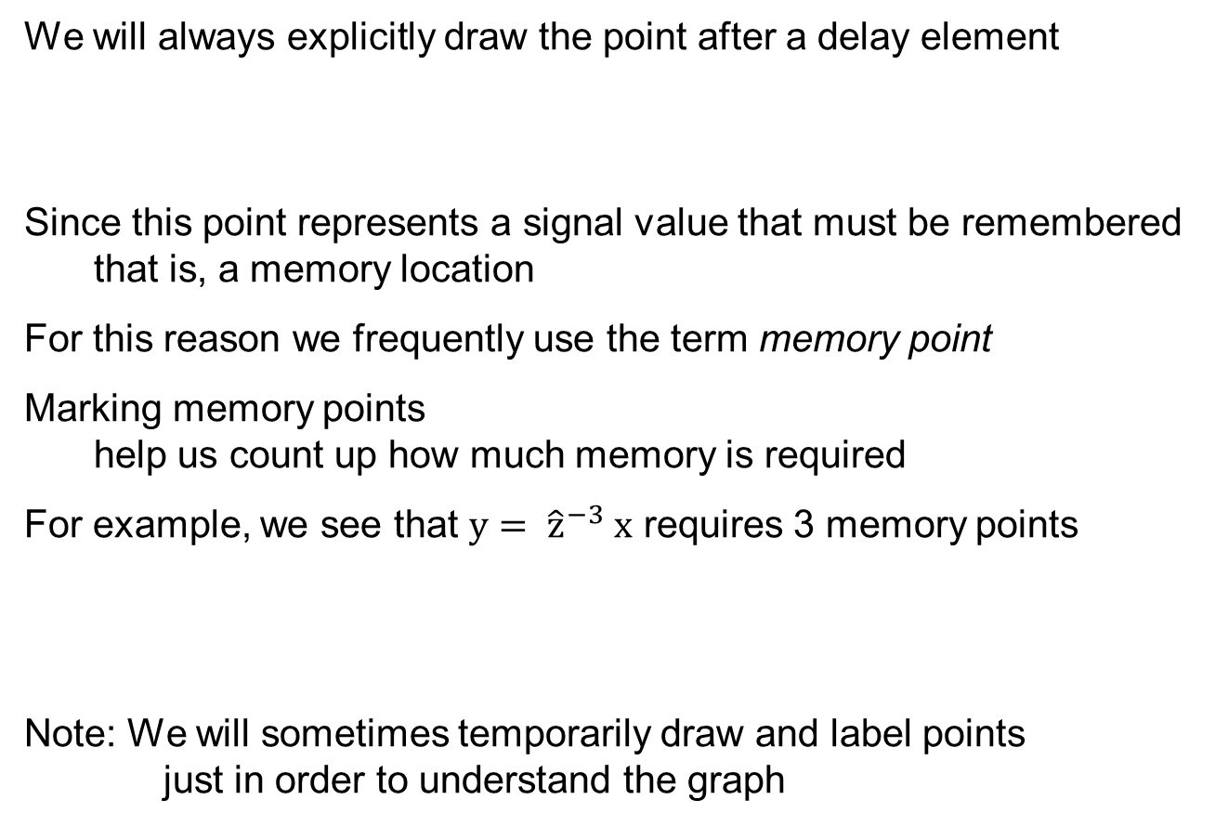
Drawing points
We will always explicitly draw the point after a delay element
Since this point represents a signal value that must be remembered
that is, a memory location
For this reason we frequently use the term memory point
Marking memory points
help us count up how much memory is required
For example, we see that $y= {\hat{z}}^{−3} x$ requires 3 memory points
Note: We will sometimes temporarily draw and label points
just in order to understand the graph
z⁻¹
x
z⁻¹
z⁻¹
z⁻¹
y

Slide 14
Adder
Signal addition is very important as well!
We define the two-signal adder
which of course means
Ɐn= -∞ … +∞ z_{n} = x_{n} + y_{n}
Note that the adder always has
2 signals going in and 1 signal coming out
As usual, we could draw the adder in many ways!
x
z
adder
z = x + y
y
y
y
y
z
x
z
x
z
x

Slide 15
Subtractor
For convenience we also define the 2-signal subtractor
Although we could have used instead
x
z
-
z = x - y
y
Note the position of the minus sign
It can be at either (or both) of the adder’s inputs!
x
z
-1
y

Slide 16
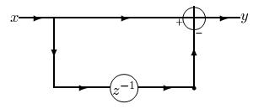

The finite difference
We can now use what we have learned so far to draw a useful graph
the finite difference y = $\hat{Δ}$ x ( i.e., y_{n} = x_{n} - x_{n-1} )
To see that this is correct label needed points (not just the memory points)
with their value at time n
y_{n} = x_{n} - x_{n-1}
x_{n}
y_{n}
splitter
x_{n-1}
x_{n}

Slide 17
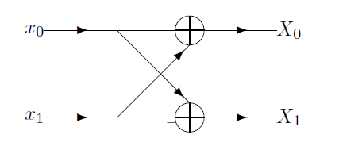

The butterfly
Remember the DFT for N=2 ?
X₀ = x₀ + x₁
X₁ = x₀ – x₁
We can draw this as a DSP graph
(it is not really a signal flow graph!)
Rotating this 90 degrees and using a lot of imagination
one can understand why this is called a butterfly

Slide 18
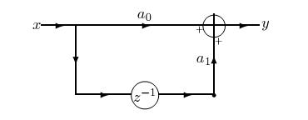
The basic MA filter
Let’s draw something even more interesting
To see that this is indeed the MA filter label all these points
y_{n} = a₀ x_{n} + a₁ x_{n-1}
x_{n}
a₀ x_{n}
y_{n}
a₁ x_{n-1}
x_{n}
x_{n-1}

Slide 19
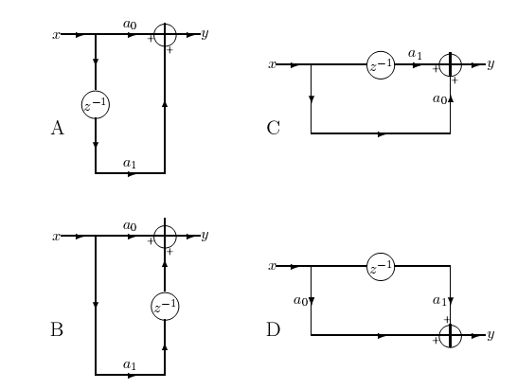
Basic MA blocks
Here are 4 interesting ways to draw this same simple MA filter
What transformations brings us from one to the other?
topological
commute
topological
topological
y_{n} = a₀ x_{n} + a₁ x_{n-1}
commute

Slide 20
Why do we need 4 blocks?
Products next to adder –
can make memoryless chip
Products all parallel –
easy to iterate (we’ll see later)
Products all parallel –
easy to iterate (we’ll see later)
y line is different height from x line
Delay element adjacent to adder

Slide 21
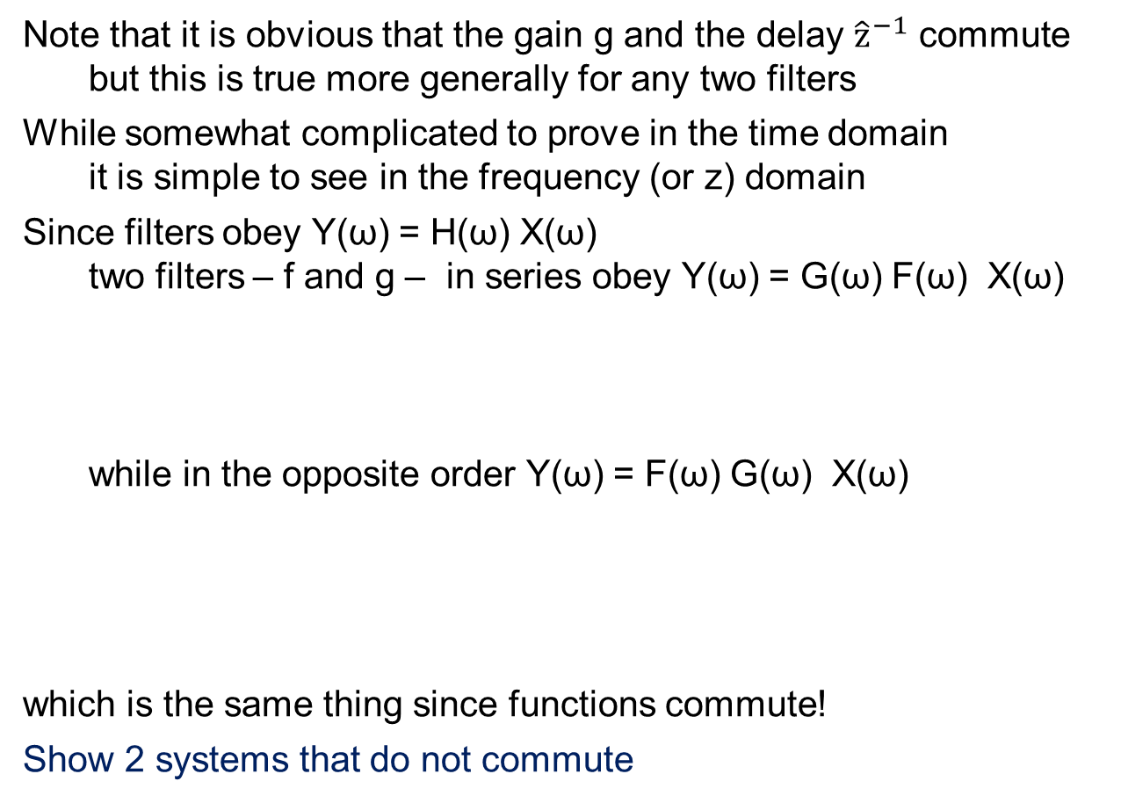
Commutativity
Note that it is obvious that the gain g and the delay ${\hat{z}}^{−1}$ commute
but this is true more generally for any two filters
While somewhat complicated to prove in the time domain
it is simple to see in the frequency (or z) domain
Since filters obey Y(ω) = H(ω) X(ω)
two filters – f and g – in series obey Y(ω) = G(ω) F(ω) X(ω)
while in the opposite order Y(ω) = F(ω) G(ω) X(ω)
which is the same thing since functions commute!
Show 2 systems that do not commute
F(ω) X(ω)
G(ω) F(ω) X(ω)
X(ω)
f
g
Y(ω)
G(ω) X(ω)
F(ω) G(ω) X(ω)
X(ω)
g
f
Y(ω)

Slide 22
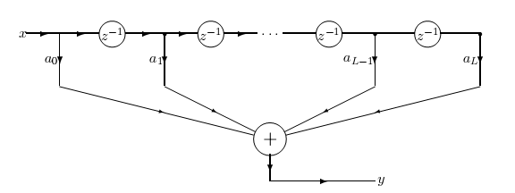
General MA
Now we consider the general MA filter with L coefficients
We would like to draw
but we only defined 2-input adders !

Slide 23
Tapped delay line
Before correcting this, note that top of this diagram
has an interesting analog interpretations
Engineers think of this as a tapped delay line
similar to a length of cable with finite transmission velocity
But since information travels in (copper or optical) cables
at 2/3 the speed of light (200 meters per μsec)
you need a long cable for significant delay !
tapped delay line

Slide 24
A data structure!
We will think of this differently (and find a data structure in addition to the algorithm)
Considering the memory points from some time
we find a data structure (assume L=8)
with the following time varying contents
We see that values that enter first from the left
exit (are discarded) first to the right
so this is a FIFO buffer
x
z⁻¹
z⁻¹
z⁻¹
z⁻¹
z⁻¹
z⁻¹
z⁻¹
y
x₈
x₇
x₆
x₅
x₄
x₃
x₂
x₁
x₉
x₈
x₇
x₆
x₅
x₄
x₃
x₂
x₁₀
x₉
x₈
x₇
x₆
x₅
x₄
x₃
x₁₁
x₁₀
x₉
x₈
x₇
x₆
x₅
x₄

Slide 25
How do we fix the adders
So, were we to use an N-input adder
we would have a FIFO, multiplications, and an adder
Let’s perform the additions one at a time!
FIFO

Slide 26
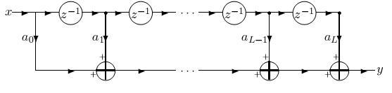
General MA – 1st way
We still have the tapped delay line = FIFO as a data structure
but now we perform Multiplication + Accumulations (MACs)
We have previously mentioned how important MACs are in DSP
Another way of looking at this is iteration on one of our basic MA blocks
Which one ?
MACs

Slide 27
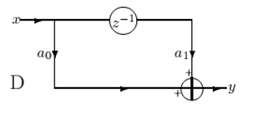
Iteration – 1st way
We iterate on basic block D
So this graph tells us
Data structure = FIFO
Algorithm = iteration over MA block D
MACs

Slide 28
The signal’s point of view
We saw how to look at this from the processing point of view
Sometimes it is useful to look at graphs from the signal’s point of view!
the signal enters the filter and is split into 2 replicas : A and B
gain is applied to replica A, replica B is delayed
replica B is split in two : C and D
gain is applied to replica C, which then is added to replica A
etc.

Slide 29
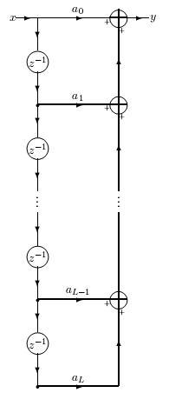
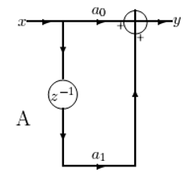
General MA – 2nd way
This isn’t the only way to compute a general MA
Here we see an alternative
It still uses a FIFO data structure
(which is now vertical – but who cares?)
Which basic MA block is used here?
So this graph tells us
Data structure = FIFO
Algorithm = iteration over MA block A
FIFO
MACs

Slide 30
Two ways to MA
Is there any difference between these two ways?
the 1st way MACs from the new x backward
a₀ x_{n} + a₁ x_{n-1} + … + a_{L} x_{n-L}
the 2nd way MACs from the earliest x forward
a_{L} x_{n-L} + … + a₁ x_{n-1} + a₀ x_{n}
Theoretically there is no difference
(addition is commutative)
but in practice there may be
Given a list of numbers sorted from smallest to largest
which way is most accurate to sum?

Slide 31
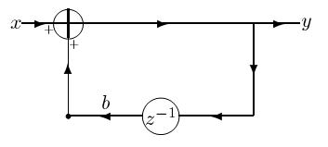
Basic AR block
What is the graph for the basic AR filter ?
Here is one way:
Note that for the first time we see a loop in the graph
in none of the MA filters was there a loop!
Whenever there is a loop, there is recursion (AR)
Put another way – loops correspond to poles

Slide 32
How does it work?
As usual – let’s label points to see why this works
We don’t worry about signals from the past influencing the output now
but non-causal loops can be paradoxical (like time travel)
This is just one way the draw the simple AR
there are 4 basic blocks here too
Can you find them?
x_{n}
x_{n} + b y_{n-1}
y_{n}
y_{n}
b y_{n-1}
y_{n-1}

Slide 33
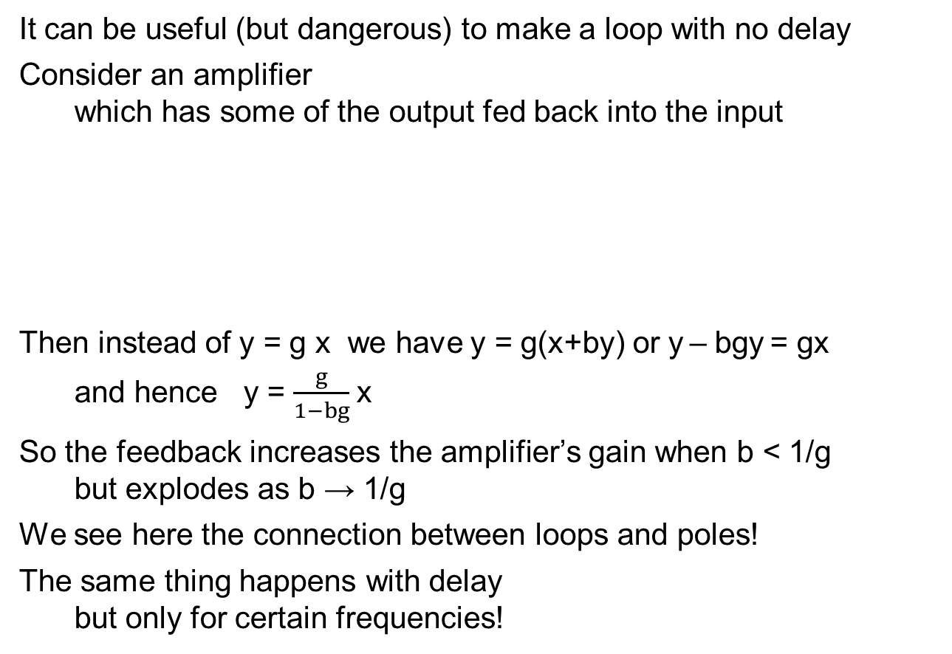
A loop with no delay
It can be useful (but dangerous) to make a loop with no delay
Consider an amplifier
which has some of the output fed back into the input
Then instead of y = g x we have y = g(x+by) or y – bgy = gx
and hence y = $\frac{g}{1−bg}$x
So the feedback increases the amplifier’s gain when b < 1/g
but explodes as b → 1/g
We see here the connection between loops and poles!
The same thing happens with delay
but only for certain frequencies!
g
x
y
g
x
y
b

Slide 34
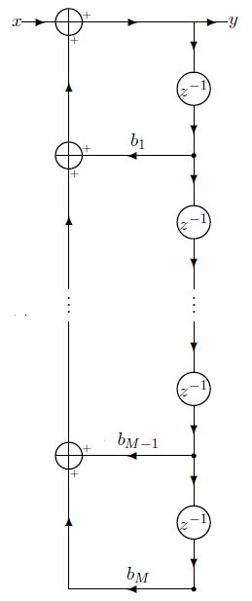
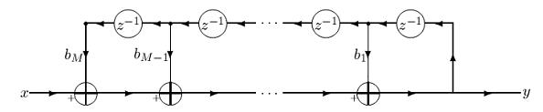
General AR filters
Here are two ways to implement the general AR filter
Explain why these indeed implement the AR
Is there any difference between these two ways?

Slide 35
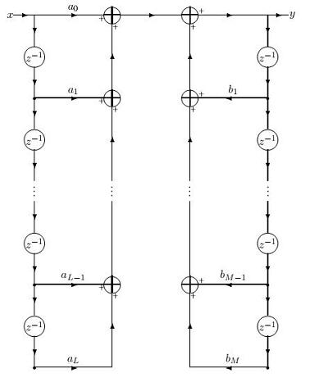
ARMA filters – stage 1
What do we do about ARMA filters?
The straightforward implementation would be
perform the MA portion using one of our MA implementations
perform the AR portion using one of our AR implementations
add the two together
MA
AR
MA
+
AR

Slide 36
How much memory?
u
By observing the graph we see
that L+M memory points are used
Without limiting generality
we can say 2L memory points
and assume L=M
Why? Take max(L,M)
and pad the other with zeros
We will now use graph theory
to reduce the number
of needed memory points

Slide 37
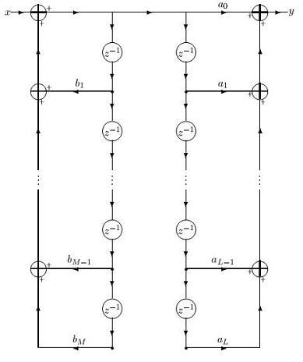
ARMA filters – stage 2
w
The graph has two filters in series
1 MA and 1 AR
Since any 2 filters commute
we can exchange their order
We obtain this new graph
Note that the signal w
between the 2 filters
is different from the signal u !

Slide 38
ARMA filters – stage 3
w_{n}
w_{n-1}
We see that there are points
representing the same signal !
All of these are
So we can combine the memory locations
and remove un-needed delays
This is a new graph transformation
w_{n-2}

Slide 39
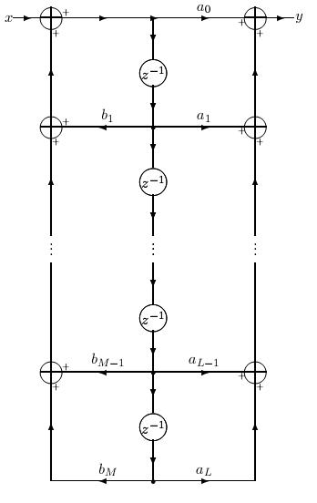
ARMA filters stage 3
We now require only L memory points
instead of 2L memory points
A reduction to 50% !

Slide 40
The transposition theorem
Another transformation that creates a new graph
that is equivalent in functionality to the original one
is given by the Transposition theorem
This transformation is more complex
since multiple operations are carried out at the same time
exchange input(s) and output(s)
reverse direction of all arrows
replace adders with splitters (since now 1 in - 2 out)
replace splitters with adders (since now 2 in - 1 out)

Slide 41
2 simple cases
a₀
a₀
x
y
y
x
Simple
MA
z⁻¹
z⁻¹
a₁
a₁
a₀
x
y
y
x
Simple
AR
z⁻¹
z⁻¹
b₁
b₁

Slide 42
Summary – the 4 transformations
We have learned 4 basic transformations
that create equivalent signal flow graphs
transformations that do not change topology
changing order of filters
identification of identical signal points
and removal of redundant branches
the transposition theorem
These transformations can be carried out mechanically
and are used to
reduce the amount of memory needed (we saw such a case!)
reduce the amount of computation needed (we’ll see next time)
This is why graphs are still used in DSP !

