Slide 1
Why do we need DSPs?
In this part of the course DSP = Digital Signal Processor
A DSP is a CPU that is used in signal processing applications
Why do we need a DSP? Why not use a regular CPU?
DSPs are optimized for DSP, and thus :
DSPs are physically small
several millimeters as compared to several centimeters
DSPs are much more energy efficient
a DSP may consumes milliwatts
as compared to standard CPUs tens of watts or more
DSPs are less expensive
a DSP may cost several dollars or less
as compared to a CPUs 10s – 100s of dollars or more

Slide 2
Other special processors
DSPs are not the only species of special CPUs
Array Processors specialize in matrix multiplication
FFT chips compute FFT even faster than DSPs
by parallelizing the butterflies (up to a given size)
Systolic Arrays have arrays of simple processors to perform
  matrix operations
  convolutions
  image processing
Graphics Processing Units were designed for graphics displays
but are now used for many parallelizable tasks
such as deep learning
AI processors, to accelerate neutral network training
Network processors are optimal for packet forwarding

Slide 3
DSP Processors
We have seen that the Multiply and Accumulate (MAC) operation
  is very prevalent in DSP computation
computation of energy
MA filters
AR filters
correlation of two signals
DFT
A Digital Signal Processor (DSP) is a CPU
that can compute MACs very efficiently
In fact, a DSP computes each individual MAC in 1 CPU clock cycle
Thus an L coefficient MA takes (about) L clock cycles in a DSP
and to perform it in real-time
L must be less than the sample interval (time between 2 inputs)

Slide 4
CPU architecture
The term architecture in CS originated
when IBM designed a series of computers
and desired to use the same (assembly) code on all of them
Like in buildings, architecture means the overall design
without quantitative details
A DSP is a CPU with a specific architecture
designed to be efficient in computation of MACs
The idea is to remove all architectural elements not needed for MACs
(e.g., cache memory) in order to keep size and power minimal
and add new architectural elements that support MACs
We will start with a simple generic CPU architecture
and see what elements we need to add

Slide 5
A simple CPU
We will assume a simplistic model of CPU architecture
the CPU is driven by a crystal (clock)
  faster CPUs can use higher frequency clocks
the CPU connects to external memory
over a bus
the CPU has an ALU with
the usual arithmetic operations
the CPU has registers
which are internal memory locations
upon which the ALU can operate
CPU
x
y
XTAL
t
ALU with
ADD, MULT, etc
bus
memory
registers
PC
a
x
y
z

Slide 6
What is the XTAL for?
All CPUs are driven by an oscillator (usually a piezoelectric crystal)
that supplies periodic pulses (we often say clocks or cycles or ticks)
We quantify efficiency of an operation by the number of ticks it requires
CPUs are rated according to the maximum frequency of the crystal
So, a 3 GHz CPU can compute 3 times as fast as a 1 GHZ CPU
if it is fed by a 3 GHZ crystal (but will be the same if fed by 1 GHz xtal!)
To increase yield, fabricated CPUs dies are tested for speed
and the CPUs rated according to the speed attained
Modern CPUs use microcode
their op-codes do not directly translate into hardware operations
but are actually subroutines in a lower level language
Each individual microcode instruction takes place in on pulse time
Most op-codes require multiple microcode instructions
(e.g., the multiplication op-code might be microcoded Toom-Cook)

Slide 7
Why registers?
CPUs are classified based on the number of addresses in an op-code
3 address CPUs: A1 = A2 op A3
2 address CPUs: A1 = A1 op A2
0 address CPUs (stack machines): op
Early computers allowed arithmetic operations on memory locations
but this severely limits memory space
So a full 3-address architecture
needs an opcode that contains 3 addresses in memory
For example, a computer with 1 MB of memory
requires 3*20bits = 60 bits just to specify memory
and more bits to describe the operation
The alternative is to enable arithmetic only on registers
which are special memory locations internal to the CPU
So, if we have 16 registers
a full 3-address architecture only requires 3*4=12 bits + operation
The cost is the need to load from and store to external memory

Slide 8
Special registers
Not all registers are created equal!
In addition to general purpose registers all CPUs have special ones
There is one special register called the Program Counter
that always holds the address of the next op-code to be performed
It is auto-incremented each operation
but can be overwritten by goto and conditional branch op-codes
In DSPs some registers are accumulators
Accumulators hold larger numbers than regular registers
(e.g., a regular register may be 16 bits in length
and an accumulator 24 bits – 8 guard bits)
Accumulators are used for accumulating
and need the longer length in order not to overflow!
Many CPUs have other special registers
such as stack pointers, loop counters, pointer registers, etc.

Slide 9
High-level MAC loop
The basic MAC loop in high level languages is
(assuming that a and x are in static buffers)
loop over all times n
  initialize y_{n} ← 0
  loop over i from 1 to number of coefficients
    y_{n} ← y_{n} + a_{i} * x_{j} (j somehow related to i)
  output y_{n}
Efficient low level programming always uses (read) pointers
since array indexing requires wasteful offset calculations
ADDR(a[i]) = ADDR(a[0]) + i * word-length
To explicitly increment the pointers
ADDR(a[i+1]) = ADDR(a[i]) + word-length
For energy and correlation i and j increase together
For convolution i increases and j decreases

Slide 10
Intermediate level MAC loop
So, in some imaginary assembly level language
our MAC loop looks like this:
loop over all times n
  clear y
  set number-of-iterations to n
  loop
    decrement number-of-iterations
    if number-of-iterations = 0 then terminate loop
    update a pointer
    update x pointer
    multiply z ← a * x (3-address addressing)
    increment y ← y + z (2-address addressing)
  output y

Slide 11
Low level MAC loop
Now let’s use registers! (remember we have a, x, and y registers)
loop over all times n
  clear y register
  set number-of-iterations to n
  loop
    update a pointer
load contents of memory addressed by a into register a
    update x pointer
    load contents of memory addressed by x into register x
    multiply z ← a * x (register operation!)
    increment y ← y + z (register operation!)
    decrement number-of-iterations
    if number-of-iterations = 0 then terminate loop
  store y

Slide 12
Zero-overhead loops
DSPs, like many CPUs, have a zero-overhead loop
This means that we can configure a special loop counter register
that auto-decrements and is tested implicitly
loop over all times n
  clear y register
  loop number-of-iterations times
    update a pointer
load contents of memory addressed by a into register a
    update x pointer
    load contents of memory addressed by x into register x
    multiply z ← a * x (register operation!)
    increment y ← y + z (register operation!)
  store y
Why do we no longer care about the decrement and testing?
Since additional hardware (silicon) takes care of this task
in parallel to other operations!

Slide 13
Cycle counting
We still can’t count clock ticks
since really low level (hardware) operations
need to take the op-code fetch and decode into account
So the clocks operations inside the outer loop look something like this:
Update pointer to a_{i}
Update pointer to x_{j}
Load contents of a_{i} into register a
Load contents of x_{j} into register x
Fetch operation (MULT)
Decode operation (MULT)
MULT a*x with result in register z
Fetch operation (INC)
Decode operation (INC)
INC register y by contents of register z
So it takes at least 10 cycles to perform each MAC using a regular CPU
Our mission (and we have decided to accept it!)
is to reduce this to 1 clock cycle by adding new silicon

Slide 14
This really isn’t right!
We ridiculously assumed each operation takes only 1 cycle
we know multiplication takes many more
addition frequently takes a few cycles
even fetch really requires at least 2 cycles
  1 to send an address to external memory
  1 to retrieve the value from the memory
So we are radically underestimating
the number of cycles a regular CPU needs
But we don’t care since this will happen in any CPU
even a DSP!

Slide 15
Step 1 - new opcode
To build a DSP (a 1-cycle MAC CPU)
we need to enhance the basic CPU with new hardware (silicon)
The easiest step is to define a new opcode called MAC
which is what Intel did in the MMX extensions
The upgraded code now looks like this:
Update pointer to a_{i}
Update pointer to x_{j}
Load contents of a_{i} into register a
Load contents of x_{j} into register x
Fetch operation (MAC)
Decode operation (MAC)
MAC a*x with incremented to accumulator y
However 7 > 1, so this is still NOT a DSP !
ALU with
ADD, MULT, MAC, etc
bus
memory
p-registers
PC
pa
px
accumulator
registers
y
a
x

Slide 16
Step 2 - register arithmetic
The two operations
Update pointer to a_{i}
Update pointer to x_{j}
could be performed in parallel
  but both are performed by the ALU
So we add pointer arithmetic units
  one for each pointer register
Special sign || used in DSP assembler
  to mean operations in parallel
ALU with
ADD, MULT, MAC, etc
bus
memory
p-registers
PC
pa
px
INC/DEC
accumulator
registers
y
a
x
z
Update pointer to a_{i} || Update pointer to x_{j}
Load contents of a_{i} into register a
Load contents of x_{j} into register x
Fetch operation (MAC)
Decode operation (MAC)
MAC a*x with incremented to accumulator y
However 6 > 1, so this is still NOT a DSP !

Slide 17
Step 3 - memory banks and buses
We would like to perform the loads in parallel
  but we can't since they both have to go over the same bus
So we add another bus
  and segment into memory banks
  so that there is no contention !
There is dual-port memory
but it has an arbitrator which adds delay
Update pointer to a_{i} || Update pointer to x_{j}
Load a_{i} into a || Load x_{j} into x
Fetch operation (MAC)
Decode operation (MAC)
MAC a*x with incremented to accumulator y
However 5 > 1, so this is still NOT a DSP !
ALU with
ADD, MULT, MAC, etc
bus
p-registers
bank 1
PC
pa
px
INC/DEC
bus
bank 2
accumulator
registers
y
a
x

Slide 18
Harvard architecture
One of the first digital computers
was the Automatic Sequence Controlled Calculator (the Mark I)
that was designed in Harvard by Howard Aiken (and built by IBM)
and employed >750,000 electromechanical components
It was funded by the US Navy
and later enhanced to become the Harvard Mark II, III, and IV
The Harvard computers were used by John von Neumann
for calculations related to the Manhattan project
and was programmed by Grace Hopper (the originator of the word bug)
The overall architecture of the Harvard computers included
a central processing unit
program memory (that is immutable during run-time)
data memory (that can be read and written during run-time)

Slide 19
Von Neumann architecture
The Electronic Numerical Integrator and Computer is often called the 1st
fully programmable, general-purpose, digital computer
It was designed by John Mauchly and J. Presper Eckert
at the University of Pennsylvania, funded by the US army
based on principles described in 1945 by John von Neumann
The overall architecture of the ENIAC included
a central processing unit
a single memory that holds both program op-codes and data
Von Neumann merged program and data memory not only to simplify
but to enable changing the program during run-time (learning)
Turing, after reading von Neumann’s paper,
abstracted these principles into what is called the Turing machine
The von Neumann architecture is used in all modern computers
except DSPs!

Slide 20
Step 4 - Harvard architecture
By adopting Harvard architecture with yet another bus to another memory
we needn't count fetch since it is performed in parallel
We can remove the decode cycle as well
(we’ll see why later)
ALU with
ADD, MULT, MAC, etc
bus
data 1
p-registers
bus
PC
pa
px
data 2
INC/DEC
accumulator
registers
bus
program
y
a
x
Update pointer to a_{i} || Update pointer to x_{j}
Load a_{i} into a || Load x_{j} into x
MAC a*x with incremented to accumulator y
However 3 > 1, so this is still NOT a DSP !

Slide 21
Step 5 - pipelines
We seem to be stuck
Update MUST be before Load
Load MUST be before MAC
But we can use a pipelined approach
It takes 1 tick per tap as long as the pipeline is full
  altogether it takes n+2 clocks (which is n for large n!)
More generally, a pipeline of depth D takes n+D-1 ticks
op
U1 | U2 | U3 | U4 | U5
 | L1 | L2 | L3 | L4 | L5
 |  | M1 | M2 | M3 | M4 | M5
t
1
2
3
4
5
6
7

Slide 22
Why do we need longer pipelines?
Why would we want D>3 ?
Remember that we said
that we don’t have to count ticks for fetch and decode?
These are actually performed in parallel using a pipeline
Doesn’t a MAC op-code have to multiply before adding?
Yes, but we can pipeline them
Remember we said that multiplication
really takes many more than 1 cycle?
We can pipeline these cycles to reduce overall execution time
Of course, adding to the pipeline’s depth
increases the delay
makes filling the pipeline more challenging
is subject to diminishing returns (Amdahl’s law)

Slide 23
Pipelines in other CPUs
Many modern CPUs employ pipelines – how are DSPs different?
DSPs employ pipelining as a last resort (when logically stuck)
other CPUs use pipelining as the main (only) parallelization
Thus non-DSP CPUs can pipeline all stages of a MAC
resulting in lower ticks/tap
but more delay and less determinism
Advanced non-DSP CPUs even employ speculative lookahead
to attempt to keep the pipeline full with conditional branches
DSPs allow programmers to monitor and manipulate the pipeline
for other CPUs pipelining is basically transparent
DSPs actually get more from pipelining
due to memory banks and Harvard architecture

Slide 24
DSP programming
DSP programming is harder than regular programming
(which is why it is today mostly done in India and eastern Europe)
For maximal efficiency :
one needs to program in assembly
one needs to know the DSP’s architecture
one needs to program in parallel assembly
one needs to place data in the correct memory banks
one needs to keep the pipeline full
The last portion often requires painstakingly rewriting and reordering
The usual technique is to start with many NOPs
and iteratively improve the program eliminating pipeline holes

Slide 25
DSP programmers
There are three types of DSP programmers
1. algorithm designers
  use floating point
  care more about theory than real-time
  usually code in MATLAB, Python, C++
2. low-level coders
  structure code for real-time
  convert algorithms from floating point to fixed point
  usually code in C
3. DSP coders
  convert real-time oriented C to parallel assembly
  work directly on the silicon
  program critical routines in DSP assembly language
  program non-critical routines in C with pragmas

Slide 26
Zero-overhead interrupts
How do the input sample values get into the buffers?
All CPUs have (serial or parallel) I/O ports
with memory for one value (bit or byte or whatever)
There are two methods for transferring from an input port to the buffer:
1. Polling – the CPU repeatedly checks if something is in port memory
this is very inefficient since we need to check overly frequently
2. Interrupts – when the input port is ready it raises an interrupt
causing the CPU to perform a context switch
Context switches are very expensive on regular CPUs
since all registers need to be saved and later restored
Most DSPs have a limited zero-overhead interrupt mechanism
where certain registers are copied into shadow registers in 1 cycle
and restored when returning form the interrupt handler
Such handlers are usually limited to a small number of instructions
(just enough to copy and increment the buffer length)
and are themselves non-interruptable

Slide 27
Fixed point
In the real world signal values are real numbers
that can be well approximated by rational numbers
but not usually by integers
Fixed point representation represents a rational number as a integer
by fixing the (binary) decimal point, described as Qm.n notation
We often take m=0 and use Qn (scientific) notation
in which the integer value I represents the rational Q = I / 2^{n}
In each part of the program
all values are represented in the same Qn
but in different parts different Qn are used
sign
bit
m
n

Slide 28
Q representation examples
On a machine with 16 bit registers
binary | integer | Q15 value | Q8 value | Q4 value
0100000000000000 | 16384 | 0.5 | 64 | 1024
0010000000000000 | 8192 | 0.25 | 32 | 512
0001000000000000 | 4096 | 0.125 | 16 | 256
1100000000000000 | -16384 | -0.5 | -64 | -1024
1010000000000000 | -8192 | -0.25 | -32 | -512
1001000000000000 | -4096 | -0.125 | -16 | -256

Slide 29
Saturation Arithmetic
Many DSPs are fixed point, i.e. handle (2s complement) integers only
Floating point is more expensive and slower
(because of the need to renormalize after calculation)
Floating point numbers can underflow
Fixed point numbers can overflow
We saw that accumulators have guard bits to protect against overflow
When regular fixed point CPUs overflow
numbers greater than MAXINT become negative
numbers smaller than -MAXINT become positive
Fixed point DSPs have a saturation arithmetic mode
numbers larger than MAXINT become MAXINT
numbers smaller than -MAXINT become -MAXINT
this is still an error, but a smaller error
There is a tradeoff between safety from overflow and SNR

Slide 30
What else is special?
We have already mentioned that DSPs support bit-reversed addressing
which speeds calculation of FFTs
However, it is important to consider what DSPs don’t have:
most DSPs run at modest clock rates compared to modern CPUs
(50MHz, 100 MHz, 200 MHz)
many DSPs are fixed point
many DSPs have modest word sizes (16/24 bits, 32/40 bits)
DSPs do not have program or data cache memory
DSPs do not use modern accelerations, e.g., speculative execution
most DSPs do not have a division op-code
DSPs do not have a square-root op-code
That’s why DSPs are amazing at DSP tasks ( but miserable at others)
but can be small and require little power

Slide 31
What – no division?
Most DSPs do not have an op-code for division, which is often needed
For example, Automatic Gain Control divides by the RMS
So what does one do?
If time is not critical one can use a library routine
but for real-time we need something better
It is enough to know how to invert y = 1/x
for which there are many iterations
that converges to the right answer
The simplest one is
Start with a reasonable guess for y
Loop
y ← y * (2 – y*x) Note that y is a fixed point !
If you start with a good guess, this will converge in a few iterations
For AGC, initializing with the previous value, 3 iterations is often enough

Slide 32
Full division
If you need to divide y = N/D
and don’t want to invert and multiply
then Goldschmidt division uses a similar trick
N’ ← N
D’ ← D
Loop until D’≈ 1
q ← 2 – D’
N’ ← N’ * q
D’ ← D’ * q
y ← N’
More generally
many operations can be carried out by finding a recursion
for which the answer is an attractive fixed point

Slide 33
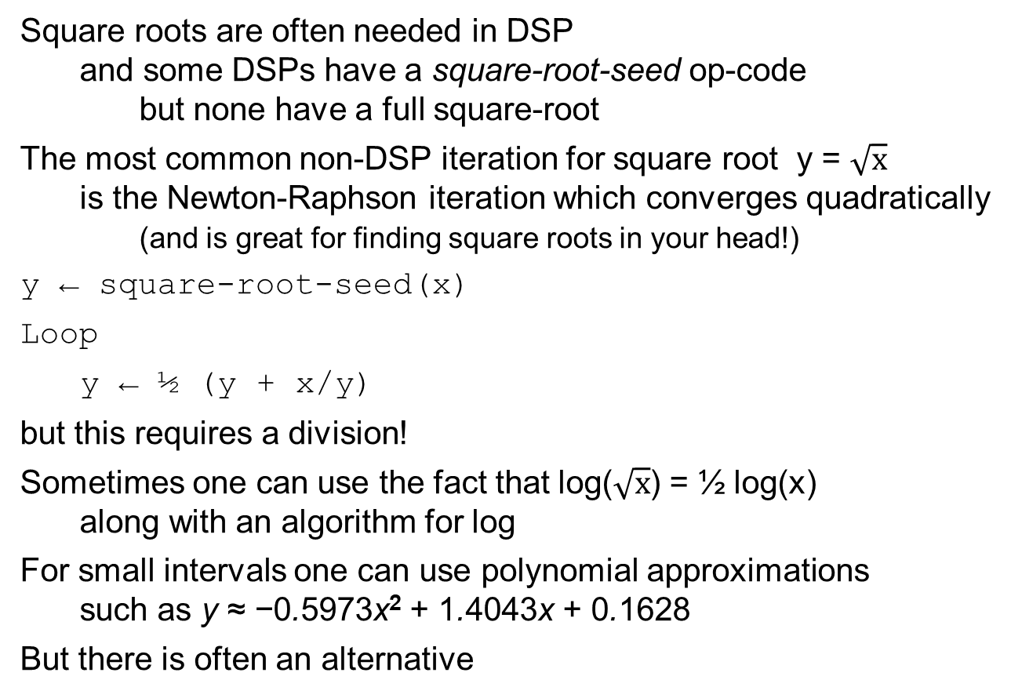
Square root
Square roots are often needed in DSP
and some DSPs have a square-root-seed op-code
but none have a full square-root
The most common non-DSP iteration for square root y = $\sqrt{x}$
is the Newton-Raphson iteration which converges quadratically
(and is great for finding square roots in your head!)
y ← square-root-seed(x)
Loop
y ← ½ (y + x/y)
but this requires a division!
Sometimes one can use the fact that log($\sqrt{x}$) = ½ log(x)
along with an algorithm for log
For small intervals one can use polynomial approximations
such as y ≈ −0.5973x² + 1.4043x + 0.1628
But there is often an alternative

Slide 34

Pythagorean addition
In DSP applications square root is mostly required as part of
Pythagorean addition
for which there are approximations such as
where 0.25 < k < 0.31
k=0.267304 gives the exact mean
k=0.300585 gives minimum variance
More importantly there is the Moler-Morrison algorithm
which requires 2 divisions
and the CORDIC algorithm that requires only shift and add
and converges exponentially, gaining 1 bit per iteration

Slide 35
Moler-Morrison
To find p, Pythagorean sum of x and y
p ← abmax(x,y)
q ← abmin(x,y)
Loop until q ≈ 0
r ← (q/p)²
s ← r/(4+r)
p ← p + 2*s*p
q ← s*q
return p
Note that p ⊕ q = x ⊕ y and 0 ≤ q ≤ p always
and that the algorithm drives q → 0

Slide 36
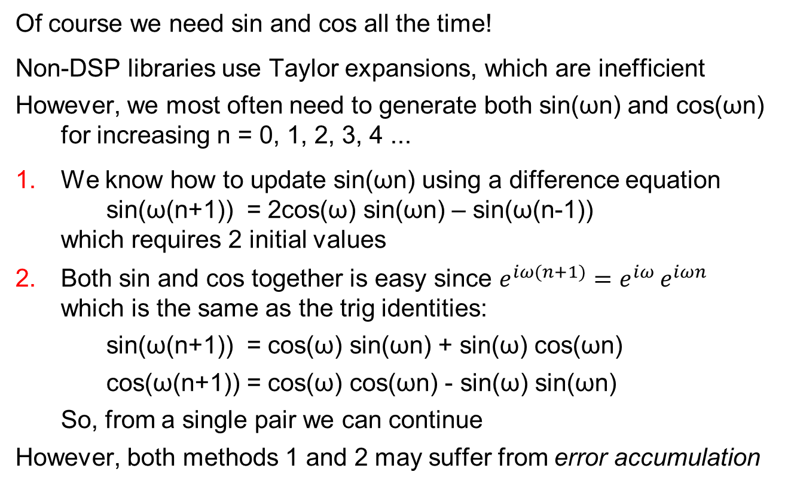
Sine and Cosine
Of course we need sin and cos all the time!
Non-DSP libraries use Taylor expansions, which are inefficient
However, we most often need to generate both sin(ωn) and cos(ωn)
for increasing n = 0, 1, 2, 3, 4 ...
1. We know how to update sin(ωn) using a difference equation
sin(ω(n+1)) = 2cos(ω) sin(ωn) – sin(ω(n-1))
which requires 2 initial values
2. Both sin and cos together is easy since $e^{iω(n+1)}=e^{iω }e^{iωn}$
which is the same as the trig identities:
sin(ω(n+1)) = cos(ω) sin(ωn) + sin(ω) cos(ωn)
cos(ω(n+1)) = cos(ω) cos(ωn) - sin(ω) sin(ωn)
So, from a single pair we can continue
However, both methods 1 and 2 may suffer from error accumulation

Slide 37
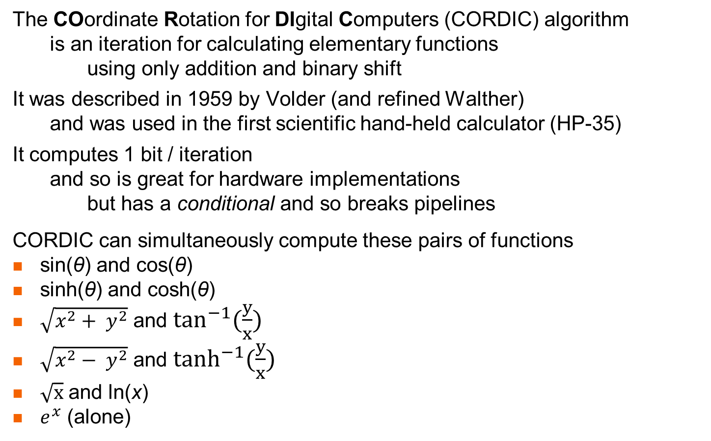
CORDIC
The COordinate Rotation for DIgital Computers (CORDIC) algorithm
is an iteration for calculating elementary functions
using only addition and binary shift
It was described in 1959 by Volder (and refined Walther)
and was used in the first scientific hand-held calculator (HP-35)
It computes 1 bit / iteration
and so is great for hardware implementations
but has a conditional and so breaks pipelines
CORDIC can simultaneously compute these pairs of functions
sin(θ) and cos(θ)
sinh(θ) and cosh(θ)
$\sqrt{x^{2}+ y^{2}}$ and $\tan^{−1}(\frac{y}{x})$
$\sqrt{x^{2}− y^{2}}$ and $\tanh^{−1}(\frac{y}{x})$
$\sqrt{x}$ and ln(x)
$e^{x}$ (alone)

Slide 38
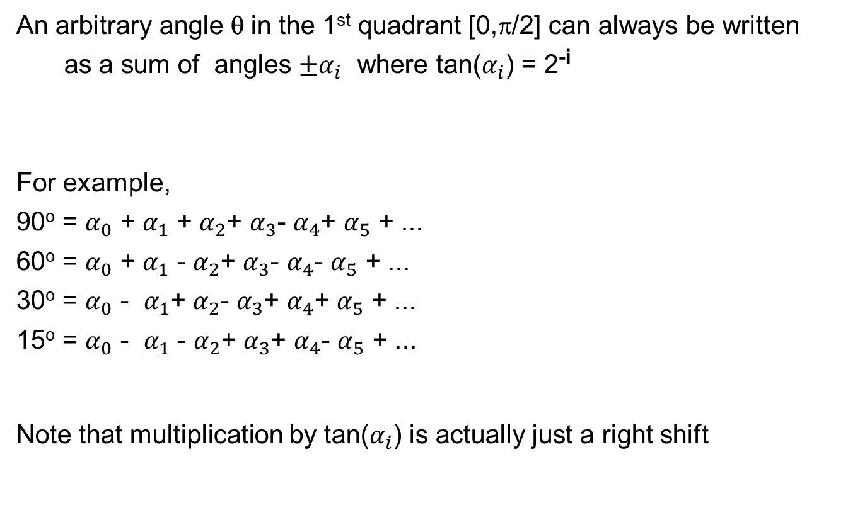
The main idea behind
CORDIC for sin/cos
An arbitrary angle θ in the 1st quadrant [0,π/2] can always be written
as a sum of angles ${±α}_{i}$ where tan($α_{i}$) = 2^{-i}
For example,
90º = $α_{0}$ + $α_{1}$ + $α_{2}$+ $α_{3}$- $α_{4}$+ $α_{5}$ + ...
60º = $α_{0}$ + $α_{1}$ - $α_{2}$+ $α_{3}$- $α_{4}$- $α_{5}$ + ...
30º = $α_{0}$ - $α_{1}$+ $α_{2}$- $α_{3}$+ $α_{4}$+ $α_{5}$ + ...
15º = $α_{0}$ - $α_{1}$ - $α_{2}$+ $α_{3}$+ $α_{4}$- $α_{5}$ + ...
Note that multiplication by tan($α_{i}$) is actually just a right shift
k | tan⁻¹ 2^{-k}
0 | 45º
1 | 26.566º
2 | 14.036º
3 | 7.125º
4 | 3.576º
5 | 1.790º
... | ...
∞
θ = ∑(± tan⁻¹ 2^{-k} )
k=0

Slide 39
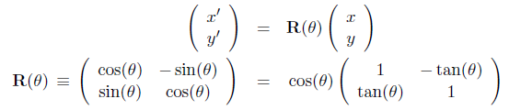
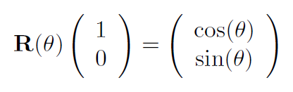
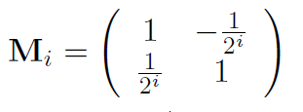
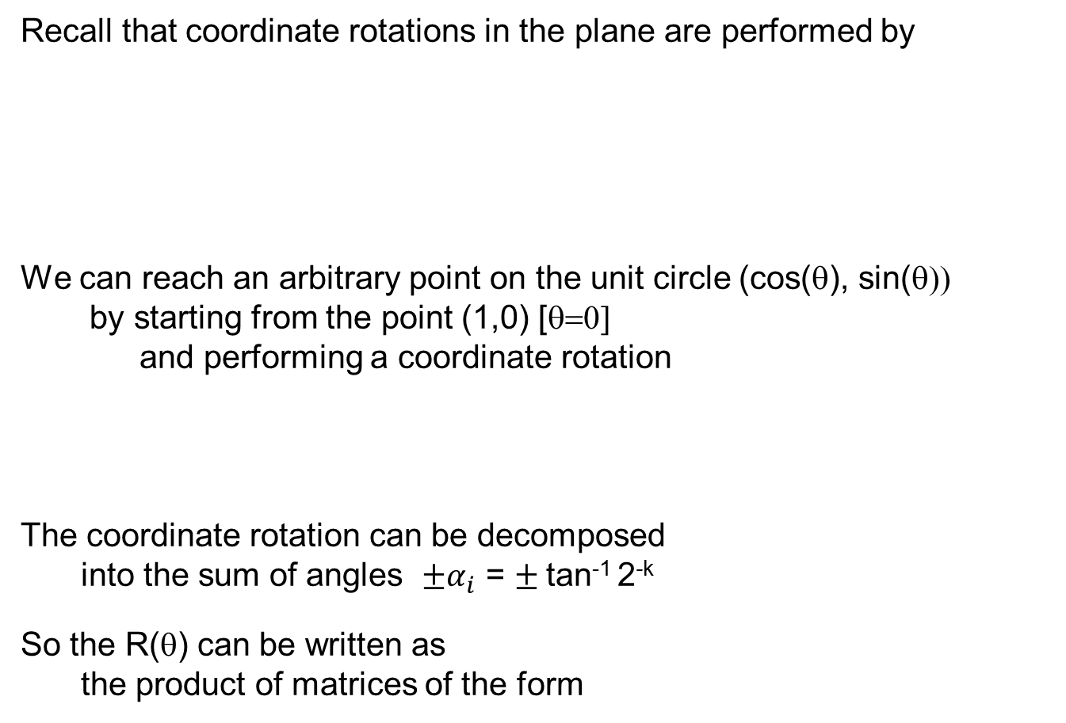
CORDIC for sin/cos
Recall that coordinate rotations in the plane are performed by
We can reach an arbitrary point on the unit circle (cos(θ), sin(θ))
by starting from the point (1,0) [θ=0]
and performing a coordinate rotation
The coordinate rotation can be decomposed
into the sum of angles ${±α}_{i}$ = $±$tan⁻¹ 2^{-k}
So the R(θ) can be written as
the product of matrices of the form
(cosθ, sinθ)
θ
(1,0)

Slide 40
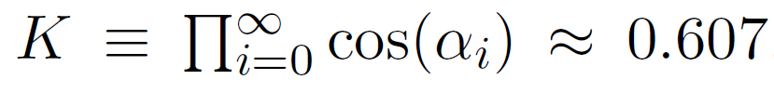
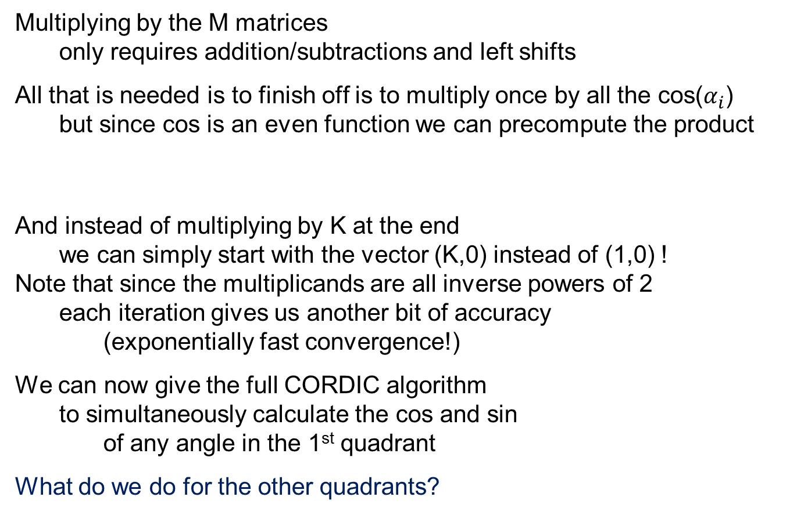
No multiplications!
Multiplying by the M matrices
only requires addition/subtractions and left shifts
All that is needed is to finish off is to multiply once by all the cos($α_{i}$)
but since cos is an even function we can precompute the product
And instead of multiplying by K at the end
we can simply start with the vector (K,0) instead of (1,0) !
Note that since the multiplicands are all inverse powers of 2
each iteration gives us another bit of accuracy
(exponentially fast convergence!)
We can now give the full CORDIC algorithm
to simultaneously calculate the cos and sin
of any angle in the 1st quadrant
What do we do for the other quadrants?

Slide 41
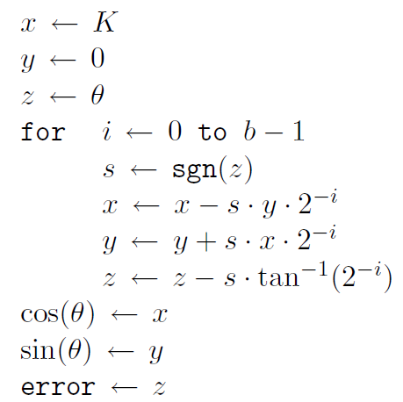
The CORDIC algorithm
The full derivation is in the course text!
depends on sgn(z)

