Slide 1
Outline
Signals
Sampling
Time and frequency domains
Systems
Filters
Convolution
MA, AR, ARMA filters
System identification
Graph theory
FFT
DSP processors
Correlation and Adaptation
Speech signal processing
Data communications

Slide 2
DSP
Digital Signal Processing vs. Digital Signal Processing
Why DSP ? use (digital) computer instead of (analog) electronics
more flexible
  new functionality requires code changes, not component changes
more accurate
  even simple amplification can not be done exactly in electronics
more stable
  code performs consistently
more sophisticated
  can perform more complex algorithms (e.g., SW receiver)
However
digital computers only process sequences of numbers
  not analog signals
requires converting analog signals to digital domain for processing
and digital signals back to analog domain

Slide 3
Signals
Analog signal
s(t)
continuous time
- ∞ < t < +∞
Digital signal
s_{n}
discrete time
n = - ∞ … +∞
Physicality requirements
s values are real
s values defined for all times
Finite energy
Finite bandwidth
Mathematical usage
s may be complex
s may be singular
Infinite energy allowed
Infinite bandwidth allowed
Energy = how "big" the signal is
Bandwidth = how "fast" the signal is

Slide 4
Some digital “signals”
Zero signal
Constant signal
( ∞ energy!)
Unit Impulse (UI)
Shifted Unit Impulse (SUI)
Step
( ∞ energy!)
n=0
n=0
1
n=0
1
n=1
1
n=0

Slide 5
Some periodic digital “signals”
1
Square wave
Triangle wave
Saw tooth
Sinusoid
(not always periodic!)
n=0
-1

Slide 6
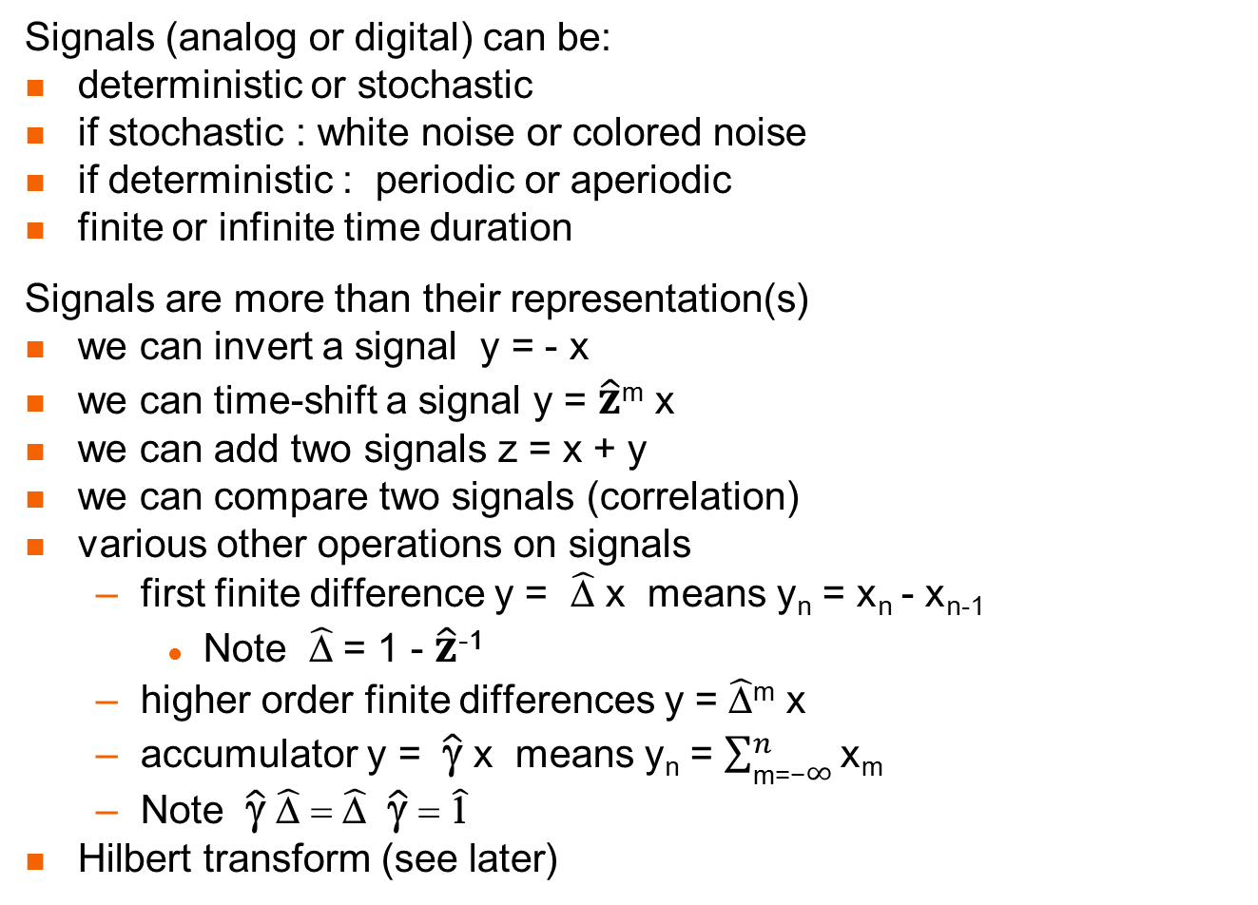
Signal types and operators
Signals (analog or digital) can be:
deterministic or stochastic
if stochastic : white noise or colored noise
if deterministic : periodic or aperiodic
finite or infinite time duration
Signals are more than their representation(s)
we can invert a signal y = - x
we can time-shift a signal y = $\hat{z}$^{m} x
we can add two signals z = x + y
we can compare two signals (correlation)
various other operations on signals
  first finite difference y = $\hat{\text{D}}$ x means y_{n} = x_{n} - x_{n-1}
    Note $\hat{\text{D}}$ = 1 - $\hat{z}$⁻¹
  higher order finite differences y = $\hat{\text{D}}$^{m} x
  accumulator y = $\hat{\text{γ}}$ x means y_{n} = $\sum_{\text{m}\text{=−}∞}^{n}{\text{x}\text{m} }$
  Note $\hat{\text{γ}}$ $\hat{\text{D}}$ = $\hat{\text{D}}$ $\hat{\text{γ}}$ = $\hat{\text{1}}$
Hilbert transform (see later)

Slide 7
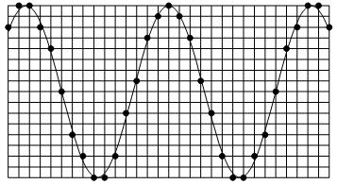
Sampling
From an analog signal we can create a digital signal
  by SAMPLING
Under certain conditions
  we can uniquely return to the analog signal
Nyquist (Low pass) Sampling Theorem
if the analog signal is BW limited and
  has no frequencies in its spectrum above F_{Nyquist}
then sampling at above 2F_{Nyquist} causes no information loss

Slide 8
Digital signals and vectors
Digital signals are in many ways like vectors
… s₋₅ s₋₄ s₋₃ s₋₂ s₋₁ s₀ s₁ s₂ s₃ s₄ s₅ … ↔ (x, y, z)
In fact, they form a linear vector space
the zero vector 0 (0_{n} = 0 for all times n)
every two signals can be added to form a new signal x + y = z
every signal can be multiplied by a real number (amplified!)
every signal has an opposite signal -s so that s + -s = 0 (zero signal)
every signal has a length - its energy
Similarly, analog signals, periodic signals with given period, etc.
However
they are (denumerably) infinite dimension vectors
the component order is not arbitrary (time flows in one direction)
  time advance operator z (z s)_{n} = s_{n+1}
  time delay operator z⁻¹ (z⁻¹ s)_{n} = s_{n-1}

Slide 9
Bases
Fundamental theorem in linear algebra
All linear vector spaces have a basis (usually more than one!)
A basis is a set of vectors b₁ b₂ … b_{d} that obeys 2 conditions :
1. spans the vector space
i.e., for every vector x : x = a₁ b₁ + a₂ b₂ + … + a_{d} b_{d}
where a₁ … a_{d} are a set of coefficients
2. the basis vectors b₁ b₂ … b_{d} are linearly independent
i.e., if a₁ b₁ + a₂ b₂ + … + a_{d} b_{d} = 0 (the zero vector)
then a₁ = a₂ = … = a_{d} = 0
OR
2. The expansion x = a₁ b₁ + a₂ b₂ + … + a_{d} b_{d} is unique
(easy to prove that these 2 statements are equivalent)
Since the expansion is unique
the coefficients a₁ … a_{d} represent the vector in that basis

Slide 10
Time and frequency domains
Vector spaces of signals have two important bases (SUIs and sinusoids)
And the representations (coefficients) of signals in these two bases
give us two domains
Time domain (axis)
s(t) s_{n}
Basis - Shifted Unit Impulses
Frequency domain (axis)
S(ω) S_{k}
Basis - sinusoids
We use the same letter capitalized to stress that these are the same signal, just different representations
To go between the representations :
analog signals - Fourier transform FT/iFT
digital signals - Discrete Fourier transform DFT/iDFT
There is a fast algorithm for the DFT/iDFT called the FFT

Slide 11
Fourier Series
In the demo we saw that many periodic analog signals
can be written as the sum of Harmonically Related Sinusoids (HRSs)
If the period is T, the frequency is f = 1/T, the angular frequency is ω = 2 π f = 2 π / T
s(t) = a₁ sin(ωt) + a₂ sin(2ωt) + a₃ sin(3ωt) + …
But this can’t be true for all periodic analog signals !
sum of sines is an odd function s(-t) = -s(t)
in particular, s(0) must equal 0
Similarly, it can’t be true that all periodic analog signals obey
s(t) = b₀ + b₁ cos(ωt) + b₂ cos(2ωt) + b₃ cos(3ωt) + …
Since this would give only even functions s(-t) = s(t)
We know that any (periodic) function can be written as the sum of
an even (periodic) function and an odd (periodic) function
s(t) = e(t) + o(t) where e(t) = ( s(t) + s(-t) ) / 2 and o(t) = ( s(t) - s(-t) ) / 2
So Fourier claimed that all periodic analog signals can be written :
s(t) = a₁ sin(ωt) + a₂ sin(2ωt) + a₃ sin(3ωt) + …
+ b₀ + b₁ cos(ωt) + b₂ cos(2ωt) + b₃ cos(3ωt) + …

Slide 12
Fourier rejected
If Fourier is right, then-
the sinusoids are a basis for vector subspace of periodic analog signals
Lagrange said that this can’t be true –
not all periodic analog signals can be written as sums of sinusoids !
His reason –
the sum of continuous functions is continuous
the sum of smooth (continuous derivative) functions is smooth
His error –
the sum of a finite number of continuous functions is continuous the sum of a finite number of smooth functions is smooth
Dirichlet came up with exact conditions for Fourier to be right :
  finite number of discontinuities in the period
  finite number of extrema in the period
  bounded
  absolutely integratable

Slide 13
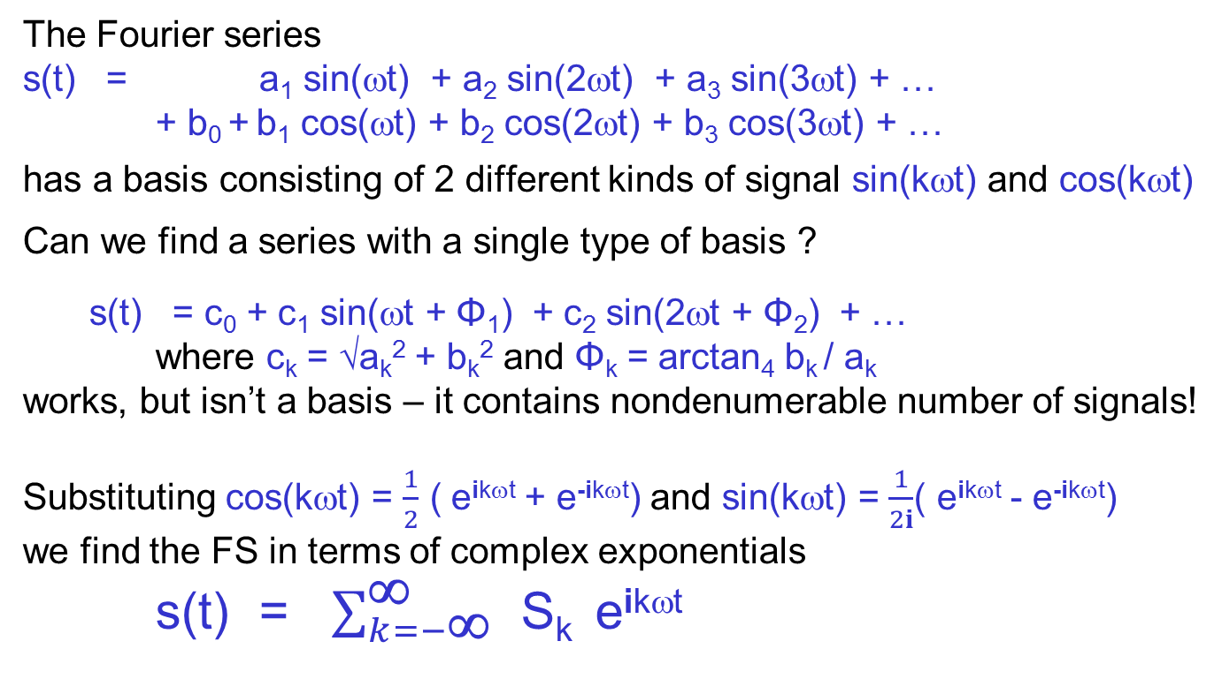
Complex exponentials Negative frequencies
The Fourier series
s(t) = a₁ sin(ωt) + a₂ sin(2ωt) + a₃ sin(3ωt) + …
+ b₀ + b₁ cos(ωt) + b₂ cos(2ωt) + b₃ cos(3ωt) + …
has a basis consisting of 2 different kinds of signal sin(kωt) and cos(kωt)
Can we find a series with a single type of basis ?
s(t) = c₀ + c₁ sin(ωt + Φ₁) + c₂ sin(2ωt + Φ₂) + …
where c_{k} = √a_{k}² + b_{k}² and Φ_{k} = arctan₄ b_{k} / a_{k}
works, but isn’t a basis – it contains nondenumerable number of signals!
Substituting cos(kωt) = $\frac{1}{2}$ ( e^{ikωt} + e^{-ikωt}) and sin(kωt) = $\frac{1}{2i}$( e^{ikωt} - e^{-ikωt})
we find the FS in terms of complex exponentials
s(t) = $\sum_{k=−\text{∞}}^{\text{∞}}{ \text{S}\text{k} }$ e^{ikωt}

Slide 14
Handling the problems
This is aesthetically pleasing, but raises two problems:
1. the basis functions e^{ikωt} are complex
and thus not signals at all !
2. the frequencies kω can be negative
what does -2 cycles per second mean ?
Using complex exponentials and negative frequencies
so simplifies the mathematics
that we will do anything to allow it
1. We are understand that the true signals are real
– they are simply Re(e^{ikωt})
At the end of the calculations we look at the real part
2. The negative frequencies are the same as the positive ones
only the phase is different (see demo)

Slide 15
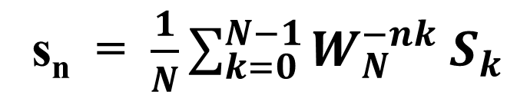
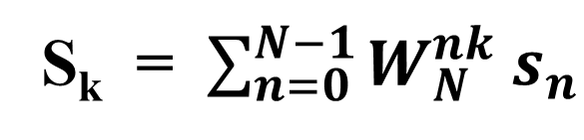
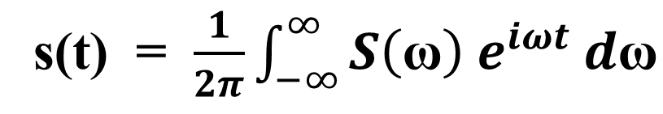
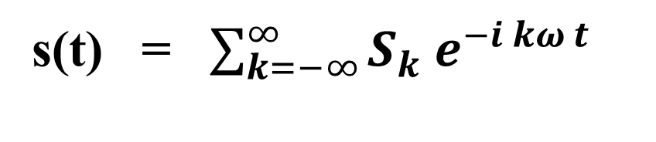
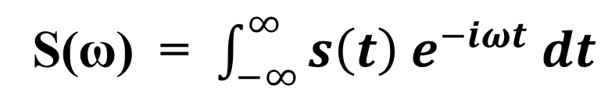
FS, FT, DFT
Fourier Series (periodic analog signal → א₀ coefficients)
Fourier Transform (general analog signal → spectrum)
Discrete Fourier Transform (finite digital signal → digital spectrum)
s(t) = $\sum_{k=−∞}^{∞}{S_{k}{ e}^{−i kω t}}$
S(ω) = $\int_{−∞}^{∞}{s\left(t\right){ e}^{−iωt} dt}$
s(t) = $\frac{1}{2π}\int_{−∞}^{∞}{S\left(\text{ω}\right){ e}^{iωt} d\text{ω}}$
S_{k} = $\sum_{n=0}^{N−1}{W_{N}^{nk} s_{n}}$
s_{n} = $\frac{1}{N}\sum_{k=0}^{N−1}{W_{N}^{−nk} S_{k}}$

Slide 16
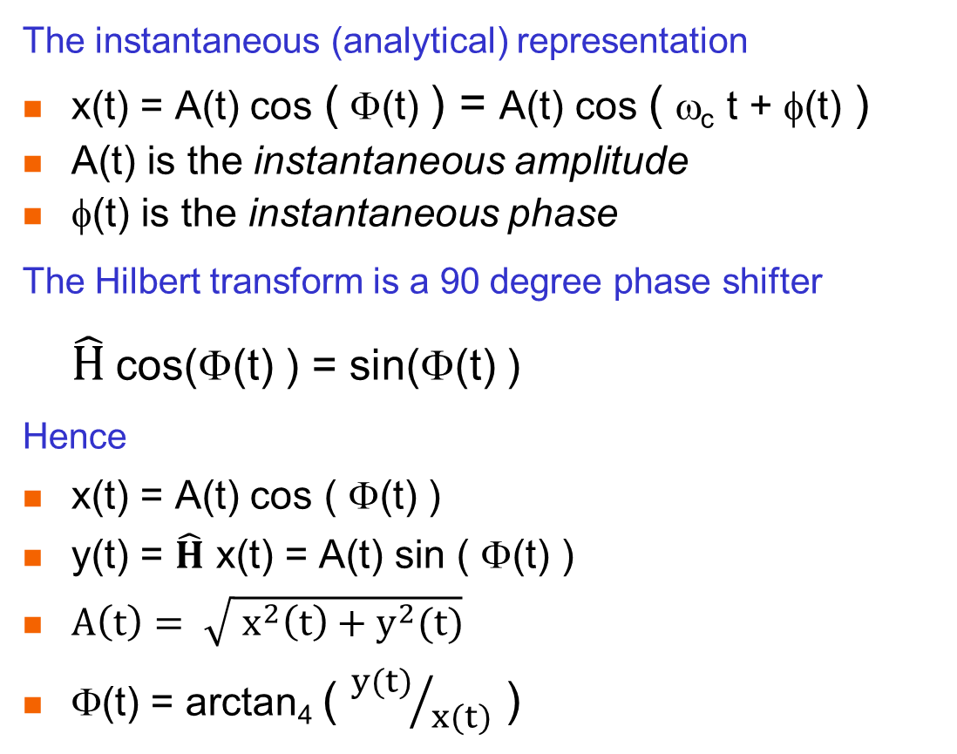
Hilbert transform
The instantaneous (analytical) representation
x(t) = A(t) cos ( Φ(t) ) = A(t) cos ( ω_{c} t + φ(t) )
A(t) is the instantaneous amplitude
φ(t) is the instantaneous phase
The Hilbert transform is a 90 degree phase shifter
$\hat{H}$ cos(Φ(t) ) = sin(Φ(t) )
Hence
x(t) = A(t) cos ( Φ(t) )
y(t) = $\hat{H}$ x(t) = A(t) sin ( Φ(t) )
$A\left(t\right)= \sqrt{{ x^{2}\left(t\right)+y}^{2}(t)}$
$\text{}$(t) = arctan₄ ( ${y(t)}/{x(t)}$ )

Slide 17
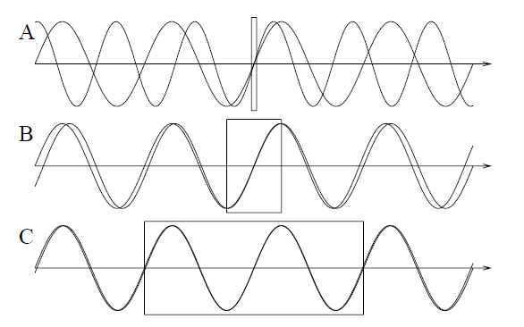
Uncertainty Theorem
When you see a sinusoid for a long time Δt
it is easy to measure its frequency : N_{cycles} / Δt
But when you only see it for a short time or even
the uncertainty in frequency Δω is large
The uncertainty theorem (well-known in quantum mechanics) says
Δω Δt > constant

Slide 18
Systems
0 or more signals as inputs
1 or more signals as outputs
1 signal as input
1 signal as output
A signal processing system has signals as inputs and outputs
The most common type of system has a single input and output
A system is called causal
  if y_{n} depends on x_{n-m} for m≥ 0 but not on x_{n+m}
A system is called linear (note - does not mean y_{n} = ax_{n} + b !)
if x₁ → y₁ and x₂ → y₂ then (ax₁+ bx₂)→ (ay₁+ by₂)
A system is called time invariant
if x → y then z^{n} x → z^{n} y
A system that is both linear and time invariant is called a filter

Slide 19
Filters
Filters have an important property
Y(ω) = H(ω) X(ω) Y_{k} = H_{k} X_{k}
In particular, if the input has no energy at frequency f
  then the output also has no energy at frequency f
  (what you get out of it depends on what you put into it)
This is the reason to call it a filter
  just like a colored light filter (or a coffee filter …)
Filters are used for many purposes, for example
filtering out noise or narrowband interference
separating two signals
integrating and differentiating
emphasizing or de-emphasizing frequency ranges

Slide 20

Filter design
f
f
f
f
f
low pass
high pass
band pass
band stop
notch
When designing filters, we specify
transition frequencies
transition widths
ripple in pass and stop bands
linear phase (yes/no/approximate)
computational complexity
memory restrictions
f
multiband
realizable LP

Slide 21
Convolution
The simplest filter types are amplification and delay
The next simplest is the moving average
a₂
a₁
a₂
a₀
a₁
a₂
a₀
a₁
a₂
a₀
a₂
a₁
a₁
a₀
a₂
a₀
a₁
a₀
*
*
*
*
*
*
*
*
*
*
*
*
*
*
*
*
*
*
*
*
*
*
*
*
*
*
*
*
*
*
*
*
*
*
*
*
*
*
*
*
*
*
*
*
*
x₀
x₁
x₂
x₃
x₄
x₅
y₀
y₀
y₀
y₀
y₀
y₀
y₁
y₁
y₁
y₁
y₁
y₂
y₂
y₂
y₂
y₃
y₃
y₃
y₄
y₄
y₅
Note that the indexes of a and x go in opposite directions
Such that the sum of the indexes equals the output index

Slide 22
Convolution
You know all about convolution !
LONG MULTIPLICATION B₃ B₂ B₁ B₀
* A₃ A₂ A₁ A₀
-----------------------------------------------
A₀B₃ A₀B₂ A₀B₁ A₀B₀
A₁B₃ A₁B₂ A₁B₁ A₁B₀
A₂B₃ A₂B₂ A₂B₁ A₂B₀
A₃B₃ A₃B₂ A₃B₁ A₃B₀
------------------------------------------------------------------------------------
POLYNOMIAL MULTIPLICATION
(a₃ x³ +a₂ x² + a₁ x + a₀) (b₃ x³ +b₂ x² + b₁ x + b₀) =
a₃ b₃ x⁶ + … + (a₃ b₀ + a₂ b₁ + a₁ b₂ + a₀ b₃ ) x³ + … + a₀ b₀

Slide 23
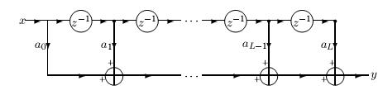
Multiply and Accumulate (MAC)
When computing a convolution we repeat a basic operation
y ← y + a * x
Since this multiplies a times x and then accumulates the answers
  it is called a MAC
The MAC is the most basic computational block in DSP
It is so important that a processor optimized to compute MACs
  is called a DSP processor

Slide 24
AR filters
Computation of convolution is iteration
In CS there is a more general form of 'loop' - recursion
Example: let's average values of input signal up to present time
  y₀ = x₀ = x₀
  y₁ = (x₀ + x₁) / 2 = 1/2 x₁ + 1/2 y₀
  y₂ = (x₀ + x₁ + x₂) / 3 = 1/3 x₂ + 2/3 y₁
  y₃ = (x₀ + x₁ + x₂ + x₃) / 4 = 1/4 x₃ + 3/4 y₂
  y_{n} = 1/(n+1) x_{n} + n/(n+1) y_{n-1} = (1-β) x_{n} + β y_{n-1}
So the present output
  depends on the present input and previous outputs
This is called an AR (AutoRegressive) filter (Udny Yule)
Note: to be time-invariant, β must be non-time-dependent

Slide 25


MA, AR and ARMA
General recursive causal system
y_{n} = f ( x_{n} , x_{n-1} … x_{n-l} ; y_{n-1} , y_{n-2} , …y_{n-m} ; n )
General recursive causal filter
This is called ARMA (for obvious reasons)
  if b_{m}=0 then MA
  if a₀=0 and a_{l >0}=0 but b_{m}≠0 then AR
Symmetric form (difference equation)

Slide 26
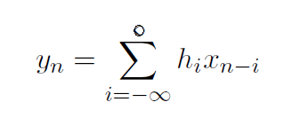
Infinite convolutions
By recursive substitution
AR(MA) filters can also be written as infinite convolutions
Example:
y_{n} = x_{n} + ½ y_{n-1}
y_{n} = x_{n} + ½ (x_{n-1} + ½ y_{n-2}) = x_{n} + ½ x_{n-1} + ¼ y_{n-2}
y_{n} = x_{n} + ½ x_{n-1} + ¼ (x_{n-2} +½ y_{n-3}) = x_{n} +½ x_{n-1} + ¼ x_{n-2} + 1/8 y_{n-3}
…
y_{n} = x_{n} + ½ x_{n-1} + ¼ x_{n-2} + 1/8 x_{n-3} + …
General form
Note: h_{n} is the impulse response (even for ARMA filters)

Slide 27
System identification
x
unknown
system
y
We are given an unknown system - how can we figure out what it is ?
What do we mean by "what it is" ?
Need to be able to predict output for any input
For example, if we know L, all a_{l}, M, all b_{m} or H(ω) for all ω
Easy system identification problem
We can input any x we want and observe y
Difficult system identification problem
The system is "hooked up" - we can only observe x and y
unknown
system

Slide 28
Filter identification
Is the system identification problem always solvable ?
Not if the system characteristics can change over time
Since you can't predict what it will do next
So only solvable if system is time invariant
Not if system can have a hidden trigger signal
So only solvable if system is linear
Since for linear systems
small changes in input lead to bounded changes in output
So only solvable if system is a filter !

Slide 29
Easy problem
Impulse Response (IR)
To solve the easy problem we need to decide which x signal to use
One common choice is the unit impulse
a signal which is zero everywhere except at a particular time (time zero)
The response of the filter to an impulse at time zero (UI)
  is called the impulse response IR (surprising name !)
Since a filter is time invariant, we know the response for impulses at any time (SUI)
Since a filter is linear, we know the response for the weighted sum of shifted impulses
But all signals can be expressed as weighted sum of SUIs
SUIs are a basis that induces the time representation
So knowing the IR is sufficient to predict the output of a filter for any input signal x
0
0

Slide 30
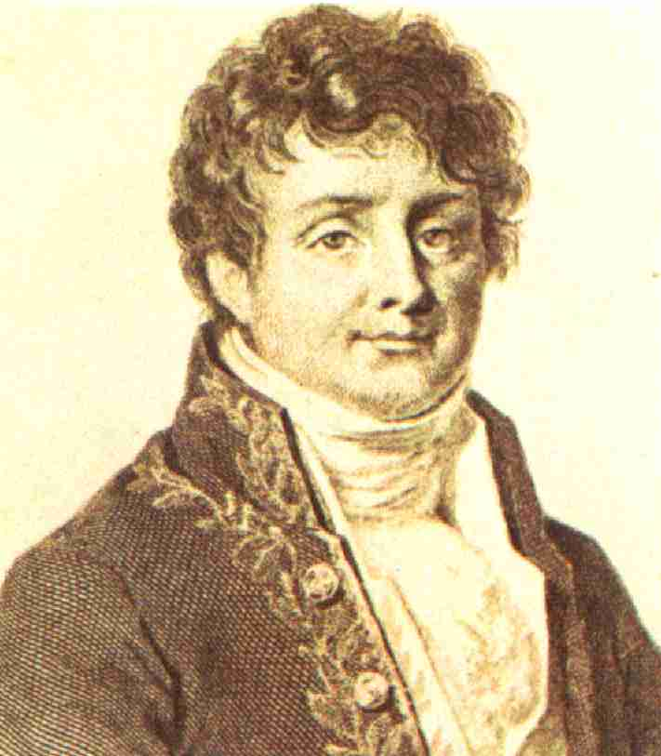
Easy problem
Frequency Response (FR)
To solve the easy problem we need to decide which x signal to use
One common choice is the sinusoid x_{n} = sin ( ω n )
Since filters do not create new frequencies (sinusoids are eigensignals of filters)
  the response of the filter to a a sinusoid of frequency ω
  is a sinusoid of frequency ω (or zero) y_{n} = A_{ω} sin ( ω n + φ_{ω} )
So we input all possible sinusoids
but remember only the frequency response FR
the gain A_{ω}
the phase shift φ_{ω}
But all signals can be expressed as weighted sum of sinsuoids
Fourier basis induces the frequency representation
So knowing the FR is sufficient to predict the output of a filter for any input x
ω
A_{ω}
φ_{ω}

Slide 31

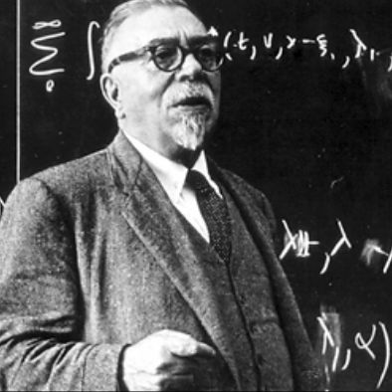

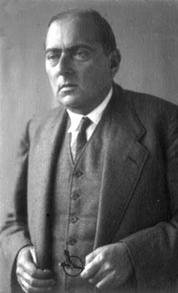
Hard problem Wiener-Hopf equations
Assume that the unknown system is an MA with 3 coefficients
Then we can write three equations for three unknown coefficients
(note - we need to observe 5 x and 3 y )
in matrix form
The matrix has Toeplitz form
which means it can be readily inverted
Note - WH equations are never written this way
instead use correlations
Norbert Wiener
Otto Toeplitz

Slide 32
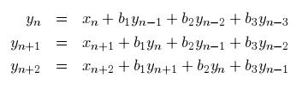

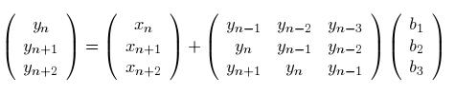
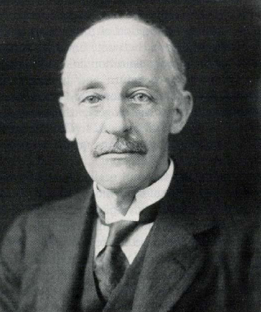
Hard problem Yule-Walker equations
Assume that the unknown system is an AR with 3 coefficients
Then we can write three equations for three unknown coefficients
(note - need to observe 3 x and 5 y)
in matrix form
The matrix also has Toeplitz form
Can be solved by Levinson-Durbin algorithm
Note - YW equations are never really written this way
instead use correlations
Your cellphone solves YW equations thousands of times per second !
Udny Yule
Sir Gilbert Walker

Slide 33
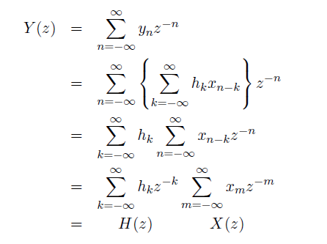
Hard Problem using z transform
H(z) is the transfer function
H(z) is the zT of the impulse function h_{n}
On the unit circle H(z) becomes the frequency response H(ω)
Thus the frequency response is the FT of the impulse response

Slide 34


H(z) is a rational function
B(z) Y(z) = A(z) X(z)
Y(z) = A(z) / B(z) X(z)
but Y(z) = H(z) X(z)
so H(z) = A(z) / B(z)
the ratio of two polynomials is called a rational function
roots of the numerator are called zeros of H(z)
roots of the denominator are called poles of H(z)

Slide 35
Summary - filters
FIR = MA = all zero
IIR AR = all pole
ARMA = zeros and poles
The following contain everything about the filter
(are can predict the output given the input)
a and b coefficients
α and β coefficients
impulse response h_{n}
frequency response H(ω)
transfer function H(z)
pole-zero diagram + overall gain
How do we convert between them ?

Slide 36
Exercises - filters
Try these:
analog differentiator and integrator
y_{n} = x_{n} + x_{n-1} causal, MA, LP find h_{n}, H(ω), H(z), zero
y_{n} = x_{n} - x_{n-1} causal, MA, HP find h_{n}, H(ω), H(z), zero
y_{n} = x_{n} + ½ y_{n-1} causal, AR, LP find h_{n}, H(ω), H(z), pole
Tricks:
H(ω=DC) substitute x_{n} = 1 1 1 1 … y_{n} = y y y y …
H(ω=Nyquist) substitute x_{n} = 1 -1 1 -1 … y_{n} = y -y y -y …
To find H(z) : write signal equation and take zT of both sides

Slide 37
Graph theory
identity = assignment
DSP graphs are made up of
points
directed lines
special symbols
points = signals
all the rest = signal processing systems
x
y
y = x
a
x
y
y = a x
gain
y
y = x
and
z = x
x
z
x
adder
splitter = tee connector
z = x + y
z
y
x
z⁻¹
y
x
z
-
unit delay
y = z⁻¹ x
z = x - y
y

Slide 38
Why is graph theory useful ?
DSP graphs capture both
algorithms and
data structures
Their meaning is purely topological
Graphical mechanisms for simplifying (lowering MIPS or memory)
Four basic transformations
Topological (move points around)
Commutation of filters (any two filters commute!)
Identification of identical signals (points) / removal of redundant branches
Transposition theorem
  exchange input and output
  reverse all arrows
  replace adders with splitters
  replace splitters with adders

Slide 39
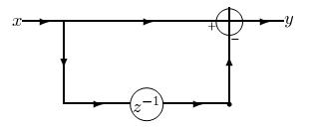
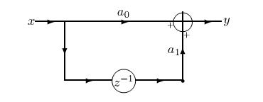
Basic blocks
y_{n} = x_{n} - x_{n-1}
y_{n} = a₀ x_{n} + a₁ x_{n-1}
Explicitly draw point only when need to store value (memory point)

Slide 40
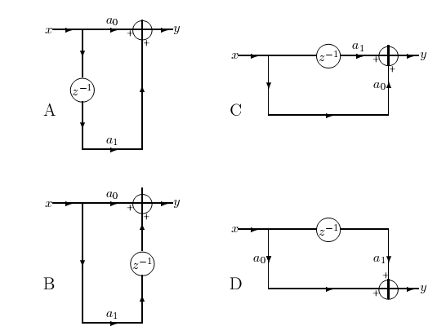
Basic MA blocks
y_{n} = a₀ x_{n} + a₁ x_{n-1}

Slide 41
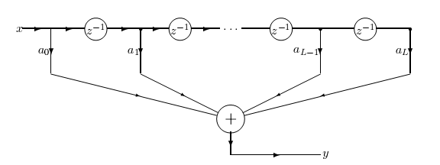
General MA
we would like to build
but we only have 2-input adders !
tapped delay line = FIFO

Slide 42
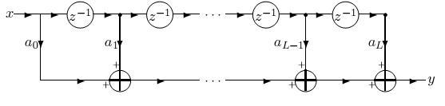
General MA (cont.)
Instead we can build
We still have tapped delay line = FIFO (data structure)
But now iteratively use basic block D (algorithm)
MACs

Slide 43
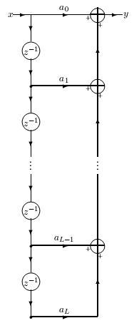
General MA (cont.)
There are other ways to implement the same MA
still have same FIFO (data structure)
  but now basic block is A (algorithm)
Computation is performed in reverse
There are yet other ways (based on other blocks)
FIFO
MACs

Slide 44
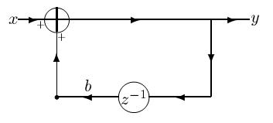
Basic AR block
One way to implement
Note the feedback
Whenever there is a loop, there is recursion (AR)
There are 4 basic blocks here too

Slide 45
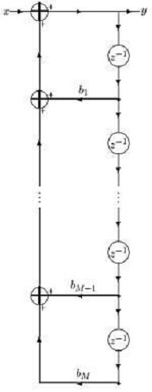
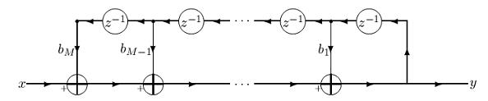
General AR filters
There are many ways to implement the general AR
Note the FIFO on outputs
  and iteration on basic blocks

Slide 46
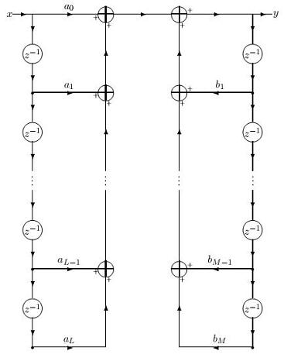
ARMA filters
The straightforward implementation :
Note L+M memory points
Now we can demonstrate
  how to use graph theory
  to save memory

Slide 47
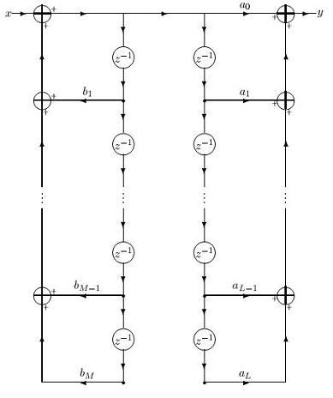
ARMA filters (cont.)
We can commute
  the MA and AR filters
  (any 2 filters commute)
Now that there are points representing
  the same signal !
Assume that L=M (w.o.l.g.)

Slide 48
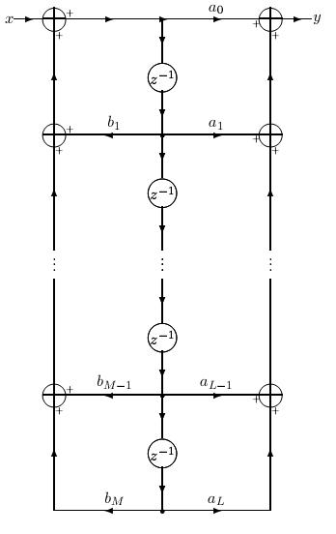
ARMA filters (cont.)
So we can use only one point
And eliminate redundant branches

Slide 49
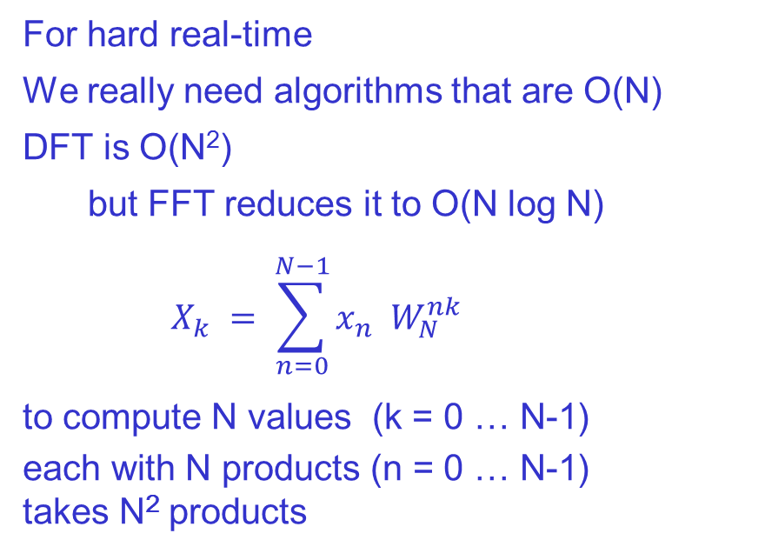
Real-time
double buffer
For hard real-time
We really need algorithms that are O(N)
DFT is O(N²)
  but FFT reduces it to O(N log N)
  $$X_{k} = \sum_{n=0}^{N−1}{x_{n} W_{N}^{nk} }$$
to compute N values (k = 0 … N-1)
each with N products (n = 0 … N-1)
takes N² products

Slide 50
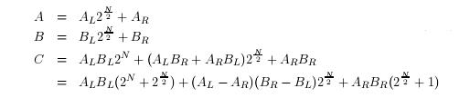
2 warm-up problems
Find minimum and maximum of N numbers
minimum alone takes N comparisons
maximum alone takes N comparisons
minimum and maximum takes 1 1/2 N comparisons
use decimation
Multiply two N digit numbers (w.o.l.g. N binary digits)
Long multiplication takes N² 1-digit multiplications
Partitioning factors reduces to 3/4 N²
Can recursively continue to reduce to O( N ^{log}₂ ³) ≈ O( N^{1.585})
Toom-Cook algorithm

Slide 51
Decimation and Partition
x₀ x₁ x₂ x₃ x₄ x₅ x₆ x₇
Decimation (LSB sort)
x₀ x₂ x₄ x₆ EVEN
x₁ x₃ x₅ x₇ ODD
Partition (MSB sort)
x₀ x₁ x₂ x₃ LEFT
x₄ x₅ x₆ x₇ RIGHT
Decimation in Time ⇔ Partition in Frequency
Partition in Time ⇔ Decimation in Frequency

Slide 52
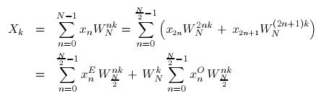
DIT (Cooley-Tukey) FFT
If DFT is O(N²) then DFT of half-length signal takes only 1/4 the time
thus two half sequences take half the time
Can we combine 2 half-DFTs into one big DFT ?
separate sum in DFT
by decimation of x values
we recognize the DFT of the even and odd sub-sequences
we have thus made one big DFT into 2 little ones

Slide 53
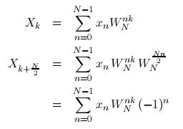


DIT is PIF
We get savings by exploiting the relationship between
  decimation in time and partition in frequency
comparing frequency values in 2 partitions
Note that same products
just different signs
+ − + − + − + −
Using the results of the decimation, we see that the odd terms all have - sign !
combining the two we get the basic "butterfly"

Slide 54

DIT all the way
We have already saved
but we needn't stop after splitting the original sequence in two !
Each half-length sub-sequence can be decimated too
Assuming that N is a power of 2, we continue decimating until we get to the basic N=2 butterfly

Slide 55
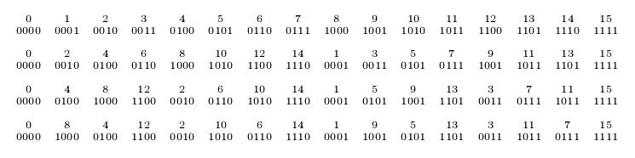
Bit reversal
the input needs to be applied in a strange order !
So abcd → bcda → cdba → dcba
The bits of the index have been reversed !
  (DSP processors have a special addressing mode for this)

Slide 56
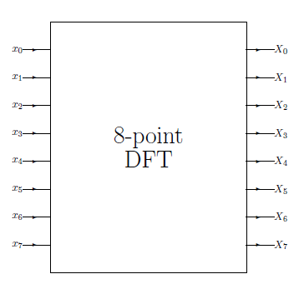
DIT N=8 - step 0

Slide 57
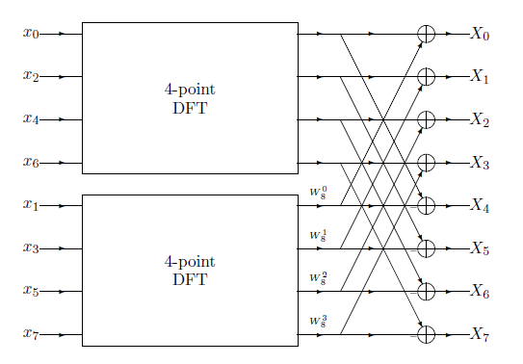
DIT N=8 - step 1

Slide 58
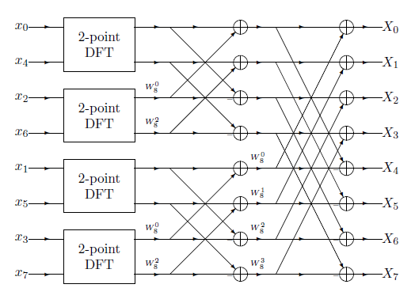
DIT N=8 - step 2

Slide 59
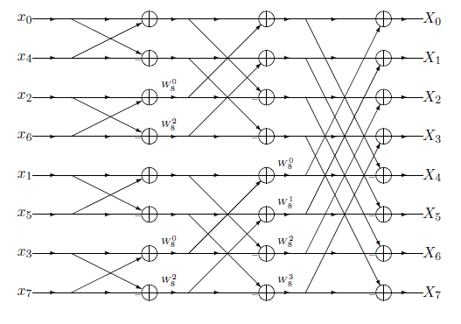
DIT N=8 - step 3

Slide 60
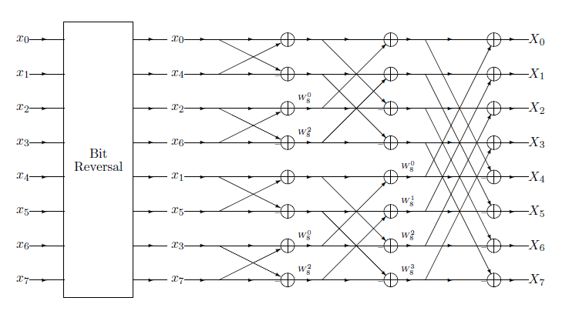
DIT N=8 with bit reversal

Slide 61
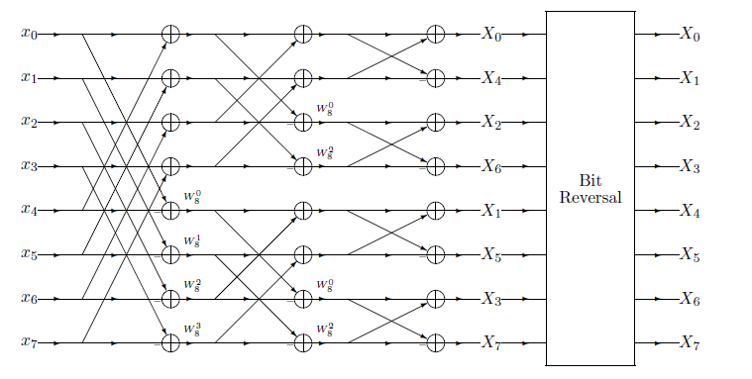
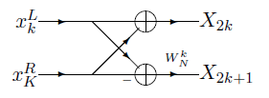
DIF N=8
DIF butterfly

Slide 62
DSP Processors
We have seen that the Multiply and Accumulate (MAC) operation
  is very prevalent in DSP computation
computation of energy
MA filters
AR filters
correlation of two signals
FFT
A Digital Signal Processor (DSP) is a CPU
that can compute each MAC tap
in 1 clock cycle
Thus the entire L coefficient MAC
takes (about) L clock cycles
For in real-time
the time between input of 2 x values
must be more than L clock cycles
DSP
x
y
XTAL
t
ALU with
ADD, MULT, etc
bus
memory
registers
PC
a
x
y
z

Slide 63
MACs
the basic MAC loop is
loop over all times n
  initialize y_{n} ← 0
  loop over i from 1 to number of coefficients
    y_{n} ← y_{n} + a_{i} * x_{j} (j related to i)
  output y_{n}
in order to implement in low-level programming
for real-time we need to update the static buffer
  from now on, we'll assume that x values in pre-prepared vector
for efficiency we don't use array indexing, rather pointers
we must explicitly increment the pointers
we must place values into registers in order to do arithmetic
loop over all times n
  clear y register
  set number of iterations to n
  loop
    update a pointer
    update x pointer
    multiply z ← a * x (indirect addressing)
    increment y ← y + z (register operations)
  output y

Slide 64
Cycle counting
We still can’t count cycles
need to take fetch and decode into account
need to take loading and storing of registers into account
we need to know number of cycles for each arithmetic operation
  let's assume each takes 1 cycle (multiplication typically takes more)
assume zero-overhead loop (clears y register, sets loop counter, etc.)
Then the operations inside the outer loop look something like this:
Update pointer to a_{i}
Update pointer to x_{j}
Load contents of a_{i} into register a
Load contents of x_{j} into register x
Fetch operation (MULT)
Decode operation (MULT)
MULT a*x with result in register z
Fetch operation (INC)
Decode operation (INC)
INC register y by contents of register z
So it takes at least 10 cycles to perform each MAC using a regular CPU

Slide 65
Step 1 - new opcode
To build a DSP
we need to enhance the basic CPU with new hardware (silicon)
The easiest step is to define a new opcode called MAC
Note that the result needs a special register
Example: if registers are 16 bit
product needs 32 bits
And when summing many need ≥40 bits
The code now looks like this:
Update pointer to a_{i}
Update pointer to x_{j}
Load contents of a_{i} into register a
Load contents of x_{j} into register x
Fetch operation (MAC)
Decode operation (MAC)
MAC a*x with incremented to accumulator y
However 7 > 1, so this is still NOT a DSP !
ALU with
ADD, MULT, MAC, etc
bus
memory
p-registers
PC
pa
px
accumulator
registers
y
a
x

Slide 66
Step 2 - register arithmetic
The two operations
Update pointer to a_{i}
Update pointer to x_{j}
could be performed in parallel
  but both performed by the ALU
So we add pointer arithmetic units
  one for each register
Special sign || used in assembler
  to mean operations in parallel
ALU with
ADD, MULT, MAC, etc
bus
memory
p-registers
PC
pa
px
INC/DEC
accumulator
registers
y
a
x
z
Update pointer to a_{i} || Update pointer to x_{j}
Load contents of a_{i} into register a
Load contents of x_{j} into register x
Fetch operation (MAC)
Decode operation (MAC)
MAC a*x with incremented to accumulator y
However 6 > 1, so this is still NOT a DSP !

Slide 67
Step 3 - memory banks and buses
We would like to perform the loads in parallel
  but we can't since they both have to go over the same bus
So we add another bus
  and we need to define memory banks
  so that no contention !
There is dual-port memory
but it has an arbitrator
which adds delay
Update pointer to a_{i} || Update pointer to x_{j}
Load a_{i} into a || Load x_{j} into x
Fetch operation (MAC)
Decode operation (MAC)
MAC a*x with incremented to accumulator y
However 5 > 1, so this is still NOT a DSP !
ALU with
ADD, MULT, MAC, etc
bus
p-registers
bank 1
PC
pa
px
INC/DEC
bus
bank 2
accumulator
registers
y
a
x

Slide 68
Step 4 - Harvard architecture
Van Neumann architecture
one memory for data and program
can change program during run-time
Harvard architecture (predates VN)
one memory for program
one memory (or more) for data
needn't count fetch since in parallel
we can remove decode as well (see later)
ALU with
ADD, MULT, MAC, etc
bus
data 1
p-registers
bus
PC
pa
px
data 2
INC/DEC
accumulator
registers
bus
program
y
a
x
Update pointer to a_{i} || Update pointer to x_{j}
Load a_{i} into a || Load x_{j} into x
MAC a*x with incremented to accumulator y
However 3 > 1, so this is still NOT a DSP !

Slide 69
Step 5 - pipelines
We seem to be stuck
Update MUST be before Load
Load MUST be before MAC
But we can use a pipelined approach
Then, on average, it takes 1 tick per tap
  actually, if pipeline depth is D, N taps take N+D-1 ticks
op
U 1 | U2 | U3 | U4 | U5
 | L1 | L2 | L3 | L4 | L5
 |  | M1 | M2 | M3 | M4 | M5
t
1
2
3
4
5
6
7

Slide 70
Fixed point
Most DSPs are fixed point, i.e. handle integer (2s complement) numbers only
Floating point is more expensive and slower
Floating point numbers can underflow
Fixed point numbers can overflow
We saw that accumulators have guard bits to protect against overflow
When regular fixed point CPUs overflow
numbers greater than MAXINT become negative
numbers smaller than -MAXINT become positive
Most fixed point DSPs have a saturation arithmetic mode
numbers larger than MAXINT become MAXINT
numbers smaller than -MAXINT become -MAXINT
this is still an error, but a smaller error
There is a tradeoff between safety from overflow and SNR

Slide 71
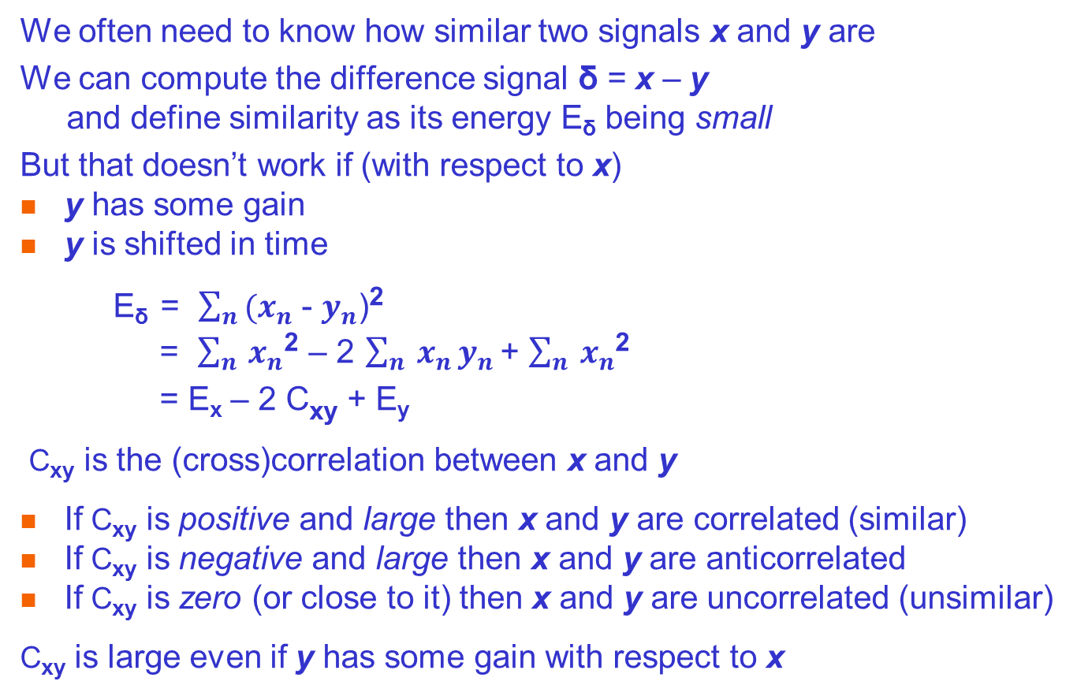
Correlation
We often need to know how similar two signals x and y are
We can compute the difference signal δ = x – y
and define similarity as its energy E_{δ} being small
But that doesn’t work if (with respect to x)
y has some gain
y is shifted in time
E_{δ} = $\sum_{n}{(x_{n}}$ - $y_{n}$)²
= $\sum_{n}{x_{n}}$² – 2 $\sum_{n}{x_{n}}y_{n}$ + $\sum_{n}{x_{n}}$²
= E_{x} – 2 C_{xy} + E_{y}
C_{xy} is the (cross)correlation between x and y
If C_{xy} is positive and large then x and y are correlated (similar)
If C_{xy} is negative and large then x and y are anticorrelated
If C_{xy} is zero (or close to it) then x and y are uncorrelated (unsimilar)
C_{xy} is large even if y has some gain with respect to x

Slide 72
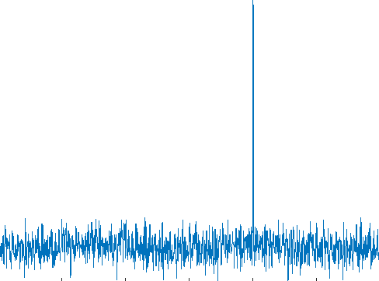
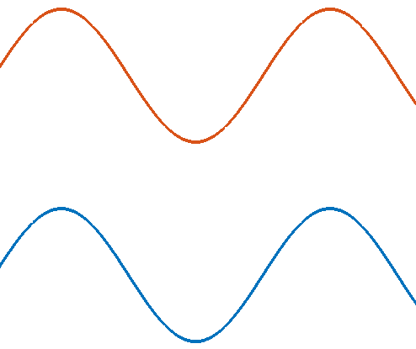
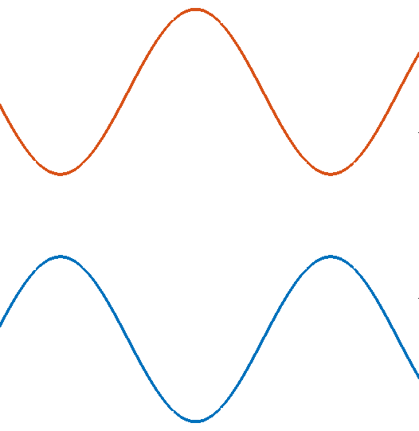
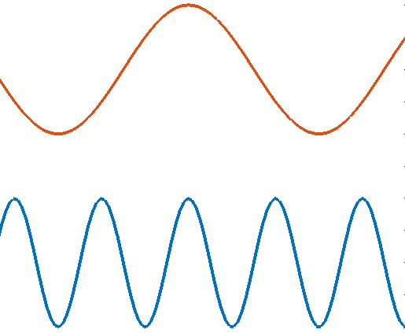
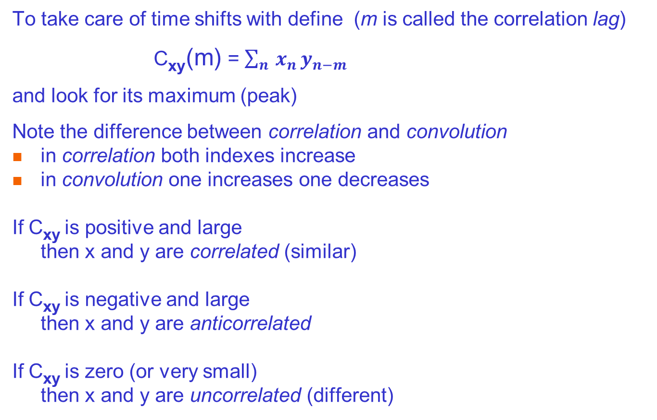
Correlation with lags
To take care of time shifts with define (m is called the correlation lag)
C_{xy}(m) = $\sum_{n}{x_{n}}y_{n−m}$
and look for its maximum (peak)
Note the difference between correlation and convolution
in correlation both indexes increase
in convolution one increases one decreases
If C_{xy} is positive and large
then x and y are correlated (similar)
If C_{xy} is negative and large
then x and y are anticorrelated
If C_{xy} is zero (or very small)
then x and y are uncorrelated (different)

Slide 73
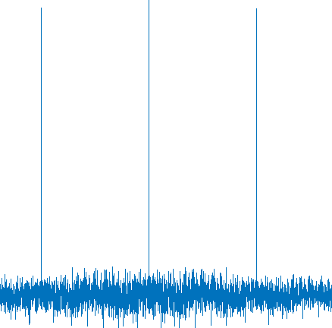

Autocorrelation
We can define the autocorrelation
C_{xx}(m) = $\sum_{n}{x_{n}}x_{n−m}$
which tells us how similar the signal is to itself shifted in time
A periodic signal has peaks at lags that are multiples of the period!
Since |c_{xx}(m)| ≤ E_{x}
it is useful to define the normalized autocorrelation
c_{xx}(m) = C_{xx}(m) / E_{x}
where |c_{xx}| ≤ 1

Slide 74


Wiener filter
Pulse radars transmit a short (and thus low energy) distinctive pulse
and received a delayed, weak, noisy copy after time t = 2 * c * R
The Wiener filter finds t by building an MA filter
with coefficients equal to the time reversed signal
The MA’s convolution performs a correlation
t

Slide 75

Prediction
Wiener’s famous paper was named
Interpolation, extrapolation and smoothing of stationary time series
where
smoothing = low-pass filtering
interpolation = resampling
extrapolation = prediction
We previously saw how Yule predicted sun-spots via an AR process
$s$*$n$ = $\sum_{m}^{M}{{b_{m} s}_{n−m}}$ where s*$n$ is the estimate of s$n$
Let’s directly derive the coefficient b for the simplest case (M=1)
We want to minimize the energy of the error signal e = y*-y
$\sum{{\text{e}}^{2}= \sum{(\text{s}n−{\text{s}}_{n}^{∗})}}$² = $\sum{(\text{s}n−\sum_{m}^{M}{{b_{m} s}_{n−m}})}\text{2}$ = (1+ $b$²)E_{s} – 2 $b$C_{s}(1)
Differentiating and setting equal to zero we find b = C_{s}(1) / E_{s} = c_{s}(1)
More generally, the coefficients are given by Yule Walker equations

Slide 76

Adaptation
We often would like to remove noise from a noisy signal
This can be accomplished
when we have a signal that is highly correlated to the noise
For example, assume 2 microphones
1. air conditioner noise q_{n}
2. speech x_{n} + filtered air conditioner noise
In the simplest case the filtering is a single-tap MA filter, a q_{n-m}
so y_{n} = x_{n} + a q_{n-m} where a and m are unknown
By finding the maximum cross-correlation
we can determine m and thus q_{n-m}
But how do we find a ?
Estimate x*_{n} = y_{n} - c q_{n-m} = x_{n} + (a-c) q_{n-m}
We need to minimize this signal’s energy
which is typically done via gradient descent
For L taps we do L-dimensional gradient descent
E_{x*}
c
h

Slide 77
Application: Speech
Speech is a wave traveling through space
at any given point it is a signal in time
The speech values are pressure differences (or molecule velocities)
There are many reasons to process speech, for example
speech storage / communications
speech compression (coding)
speed changing, lip sync,
text to speech (speech synthesis)
speech to text (speech recognition)
translating telephone
speech control (commands)
speaker recognition (forensic, access control, spotting, …)
language recognition, speech polygraph, …
voice fonts

Slide 78
Phonemes
The smallest acoustic unit that can change meaning
Different languages have different phoneme sets
Types: (notations: phonetic, CVC, ARPABET)
  Vowels
    front (heed, hid, head, hat)
    mid (hot, heard, hut, thought)
    back (boot, book, boat)
    dipthongs (buy, boy, down, date)
  Semivowels
    liquids (w, l)
    glides (r, y)

Slide 79
Phonemes - cont.
  Consonants
    nasals (murmurs) (n, m, ng)
    stops (plosives)
      voiced (b,d,g)
      unvoiced (p, t, k)
    fricatives
      voiced (v, that, z, zh)
      unvoiced (f, think, s, sh)
    affricatives (j, ch)
    whispers (h, what)
    gutturals ( ח ,ע )
    clicks, etc. etc. etc.

Slide 80
Voiced vs. Unvoiced Speech
When vocal cords are held open air flows unimpeded
When laryngeal muscles stretch them glottal flow is in bursts
When glottal flow is periodic called voiced speech
Basic interval/frequency called the pitch (f₀)
Pitch period usually between 2.5 and 20 milliseconds
Pitch frequency between 50 and 400 Hz
You can feel the vibration of the larynx
Vowels are always voiced (unless whispered)
Consonants come in voiced/unvoiced pairs
for example : B/P K/G D/T V/F J/CH TH/th W/WH Z/S ZH/SH

Slide 81
Excitation spectra
Voiced speech
Pulse train is not sinusoidal – rich in harmonics
Unvoiced speech
Common assumption : white noise
f
pitch
f

Slide 82
Effect of vocal tract
Mouth and nasal cavities have resonances
Resonant frequencies depend on geometry

Slide 83
Effect of vocal tract - cont.
Sound energy at these resonant frequencies is amplified
Frequencies of peak amplification are called formants
F1
F2
frequency response
F3
F4
frequency
voiced speech
unvoiced speech
F0

Slide 84

Formant frequencies
Peterson - Barney data (note the “vowel triangle”)
f₂
f₁

Slide 85

Sonograms

Slide 86



Basic LPC Model
Pulse
Generator
U/V
switch
G
LPC
synthesis
filter
s
White Noise
Generator

Slide 87
Basic LPC Model - cont.
Pulse generator produces a harmonic rich periodic impulse train (with pitch period and gain)
White noise generator produces a random signal
(with gain)
U/V switch chooses between voiced and unvoiced speech
LPC filter amplifies formant frequencies
(all-pole or AR IIR filter)
The output will resemble true speech to within residual error

Slide 88
Application: Data Communications
Communications is moving information from place to place
Information is the amount of surprise, and can be quantified!
Communications was originally analog – telegraph, telephone
All physical channels
have limited bandwidth (BW)
add noise (so that the signal to noise ratio SNR is finite)
so analog communications always degrades
and there is no way to completely remove noise
In analog communications the only solution to noise
is to transmit a stronger signal (amplification amplifies N along with S)
Communications has become digital
digital communications is all or nothing
  perfect reception or no data received

Slide 89
Shannon’s Theorems
1. Separation Theorem
2. Source Encoding Theorem
Information can be quantified (in bits)
3. Channel Capacity Theorem
C = BW log₂ ( SNR + 1 )
analog signal
bits
bits
info
source
encoder
channel
encoder
channel
channel
decoder
source
decoder
info

Slide 90
Modem design
Shannon’s theorems are existence proofs - not constructive
So we need to be creative to reach channel capacity
Modem design :
NRZ
RZ
PAM
FSK
PSK
QAM
DMT

Slide 91
NRZ
Our first attempt is to simply transmit 1 or 0 (volts?)
NRZ = Non Return to Zero (i.e., NOT RZ)
Information rate = number of bits transmitted per second (bps)
But this is only good for short serial cables (e.g. RS232), because
DC
high bandwidth (sharp corners) and Intersymbol interference
Timing recovery

Slide 92
DC-less NRZ
So what about transmitting -1/+1?
This is better, but not perfect!
DC isn’t exactly zero
Still can have a long run of +1 OR -1 that will decay
Even without decay, long runs ruin timing recovery

Slide 93
RZ
What about Return to Zero ?
No long +1 runs, so DC decay less important
BUT half width pulses means twice bandwidth!

Slide 94

NRZ InterSymbol Interference (ISI)
low-pass filtered signal keeps up with bit changes
insufficient BW to keep up with bit changes

Slide 95
OOK
Even better - use OOK (On Off Keying)
Absolutely no DC!
Based on sinusoid (“carrier”)
Can hear it (morse code)

Slide 96
NRZ - Bandwidth
The PSD (Power Spectral Density) of NRZ is a sinc (sinc(x) = sin(x)/x)
The first zero is at the bit rate (uncertainty principle)
So channel bandwidth limits bit rate
DC depends on levels (may be zero or spike)

Slide 97
OOK - Bandwidth
PSD of -1/+1 NRZ is the same, except there is no DC component
If we use OOK the sinc is mixed up to the carrier frequency
(The spike helps in carrier recovery)

Slide 98
From NRZ to n-PAM
+1
NRZ
4-PAM
(2B1Q)
8-PAM
Each level is called a symbol or baud
Bit rate = number of bits per symbol * baud rate
-1
1
1
1
0
0
1
0
+3
GRAY CODE
10 => +3
11 => +1
01 => -1
00 => -3
+1
-1
-3
11
10
01
01
00
11
01
GRAY CODE
100 => +7
101 => +5
111 => +3
110 => +1
010 => -1
011 => -3
001 => -5
000 => -7
111
001
010
011
010
000
110

Slide 99
PAM - Bandwidth
BW (actually the entire PSD) doesn’t change with n !
So we should use many bits per symbol
But then noise becomes more important
(Shannon strikes again!)
BAUD RATE

Slide 100
Trellis coding
Traditionally, noise robustness is increased
by using an Error Correcting Code (ECC)
But an ECC separate from the modem
disobeys the separation theorem, and is not optimal !
Ungerboeck found how to integrate demodulation with ECC
This technique is called Trellis Coded PAM (TC-PAM)
Basic idea:
Once the receiver makes a hard decision it is too late
When an error occurs, use the analog information

Slide 101
FSK
What can we do about noise?
If we use frequency diversity we can gain 3 dB
Use two independent OOKs with the same information
(no DC)
This is FSK - Frequency Shift Keying
Note that sinusoids are orthogonal – but only over long times !

Slide 102
ASK
What about Amplitude Shift Keying - ASK ?
2 bits / symbol
Generalizes OOK like multilevel PAM did to NRZ
Not widely used since hard to differentiate between levels
Is FSK better?

Slide 103
FSK
FSK is based on orthogonality of sinusoids of different frequencies
Make decision only if there is energy at f₁ but not at f₂
Uncertainty theorem says this requires a long time
So FSK is robust but slow (Shannon strikes again!)

Slide 104
PSK
What about sinusoids of the same frequency but different phases?
Correlations reliable after a single cycle
So let’s try BPSK
1 bit / symbol
or QPSK
2 bits / symbol
Bell 212 2W 1200 bps
V.22

Slide 105
QAM
Finally, we can combine PSK and ASK (but not FSK)
2 bits per symbol
This is getting confusing

Slide 106
The secret math behind it all
Remember the instantaneous representation ?
x(t) = A(t) cos ( 2 π f_{c} t + φ(t) )
A(t) is the instantaneous amplitude
φ(t) is the instantaneous phase
This obviously includes ASK and PSK as special cases
actually all bandwidth limited signals can be written this way
analog AM, FM and PM
FSK changes the derivative of φ(t)
The way we defined them A(t) and φ(t) are not unique
the canonical pair (Hilbert transform)

Slide 107
Star watching
For QAM eye diagrams are not enough
Instead, we can draw a diagram with
x and y as axes
A is the radius, φ the angle
For example, QPSK can be drawn (rotations are time shifts)
Each point represents 2 bits!

Slide 108
QAM constellations
16 QAM V.29 (4W 9600 bps)
V.22bis 2400 bps Codex 9600 (V.29)
2W
first non-Bell modem (Carterphone decision)
Adaptive equalizer
Reduced PAR constellation
Today - 9600 fax!
8PSK
V.27
4W
4800bps

Slide 109

Voicegrade modem constellations

Slide 110
Multicarrier Modulation and OFDM
NRZ, RZ, etc. have NO carrier
PSK, QAM have ONE carrier
MCM has MANY carriers
Achieve maximum capacity by direct water pouring!
PROBLEM
Basic FDM requires guard frequencies
Squanders good bandwidth
Subsignals are orthogonal if spaced precisely by the baud rate
No guard frequencies are needed

Slide 111

DMT
Measure SNR(f) during initialization
Water pour QAM signals according to SNR
Each individual signal narrowband --- no ISI
Symbol duration > channel impulse response time --- no ISI
No equalization required

Slide 112

Application : Stock Market
This signal is hard to predict (extrapolate)
self-similar and fractal dimension
polynomial smoothing leads to overfitting
noncausal MA smoothing (e.g., Savitsky Golay) doesn’t extrapolate
causal MA smoothing leads to significant delay
AR modeling works well
  but sometimes need to bet the trend will continue
  and sometimes need to bet against the trend

