Slide 1
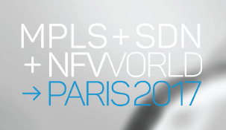
Virtual CPE Reality
Yaakov (J) Stein
CTO

Slide 2


Orchestration: Etymology
Cynics opine that the only difference between
conventional networking and SDN/NFV-enabled networking
lies in replacing the word management with the word orchestration
To investigate this claim we need to ask What is orchestration ?
The term originates in music
orchestration is the practice of writing/adapting music for an orchestra
Note: the person who conducts an orchestra is a conductor not an orchestrator
conducting is the art of directing a musical performance, i.e.
setting the tempo
ensuring ensemble members enter and exit at the appropriate times
shaping phrasing according to policy
To conform with the time-honored musical convention
the composing of scripts by a DevOps writer should be orchestration
the running of a management system really should be conducting
Note: some web services chose yet another artistic analogy
and talk of service choreography

Slide 3

It all started with Data Center Orchestration ...
So why do we use the term orchestration in SDN/NFV ?
The term was inherited from data center operations
In data centers orchestration denotes:
the automated management and coordination of
computational resources, workflows and services
This task was originally carried out by sysadmins by writing scripts
and so was aptly named orchestration
With the advent of ubiquitous cloud services orchestration was redefined to:
deploying and monitoring of virtualized resources
and management of highly dynamic workflows
But there is even more to the orchestration analogy ...

Slide 4
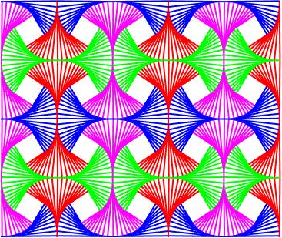
Physical Entities Are Typically Complex
Physical systems are expensive and time-consuming to develop and to deploy
and are thus designed to be multifunctional
Hence for networks based on such physical entities
management really means configuration :
selecting desired functionalities from among the many available ones
initializing each desired functionality
Reacting to events in the network is mostly handled by control protocols
For example, a physical router may really include the following functionalities:
● Ethernet switch ● DHCP server
● IPv4 unicast forwarder ● IPv6 unicast forwarder
● IPv4 multicast forwarder ● IPv6 multicast forwarder
● IPv4 intradomain control protocol peer ● IPv4 interdomain control protocol peer
● NAT ● tunneling endpoint
● firewall ● IPsec gateway
and many more ...

Slide 5


Virtual Entities Can Afford To Be Atomic
Virtual functions are inexpensive and fast to develop and deploy
hence we can afford to make them atomic
and build composite functions as needed by service chaining
In a microservices architecture
services have fine granularity
interconnection protocols are lightweight
services are independently deployable
Atomic functions need to be
dynamically placed at the proper place along the service path
informed from whom to receive inputs and to whom to provide outputs
informed as to (SLA related) policy considerations
but require very little other configuration
Hence for networks based on such virtual entities
orchestration means functional selection, placement, and chaining
but also real-time reaction to network events

Slide 6
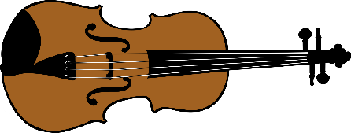


Orchestration: Revisited
So, we now have a deeper understanding for the word orchestration
A complex appliance is similar to an entire orchestra with its own conductor
while an atomic virtual function is like a single musical instrument
This is advantageous since the same violin can play many different scores, and
play alongside 100 other instruments in a symphony orchestra
play alongside 40 other instruments in a chamber orchestra
play alongside 3 other instruments in a string quartet
play alone in a solo performance
An orchestra manager deals with
financial aspects
overall policy
but doesn’t get involved in the functioning of individual musicians
An orchestrator has to
intimately know each instrument and its relations to the others
produce a score for each instrument
give instructions to the conductor as to how to react in real-time

Slide 7
Ramifications of Atomicity
Functionality and APIs for atomic functions are simpler
and may be better adapted to service requirements
Functionality and APIs for atomic functions are more standardizable
this leads to more drop-in options and less vendor lock-in, and
expands the repertoire of service types using the same production process
New atomic functions combinations can be created on-the-fly
but only the compound function need be revealed to customers
Atomic functions require fewer and less exotic resources
and can hence be more easily located (even in weak vCPEs) and relocated
There may be many more atomic functions to orchestrate
but the amplification is by a factor, not by an order of magnitude
Faults and root cause identification can be centrally handled
based on standardized events from virtualized elements
rather than mostly up to internal logic of complex physical element

Slide 8
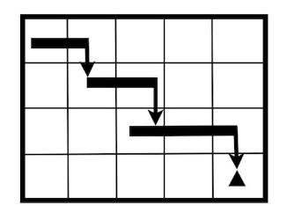
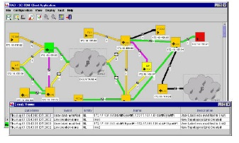

Operations for Conventional Networks
In the operations of networks based on physical appliances
configuration management is only one step out of many :
long term planning (BSS)
based on customer relationships and technological advances
predict needed hardware resources from many link/equipment types
purchasing, directing layout of physical resources
service planning (OSS)
based on customer requests and legal constraints (e.g., SLAs)
determine how to most efficiently provide promised service
management (NMS)
configuration and commissioning testing
control (protocols)
monitoring and reporting
reacting to events

Slide 9
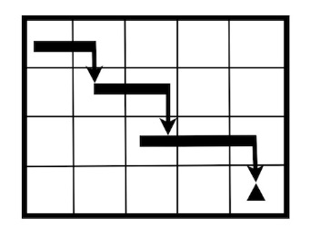
Operations for Orchestrated Networks
There are fewer steps in operations for networks employing virtual entities
long term planning (BSS)
measure and collect trend information
acquire three types of hardware resources
links (physical (fiber) or virtual (lambda))
switches (physical (appliances) or virtual (vSwitches))
computational (physical (CPU) or virtual (VM))
acquire pools of software licenses
orchestration and control
Note that short term planning has disappeared
as it is carried out automagically by the orchestration system
For example – actual software images may be retrieved automatically
It is interesting that SDN uses the term control
in an attempt to emphasize its speed and dynamic nature
On the other hand NFV uses the word management
because it was more comfortable for service providers

Slide 10
vCPE vs. Cloud-based NFV
We already mentioned that NFV and orchestration facilitates function relocation
In fact, NFV can not simply mean making appliances out of software -
network appliances have been software-intensive for years!
NFV actually means:
running network functionality on generic COTS whitebox servers
breaking down network functions into atomic functions
placement
chaining these functions together
optimizing and managing the computational and network infrastructures
The first point is the definition of NFV, and we have discussed 2, 3, and 4
Cloud-based NFV satisfies 1-3 by replacing hardware with generic software
but doesn’t optimize the computational or network infrastructure
The option to relocate VNFs to the (v)CPE fundamentally changes the network
both in deploying functionalities in new places
and potentially redirecting traffic in new ways (e.g., SD-WAN)

Slide 11
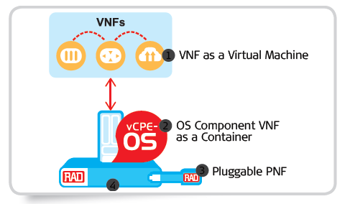
Why vCPE ? (1)
Why is the vCPE concept attractive to service providers?
The originally envisioned advantage of NFV was performance scaling
in order to maintain profitability margins
vCPE platforms do not offer any CAPEX pricing advantage
since typically CPE devices are already engineered for cost reduction
In fact, generic software implementations are generally less efficient
making it challenging even to meet appliance costs
The advantage in vCPE is agility in function and service creation
Visit RAD’s Booth #301

Slide 12
Why vCPE ? (2)
This agility results in:
reduced time to develop attractive new services
e.g., SD-WAN services (a prime application of vCPE)
reduced time to revenue and offering of Minimal Viable Products
enhanced user experience
try & buy
quick turn-up, etc.
user charged for functionality only when needed
ability to support two VPN types in a single platform
IP (traffic can go through DC/HQ)
CE (ELINE)
ability to support two fundamentally types of VNFs
customer visible Value Added Services (beyond basic connectivity)
operational (only visible to the service provider)
from networking to IT premium services
computications enabler (as discussed last year)

Slide 13
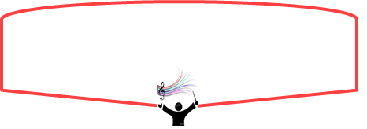
























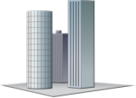




From Management to Orchestration
Customer Service
load
balancing
router
encrypt
firewall
DPI
Cloud
Orchestration
Management
router
firewall
encrypt
encrypt
router
DPI
μwave
cellular
encrypt
internet
router
firewall
MEC
encrypt
v
fiber
firewall
CPE
DPI
DPI
storage
encrypt
ad-hoc
mesh
router

Slide 14
Yaakov (J) Stein
CTO
Yaakov_s@rad.com

