Slide 1
SDN & NFV OpenFlow and ForCES IETF-93
Presented by
Yaakov Stein RAD (yaakov_s@rad.com)
Evangelos Haleplidis U of Patras (ehalep@ece.upatras.gr)

Slide 2
Why SDN and NFV ?
Before explaining what SDN and NFV are
we need to explain why SDN and NFV are
Its all started with two related trends ...
1. The blurring of the distinction
between computation and communications
revealing a fundamental disconnect
between software and networking
2. The decrease in profitability
of traditional communications service providers
along with the increase in profitability
of Cloud and Over The Top service providers
The 1st led directly to SDN
and the 2nd to NFV
but today both are intertwined

Slide 3
1. Computation and communications
Once there was little overlap
between communications (telephone, radio, TV)
and computation (computers)
Actually communications devices always ran complex algorithms
but these are hidden from the user
But this dichotomy has become blurred
Most home computers are not used for computation at all
rather for entertainment and communications (email, chat, VoIP)
Cellular telephones have become computers
The differentiation can still be seen in the terms algorithm and protocol
Protocol design is fundamentally harder
since there are two interacting entities (the interoperability problem)
SDN academics claim that packet forwarding is a computation problem
and protocols as we know them should be avoided

Slide 4

1. Rich communications services
Traditional communications services are pure connectivity services
transport data from A to B
with constraints (e.g., minimum bandwidth, maximal delay)
with maximal efficiency (minimum cost, maximized revenue)
Modern communications services are richer
combining connectivity and network functionalities
e.g., firewall, NAT, load balancing, CDN, parental control, ...
Such services further blur the computation/communications distinction
and make service deployment optimization more challenging

Slide 5
1. Software and networking speed
Today, developing a new iOS/Android app takes hours to days
but developing a new communications service takes months to years
Even adding new instances of well-known services
is a time consuming process for conventional networks
When a new service types requires new protocols, the timeline is
protocol standardization (often in more than one SDO)
hardware development
interop testing
vendor marketing campaigns and operator acquisition cycles
staff training
deployment
This leads to a fundamental disconnect
between software and networking development timescales
An important goal of SDN and NFV is
to create new network functionalities at the speed of software
how long has it been since the first IPv6 RFC ?

Slide 6
2. Today’s communications world
Today’s infrastructures are composed of many different Network Elements (NEs)
sensors, smartphones, notebooks, laptops, desk computers, servers,
DSL modems, Fiber transceivers,
SONET/SDH ADMs, OTN switches, ROADMs,
Ethernet switches, IP routers, MPLS LSRs, BRAS, SGSN/GGSN,
NATs, Firewalls, IDS, CDN, WAN aceleration, DPI,
VoIP gateways, IP-PBXes, video streamers,
performance monitoring probes , performance enhancement middleboxes,
etc., etc., etc.
New and ever more complex NEs are being invented all the time,
and while equipment vendors like it that way
Service Providers find it hard to shelve and power them all !
In addition, while service innovation is accelerating
the increasing sophistication of new services
the requirement for backward compatibility
and the increasing number of different SDOs, consortia, and industry groups
which means that
it has become very hard to experiment with new networking ideas
NEs are taking longer to standardize, design, acquire, and learn how to operate
NEs are becoming more complex and expensive to maintain

Slide 7
2. The service provider crisis
$
revenue
Service Provider bankruptcy point
margin
CAPEX + OPEX
desirable CAPEX + OPEX
time
This is a qualitative picture of the service provider’s world
Revenue is at best increasing with number of users
Expenses are proportional to bandwidth – doubling every 9 months
This situation obviously can not continue forever !

Slide 8
Two complementary solutions
Software Defined Networks (SDN)
SDN advocates replacing standardized networking protocols
with centralized software applications
that configure all the NEs in the network
Advantages:
easy to experiment with new ideas
control software development is much faster than protocol standardization
centralized control enables stronger optimization
functionality may be speedily deployed, relocated, and upgraded
Network Functions Virtualization (NFV)
NFV advocates replacing hardware network elements
with software running on COTS computers
that may be housed in POPs and/or datacenters
Advantages:
COTS server price and availability scales with end-user equipment
functionality can be located where-ever most effective or inexpensive
functionalities may be speedily combined, deployed, relocated, and upgraded

Slide 9
SDN

Slide 10
Abstractions
SDN was triggered by the development of networking technologies
not keeping up with the speed of software application development
Computer science theorists theorized
that this derived from not having the required abstractions
In CS an abstraction is a representation
that reveals semantics needed at a given level
while hiding implementation details
thus allowing a programmer to focus on necessary concepts
without getting bogged down in unnecessary details
Programming is fast because programmers exploit abstractions
Example:
It is very slow to code directly in assembly language (with few abstractions, e.g. opcode mnemonics)
It is a bit faster to coding in a low-level language like C (additional abstractions : variables, structures)
It is much faster coding in high-level imperative language like Python
It is much faster yet coding in a declarative language (coding has been abstracted away)
It is fastest coding in a domain-specific language (only contains the needed abstractions)
In contrast, in protocol design we return to bit level descriptions every time

Slide 11
Packet forwarding abstraction
The first abstraction relates to how network elements forward packets
At a high enough level of abstraction
all network elements perform the same task
Abstraction 1 Packet forwarding as a computational problem
The function of any network element (NE) is to
receive a packet
observe packet fields
apply algorithms (classification, decision logic)
optionally edit the packet
forward or discard the packet
For example
An Ethernet switch observes MAC DA and VLAN tags, performs exact match, forwards the packet
A router observes IP DA, performs LPM, updates TTL, forwards packet
A firewall observes multiple fields, performs regular expression match, optionally discards packet
We can replace all of these NEs with a configurable whitebox switch

Slide 12

Network state and graph algorithms
How does a whitebox switch learn its required functionality ?
Forwarding decisions are optimal
when they are based on full global knowledge of the network
With full knowledge of topology and constraints
the path computation problem can be solved by a graph algorithm
While it may sometimes be possible to perform path computation (e.g., Dijkstra)
in a distributed manner
It makes more sense to perform them centrally
Abstraction 2 Routing as a computational problem
Replace distributed routing protocols with graph algorithms
performed at a central location
Note with SDN, the pendulum that swung
from the completely centralized PSTN
to the completely distributed Internet
swings back to completely centralized control

Slide 13
Configuring the whitebox switch
How does a whitebox switch acquire the information needed to forward
that has been computed by an omniscient entity at a central location ?
Abstraction 3 Configuration
Whitebox switches are directly configured by an SDN controller
Conventional network elements have two parts:
smart but slow CPUs that create a Forwarding Information Base
fast but dumb switch fabrics that use the FIB
Whitebox switches only need the dumb part, thus
eliminating distributed protocols
not requiring intelligence
The API from the SDN controller down to the whitebox switches
is conventionally called the southbound API (e.g., OpenFlow, ForCES)
Note that this SB API is in fact a protocol
but is a simple configuration protocol
not a distributed routing protocol

Slide 14
Separation of data and control
You will often hear stated that the defining attribute of SDN is
the separation of the data and control planes
This separation was not invented recently by SDN academics
Since the 1980s all well-designed communications systems
have enforced logical separation of 3 planes :
data plane (forwarding)
control plane (e.g., routing )
management plane (e.g., policy, commissioning, billing)
What SDN really does is to
1) insist on physical separation of data and control
2) erase the difference between control and management planes
management plane
control plane
data plane

Slide 15
Control or management
What happened to the management plane ?
Traditionally the distinction between control and management was that :
management had a human in the loop
while the control plane was automatic
With the introduction of more sophisticated software
the human could often be removed from the loop
The difference that remains is that
the management plane is slow and centralized
the control plane is fast and distributed
So, another way of looking at SDN
is to say that it merges
the control plane
into a single centralized management plane

Slide 16
SDN vs. distributed routing
Distributed routing protocols are limited to
finding simple connectivity
minimizing number of hops (or other additive cost functions)
but find it hard to perform more sophisticated operations, such as
guaranteeing isolation (privacy)
optimizing paths under constraints
setting up non-overlapping backup paths (the Suurballe problem)
integrating networking functionalities (e.g., NAT, firewall) into paths
This is why MPLS created the Path Computation Element architecture
An SDN controller is omniscient (the God box)
and holds the entire network description as a graph
on which arbitrary optimization calculations can be performed
But centralization comes at a price
the controller is a single point of failure
(more generally different CAP-theorem trade-offs are involved)
the architecture is limited to a single network
additional (overhead) bandwidth is required
additional set-up delay may be incurred

Slide 17
Flows
It would be too slow for a whitebox switch
to query the centralized SDN controller
for every packet received
So we identify packets as belonging to flows
Abstraction 4 Flows (as in OpenFlow)
Packets are handled solely based on the flow to which they belong
Flows are thus just like Forwarding Equivalence Classes
Thus a flow may be determined by
an IP prefix in an IP network
a label in an MPLS network
VLANs in VLAN cross-connect networks
The granularity of a flow depends on the application

Slide 18
Control plane abstraction
In the standard SDN architecture, the SDN controller is omniscient
but does not itself program the network
since that would limit development of new network functionalities
With software we create building blocks with defined APIs
which are then used, and perhaps inherited and extended, by programmers
With networking, each network application has a tailored-made control plane
with its own element discovery, state distribution, failure recovery, etc.
Note the subtle change of terminology we have just introduced
instead of calling switching, routing, load balancing, etc. network functions
we call them network applications (similar to software apps)
Abstraction 5 Northbound APIs instead of protocols
Replace control plane protocols with well-defined APIs to network applications
This abstraction hide details of the network from the network application
revealing high-level concepts, such as requesting connectivity between A and B
but hiding details unimportant to the application
such as details of switches through which the path A → B passes

Slide 19
SDN overall architecture
app
app
app
app
Network Operating System
northbound interface
SDN controller
southbound interface
(e.g., OpenFlow, ForCES)
SDN switch
SDN switch
SDN switch
SDN switch
Network
SDN switch
SDN switch

Slide 20
Network Operating System
For example, a computer operating system
sits between user programs and the physical computer hardware
reveals high level functions (e.g., allocating a block of memory or writing to disk)
hides hardware-specific details (e.g., memory chips and disk drives)
We can think of SDN as a Network Operating System
user
application
user
application
user
application
Note: apps can be added without changing OS
network
application
network
application
network
application
Computer Operating System
Network Operating System
HW
component
HW
component
HW
component
whitebox
switch
whitebox
switch
whitebox
switch

Slide 21
SDN overlay model
We have been discussing the purist SDN model
where SDN builds an entire network using whiteboxes
For non-greenfield cases this model requires
upgrading (downgrading?) hardware to whitebox switches
An alternative model builds an SDN overlay network
The overlay tunnels traffic through the physical network
running SDN on top of switches that do not explicitly support SDN
Of course you may now need to administer two separate networks

Slide 22
Organizations working on SDN
The IRTF’s SDNRG
see RFC 7426
The Open Networking Forum (ONF)
responsible for OpenFlow and related work
promoting SDN principles
ITU-T SG13
working on architectural issues
and many open source communities, including :
OpenDaylight
ON.Lab
Open Source SDN (OSSDN)
many other controllers

Slide 23
NFV

Slide 24
Virtualization of computation
In the field of computation, there has been a major trend towards virtualization
Virtualization here means the creation of a virtual machine (VM)
that acts like an independent physical computer
A VM is software that emulates hardware (e.g., an x86 CPU)
over which one can run software as if it is running on a physical computer
The VM runs on a host machine
and creates a guest machine (e.g., an x86 environment)
A single host computer may host many fully independent guest VMs
and each VM may run different Operating Systems and/or applications
For example
a datacenter may have many racks of server cards
each server card may have many (host) CPUs
each CPU may run many (guest) VMs
A hypervisor is software that enables creation and monitoring of VMs

Slide 25
Network Functions Virtualization
CPUs are not the only hardware device that can be virtualized
Many (but not all) NEs can be replaced by software running on a CPU or VM
This would enable
using standard COTS hardware (whitebox servers)
reducing CAPEX and OPEX
fully implementing functionality in software
reducing development and deployment cycle times, opening up the R&D market
consolidating equipment types
reducing power consumption
optionally concentrating network functions in datacenters or POPs
obtaining further economies of scale. Enabling rapid scale-up and scale-down
For example, switches, routers, NATs, firewalls, IDS, etc.
are all good candidates for virtualization
as long as the data rates are not too high
Physical layer functions (e.g., Software Defined Radio) are not ideal candidates
High data-rate (core) NEs will probably remain in dedicated hardware

Slide 26
Potential VNFs
Potential Virtualized Network Functions
forwarding elements: Ethernet switch, router, Broadband Network Gateway, NAT
virtual CPE: demarcation + network functions + VASes
mobile network nodes: HLR/HSS, MME, SGSN, GGSN/PDN-GW, RNC, NodeB, eNodeB
residential nodes: home router and set-top box functions
gateways: IPSec/SSL VPN gateways, IPv4-IPv6 conversion, tunneling encapsulations
traffic analysis: DPI, QoE measurement
QoS: service assurance, SLA monitoring, test and diagnostics
NGN signalling: SBCs, IMS
converged and network-wide functions: AAA servers, policy control, charging platforms
application-level optimization: CDN, cache server, load balancer, application accelerator
security functions: firewall, virus scanner, IDS/IPS, spam protection

Slide 27
Function relocation
Once a network functionality has been virtualized
it is relatively easy to relocate it
By relocation we mean
placing a function somewhere other than its conventional location
e.g., at Points of Presence and Data Centers
Many (mistakenly) believe that the main reason for NFV
is to move networking functions to data centers
where one can benefit from economies of scale
Some telecomm functionalities need to reside at their conventional location
Loopback testing
E2E performance monitoring
but many don’t
routing and path computation
billing/charging
traffic management
DoS attack blocking
Note: even nonvirtualized functions can be relocated

Slide 28
Example of relocation with SDN
SDN is, in fact, a specific example of function relocation
In conventional IP networks routers perform 2 functions
forwarding
observing the packet header
consulting the Forwarding Information Base
forwarding the packet
routing
communicating with neighboring routers to discover topology (routing protocols)
runs routing algorithms (e.g., Dijkstra)
populating the FIB used in packet forwarding
SDN enables moving the routing algorithms to a centralized location
replace the router with a simpler but configurable whitebox switch
install a centralized SDN controller
runs the routing algorithms (internally – w/o on-the-wire protocols)
configures the NEs by populating the FIB

Slide 29
Virtualization and Relocation of CPE
Recent attention has been on NFV
for Customer Premises Equipment
pCPE
Network
Partial Virtualization
Full Virtualization
pvCPE
vCPE
Partial Relocation
pvCPE
vCPE
vCPE
vCPE
Full Relocation
pCPE
vCPE
vCPE

Slide 30
Distributed NFV
The idea of optimally placing virtualized network functions in the network
from edge (CPE) through aggregation through PoPs and HQs to datacenters
is called Distributed-NFV (DNFV)
Optimal location of a functionality needs to take into consideration:
resource availability (computational power, storage, bandwidth)
real-estate availability and costs
energy and cooling
management and maintenance
other economies of scale
security and privacy
regulatory issues
For example, consider moving a DPI engine from where it is needed
this requires sending the packets to be inspected to a remote DPI engine
If bandwidth is unavailable or expensive or excessive delay is added
then DPI must not be relocated
even if computational resources are less expensive elsewhere!

Slide 31
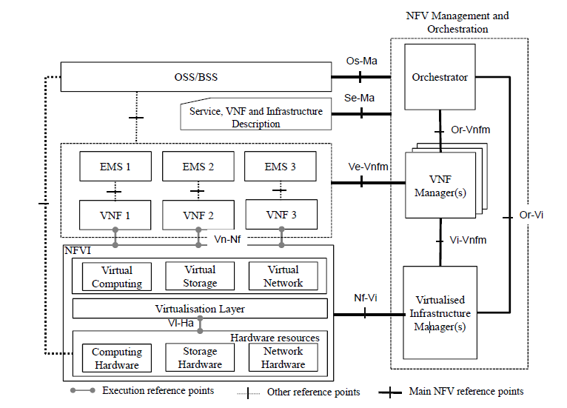
ETSI NFV-ISG architecture

Slide 32
MANO ? VIM ? VNFM? NFVO?
Traditional NEs have NMS (EMS) and perhaps are supported by an OSS
NFV has in addition the MANO (Management and Orchestration) containing :
an orchestrator
VNFM(s) (VNF Manager)
VIM(s) (Virtual Infrastructure Manager)
lots of reference points (interfaces) !
The VIM (usually OpenStack) manages NFVI resources in one NFVI domain
life-cycle of virtual resources (e.g., set-up, maintenance, tear-down of VMs)
inventory of VMs
FM and PM of hardware and software resources
exposes APIs to other managers
The VNFM manages VNFs in one VNF domain
life-cycle of VNFs (e.g., set-up, maintenance, tear-down of VNF instances)
inventory of VNFs
FM and PM of VNFs
The NFVO is responsible for resource and service orchestration
controls NFVI resources everywhere via VIMs
creates end-to-end services via VNFMs

Slide 33
Organizations working on NFV
ETSI NFV Industry Specification Group (NFV-ISG)
architecture and MANO
Proofs of Concept
ETSI Mobile Edge Computing Industry Specification Group (MEC ISG)
NFV for mobile backhaul networks
Broadband Forum (BBF)
vCPE for residence and business applications
and many open source communities, including :
Open Platform for NFV (OPNFV)
open source platform for accelerating NFV deployment
OpenStack – the most popular VIM
Open vSwitch – an open source switch supporting OpenFlow
DPDK, ODP – tools for making NFV more efficient

Slide 34
OpenFlow

Slide 35
What is OpenFlow ?
OpenFlow is an SDN southbound interface –
i.e., a protocol from an SDN controller to an SDN switch (whitebox)
that enables configuring forwarding behavior
What makes OpenFlow different from similar protocols is its switch model
it assumes that the SDN switch is based on TCAM matcher(s)
so flows are identified by exact match with wildcards on header field
supported header fields include:
Ethernet - DA, SA, EtherType, VLAN
MPLS – top label and BoS bit
IP (v4 or v6) – DA, SA, protocol, DSCP, ECN
TCP/UDP ports
OpenFlow grew out of Ethane and is now developed by the ONF
it has gone through several major versions
the latest is 1.5.0

Slide 36
OpenFlow
The OpenFlow specifications describe
the southbound protocol between OF controller and OF switches
the operation of the OF switch
The OpenFlow specifications do not define
the northbound interface from OF controller to applications
how to boot the network
how an E2E path is set up by touching multiple OF switches
how to configure or maintain an OF switch (which can be done by of-config)
The OF-CONFIG specification defines
a configuration and management protocol between
OF configuration point and OF capable switch
configures which OpenFlow controller(s) to use
configures queues and ports
remotely changes port status (e.g., up/down)
configures certificates
switch capability discovery
configuration of tunnel types (IP-in-GRE, VxLAN )
OF
OF
OF
OF
switch
OF
switch
NB for Open vSwitch OVSDB (RFC 7047) can also be used
OF
switch
OF-CONFIG
OF capable switch

Slide 37
OF matching
The basic entity in OpenFlow is the flow
A flow is a sequence of packets
that are forwarded through the network in the same way
Packets are classified as belonging to flows
based on match fields (switch ingress port, packet headers, metadata)
detailed in a flow table (list of match criteria)
Only a finite set of match fields is presently defined
and an even smaller set that must be supported
The matching operation is exact match
with certain fields allowing bit-masking
Since OF 1.1 the matching proceeds in a pipeline
Note: this limited type of matching is too primitive
to support a complete NFV solution
(it is even too primitive to support IP forwarding, let alone NAT, firewall ,or IDS!)
However, the assumption is that DPI is performed by the network application
and all the relevant packets will be easy to match

Slide 38
OF flow table
match fields
actions
counters
flow entry
match fields
actions
counters
match fields
actions
counters
flow miss entry
actions
counters
The flow table is populated by the controller
The incoming packet is matched by comparing to match fields
For simplicity, matching is exact match to a static set of fields
If matched, actions are performed and counters are updated
Entries have priorities and the highest priority match succeeds
Actions include editing, metering, and forwarding

Slide 39
OpenFlow 1.3 basic match fields
Switch input port
Physical input port
Metadata
Ethernet DA
Ethernet SA
EtherType
VLAN id
VLAN priority
IP DSCP
IP ECN
IP protocol
IPv4 SA
IPv4 DA
IPv6 SA
IPv6 DA
TCP source port
TCP destination port
UDP source port
UDP destination port
SCTP source port
SCTP destination port
ICMP type
ICMP code
ARP opcode
ARP source IPv4 address
ARP target IPv4 address
ARP source HW address
ARP target HW address
IPv6 Flow Label
ICMPv6 type
ICMPv6 code
Target address for IPv6 ND
Source link-layer for ND
Target link-layer for ND
IPv6 Extension Header pseudo-field
MPLS label
MPLS BoS bit
PBB I-SID
Logical Port Metadata (GRE, MPLS, VxLAN)
bold match fields MUST be supported

Slide 40
OpenFlow Switch Operation
There are two different kinds of OpenFlow compliant switches
OF-only all forwarding is based on OpenFlow
OF-hybrid supports conventional and OpenFlow forwarding
Hybrid switches will use some mechanism (e.g., VLAN ID ) to differentiate
between packets to be forwarded by conventional processing
and those that are handled by OF
The switch first has to classify an incoming packet as
conventional forwarding
OF protocol packet from controller
packet to be sent to flow table(s)
OF forwarding is accomplished by a flow table or since 1.1 by flow tables
An OpenFlow compliant switch must contain at least one flow table
OF also collects PM statistics (counters)
and has basic rate-limiting (metering) capabilities
An OF switch can not usually react by itself to network events
but there is a group mechanism that can be used for limited reactions

Slide 41
Matching fields
An OF flow table can match multiple fields
So a single table may require
ingress port = P and
source MAC address = SM and destination MAC address = DM and
VLAN ID = VID and EtherType = ET and
source IP address = SI and destination IP address = DI and
IP protocol number = P and
source TCP port = ST and destination TCP port = DT
This kind of exact match of many fields is expensive in software
but can readily implemented via TCAMs
OF 1.0 had only a single flow table
which led to overly limited hardware implementations
since practical TCAMs are limited to several thousand entries
OF 1.1 introduced multiple tables for scalability
ingress
port
Eth
DA
Eth
SA
VID
ET
IP
SA
IP
DA
IP
pro
TCP
SP
TCP
DP

Slide 42
OF 1.1+ flow tables
flow table
0
flow table
1
…
flow table
n
packet
in
action
set
packet
out
Table matching
each flow table is ordered by priority
highest priority match is used (match can be made “negative” using drop action)
matching is exact match with certain fields allowing bit masking
table may specify ANY to wildcard the field
fields matched may have been modified in a previous step
Although the pipeline was introduced mainly for scalability
it gives the matching syntax more expressibility to (although no additional semantics)
In addition to the verbose
if (field1=value1) AND (field2=value2) then …
if (field1=value3) AND (field2=value4) then …
it is now possible to accommodate
if (field1=value1) then if (field2=value2) then …
else if (field2=value4) then …

Slide 43
Unmatched packets
What happens when no match is found in the flow table ?
A flow table may contain a flow miss entry
to catch unmatched packets
The flow miss entry must be inserted by the controller just like any other entry
and is defined as wildcard on all fields, and lowest priority
The flow miss entry may be configured to :
discard packet
forward to a subsequent table
forward (OF-encapsulated) packet to controller
use “normal” (conventional) forwarding (for OF-hybrid switches)
If there is no flow miss entry
the packet is by default discarded
but this behavior may be changed via of-config

Slide 44
OF switch ports
The ports of an OpenFlow switch can be physical or logical
The following ports are defined :
physical ports (connected to switch hardware interface)
logical ports connected to tunnels (tunnel ID and physical port are reported to controller)
ALL output port (packet sent to all ports except input and blocked ports)
CONTROLLER packet from or to controller
TABLE represents start of pipeline
IN_PORT output port which represents the packet’s input port
ANY wildcard port
LOCAL optional – switch local stack for connection over network
NORMAL optional port sends packet for conventional processing (hybrid switches only)
FLOOD output port sends packet for conventional flooding

Slide 45
Instructions
Each flow entry contains an instruction set to be executed upon match
Instructions include:
Metering : rate limit the flow (may result in packet being dropped)
Apply-Actions : causes actions in action list to be executed immediately
(may result in packet modification)
Write-Actions / Clear-Actions : changes action set associated with packet
which are performed when pipeline processing is over
Write-Metadata : writes metadata into metadata field associated with packet
Goto-Table : indicates the next flow table in the pipeline
if the match was found in flow table k
then goto-table m must obey m > k

Slide 46
Actions
OF enables performing actions on packets
output packet to a specified port
drop packet (if no actions are specified)
apply group bucket actions (to be explained later)
overwrite packet header fields
copy or decrement TTL value
push or pop push MPLS label or VLAN tag
set QoS queue (into which the packet will be placed before forwarding)
Action lists are performed immediately upon match
actions are accumulatively performed in the order specified in the list
particular action types may be performed multiple times
further pipeline processing is on the modified packet
Action sets are performed at the end of pipeline processing
actions are performed in the order specified in OF specification
actions can only be performed once
mandatory to support
optional to support

Slide 47
Meters
OF is not very strong in QoS features
but does have a metering mechanism
A flow entry can specify a meter, and the meter measures and limits the aggregate rate of all flows to which it is attached
The meter can be used directly for simple rate-limiting (by discarding)
or can be combined with DSCSP remarking for DiffServ mapping
Each meter can have several meter bands
if the meter rate surpasses a meter band, the configured action takes place
where possible actions are
drop
increase DSCP drop precedence

Slide 48
OpenFlow statistics
OF switches maintain counters for every
flow table
flow entry
port
queue
group
group bucket
meter
meter band
Counters are unsigned integers and wrap around without overflow indication
Counters may count received/transmitted packets, bytes, or durations
See table 5 of the OF specification for the list of mandatory and optional counters

Slide 49
Flow removal and expiry
Flows may be explicitly deleted by the controller at any time
However, flows may be preconfigured with finite lifetimes
and are automatically removed upon expiry
Each flow entry has two timeouts
hard_timeout : if non-zero, the flow times out after X seconds
idle_timeout : if non-zero, the flow times out
after not receiving a packet for X seconds
When a flow is removed for any reason,
there is flag which requires the switch to inform the controller
that the flow has been removed
the reason for its removal (expiry/delete)
the lifetime of the flow
statistics of the flow

Slide 50
Groups
Groups enable performing some set of actions on multiple flows
thus common actions can be modified once, instead of per flow
Groups also enable additional functionalities, such as
replicating packets for multicast
load balancing
protection switch
Group operations are defined in group table
Group tables provide functionality not available in flow table
While flow tables enable dropping or forwarding to one port
group tables enable (via group type) forwarding to :
a random port from a group of ports (load-balancing)
the first live port in a group of ports (for failover)
all ports in a group of ports (packet replicated for multicasting)
Action buckets are triggered by type:
All execute all buckets in group
Indirect execute one defined bucket
Select (optional) execute a bucket (via round-robin, or hash algorithm)
Fast failover (optional) execute the first live bucket
ID
type
counters
action buckets

Slide 51
Slicings
Network slicing
A network can be divided into isolated slices
each with different behavior
each controlled by different controller
Thus the same switches can treat different packets in completely different ways
(for example, L2 switch some packets, L3 route others)
Bandwidth slicing
OpenFlow supports multiple queues per output port
in order to provide some minimum data bandwidth per flow
This is also called slicing since it provides a slice of the bandwidth to each queue
Queues may be configured to have :
given length
minimal/maximal bandwidth
other properties

Slide 52
OpenFlow protocol packet format
OF runs over TCP (optionally SSL for secure operation) using port 6633
and is specified by C structs
OF is a very low-level specification (assembly-language-like)
Ethernet header
IP header (20B)
TCP header with destination port 6633 or 6653 (20B)
Version (1B)
0x01/2/3/4
Type (1B)
Length (2B)
OpenFlow
Transaction ID (4B)
Type-specific information

Slide 53
OpenFlow messages
The OF protocol was built to be minimal and powerful
There are 3 types of OpenFlow messages :
OF controller to switch
populates flow tables which SDN switch uses to forward
request statistics
OF switch to controller (asynchronous messages)
packet/byte counters for defined flows
sends packets not matching a defined flow
Symmetric messages
hellos (startup)
echoes (heartbeats, measure control path latency)
experimental messages for extensions

Slide 54
OpenFlow message types
Symmetric messages
0 HELLO
1 ERROR
2 ECHO_REQUEST
3 ECHO_REPLY
4 EXPERIMENTER
Switch configuration
5 FEATURES_REQUEST
6 FEATURES_REPLY
7 GET_CONFIG_REQUEST
8 GET_CONFIG_REPLY
9 SET_CONFIG
Asynchronous messages
10 PACKET_IN = 10
11 FLOW_REMOVED = 11
12 PORT_STATUS = 12
Controller command messages
13 PACKET_OUT
14 FLOW_MOD
15 GROUP_MOD
16 PORT_MOD
17 TABLE_MOD
Multipart messages
18 MULTIPART_REQUEST
19 MULTIPART_REPLY
Barrier messages
20 BARRIER_REQUEST
21 BARRIER_REPLY
Queue Configuration messages
22 QUEUE_GET_CONFIG_REQUEST
23 QUEUE_GET_CONFIG_REPLY
Controller role change request messages
24 ROLE_REQUEST
25 ROLE_REPLY
Asynchronous message configuration
26 GET_ASYNC_REQUEST
27 GET_ASYNC_REPLY
28 SET_ASYNC
Meters and rate limiters configuration
29 METER_MOD
Interestingly, OF uses a protocol version and TLVs for extensibility
These are 2 generic control plane mechanisms,
of the type that SDN claims don’t exist …

Slide 55
Session setup and maintenance
An OF switch may contain default flow entries to use
before connecting with a controller
The switch will boot into a special failure mode
An OF switch is usually pre-configured with the IP address of a controller
An OF switch may establish communication with multiple controllers in order
to improve reliability or scalability; the hand-over is managed by the controllers.
OF is best run over a secure connection (TLS/SSL),
but can be run over unprotected TCP
Hello messages are exchanged between switch and controller upon startup
hellos contain version number and optionally other data
Echo_Request and Echo_reply are used to verify connection liveliness
and optionally to measure its latency or bandwidth
Experimenter messages are for experimentation with new OF features
If a session is interrupted by connection failure
the OF switch continues operation with the current configuration
Upon re-establishing connection the controller may delete all flow entries

Slide 56
Bootstrapping
How does the OF controller communicate with OF switches
before OF has set up the network ?
The OF specification explicitly avoids this question
one may assume conventional IP forwarding to pre-exist
one can use spanning tree algorithm with controller as root,
once switch discovers controller it sends topology information
How are flows initially configured ?
The specification allows two methods
proactive (push) flows are set up without first receiving packets
reactively (pull) flows are only set up after a packet has been received
A network may mix the two methods
Service Providers may prefer proactive configuration
while enterprises may prefer reactive

Slide 57
Barrier message
An OF switch does not explicitly acknowledge message receipt or execution
OF switches may arbitrarily reorder message execution
in order to maximize performance
When the order in which the switch executes messages is important
or an explicit acknowledgement is required
the controller can send a Barrier_Request message
Upon receiving a barrier request
the switch must finish processing all previously received messages
before executing any new messages
Once all old messages have been executed
the switch sends a Barrier_Reply message back to the controller

Slide 58
ForCES

Slide 59
ForCES History
FORwarding & Control Element Separation.
IETF working group
Established in 2001
Era of Network Processing Forum (NPF)
Need for open and standardized programmable interfaces for off-the-shelf network processor devices¹
Concluded in 2015
Set of:
Protocols
Model
¹https://datatracker.ietf.org/doc/charter-ietf-forces/03/

Slide 60
ForCES History – Major milestones
Date | RFC | I/PS | Milestone
July 2001 |  |  | Working group established
Dec 2003 | RFC3654 | I | Requirements RFC
Apr 2004 | RFC3746 | I | Framework RFC
Jul 2009 | (RFC6053) |  | 1st interoperability test
Mar 2010 | RFC5810 | PS | ForCES Protocol
Mar 2010 | RFC5811 | PS | SCTP-TML
Mar 2010 | RFC5812 | PS | ForCES Model
Feb 2011 | (RFC6984) |  | 2nd interoperability test
Jun 2013 | RFC6956 | PS | LFB library (Data model)
May 2013 |  |  | Re-chartered
Oct 2014 | RFC7391 | PS | ForCES Protocol Extension
Nov 2014 | RFC7408 | PS | ForCES Model Extension
Mar 2015 |  |  | Working group concluded

Slide 61
ForCES terminology
Protocol (RFC5810)
The ForCES protocol is a master-slave protocol in which FEs are slaves and CEs are masters. Includes both the management of the communication channel and the control messages.
FE Model (RFC5812)
The FE model provides the basis to define the information elements exchanged between the CE and the FE in the ForCES protocol. The FE model is primarily an information model², but includes aspects of a data model.
²https://tools.ietf.org/html/rfc3444

Slide 62
Conceptual view
Services / Applications
ForCES Protocol
Binary
Carrying information described by model
FE Model
Representation of resources
Northbound Interface
CE
ForCES agent
Model
ForCES protocol
FE
ForCES agent
Model
Implementation Specific Interface
Resources (Hardware/Software)
Network Device

Slide 63
ForCES juxtaposition on SDN (RFC7426)
Application Plane
Service
App
Network Service Abstraction Layer (NSAL)
Service Interface
Control Plane
Management Plane .
Service
App
App
Service
Control Abstraction Layer (CAL)
Management Abstraction Layer (MAL)
CP
Southbound
Interface
ForCES Protocol
MP
Southbound
Interface
ForCES Model
Network Device
Device and Resource Abstraction Layer (DAL)
App
Forwarding Plane
Operational Plane

Slide 64
ForCES Framework (RFC3746)
Network Element (NE)
Network Element (NE)
Packet Processing Entity
Constitutes of CEs & FEs
Multiple CEs to FEs for HA
CEs/FEs Physical or Virtual
NE components distributed
Local (within one box)
Geographical distributed (LAN/WAN/Internet)
Control Plane
Control Element (CE)
Control Element (CE)
Control Element (CE)
ForCES protocol
Forwarding Plane
Forwarding Element (FE)
Forwarding Element (FE)
Forwarding Element (FE)

Slide 65
ForCES Framework (RFC3746)
Managers (CE/FE)
Bootstrap and subsidiary mechanisms.
CE/FE discovery
Determine which CEs/FEs will communicate.
FE manager (part) in charter
Subsidiary mechanism³
Could be:
A protocol (proprietary/open)
E.g. ForCES³
Simple text file
ForCES Network Element
Control Plane
CE Manager
CE
CE
FE Manager
Forwarding Plane
FE
FE
³https://www.ietf.org/id/draft-ietf-forces-lfb-subsidiary-management-01.txt (to be published)

Slide 66
ForCES FE Model (RFC5812)
ForCES FE Model
NEs composed of logically separate packet processing elements
Model FEs using Logical Functional Blocks (LFBs).
Fine (or coarse as needed) grained operations
Hardware/Software
Physical/Virtual
FE – directed graph of LFB class instances
Graph can be dynamic if supported by implementation
Includes both Capability & State Model
XML schema
Rules on how to describe LFB model libraries in XML.
ForCES FE Model
(Meta Model)
LFB Model
(Model)
Resource
(Implementation)

Slide 67
LFB Model (RFC5812)
Written in XML
Object-oriented approach
Model defines LFB Classes
Instantiate LFB Instances
Features
LFB Class Versioning
LFB Class Inheritance
Backwards/Forwards compatibility
Point of interoperability between implementations
Similar to SNMP MIBs
Control Element (CE)
ForCES
Forwarding Element (FE)
Class 5
Inst 1
Class 4
Inst 1
Class 6
Inst 1
Class 4
Inst 2
Class 7
Inst 1
Class 4
Inst 3

Slide 68
ForCES Model – Core LFBs
Core LFBs (FE Management as a whole)
FEObject LFB (Class ID 1 – RFC5812)
Regards capabilities and state of FE e.g.:
Instantiated LFBs (Can be used to instantiate new LFBs runtime)
LFB Topology (Can be used to change topology runtime)
Supported LFBs
FEProtocol LFB (Class ID 2 – RFC5810)
Regards protocol functionality e.g.:
All CEs
Heartbeat policies
HA policies/capabilities

Slide 69
ForCES Model – LFBs (RFC5812)
Logical Functional Block Class
Fine-grained or coarse grained per need.
Abstractions:
Input / Output Ports
Frame Expected/Frame Produced
Packet
Metadata
Singleton/Group
Components
Capabilities
Events
From/To CE
Packet/Metadata
Components
Packet’/Metadata’
Capabilities
Packet/Metadata
Events
Packet’/Metadata’
Packet/Metadata
Packet’/Metadata’
Packet/Metadata
Packet’/Metadata’
LFB Class

Slide 70
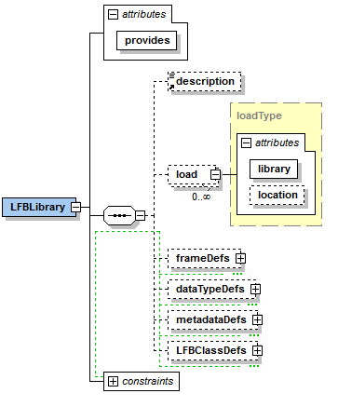
ForCES Model – LFB Library (RFC5812)
Sequence of top-level elements
Optional list (ordered)
Description (Description)
Load (Imports)
Frame Definitions
Data Type Definitions
Metadata Type Definitions
LFB class Definition

Slide 71
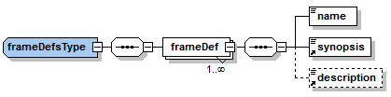
ForCES Model – Frames
Frames or Packets Definitions expected/produced from/at LFB ports
Example:
<frameDef>
<name>IPv4</name>
<synopsis>An IPv4 packet</synopsis>
</frameDef>

Slide 72
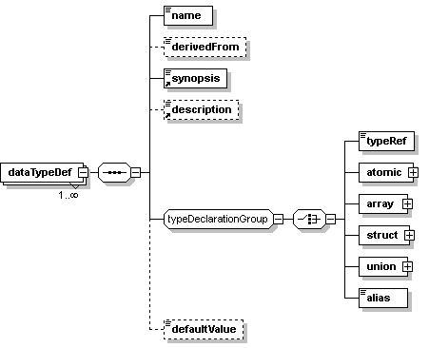
ForCES Model – DataTypes (RFC5812)
Datatype definition
C-like base datatypes
Atomic
char, uchar, byte[N]
String, String[N], octetstring[N]
(u)int16, (u)int32, (u)int64
float32, float64
Boolean
Compound
Struct
Arrays
Alias (Symbolic Links)
Augmentations
Building blocks for custom-defined datatypes.

Slide 73
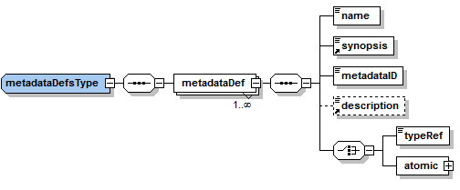
ForCES Model – Metadata
Metadata Type definition
Data produced by LFBs to assist other LFB’s processing
E.g. PHYPortID.
Atomic (RFC5812)/Compound (RFC7408) Data type
Metadata ID MUST be LFB library unique

Slide 74
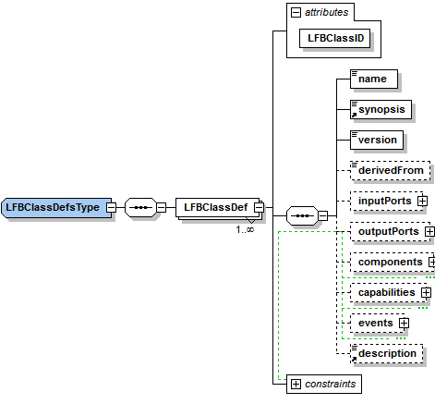
ForCES Model – LFB Class
Define LFB classes
LFB Class ID Globally (NE) Unique (uint32)
Version
Derived From (inheritance)
LFB Class Definition
Components
Capabilities
Events

Slide 75
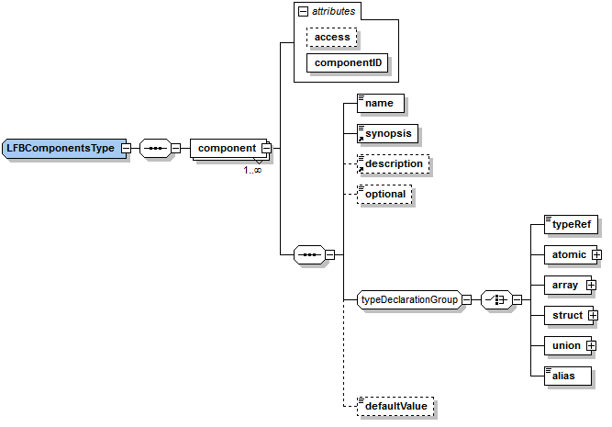
ForCES Model – Components
Operational Parameters visible to CE
Component ID
Unique per component level
Access control
Read-only
Read-write
Read-reset
Trigger-only
Write-only
Datatype Reference

Slide 76
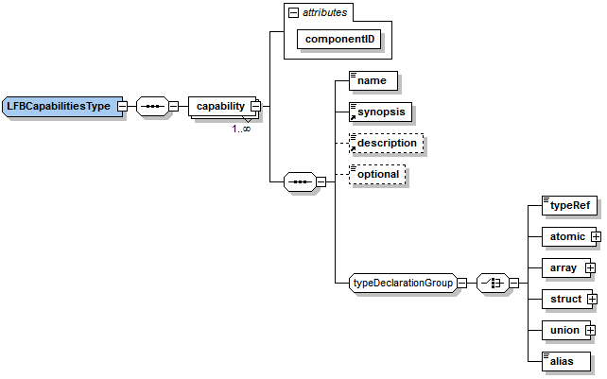
ForCES Model – Capabilities
Limitations or Capabilities advertised by LFB
E.g. HA capabilities
E.g. Port number Limit
Similar to Components
Read-Only
Component ID unique

Slide 77
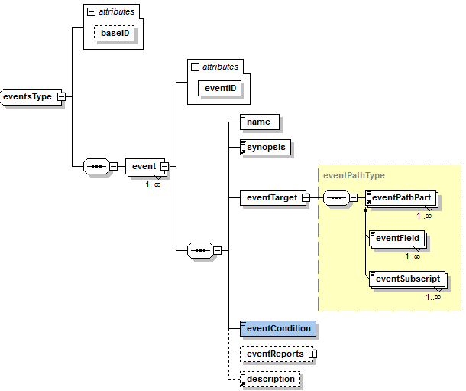
ForCES Model – Events
Custom-defined
Base ID unique
Subscription-based
Event Conditions
Created
Deleted
Changed
LessThan
GreaterThan
BecomesEqualTo (Model Extension)
Filters
Threshold
Hysterisis
Count
Interval (in milliseconds)
Event Reports (Component reported)

Slide 78
ForCES Model – LFB Example
<dataTypeDefs>
<dataTypeDef>
<name>PacketCounter</name>
<synopsis>Counts Packets</synopsis>
<typeRef>uint32</typeRef>
</dataTypeDef>
</dataTypeDefs>
<LFBClassDefs>
<LFBClassDef LFBClassID="1000">
<name>Monitor</name>
<synopsis>A monitor LFB for packets</synopsis>
<version>1.0</version>
<components>
<component componentID="1" access="read-only">
<name>GoodPackets</name>
<synopsis>Good packets</synopsis>
<typeRef>PacketCounter</typeRef>
</component>
<component componentID="2" access="read-only">
<name>BadPackets</name>
<synopsis>Bad packets</synopsis>
<typeRef>PacketCounter</typeRef>
</component>
</components>
<capabilities>
<capability componentID="3">
<name>PacketCheck</name>
<synopsis>Type of checks</synopsis>
<struct>
<component componentID="1">
<name>CRC</name>
<synopsis>Checks for CRC</synopsis>
<typeRef>boolean</typeRef>
</component>
<component componentID="2">
<name>BadFrame</name>
<synopsis>Checks for bad frames</synopsis>
<typeRef>boolean</typeRef>
</component>
</struct>
</capability>
</capabilities>
<events baseID=“4">
<event eventID="1">
<name>CheckBadPackets</name>
<synopsis>Checks for bad packets</synopsis>
<eventTarget>
<eventField>BadPackets</eventField>
</eventTarget>
<eventGreaterThan>1000</eventGreaterThan>
<eventReports>
<eventReport>
<eventField>BadPackets</eventField>
</eventReport>
</eventReports>
</event>
</events>
</LFBClassDef>

Slide 79
ForCES Protocol (RFC5810)
Protocol & Transport Layer
ForCES
Base ForCES semantics and encapsulation (RFC 5810)
Two phases:
Pre-association
Post-association
Transport depends on underlying media. One is standardized (RFC 5811) – others expected to be
Standardized TML: SCTP with strict priority schedule
High Priority (HP): Strictly reliable channel
Medium Priority (MP): Semi-reliable
Low Priority (LP): Unreliable channel
CE
Protocol Layer (ForCES protocol)
Transport Layer (SCTP)
HP
MP
LP
FE
Transport Layer (SCTP)
Protocol Layer (ForCES protocol)

Slide 80
ForCES Protocol (cont.)
Simple Commands (Verbs) (Model elements are nouns)
Set/Get/Del
Set/Get Properties (for properties & events)
Message Acknowledgment
Always/Never/On Failure/On success
Transactional capability (2 Phase Commit)
Various Execution modes
Execute all or none
Execute till failure
Execute on failure
Scalability
Batching
Command pipeline
Security
IPSec
Traffic Sensitive Heartbeating
High Availability
Hot/Cold Standby
CE
Protocol Layer (ForCES protocol)
Transport Layer (SCTP)
HP
MP
LP
FE
Transport Layer (SCTP)
Protocol Layer (ForCES protocol)

Slide 81
ForCES Protocol – Addressing
Addressing scheme similar to SNMP MIBs (OIDs)
FEs in an NE uniquely distinguished by a 32-bit ID (FEID)
FEID within FE Protocol LFB (Assigned by FE Manager)
LFB Class IDs unique 32-bit ID (IANA assigned)
LFB Instance ID unique per FE
Components/Capabilities/Struct Components/Events have 32-bit IDs
Arrays – Each row with a 32-bit row ID index
Supports Key content addressable
Path: Verb+/FEID/LFB Class/LFB Instance/Path to component
E.g. GET /FE 3/Port/1/PortTable/ifindex10
Wire: 7 /3/4/1/1/10

Slide 82
ForCES Protocol – Message Construction
Common Header
Redirect TLV
LFBSelect TLV
ASResult TLV
ASTeardown TLV
Operation TLV
PathData TLV
Optional KeyInfoTLV
PathDataTLV
Result TLV
FullData TLV
SparseData TLV

Slide 83
Newest additions
Subsidiary mechanism LFB
LFB to handle management functions on FEs
Load/Unload new LFBs
Setup CE connectivity
InterFE LFB
LFB to chain functionality of LFBs across multiple FEs
Forwarding Element (FE)
Forwarding Element (FE)
LFB3
LFB3
LFB1
LFB2
Inter
LFB
Inter
LFB
LFB2
LFB4
LFB3
LFB4
LFB3
LFB4

Slide 84

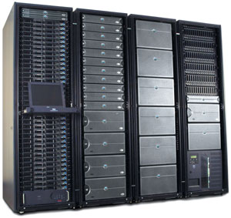
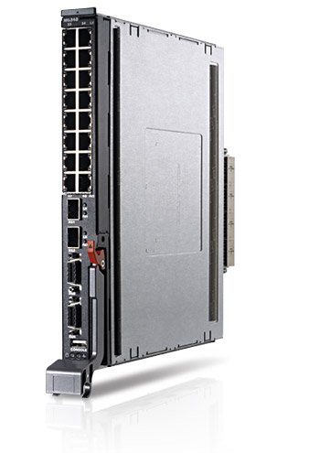





Usage Examples
CE
FE
FE

Slide 85
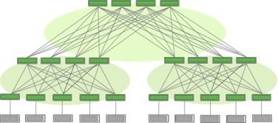
Usage Examples (Data Center)

Slide 86
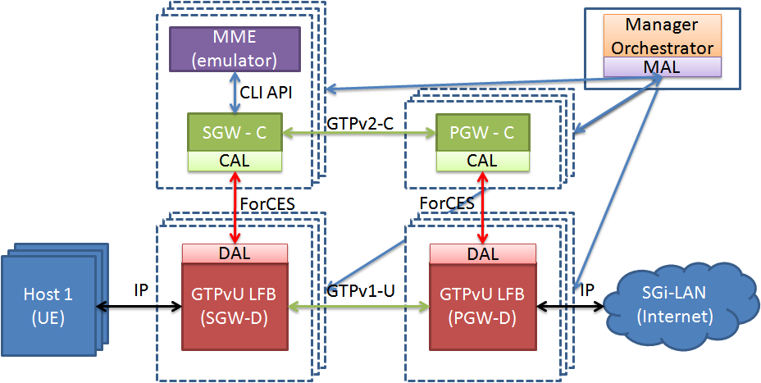
Usage examples (SDN/NFV)

Slide 87

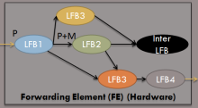
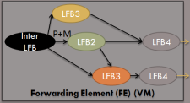

Usage examples (Common model)
Network Manager
App
App
App
App
ForCES Abstraction Layer
ForCES Layer
ForCES Layeryer
ForCES Layer
ForCES Layer
ForCES Layer
ForCES Layer
Network Devices
Network Devices
ForCES Layer
ForCES Layer
Network Devices
Network Devices
Network Devices
Network Devices
Network Devices
Network Devices
Network Devices
Network Devices
VM
Hypervisor
Network Devices
Network Devices
VM
Hypervisor
VM
Hypervisor
VNF
VNF
VM
ForCES
ForCES
VNF
VNF
VM
VM
ForCES
ForCES
ForCES
VM
VNF
VNF
VNF
ForCES
VNF
ForCES
VNF
ForCES
ForCES Layer
ForCES
VNF
VNF
VNF
VM
VNF
VNF
VNF
ForCES
VNF
VM
VNF
VNF
VNF
VNF
VNF
VNF
VNF
VNF
VNF
VNF
VNF
VNF
VNF
ForCES (for configuration)
ForCES (for management)
Open API (with ForCES semantics)

Slide 88
Summary & Conclusion
ForCES has a potential to be used where separation is required.
Besides datapath management
Wired
Device management (Up/Down)
Change device functionality (if device is capable)
Wireless
Channel selection
SSID management
Adjust RF parameters
Access Control
LTE
Management of devices (from base stations to backbone) from a central location

Slide 89
Thank you for listening
RFC 3746
NE
RFC5813
RFC5812
RFC6956
RFC7408
CE
FE
CE Manager
ForCES PL
RFC5810
RFC7121
RFC7391
ForCES PL
SCTP TML
SCTP TML
RFC5811
FE Manager
IPSec
IPSec
RFC5811
ForCES RFC Roadmap

