Slide 1
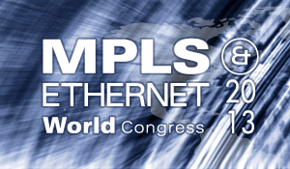
QoSDN
QoS-assured Networks vs.
SDN
Presented by:
Yaakov (J) Stein
CTO

Slide 2
2012 DA14
On Friday, Feb. 15 2013, an asteroid named 2012DA14
about 30 meters across
weighing about 40,000 metric tons)
traveling at about 28,000 km/h
came within 27,700 km of earth
Yet astronomers classified this Near Earth Object as
white (nonhazardous) on the Torino scale !
geostationary satellites - 35,786 km
mean lunar distance 384,400 km

Slide 3
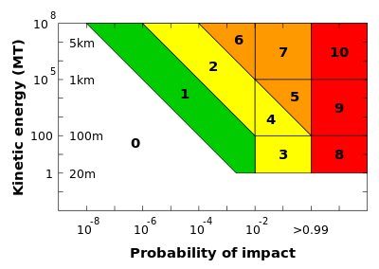
Torino scale
The Torino scale gauges NEO importance
based on (very roughly) :
how close the object is
how big* the object is
* the energy also depends on how fast the NEO is moving
Of course, this is geocentric point of view
From the NEO’s point of view the question is
whether the earth is getting in the way of its progress potentially endangering its continued existence

Slide 4
Impact of SDN on SP networks
The potential impact of SDN on Service Provider networks is similar
It depends on :
how close SDN is to what SP’s want
how big* a change SDN can bring
* it also depends how rapidly SDN is maturing
Of course, this is the Service Provider’s point of view
From the SDN community point of view the question is
whether the SP network requirements get in their way
potentially killing SDN entirely (at least in the SP space)
In order to understand the potential impact of SDN on SP networks
we need to first define what we mean (for the purposes of this talk)
by SDN and SP networks
Our focus is on SP networks
but much of what we say is true
for campus and enterprise networks
We will not discuss the advantages of SDN
for research in academic networks
Nor certain special security applications

Slide 5
What is a Service Provider network ?
A network that :
provides a communications service to a customer
  the customer may be an end-user or yet another SP
provides QoS assurances (always availability, often performance)
  since vanilla service is mostly free
provides 1. and 2. profitably
  all SPs that still exist agree on this point …
If SDN can truly fulfill these, this would be close !
Note that the following are not part of this definition :
use of specific routing protocols and packet formats (Ethernet, MPLS, IP)
  this is just a means of attaining 1. supra
use of Traffic Engineering, FM, PM, protection switching, …
  these are just means of attaining 2. supra
use of special purpose hardware rather than merchant silicon
  this is just a means of attaining 3. supra

Slide 6
What is a Software Defined network ?
A network that :
utilizes general purpose computational resources
  forwarding elements need to be flexibly reprogrammable
considers packet forwarding to be a computational problem
  usually implies centralized server having complete knowledge of network state
replaces fundamental principles of communications theory with those of computation and software design (modularity, abstractions, …)
  which SDN proponents believe are completely different principles
If SDN truly changes a fundamental principle, this would be big !
Open Source does not seem to be a indispensable requirement of SDN today !
Why isn’t SDN out in the Daylight ?
Note that the using OpenFlow as a means to configure
standard routers/switches does not fall under this definition
(not obeying any of the above)

Slide 7
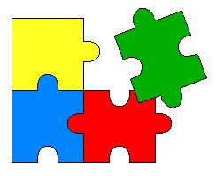
What are the fundamental principles ?
Before replacing them, let’s explore what are the truly fundamental principles of classical communications theory
Shannon’s (source/channel) separation theorem
Virtual Connections and Virtual Private Networks
Separation of data, control, and management planes
Peer-peer and client/server relationships
Note that they are all about …
breaking the problem into parts, or
joining parts to make a whole

Slide 8

Shannon’s Separation theorem
application
layer
physical layer
application
layer
information source
source
encoder
bits
channel
encoder
analog
signal
degrading
channel
analog
signal
channel
decoder
bits
source
decoder
information sink
digital channel
known capacity
nothing allowed here
nothing allowed here
The separation theorem leads to digital communications
It states that the optimal communications system has precisely 4 parts
Any further partitioning reduces optimality
In particular, the celebrated 7-layer OSI (X.200) model
is in direct contradiction to the separation theorem
and indeed leads to gross inefficiencies
It was put in place to facilitate implementation
and should not be considered a fundamental principle
So, if SDN violates this layering model
it violates tradition, not fundamental principles (and may actually improve efficiency)

Slide 9
Virtual Connections and VPNs
The separation theorem speaks about communications links
and early telegraph and telephone connections were indeed links
However, it is impossible (or at least very inefficient)
to directly connect every 2 points that need to communicate
Instead, one can
create a connected graph of arbitrary topology (a network)
find a path connecting any two points (a virtual connection)
Furthermore, one can logically create a fully connected graph,
sub-graphs of which are are virtual private networks
In order to implement this scheme, one must
associate an address (which becomes part of the Shannon information) to each point
implement a scheme to forward information through the original graph
This type of virtualization is used in computation all the time !

Slide 10
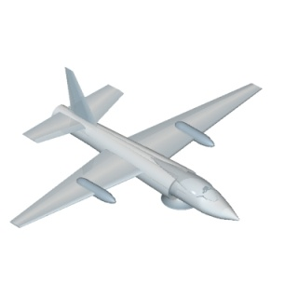
Data, control, and management planes (1.)
In order to facilitate forwarding
it is worthwhile to distinguish between :
forwarding
routing (i.e., learning how to forward)
administration (setting policy, service commissioning, monitoring, billing, …)
This leads to defining three planes – data (or user), control, and management
Traditionally the distinction between control and management was that :
management had a human in the loop
while the control plane was automatic
With the introduction of more sophisticated software
the human could often be removed from the loop
The difference that remains is that
the management plane is slow and centralized
the control plane is fast and distributed
We will see that these characteristics are important!
management plane
control plane
data plane

Slide 11

Data, control, and management planes (2.)
It is interesting that many SDN proponents believe
that separation of the data and control planes is a defining attribute of SDN rather than a time-honored fundamental characteristic of networks
This belief apparently arises from these proponents
being familiar with the Linux router
which does not clearly separate forwarding from routing
However, the Linux router was written by programmers
not by networking experts
management plane
control plane
data plane

Slide 12
Peer-peer and client/server
In the same way that we virtualized the idea of a link (first virtualization)
we can virtualize the idea of a (virtual) network (second virtualization)
So, we needn’t require a single end-user to create a link
and we needn’t require a single SP to create the entire (virtual) network
Rather we can combine (virtual) networks to provide the end-end service
There are two ways to connect two networks (G.805)
client/server interworking (layering, OTT)
peer to peer interworking (stitching)
Unlike OSI layering
there are very good (business) reasons for these:
maintaining a generic interface
modularity
effect isolation
information hiding
In other words, precisely the principles of modern software design !

Slide 13


The CAP Theorem
So, we haven’t found any fundamental principles of communications theory that are alien to computation theory !
So, let’s try the other way around
let’s look at a theorem from computation theory
There are three desirable characteristics of a distributed computational system
Consistency (get the same answer no matter which computational element responds)
Availability (get an answer without unnecessary delay)
Partition tolerance (get an answer even if there a malfunctions in the system)
The CAP (Brewer’s) theorem states that you can have any 2 of these, but not all 3 !
SDN teaches us that routing/forwarding packets is a computational problem
so a network is a distributed computational system
So networks can have at most 2 of these characteristics
Which characteristics do we need, and which can we forgo ?

Slide 14
CAP: the SP Network Choice
SPs pay dearly for lack of service
not only in lost revenues, but in SLA violation penalties
SP networks are designed for :
high availability (five nines) and
high partition tolerance (50 millisecond restoration times)
So, consistency must suffer
black-holed packets (compensated by TTL fields, CV testing, etc.)
eventual consistency (but steady state may never be reached)
This is a conscious decision on the part of the SP
The precise trade-off is maintained by a judicious combination
of centralized management and distributed control planes
CAP
X

Slide 15
CAP: the SDN Choice
SDN has emphasized consistency (perhaps natural for software proponents)
So such SDNs must forgo either availability or partition tolerance (or both)
Either alternative may rule out use of SDN in SP networks
Relying solely on a single¹ centralized controller
(which in communications parlance is a pure management system)
may lead to more efficient bandwidth utilization
but means giving up partition tolerance
However, there are no specific mechanisms to attain availability either !
Automatic protection switching needs to be performed quickly
which can not be handled by a remote controller alone²
X
CAP
¹ Using multiple collocated controllers does not protect against connectivity failures.
Using multiple non-collocated controllers requires synchronization, which can lead to low availability.
² There are solutions, such as triggering preconfigured back-up paths,
but present SDN protocols do not support conditional forwarding very well.

Slide 16
SDN switch security
Client/server (G.805) layering enables Service Providers
to serve a higher-layer SP
to be served by a lower-layer SP
Layer violations may lead to security breaches, such as :
billing avoidance
misrouting or loss of information
information highjacking
information tampering
Layer respect is often automatically enforced by network element functionality
A fully programmable forwarding element may create layer violations, due to :
programming bugs or
being taken over by malicious entities
If fully programmable elements (SDN switches) become widely deployed
Service Providers will need to deploy additional security mechanisms
It may prove impossible to protect against certain SDN security breaches

Slide 17
So, how big and close is SDN ?
Despite to claims to the contrary, SDN
does not repudiate any principles of communications theory
does not propose any revolutionary new principles of its own
Thus it has no impact on communications theory
If SDN is limited to defining a new management protocol (e.g., OpenFlow)
that may lead to more efficient bandwidth utilization
or more sophisticated security mechanisms
this can be readily adopted, with minimal impact on SP networks
(As SDN proponents remind us, we have so many protocols already …)
SDN does opt for a different CAP theorem trade-off
preferring consistency to availability and partition-tolerance
This means that it is far off-course for present-day SP networks
and will require rethinking of its applicability
New security threats from misbehaving network elements
may present difficult challenges to Service Providers
strongly impacting their operations

