Slide 1
IPR and patents
Yaakov (J) Stein
CTO

Slide 2
Types of property
Real property
Personal property
Intellectual property (IPR)

Slide 3
4 ways to handle technological IPR
Secrecy
  e.g., Karmarkar’s algorithm
  Idea: keep the competition in the dark
Protection
  e.g., patenting sensitive technologies
  Ideas: claim ownership, directly block competitors
Standardization
  e.g., participation in standardization bodies
  Ideas: grow market, influence final technology
Publishing (releasing to the public domain)
  e.g., articles in professional journals, lectures at open conferences
  Ideas: expert recognition, keep others from blocking you

Slide 4
Types of IPR
utility patents (inventions)
design patents (industrial designs)
copyrights
trademarks
trade secrets
trade dress (distinctive packaging)
publicity rights (of celebrities)
geographical indications (terroir, e.g., of wine)
database rights (EU)
...

Slide 5
Why IPR ?
IPR creates an artificial monopoly – why is this justified ?
utilitarian (economic) theory
  promote innovation and incentivize progress in arts and sciences
labor desert theory
  natural rights
  Lockean proviso (there is enough left in common for others)
moral rights
Note that all forms of IPR are limited
in term
in jurisdiction
in scope

Slide 6
IPR law
Unauthorized use of someone else’s IPR is called infringement
Infringement may be the subject of civil law or criminal law
Infringement does not necessarily require knowledge
but willful infringement may be more serious (e.g., triple damages)
IPR rights
are always limited in time duration
are usually limited to a given jurisdiction
sometimes require registration and/or examination in a jurisdiction
There are ways to legally use someone else’s IPR
assignment
exclusive license
non-exclusive license
A license is an authorization/permission by the IPR owner
to exercise a privilege that otherwise would constitute infringement
License terms often involve payments ☹

Slide 7
Utility patents
promote progress in science and technology
rights are per jurisdiction
  each country has national patent office (e.g. USPTO)
  in EU - European Patent Organization (EP)
  Paris convention
  Patent Cooperation Treaty (PCT) - WIPO
grant exclusivity to inventor against infringement
  making, using, selling, offering for sale, exporting
  not against researching, drawing, thinking about
  note - unlike copyright, infringement does not require copying
exclusivity is for a limited period of time
  in US: 20 years from filing (once was 17 years from grant)
priority and first to file

Slide 8
Requirements
Utility
  must be industrially/commercially useful
Novelty
  must not be previously known/used/published/patented
  in US, inventor may publish up to 1 year before application
  elsewhere – no prior disclosure is allowed
  applications are usually published after 18 months
Non-obviousness
  to a person well versed in the art
  once required creative spark
  sufficiently different from existing knowledge
  only real advances are awarded patents

Slide 9
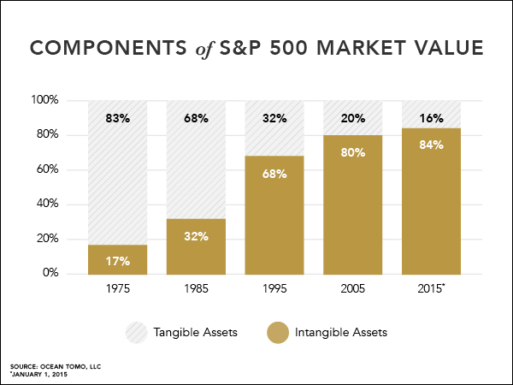
Why patent ?
There are many reasons to apply for a patent
offensive
  licensing and royalties
  monopoly
  NPE (trolls)
defensive
  protect market share
  freedom to operate
  balance of fear
valuation
  IPR is a significant fraction of value of technology companies
    >80% of value of S&P500 companies is intangible
    upon acquisition may add M$ per issued patent to company value

Slide 10
What can be patented?
Given Utility, Novelty, and Non-obviousness
the following types of inventions can be patented
machines (man-made products)
processes (including some algorithms)
In the US, the machine or transformation test was often used
is the invention implemented by a particular machine ?
does the invention transform an article from one state to another ?

Slide 11
What can not be patented?
Some examples :
abstract ideas
natural phenomena, law of nature, scientific theories
mathematical facts and methods
methods for performing purely mental acts
computer programs
presentations of information
purely aesthetic creations (literary works, music compositions)
forms of energy
naturally occurring genetic material (DNA sequences)

Slide 12
Software
Algorithms may be protected by patents
Databases may be protected (in the EU) by the database directive
Source code may be protected by copyrights
Some history (in the US) will help explain …
1974 Commission on New Technological Uses of Copyrighted Works
decided that computer programs, to the extent that they embody
an author's original creation, are proper subject matter of copyright
1980 US Congress added computer program to copyright law
1983 Apple vs. Franklin: Court of Appeals decides that even object code
is subject to copyright
1986 Whelan v. Jaslow, Broderbund v. Unison: extended software copyright to
structure, organization, look-and-feel
1997 No Electronic Theft Act raises criminal penalties (even w/o monetary gain)
to 5 years + 250K$ + higher civil damages, closing the LaMacchia loophole

Slide 13

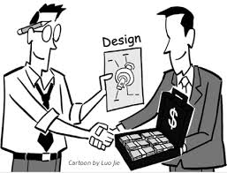

How much is a patent worth ?
Patents can be sold, so patents have monetary value
How can this value be estimated ?
compare to price of similar patents recently sold
  often hard to know, since price is frequently not released
  a consortium offered 1.3M$ for Orckit’s close to 200 patents – about $7.5K per patent
  RAD just purchased a patent with 5 years left to run for $60K
  RAD once sold a patent for $250K
  IPOfferings LLC says that the average paid for issued US patent is $375K
  Google acquired Motorola Mobility, essentially for its 17,000 patents, for $12.5B, i.e., about $735K per patent
  Rockstar consortium (Apple/Ericsson/Microsoft/Sony) paid 4.5B$ for 6000 patents from bankrupt Nortel (easily trumping Google that bid a mere 900M$), i.e. $750k per patent!
how much is it worth to a NPE (troll)?
  number of potential infringers
  royalties (Georgia-Pacific factors)
how much is it worth to a PE?
  save litigation costs (average $5M per suit)
  save royalty payments
  freedom to operate
technical valuation

Slide 14
Stages in patenting
The following need to be performed in each jurisdiction
Prior art search
in the US - you may want to file a provisional application
Drafting
Filing (from now on patent pending)
Publication (usually after 18 months)
Prosecution (office actions, final office action, RCE, appeals)
Allowance
Fees
Issuance (patent number)
Marking
Maintenance (periodic fees)
Expected expense to receive a US patent $10K-$20K
Expected expense to receive worldwide family coverage $50K-$100K
Yearly maintenance on a worldwide family $5K

Slide 15
Provisional patent applications
Since 1995, the US PTO allows filing a provisional application
Provisional applications
have lower fees
are simpler to prepare (do not even require claims)
do not require filing Information Disclosure Statements
capture a priority date
allow the filer to mark products patent pending
but
are never examined and thus never become patents
there is no such thing as a provisional patent !
only last for 1 year and can not be extended
all rights are lost if you don’t file a nonprovisional patent application
So, it is worthwhile filing a provisional patent applications
if you are unsure of the usefulness of the invention
if you are waiting for funding to develop the invention (and pay fees)

Slide 16
Where to file?
Patents are per jurisdiction
and each patent office has its own requirements
US
Canada
EPO – common examination, but need to file in each country!
PCT (Patent Cooperation Treaty) – no protection by itself!
Japan
China
To decide, consider
where are your competitors?
where are your customers?

Slide 17
Patent families
There are often many related patents in a family
similar patents in different jurisdictions
  may be different due to different requirements and details of prosecution process in various patent offices
continuation
  additional claims to previous patent
  must be filed before issuance of original patent
divisional
  distinct variant
  often filed following examiner restriction relating to multiple inventions
  must be filed before issuance of original patent
Continuation In Part
  adds subject matter not in original patent
  retains priority date (and term) of original patent
  must be filed during lifetime of original patent

Slide 18
Format of US patent
First page
  number, title, dates, inventors, assignee, search codes, references, credits, abstract, figure
Drawing sheets
Description
  Background (including field of invention and prior art)
  Summary
  Brief description of drawings
  Detailed description of preferred embodiment(s)
Claims
  independent
  dependent
  claim language is not plain English

Slide 19
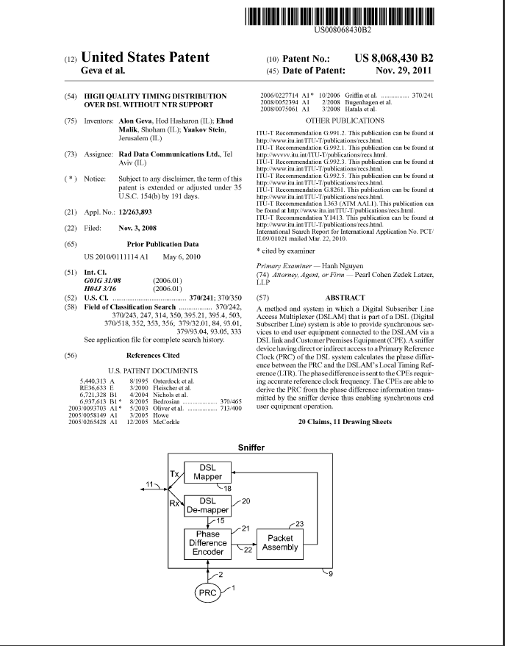
First page

Slide 20
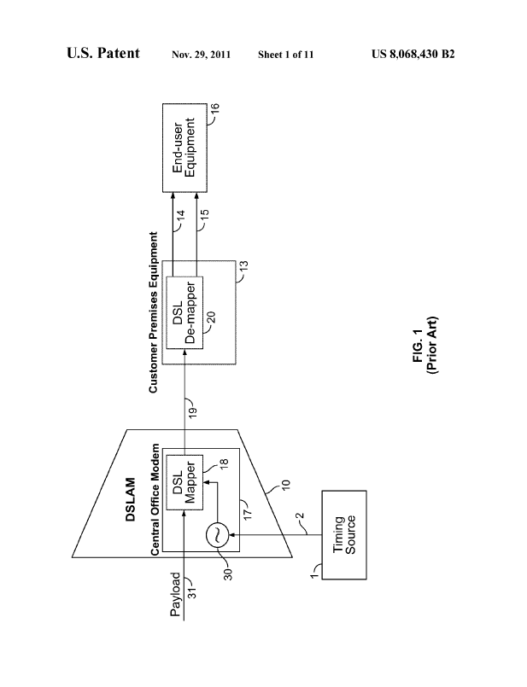
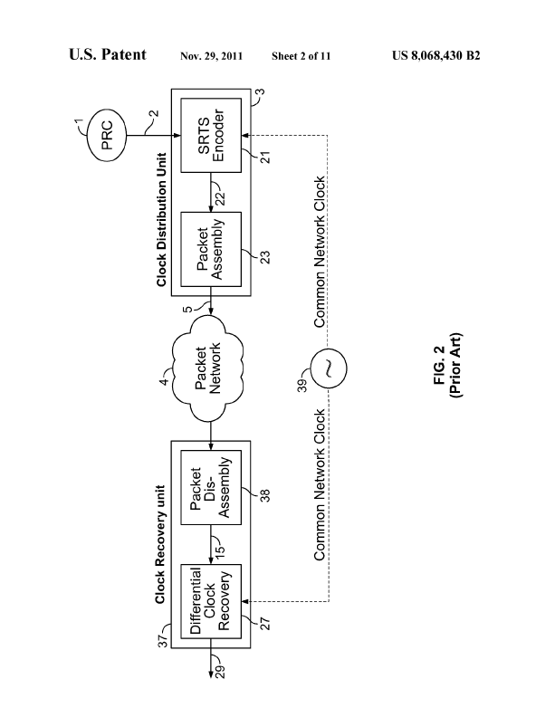
Drawing sheets
...

Slide 21
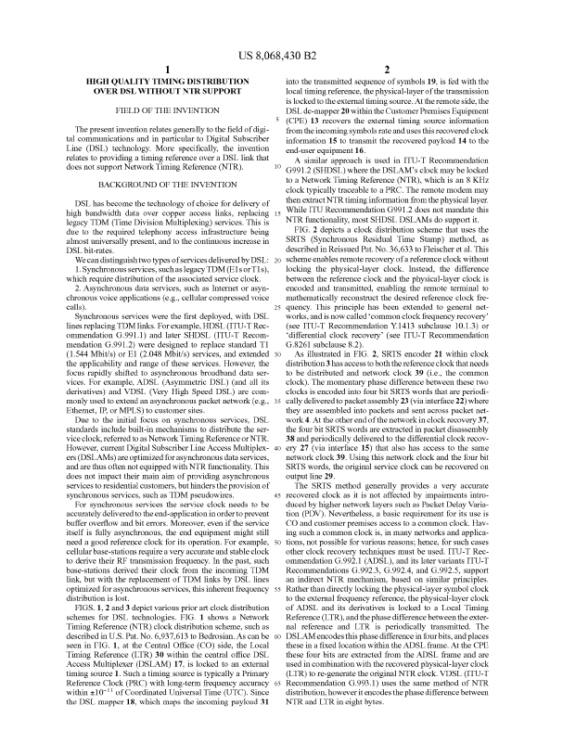
Description

Slide 22
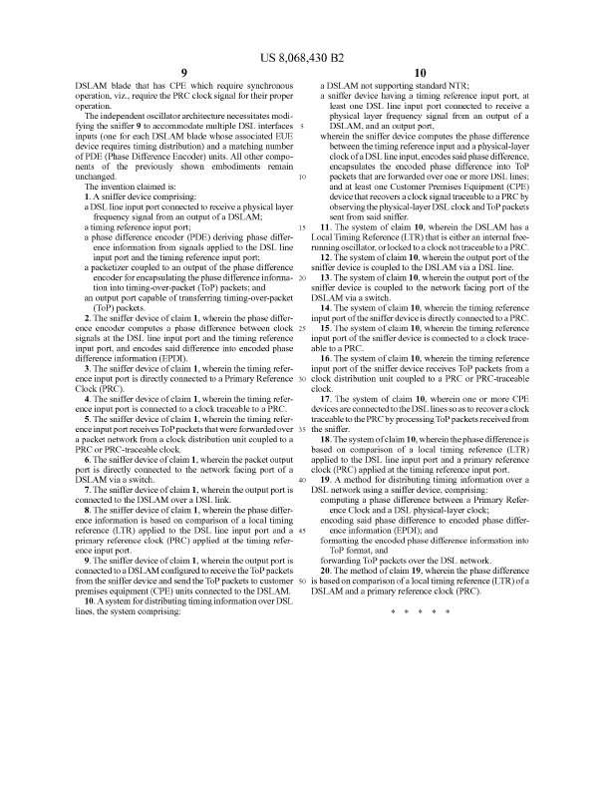
Claims
claims define the patent coverage
must define technical features
(description defines terms used)

Slide 23
Claim language
A claim consists of
Preamble
  An apparatus, A device ...
  A method ...
  A system ...
  ... according to claim X
    independent vs. dependent claims
Transitional phrase
  comprising ...
  having at least one ...
Limitations describing how desired result is achieved
Purpose (Optional) describing the invention’s goal
  wherein ...
  whereby ...

Slide 24
Claim types
There are many types of claims:
method/process/use claim
  mathematical
  computer-aided process
product/apparatus claim
system claim
means plus function
business method (Bilski, Alice)
Consider who will infringe
the end user
a competing vendor
a component manufacturer
Consider how infringement will be proven

Slide 25
RAD’s issued patents
TDMoIP family
US 6,731,649 TDM OVER IP (IP CIRCUIT EMULATION)
DE 60125107 TDM über IP (IP-Schaltungsemulation)
France 1,176,774 TDM OVER IP (IP CIRCUIT EMULATION SERVICE)
UK 1,176,774 TDM OVER IP (IP CIRCUIT EMULATION SERVICE)
EP 1,176,774 TDM OVER IP (IP CIRCUIT EMULATION)
Timing family US
US 8,068,430 HIGH QUALITY TIMING DISTRIBUTION OVER DSL WITHOUT NTR SUPPORT
US 8,660,150 HIGH QUALITY TIMING DISTRIBUTION OVER DSL WITHOUT NTR SUPPORT divisional
US 8,971,356 TIMING OVER PACKET DEMARCATION ENTITY US 9,525,502 TIMING OVER PACKET DEMARCATION ENTITY divisional
SFP functionality family
US 8,851,929 SFP FUNCTIONALITY EXTENDER
US 8,641,429 SFP SUPERCAGE
US 8,982,726 NETWORK DEVICE
US 9,025,490 NETWORK DEVICE
MiCLK family
US 9,276,689 PLUGGABLE MASTER CLOCK
JAPAN 5,833,799
EP 2,901,587 DE 13,801,768 Switzerland/Lichtenstein Finland France UK Italy Austria
DSL
US 6,829,246 SYSTEM AND METHOD FOR EXTENDING THE RANGE OF XDSL SERVICES
OAM family
US 9,369,362 TRIANGLE LOOPBACK

Slide 26
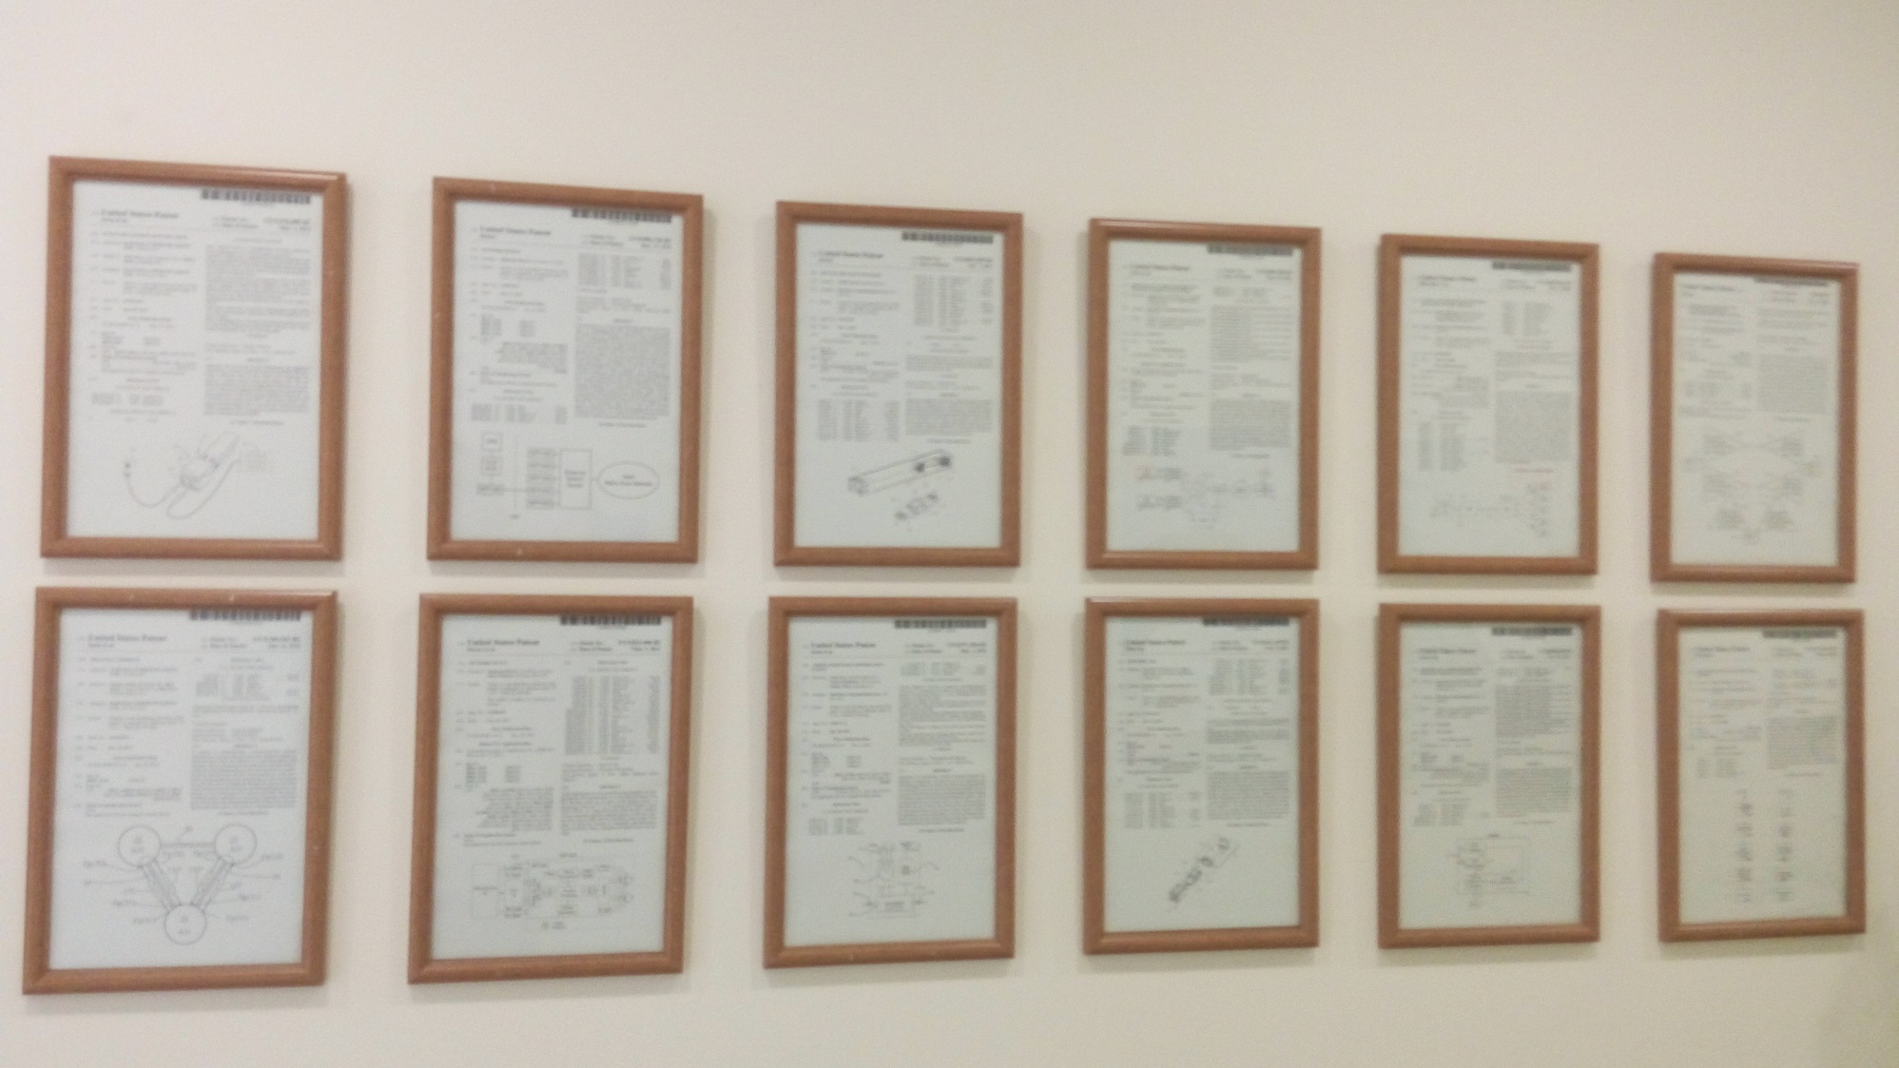
RAD’s wall of patents

Slide 27
Searching
Google patent search www.google.com/patents
US-PTO www.uspto.gov/patent
WIPO www.wipo.int/patents/en/
EPO Espacenet www.epo.org/searching/free/espacenet.html
EP patent wrappers register.epo.org/regviewer
US-PTO wrappers portal.uspto.gov/pair/PublicPair
Latest patents www.latestpatents.com/
IP marketplace www.ip-marketplace.org/
Note – many companies do not allow R&D to look at patents
in order to avoid willful infringement and triple damages

