Slide 1
Joint
SDN & NFV
Optimization
SDNRG @ IETF-93
Presented by:
Yaakov (J) Stein
Tel Aviv University team
Boaz Patt-Shamir
Guy Even
Research funded under the Neptune consortium

Slide 2
Recap: rich communications services
Traditional communications services are pure connectivity services
transport data from A to B
with constraints (e.g., minimum bandwidth, maximal delay)
with maximal efficiency (minimum cost, maximized revenue)
Modern communications services are richer
combining connectivity and network functionalities
e.g., firewall, NAT, load balancing, CDN, parental control, ...
We deal with a service provider that
maintains a network of communications and computational resources
maintains an inventory of VNFs
dynamically sets up and tears down services
charges based on
  service requirements
  time between set-up and tear-down
The service provider employs an orchestrator to maximize profits
(profit is the difference between revenue and expenses)

Slide 3
Recap SDN/NFV Optimization Problems
Given a network with distributed computational resources for VNFs
we distinguish three SDN/NFV optimization problems
pure SDN path computation (no VNFs needed)
pure NFV placement (routing performed separately)
joint SDN/NFV path/placement
The first problem has many classic solutions (see the PCE literature)
The second problem (NFV placement) has been studied recently
The third problem is as yet unsolved

Slide 4
On-line optimization
A batch (off-line) algorithm receives the list of all services to be set up
and simultaneously finds all the allocations for a clean network
We require an on-line algorithm
that services requests of unknown duration as they come in
We do not allow pre-emption or re-optimization of service already set-up
The on-line case is harder since we don’t know ahead of time
whether it is worthwhile to use up resources for a given request
and risk having to deny some later request that may be more profitable
Simple example
  first request requires 100% of a resource and pays x
  later requests require some of that resource and together pay y>>x
  How do we know whether to accept or deny the first request ?
  if we accept, we lose y-x if later requests do arrive
  if we deny and later requests never arrive, we lose x

Slide 5
Formal definition of the joint problem
Known
full network topology graph
  link and node current resource loading information
places where computational resources are available
  resource availability
other SDN or NFV criteria and constraints
Service request definition
traffic ingress and egress points
service data-rate and delay requirements
sequence of VNF(s) to be installed
Note: we do not yet support partial ordering of VNFs other than by exhaustively testing every possible order
  computational (including memory, storage, etc.) requirements
service set-up or tear-down ?
Find
the optimal path and VNF placement(s)

Slide 6
The solution
Our solution combines two ideas:
use of Cartesian Graph Product
use of an ACCEPT/STANDBY mechanism
The first idea is a method of transforming the joint problem
into a conventional path computation problem on a single network graph
switch (network resource)
server (compute resource)

Slide 7
Step 1 : Cartesian Product
ingress
egress
Assume 2 VNFs : A and B
A
B
egress
ingress
A
B
A
PRODUCT GRAPH
The product graph is much larger than the original graph, but still manageable

Slide 8
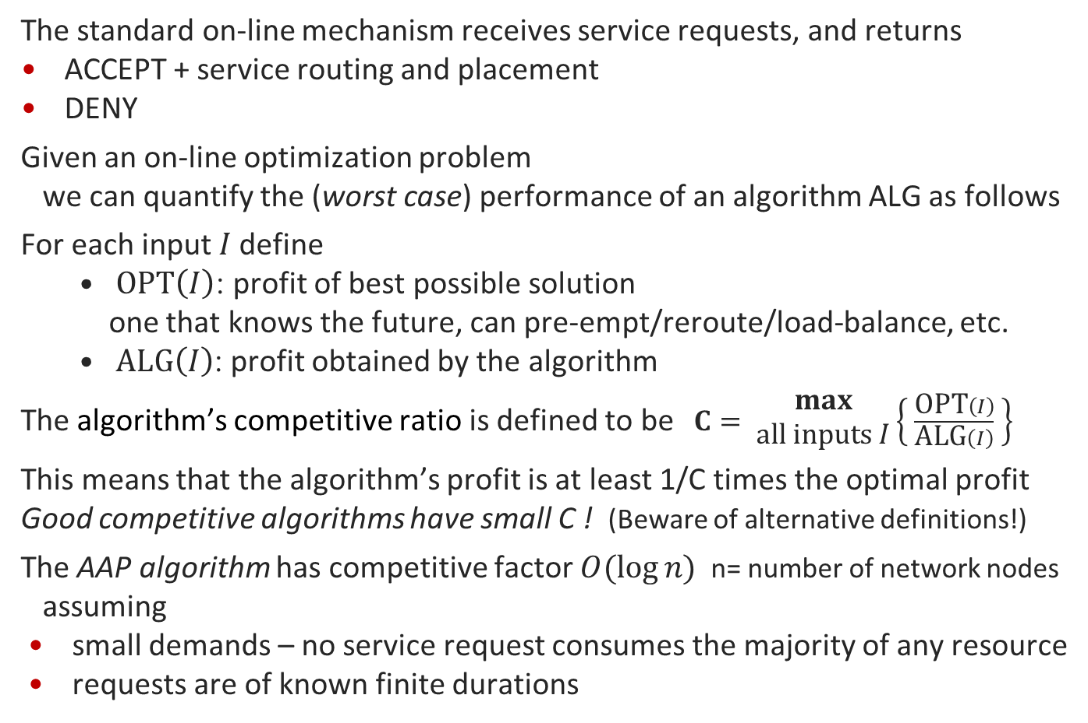
Performance of competitive algorithms
The standard on-line mechanism receives service requests, and returns
ACCEPT + service routing and placement
DENY
Given an on-line optimization problem
we can quantify the (worst case) performance of an algorithm ALG as follows
For each input 𝐼 define
  $\text{OPT}\left(I\right)$: profit of best possible solution
  one that knows the future, can pre-empt/reroute/load-balance, etc.
  $\text{ALG}\left(I\right)$: profit obtained by the algorithm
The algorithm’s competitive ratio is defined to be $C= \begin{matrix}max \\ \text{all} \text{inputs} I\end{matrix}⁡\left\{ \frac{\text{OPT}\left(I\right)}{\text{ALG}\left(I\right)} \right\}$
This means that the algorithm’s profit is at least 1/C times the optimal profit
Good competitive algorithms have small C ! (Beware of alternative definitions!)
The AAP algorithm has competitive factor $O(\log{n)}$ n= number of network nodes
assuming
small demands – no service request consumes the majority of any resource
requests are of known finite durations

Slide 9
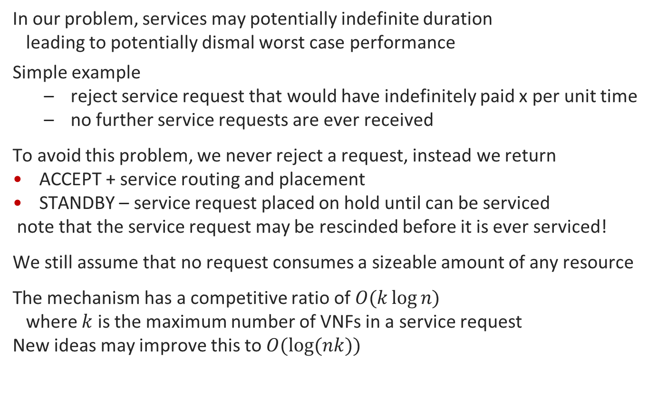
Step 2: ACCEPT/STANDBY response
In our problem, services may potentially indefinite duration
leading to potentially dismal worst case performance
Simple example
  reject service request that would have indefinitely paid x per unit time
  no further service requests are ever received
To avoid this problem, we never reject a request, instead we return
ACCEPT + service routing and placement
STANDBY – service request placed on hold until can be serviced
note that the service request may be rescinded before it is ever serviced!
We still assume that no request consumes a sizeable amount of any resource
The mechanism has a competitive ratio of $O(k\log{n)}$
where $k$ is the maximum number of VNFs in a service request
New ideas may improve this to $O(\log{(nk))}$

Slide 10
Summary
By combining the two ideas
use of Cartesian Graph Product
use of an ACCEPT/STANDBY mechanism
we obtain a tractable on-line joint SDN/NFV optimization algorithm

