Slide 1
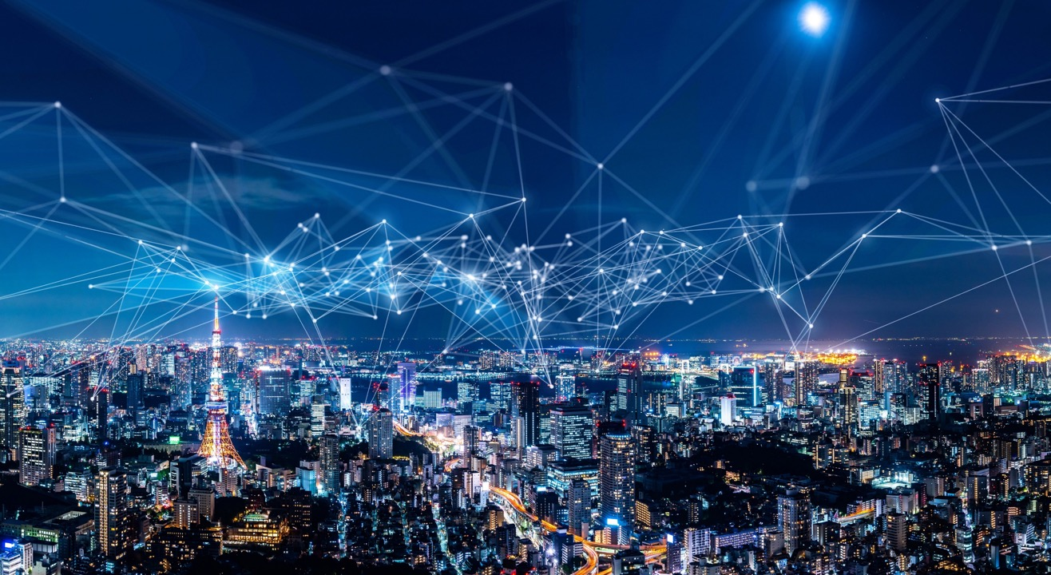

A
Gentle
Introduction
to
QoE
Y(J)S

Slide 2










Why do we pay for services ?
Do you use:
Zoom ? WhatsApp ?
Gmail ?
YouTube ? TikTok ?
Facebook ? LinkedIn ?
Dropbox ? Google search ?
Free Wi-Fi ?
If you can get all these for free
why does anyone pay for anything ?

Slide 3
Paying for QoS
The simple answer is that we no longer pay for services
we pay for Quality of Service guarantees
We pay for the right to complain!
This all started with telephony voice service
But why are we willing to pay for QoS ?
price
toll quality
with mobility
QoS
BE

Slide 4
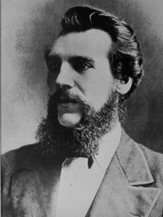
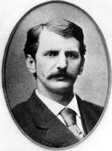
Fathers of the telephone service
Who is this?
Who is this?

Slide 5
Father of the telephone
Everyone knows that the father of the telephone was
Alexander Graham Bell
(along with his assistant Thomas Watson)
But Bell did not invent the telephone network
Bell and Watson sold pairs of phones to customers
leaving the customers responsible for operations

Slide 6
Father of the telephone network
The father of the telephone network was Theodore Vail
Theodore Vail should be remembered for many reasons :
Cousin of Alfred Vail (co-inventor of the telegraph along with Samuel Morse)
Ex-General Superintendent of US Railway Mail Service
First general manager of Bell Telephone
Solved major technological problems (such as copper wires and twisted pairs)
Established principle of revenue reinvestment in R&D
Established Bell Telephones IPR division
Executed merger with Western Union to form AT&T
Vail organized telephony as a service (like the postal service!) *
* Vailism is the philosophy that public services
should be run as closed centralized monopolies for the public good

Slide 7
What’s the difference ? (Product vs. Service)
In the Bell-Watson model the customer pays once for a product
but is responsible for
installation (telephones, wiring)
operations (power, repair)
maintenance
Bell was responsible only for providing functioning telephones
In the Vail model the customer pays a monthly fee for a service
and the service provider assumes responsibility for everything
including Operations, Administration, and Maintenance
to ensure Quality of Service
+

Slide 8

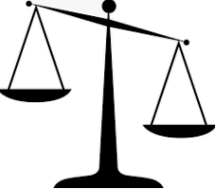
Quality of what?
If we are willing to pay for the right to complain about the quality of service
then quality must be something that the customer experiences
ITU-T defines Quality of Experience (QoE) as
the acceptability of a service as perceived subjectively by the end-user
But subjective measures can be very hard to quantify
and lead to disagreements between customer and service provider
To avoid disagreements, objective Quality of Service (QoS) parameters
were conventionally used
QoS parameters are believed to have some correlation with QoE
and can be used as proxies for true QoE

Slide 9
Technical QoS parameters
Example technical commitments (QoS parameters) :
Connectivity parameters
availability (e.g., the famous five nines)
restore time (e.g., the famous 50 ms)
Noise (error) level parameters
SNR
BER
Packet Loss Ratio
defect densities
Information rate parameters
bandwidth, throughput, goodput
Information latency parameters
1-way delay
round trip delay
delay variation (jitter, wander, PDV)
fault
parameters
Connectivity (availability)
always influences QoE
Performance parameters
may influence QoE
(depending on service type)
performance parameters

Slide 10
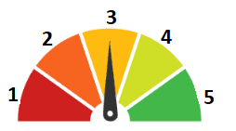
So that’s QoS! Remind me what QoE is …
QoE is a subjective (psychophysical) measure of user satisfaction
usually quantified on a coarse scale : 1 … 5
In order to neutralize personal preferences
standards mandate averaging QoE ratings over many users
resulting in a Mean Opinion Score
MOS was originally defined for telephony quality speech
but later extended to other services
MOS testing is complex, time-consuming and expensive
since biological and psychophysical phenomena are critical!
MOS

Slide 11
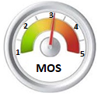

Slide 12
Example: visual acuity
Our eyes have finite acuity
and perfect (6/6) vision is defined as resolution of 1 arc minute
So, from a QoE standpoint, there is no reason to display an image
at a resolution above the visual acuity
In the figure you can see what this means for standard video resolutions
For example
with a 5" smartphone held at 25 cm
you can't differentiate between HD and UHD
while you can with a 21" PC screen at 45 cm!

Slide 13
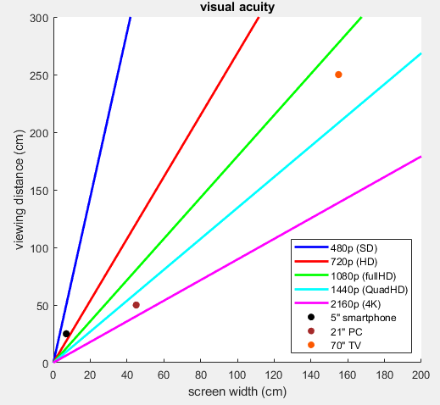
above line - too far away to fully resolve
below line - too close - pixelization may be noticeable

Slide 14
Example: auditory masking
Our ears (or actually our cochlea) have physical limitations
Masking occurs when the perception of one sound is suppressed
by the presence of another sound
Frequency masking
A tone too close in frequency to a stronger tone is not perceived
Temporal masking
A tone too close in time to a stronger tone is not perceived

Slide 15
So, QoE is all about acuity and resolution?
While some of QoE comes from physical limits on sharpness of perception
most derives from psychophysical phenomena
Psychophysics quantitatively investigates the relationship between physical stimuli and the sensations and perceptions they produce
The basic question of psychophysics is
what are the relationships between internal units (what we perceive)
and external units (the true strength of the physical phenomenon)
These relationships can only be determined by psychophysical experiments

Slide 16

Psychophysics 1 - Weber’s law
In 1834 Ernst Weber defined the Just Noticeable Difference (JND)
as the minimal physical change that produces a noticeable difference
Weber discovered that the JND was proportional to the stimulus value
For example: Weber’s coin experiment
subject noticed 2 coins vs 1 Δ I = k I
but not 11 vs 10 !
and the principle same is true for
length of lines
saltiness of salt-water
strength of sound

Slide 17
Psychophysics 2 - Fechner’s law
Gustav Theodor Fechner was a student of Weber
While viewing the sun in order to measure JNDs he went blind
but later regained his sight and took this as a sign
that he would solve the psychophysical problem
the relation between internal (psychological) units and external (physical) ones
His assumption: each JND is single internal unit
Weber’s law says we perceive external values multiplicatively Y(I+1) = (1+k) Y(I)
Fechner concluded that internal unit must be the log of the external one:
Y = A log I + B
The day he discovered this law (October 22 1850) is celebrated as Fechner Day

Slide 18
Example: Fechner’s law for hearing
Fechner’s law holds for both amplitude and frequency!
Amplitude
We perceive log power ratios, and thus deciBels are the natural units
dB = 10 log ( P / P_{ref} )
This explains how we can perceive 7 orders of magnitude of sound strengths
Frequency
We perceive log frequency ratios, and thus octaves are the natural units
A₁ = 55 Hz A₂ = 110 Hz A₃ = 220 Hz A₄ = 440 Hz
A₅ = 880 Hz A₆ = 1760 Hz A₇ = 3520 Hz A₈ = 7040 Hz

Slide 19
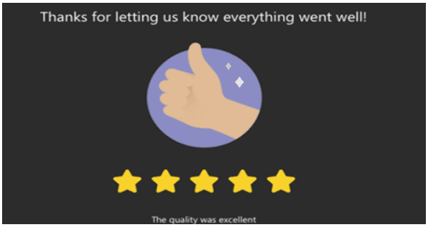
Back to QoE
QoE is quantified on a scale between 1 and 5 called MOS
MOS is measured by having some number (e.g., 32 or 64) of listeners
listen and score speech on a scale from 1 (bad) to 5 (excellent)
and averaging over these scores (finding the mean)
Today MOS measurement is commonly crowdsourced
with participation of millions of users
and used to optimize modern codecs and delivery mechanisms

Slide 20
MOS for telephony
The first service for which MOS was used was telephony-grade voice
which is defined in ITU-T Recommendation P.800
Because of 19th century limitations (poor microphones)
it was decided that people will pay for MOS=4 (toll quality)
Today we can do much better
but telephony before 4G was stuck at toll quality level
      Modern cellular and conferencing voice has MOS ≈ 5
      Toll quality (PSTN) voice has MOS = 4
      2/3G cellular voice has MOS ≈ 3.6
      Synthetic or military-quality voice has MOS ≈ 2.5

Slide 21
MOS for other services
Similar subjective methodologies and 5-point MOS scales
are used for other services, such as
high quality audio (e.g., broadcast music)
video
audio+video
video over IP networks
general web browsing
gaming
…

Slide 22
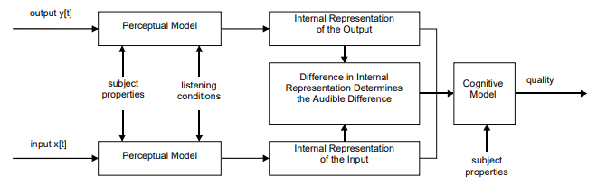
Objective MOS?
MOS testing is so complex and expensive
that objective mechanisms have been developed to predict MOS
These mechanisms exploit biological and psychophysical models
For example, PSQM (ITU-T P.861) and PEAQ (ITU-R BS-1387)
for telephone grade speech and broadcast-quality audio respectively
model the human auditory perception system

Slide 23
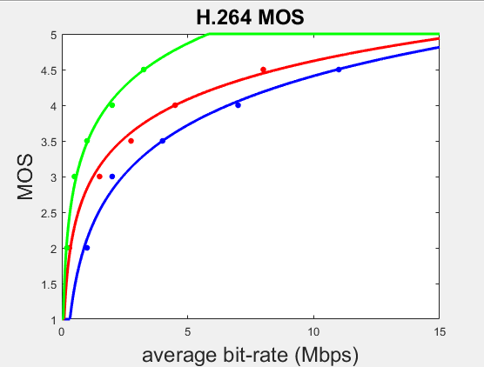
Example: empirical MOS for H.264 codecs
Expensive subjective testing
has been carried out
for standardized codecs
For H.264
(MPEG-4 Part 10 or Advanced Video Coding)
The points can be matched to
a Fechner-type formula
MOS ≈ A ln(bit-rate) + B
small screen (smartphone)
laptop or PC screen
large screen (TV)

Slide 24
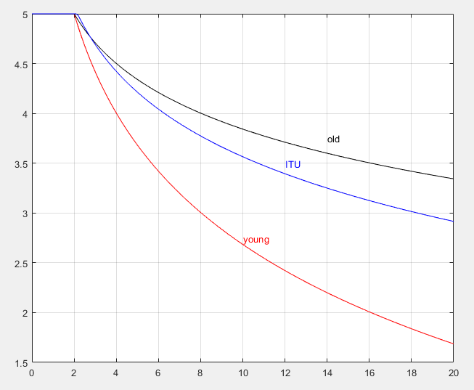
Example: Web browsing
MOS experiments have been performed for general web browsing
It turns out that QoE mostly depends on page stabilization time
Most people will be satisfied if a requested page stabilizes
within 2 to 8 seconds of clicking on its link (depending on browser’s age)
ITU-T G.1030 gives MOS formulae
e.g., MOS = 5.72 - 0.936 ln(T)
(clipped so that 1 ≤ MOS ≤ 5)
Note that some use
MOS = 6 - 1.44 ln(T) for younger people
MOS = 5.5 - 0.72 ln(T) for older people

Slide 25
Recency and Primacy effects
But there is much more to psychophysics than Fechner’s law!
Recency effect
There is cognitive bias towards sensations that came last
Primacy effect
There is cognitive bias towards sensations that came first (first impression)
So, when calculating MOS for a long phenomenon
one must weight the beginning and end
and the middle almost doesn’t count!

Slide 26
So that’s QoE! Remind me what QoS is …
QoE is an end-to-end subjective measure of end-user satisfaction
QoS parameters are objective parameters of communications services
and so seemingly have nothing to do with QoE!
Theory: Communications services quantifiable cause QoE degradation
QoE(end-to-end) = QoE(initial) - communications-degradation
Hypothesis: Were we to know all the relevant QoS parameters
we could predict the QoE degradation for any given application
So, assuming that the initial QoE was perfect (MOS=5) or known
QoE = f (application; QoS₁, QoS₂, … QoS_{n})

Slide 27
Why QUIC ?
QUIC was devised to improve browsing QoE
Modern web pages contain many links (often >100)
for each of which we need to wait (for example)
1+ short(?) RTT for DNS lookup (when not cached) 5 ms
1 RTT for TCP 3-way handshake 20 ms
2 RTTs for TLS set-up 40 ms
1 RTT for GET + response 20 ms
example TOTAL 85 ms
So, for 100 links, even with infinite bandwidth (i.e., no load time)
we are already over the 8 seconds MOS threshold
But QUIC can shave 5 seconds off that !!!

Slide 28

Example: compressed video over packet networks
For networking degradation of compressed video over packet networks
we need to differentiate between 2 cases
real-time video (e.g., over RTP/UDP)
QoE is influenced by codec, Q, resolution, data-rate, PLR, delay, PDV
streaming video (over TCP or QUIC), e.g.,
  Dynamic Adaptive Streaming over HTTP for mpeg and other codecs
  HTTP Live Streaming for H.264/H.265
QoE is influenced by
codec
resolution, resolution changes
max data-rate
Time-To-Play, stall frequency, stall duration

Slide 29
Why DASH/HLS ?
Many on-line platforms (e.g., YouTube) hide TTP from users
by playing advertisement (for free services)
or promos (for premium services)
Stalls remain by-far the most significant factor in determining MOS
Modern DASH and HLS clients utilize sophisticated criteria
to almost entirely avoid stalls
by monitoring buffer level
and requesting chunks of Q factor and resolution
in accordance with the desired bit-rate

Slide 30
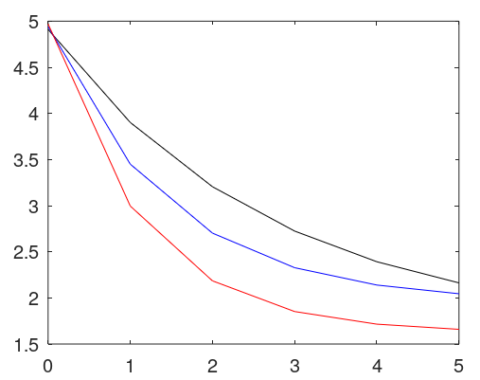
Stalls
In MOS studies, stalls are by far the dominant factor in the MOS equation
It turns out that stalls impact QoE through 2 separate terms
L stall duration(s)
N number of stall events
and not through the total stall duration T = LN
One crowd-sourced study found
L | MOS(N)
1 sec | 3.26 exp(-0.37 N) + 1.65
2 sec | 2.99 exp(-0.69 N) + 1.95
4 sec | 3.35 exp(-0.89 N) + 1.62
1 s
2 s
4 s

Slide 31
ITU is where everything is happening!
Subjective MOS
P.10 Vocabulary for performance, quality of service and quality of experience.
P.80 Methods for objective and subjective assessment of speech quality
BT.500 Subjective assessment of TV quality
P.120x QoE for streaming media
P.130x QoE for conferencing
P.1501 QoE for browsing
P.1502 QoE for digital financial services
QoE
G.107 E-model
G.1000 Communications QoS
G.1011 reference guide and taxonomy
G.1010 multimedia applications
G.1030 planning for applications over IP networks
G.1031 browsing
G.1035 QoE for VR
G.1072 QoE for cloud gaming
…
Objective MOS
P.861 (PSQM) telephony audio
P.862 (PESQ) telephony audio
BS-1387 (PEAQ) wideband audio
P.563 single‐ended objective MOS
J.14x QoE for digital TV part 1
J.24x QoE for digital TV part 2 (PEVQ)
J.24x QoE for digital TV part 3
And there is much more !

Slide 32

But there is a problem!
Recently a fundamental flaw has been found in our QoS→QoE paradigm
It turns out
that for modern communications services
there is no relationship QoE ≠ f (application; QoS_{i} )
Hence QoS and SLAs are now becoming meaningless
Let’s explain why!
PM
FM
SLA
OAM
QoS

Slide 33
Conventional communications services
The traditional communications service
was a pure transport service
Transport information:
from site X to site Y (or between N>2 sites)
with data rate at least R
with latency no more than L

Slide 34

Rich communications services
Today, the service provided is much richer
Transport information :
from site X to site Y (or between N>2 sites)
with application information rate at least R
with experienced latency no more than L
while performing (virtual) network functions
  NAT, tunneling
  firewall, IDS
  TCP proxy, WAN optimization
  trans-coding, trans-rating
  caching, CDN
  payload manipulation

Slide 35
QoS for rich services
Remember, the only reason to guarantee/measure a QoS KPI
is its relationship to QoE
But that relationship was only established
for traditional services
It turns out that one can prove
that in general for rich communications services
there can be no such relationship
QoE ≠ f (application; QoS_{i} )
In future, SLAs will have to be based directly on QoE
see e.g., this paper or this talk
(development partially funded under Neptune)

Slide 36
So, what can be done?
QoE is known by the end application and user
and can be reported by the app and/or user
No matter what happens in the network
the end-user will react according to the QoE (s)he experiences
For example
truly poor QoE will lead to users aborting sessions
truly good QoE will lead to users increasing usage
So, we need to monitor both machine and human behavior

Slide 37

Summary
QoE is the only justification for payment for a communications service
QoE is defined via (subjective) psychophysical experiments
QoE may be objectively estimated
QoE is conventionally assumed to be derivable from on QoS degradations
but this assumption is becoming questionable
QoE may be estimated by monitoring behavior

Slide 38
