Slide 1
SDN & NFV and all that
Yaakov (J) Stein
CTO – RAD Data Communications
Chair – Neptune Consortium

Slide 2

Why SDN and NFV ?
Before explaining what SDN and NFV are
we need to explain why SDN and NFV are
Its all started with two related trends ...
1. The blurring of the distinction
between computation and communications
(and thus between algorithms and protocols)
revealing a fundamental disconnect
between software and networking
2. The decrease in profitability
of traditional communications service providers
along with the increase in profitability
of Cloud and Over The Top service providers
The 1st led directly to SDN
and the 2nd to NFV
but today the two technologies are completely intertwined

Slide 3







1. Computation and communications
Once there was no overlap
between communications (telephone, radio, TV)
and computation (computers)
This dichotomy has certainly blurred in our private lives !
Most home computers are not used for computation at all
rather for communications (email, chat, VoIP)
Smart cellular telephones have become computers
and are used more for running apps than for telephone calls
But in professional contexts (business services, utilities operations, ...)
separate IT and communications departments are still the norm
switches/routers and servers are still acquired and operated differently

Slide 4
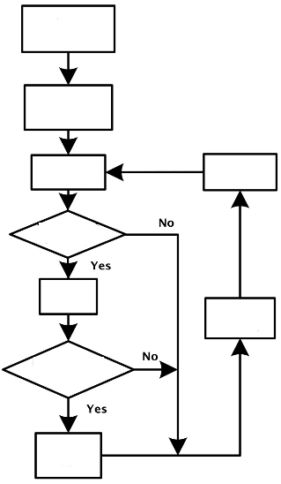
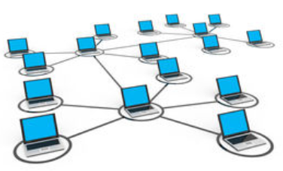
1. Algorithms vs. Protocols
The differentiation can still be seen in the terms algorithm and protocol
An algorithm is a set of operations to be performed by an entity
to accomplish something (e.g., solve a problem)
A protocol is a set of operations to be performed between 2 entities
to exchange information
Protocol design is fundamentally harder
since there are interacting entities (the interoperability problem)
SDN academics claim that packet forwarding and routing
can be solved as algorithms
and protocols can be avoided

Slide 5

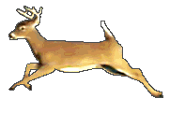
1. Software and networking speed
Today, developing a new iOS/Android app takes hours to days
but developing a new communications service takes months to years
Even adding new instances of well-known services
is a time consuming process for conventional networks
When a new service types requires new protocols, the timeline is
protocol standardization (often in more than one SDO)
hardware development
interoperability testing
vendor marketing campaigns and operator acquisition cycles
staff training and deployment
This leads to a fundamental disconnect
between software and networking development timescales
An important goal of SDN and NFV is
to create new network functionalities at the speed of software
the first IPv6 RFC was published in 1998

Slide 6


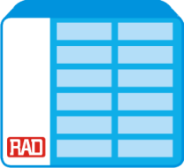



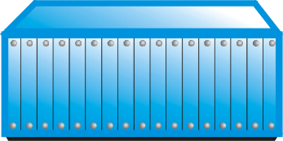











2. Today’s communications world
The second trend is the decrease in service provider profitability
Today’s infrastructures are composed of many different Network Elements (NEs)
sensors, smartphones, notebooks, laptops, desk computers, servers,
DSL modems, Fiber transceivers,
SONET/SDH ADMs, OTN switches, ROADMs,
Ethernet switches, IP routers, MPLS LSRs, BRAS, SGSN/GGSN,
NATs, Firewalls, IDS, CDN, WAN aceleration, DPI,
VoIP gateways, IP-PBXes, video streamers,
performance monitoring probes , performance enhancement middleboxes,
etc., etc., etc.
New and ever more complex NEs are being invented all the time,
and while equipment vendors like it that way
Service Providers find it hard to shelve and power them all !

Slide 7
2. The service provider crisis
$
revenue
Service Provider bankruptcy point
margin
CAPEX + OPEX
desirable CAPEX + OPEX
time
This is a qualitative picture of the (western) service provider’s world
Revenue is (at best) increasing with number of users
Expenses are proportional to bandwidth – doubling every 9 months
This situation obviously can not continue forever !

Slide 8



Two complementary solutions
Software Defined Networks (SDN) whitebox switches
SDN advocates replacing standardized networking protocols
with centralized software applications
that configure all the NEs in the network
Advantages:
control software development is much faster than protocol standardization
centralized control enables stronger optimization
functionality may be speedily deployed, relocated, and upgraded
Network Functions Virtualization (NFV) whitebox servers
NFV advocates replacing hardware network elements
with software running on COTS computers
that may be housed in POPs and/or datacenters
Advantages:
COTS server price and availability scales with end-user equipment
functionality can be located where-ever most effective or inexpensive
functionalities may be speedily combined, deployed, relocated, and upgraded

Slide 9
SDN

Slide 10
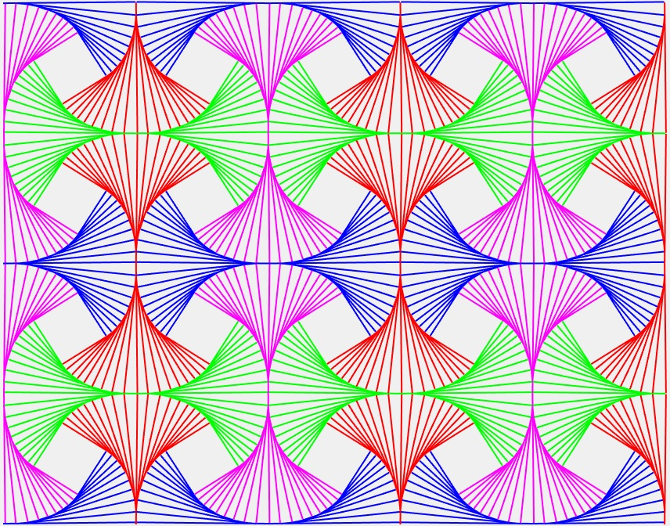
Abstractions
SDN was triggered by the development of networking technologies
not keeping up with the speed of software application development
Computer science theorists theorized
that this derived from not having the required abstractions
In CS an abstraction is a representation
that reveals semantics needed at a given level
while hiding implementation details
thus allowing a programmer to focus on necessary concepts
without getting bogged down in unnecessary details
Programming is fast because programmers exploit abstractions
Example:
It is very slow to code directly in assembly language (with few abstractions, e.g. opcode mnemonics)
It is a bit faster to coding in a low-level language like C (additional abstractions : variables, structures)
It is much faster coding in high-level imperative language like Python
It is much faster yet coding in a declarative language (coding has been abstracted away)
It is fastest coding in a domain-specific language (only contains the needed abstractions)
In contrast, in protocol design we return to bit level descriptions every time!

Slide 11
Packet forwarding abstraction
The first abstraction relates to how network elements forward packets
At a high enough level of abstraction
all network elements perform the same task
Abstraction 1 Packet forwarding as a computational problem
The function of any network element (NE) is to
receive a packet
observe packet fields
apply algorithms (classification, decision logic)
optionally edit the packet
forward or discard the packet
For example
An Ethernet switch observes MAC DA and VLAN tags, performs exact match, forwards the packet
A router observes IP DA, performs LPM, updates TTL, forwards packet
A firewall observes multiple fields, performs regular expression match, optionally discards packet
We can replace all of these NEs with a configurable whitebox switch

Slide 12

Network state and graph algorithms
How does a whitebox switch learn its required functionality ?
Forwarding decisions are optimal
when they are based on full global knowledge of the network
With full knowledge of topology and constraints
the path computation problem can be solved by a graph optimization algorithm
Distributed protocols can only perform certain path computations (e.g., Dijkstra)
Abstraction 2 Routing as a computational problem
Replace distributed routing protocols with graph algorithms
performed at a central location (the SDN controller or GodBox)
Note with SDN, the pendulum that swung
from the completely centralized PSTN
to the completely distributed Internet
swings back to completely centralized control

Slide 13

Configuring the whitebox switch
Conventional network elements have two parts:
smart but slow CPUs that create a Forwarding Information Base
fast but dumb switch fabrics that use the FIB
Whitebox switches only need the dumb part, thus
eliminating distributed protocols
not requiring intelligence
How does a whitebox switch acquire the information needed to forward
that has been computed by an omniscient entity at a central location ?
Abstraction 3 Configuration
Whitebox switches are directly configured by the SDN controller
The API from the SDN controller down to the whitebox switches
is conventionally called the southbound API (e.g., OpenFlow, ForCES)
Note that this SB API is in fact a protocol
but is a simple configuration protocol
not a distributed routing protocol

Slide 14
Separation of data and control
You will often hear stated that the defining attribute of SDN is
the separation of the data and control planes
This separation was not invented recently by SDN academics
Since the 1980s all well-designed communications systems
have enforced logical separation of 3 planes :
data plane (forwarding)
control plane (e.g., routing )
management plane (e.g., policy, commissioning, billing)
What SDN really does is to
1) insist on physical separation of data and control
2) merge the control and management planes
management plane
control plane
data plane

Slide 15

Flows
It would be too slow for a whitebox switch
to query the centralized SDN controller
for every packet received
So we identify packets as belonging to flows
Abstraction 4 Flows (as in OpenFlow)
Packets are handled solely based on the flow to which they belong
Flows are thus just like Forwarding Equivalence Classes in IP networking
Thus a flow may be determined by
an IP prefix in an IP network
a label in an MPLS network
VLANs in VLAN cross-connect networks
The granularity of a flow depends on the application

Slide 16
Control plane abstraction
In the standard SDN architecture, the SDN controller is omniscient
but does not itself program the network
since that would limit development of new network functionalities
With software we create building blocks with defined APIs
which are then used, and perhaps inherited and extended, by programmers
With networking, each network application has a tailored-made control plane
with its own element discovery, state distribution, failure recovery, etc.
Note the subtle change of terminology we have just introduced
instead of calling switching, routing, load balancing, etc. network functions
we call them network applications (similar to software apps)
Abstraction 5 Northbound APIs instead of protocols
Replace control plane protocols with well-defined APIs to network applications
This abstraction hide details of the network from the network application
revealing high-level concepts, such as requesting connectivity between A and B
but hiding details unimportant to the application
such as details of switches through which the path A → B passes

Slide 17
SDN overall architecture
app
app
app
app
northbound interface
SDN controller
southbound interface
(e.g., OpenFlow)
whitebox switch
whitebox switch
whitebox switch
whitebox switch
Network
whitebox switch
whitebox switch

Slide 18
NFV

Slide 19
Concretization and Virtualization
VIRTUALIZATION
special purpose processors
general
purpose
software
PHYSICS
dedicated hardware
ASIC
FPGA
firmware
LOGIC
CONCRETIZATION
Computational tasks can be carried out on many platforms
Concretization means moving a task to the left
Justifications for concretization include :
  cost savings for mass produced products
  miniaturization/packaging constraints
  need for high processing rates
  energy savings / power limitation / low heat dissipation
Virtualization is the opposite - moving a task to the right
(although frequently reserved for the extreme case of hardware → software)

Slide 20


Justifications for Virtualization
The justifications for virtualization are initially harder to grasp
  lower development efforts and cost
  flexibility and ability to upgrade functionality
  chaining multiple functions on a single platform
  facilitating function relocation
By function relocation we mean
moving the network function from its conventional place
to some other place (e.g., to a Data Center)
Relocation has received much attention in the networking community
since moving networking functions to Data Centers
often enables benefiting from economies of scale
This emphasis on this single reason for virtualization has been so strong
that it has led many to completely confuse virtualization and relocation
when in fact
nonvirtualized functions can be relocated (at the expense of CAPEX and truck rolls)
virtualized functions can remain in situ (will get to that in a moment)
Data Center

Slide 21
Virtualization of computation
In the field of computation, there has been a major trend towards virtualization
Virtualization here means the creation of a virtual machine (VM)
that acts like an independent physical computer
A VM is software that emulates hardware (e.g., an x86 CPU)
over which one can run software as if it is running on a physical computer
The VM runs on a host machine
and creates a guest machine (e.g., an x86 environment)
A single host computer may host many fully independent guest VMs
and each VM may run different Operating Systems and/or applications
A typical data center has many server racks
each rack has many has many (blade) server cards
each server card has many (host) CPUs
each CPU has many (guest) VMs

Slide 22
Network Functions Virtualization
CPUs are not the only hardware device that can be virtualized
Many (but not all) NEs can be replaced by software running on a CPU or VM
This would enable
using standard COTS hardware (whitebox servers)
  reducing CAPEX and OPEX
fully implementing functionality in software
  reducing development and deployment cycle times, opening up the R&D market
consolidating equipment types
  reducing power consumption
optionally concentrating network functions in datacenters or POPs
  obtaining further economies of scale. Enabling rapid scale-up and scale-down
For example, switches, routers, NATs, firewalls, IDS, etc.
are all good candidates for virtualization
as long as the data rates are not too high
We call this idea Network Functions Virtualization (NFV)
and the functions themselves Virtual Network Functions (VNFs)

Slide 23

Potential VNFs
Potential Virtualized Network Functions
forwarding elements: Ethernet switch, router, Broadband Network Gateway, NAT
virtual CPE: demarcation + network functions + VASes
mobile network nodes: HLR/HSS, MME, SGSN, GGSN/PDN-GW, RNC, NodeB, eNodeB
residential nodes: home router and set-top box functions
gateways: IPSec/SSL VPN gateways, IPv4-IPv6 conversion, tunneling encapsulations
traffic analysis: DPI, QoE measurement
QoS: service assurance, SLA monitoring, test and diagnostics
NGN signalling: SBCs, IMS
converged and network-wide functions: AAA servers, policy control, charging platforms
application-level optimization: CDN, cache server, load balancer, application accelerator
security functions: firewall, virus scanner, IDS/IPS, spam protection
Note:
Physical layer functions (e.g., Software Defined Radio) are not ideal VNF candidates

Slide 24
Whiteboxes
A computational platform that can carry out NFV
is called a whitebox server
Just like a whitebox switch in SDN is called a white (not black!) box
because its internal mechanism is simple and completely known
the whitebox server in NFV is a completely standard server
and its functioning is completely determined by the installed software
Whitebox switch means an SDN (e.g., OpenFlow) switch
most frequently an inexpensive configurable hardware switch
possibly a configurable software switch (e.g., Open vSwitch)
Whitebox server means a COTS computation platform
most frequently an x86-based CPU or VM capable of running VNFs
possibly combined hardware networking functionality
capable of running multiple arbitrary VNFs

Slide 25
Function relocation
Once a network functionality has been virtualized
it is relatively easy to relocate it
By relocation we mean
placing a function somewhere other than its conventional location
e.g., at Points of Presence and Data Centers
Many (mistakenly) believe that the main reason for NFV
is to move networking functions to data centers
where one can benefit from economies of scale
Some telecomm functionalities need to reside at their conventional location
Loopback testing
E2E performance monitoring
but many don’t, and can be relocated to a datacenter
routing and path computation
billing/charging
traffic management
DoS attack blocking
Note: even nonvirtualized functions can be relocated

Slide 26
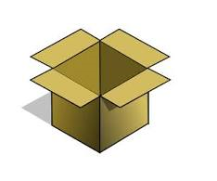


Service function chaining
(Service) function chaining is a new SDN+NFV application
that has been receiving a lot of attention
Its main application is inside data centers
but there are also applications in mobile networks
A packet needs to be steered through a chain of functions (services)
Examples of services (functions) :
firewall
DPI for analytics
NAT
CDN
billing
load balancing
The chaining can be performed by SDN or static routing, source routing, segment routing, policy-based routing, new mechanisms
It is useful to be able to pass metadata between functions

Slide 27
SDN as function relocation
SDN provides a specific example of function relocation
In conventional IP networks routers perform 2 functions
forwarding (the whitebox part)
  observing the packet header
  consulting the Forwarding Information Base
  forwarding the packet
routing
  communicating with neighboring routers to discover topology (routing protocols)
  runs routing algorithms (e.g., Dijkstra)
  populating the FIB used in packet forwarding
SDN enables moving the routing algorithms to a centralized location
replace the router with simple whitebox switch
install a centralized SDN controller
  runs the routing algorithms (internally – w/o on-the-wire protocols)
  configures the NEs by populating the FIB
As we warned you, SDN and NFV are completely intertwined

Slide 28

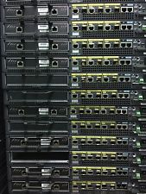

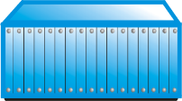
Distributed NFV
The idea of optimally placing virtualized network functions in the network
from edge (vCPE) through aggregation through PoPs and HQs to datacenters
is called Distributed-NFV (DNFV)
Optimal location of a functionality needs to take into consideration:
resource availability (computational power, storage, bandwidth)
real-estate availability and costs
energy and cooling
management and maintenance
other economies of scale
security and privacy
regulatory issues
For example, consider moving a DPI engine from where it is needed
this requires sending the packets to be inspected to a remote DPI engine
If bandwidth is unavailable or expensive or excessive delay is added
then DPI must not be relocated
even if computational resources are less expensive elsewhere!
agg
vCPE
PoP
Data Center

Slide 29
Rich communications services
Traditional communications services are pure connectivity services
transport data from A to B
with constraints (e.g., minimum bandwidth, maximal delay)
with maximal efficiency (minimum cost, maximized revenue)
Together, SDN and DNFV enable richer communications services
combining connectivity and network functionalities
e.g., firewall, NAT, load balancing, CDN, acceleration, parental control, ...
Rich communications services
eliminate the computation/communications distinction

