Slide 1
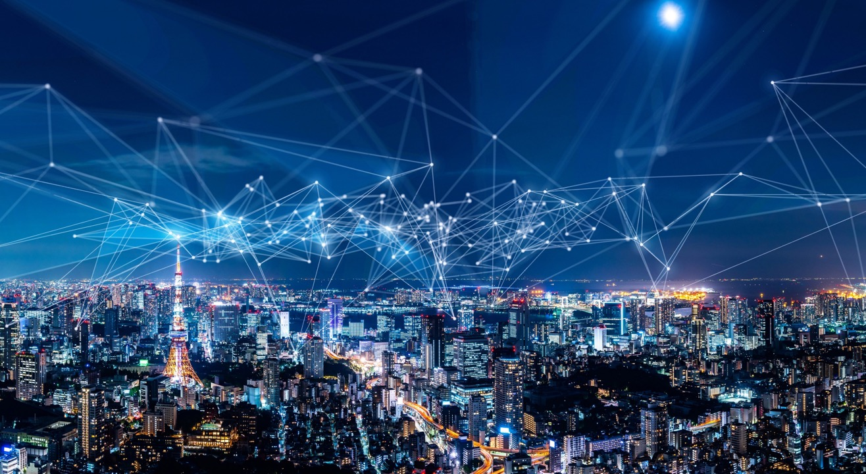

Post
Quantum
Communications
Y(J)S

Slide 2
My 9th Allot Time
5 January 2022 5 things everyone should know about 5G
23 March 2022 Quality of what? QoS, QoE and their connection
11 May 2022 How the World has Become Virtual
7 September 2022 The Four Building Blocks of Secure Communications
16 November 2022 5G Security Challenges (Cyber Time with Ed Amoroso)
22 February 2023 Patently Protected
3* May 2023 Traffic Inspection in the Year 1 AD (After DPI)
14 January 2025 AI-llot
10 September 2025 Post Quantum Communications
* continued 10 May 2023 due to DoS

Slide 3
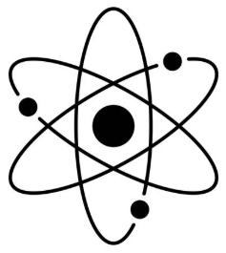
What is quantum mechanics?
Quantum Mechanics is a physical theory for the behavior of small particles
such as atoms, protons, electrons, photons
QM is true in the sense that it can predict many phenomena with amazing accuracy
but while you can learn QM, you can never understand QM
QM is astoundingly useful - much of our modern lives depend on quantum technologies
such as semiconductors*, atomic clocks, LEDs, solar cells, lasers
QM is not, however, a theory of everything, since
there are more fundamental theories such as Quantum Field Theory
QM is incompatible with relativity theory, another extremely well-tested theory
* in a sense all computers are quantum computers …

Slide 4
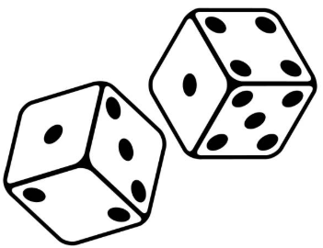
What does quantum mechanics say?
QM is nondeterministic (God does play dice)
everything is described by a wavefunction
often use Dirac’s (bra and) ket notation |Ψ >
from which one can only derive probabilities |< Ψ |Ψ >|²
wavefunctions are complex fields (their absolute squares are the probabilities!)
so, they can constructively or destructively interfere
physical observables (e.g., position, energy) are operators on wavefunctions
< Ψ | Ô |Ψ >
noncommuting observables (e.g., position/momentum, energy/time)
can’t be simultaneously measured
measuring one smears out the other (uncertainty relations)

Slide 5

What else does quantum mechanics say?
QM is weird (counterintuitive to beings used to classical physics)
a wavefunction can be a superposition of multiple base states (Schrödinger’s cat)
|Ψ > = α₁ |ϕ₁ > + α₂ |ϕ₂ > (α_{i} complex numbers, with |α ₁|² ⁺ |α ₂|² = 1)
observing (measuring) collapses the wavefunction to one of the possible states
with probability |α|²
particles are indistinguishable (e.g., all electrons are the same electron)
2 particles can be entangled - collapsing one wavefunction
instantly collapses and instantaneously determines the other
(even when they are far apart, Einstein’s spooky action at a distance)

Slide 6
What is a quantum computer?
A Quantum Computer uses quantum phenomena to perform calculations
QCs use qubits instead of bits
can be in state 0, 1, or a general superposition of both α₀ |0 > + α₁ |1 > (3 real parameters !)
2 qubits can be entangled
QCs compute using quantum gates instead of classical logic gates
when input qubits are superpositions, gate outputs are superpositions of the answers
hence QCs natively perform massively parallel computation
but reading the output is a measurement which collapses the output wavefunction
so, while the QC knows all the answers, we can only read out one
Luckily, you don’t need to know too much QM to understand QCs

Slide 7
But - what are qubits made of?
Many different quantum systems have been used as qubits, as long as they allow superposition, entanglement, sufficient coherence, and can be measured
superconducting qubits (IBM, Google, Rigetti)
trapped ion qubits (IonQ, Quantinuum)
spin qubits, quantum dot qubits (Intel)
photonic qubits (Xanadu, PsiQuantum, Heqa)
topological qubits (Microsoft)
neutral atom qubits (QuEra, PASQAL, ColdQuanta)
…

Slide 8
Why can QCs be faster that classical computers?
When searching for a given output with classical gates
one needs to try all 2^{n} input combinations
But a quantum gates operates on all combinations simultaneously
0
0
0
0
0
0
0
0
0
0
0
0
0
0
0
1
0
0
0
0
0
0
1
0
0
0
0
0
0
0
1
1
0
0
0
0
0
1
0
0
1
1
1
1
1
1
1
0
1
1
1
1
1
1
1
1
classical
logic
gate
…
Quantum supremacy is when a quantum computer can solve some problem
that no classical computer can
(in a reasonable amount of time)
superposition state
quantum
gate

Slide 9



Some quantum gates (note - must be reversible!)
1-qubit gate
superposition!
Hadamard
gate
|0 > + |1 >
Hadamard
gate
|0 > - |1 >
|0 >
|1 >
$$\sqrt{2}$$
$$\sqrt{2}$$
2-qubit CNOT gate
|0 >
control
line
|0 >
|0 >
|0 >
|1 >
|1 >
|1 >
|1 >
|0 >
|0 >
|1 >
|1>
|0 >
|1 >
|1 >
|0 >
Entangler
|0 >
H
No cloning theorem
|0 > |0 > + |1 > |1 >
|0 >
|Ψ >
|Ψ >
$$\sqrt{2}$$
Bell state
(maximally entangled)
whatever
|Ψ >
Notes:
Hadamard and CNOT are their own inverses.
In the no cloning must have 2 inputs for reversibility.

Slide 10
Is this a WOW now?
A QC is not (yet?) reliable (topological qubits, if they can be made, may solve this problem)
qubits have short coherence times - they typically decay after 10s μsec - 1 sec
qubits can interfere with each other (crosstalk) and be influenced by external noise
quantum gates are noisy - they typically have 0.1 - 2% error
reading the answers introduces errors - typically 1-5%
some experts actually believe that these problems may be unsurmountable
QCs are (still?) very small
to overcome decoherence and gate errors one needs quantum error correction
that combines many (rule of thumb ≈1000) noisy physical qubits into a single reliable logical qubit
while current QCs may have 10s to > 100 physical qubits, they have very few logical qubits
Even a large and reliable QC is not a general-purpose supercomputer
it is not efficient at most ordinary computations that a regular computer can perform
but it can …

Slide 11
What can we do with a quantum computer?
Quantum computers obey quantum mechanics
so, they can natively emulate complex physical systems
rather than simulating them by solving complex coupled equations
Hence, QCs can solve problems in chemistry, for e.g.,
drug discovery
materials science
Quantum computers are massively parallel processors
and so can be used to solve various optimization problems, e.g.,
logistics, transportation, energy management
finance
engineering

Slide 12
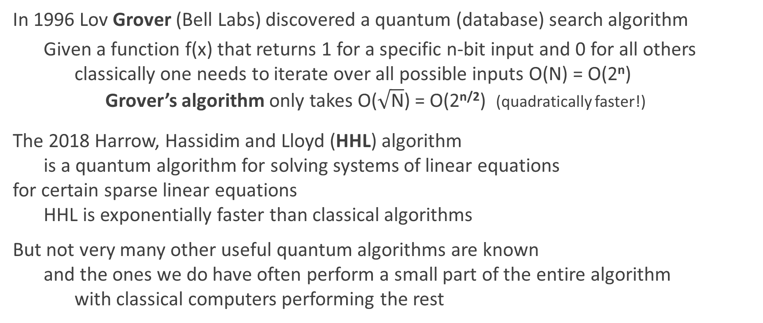
What else can we do with a quantum computer?
In 1996 Lov Grover (Bell Labs) discovered a quantum (database) search algorithm
Given a function f(x) that returns 1 for a specific n-bit input and 0 for all others
classically one needs to iterate over all possible inputs O(N) = O(2^{n})
Grover’s algorithm only takes O($\sqrt{\text{N}}$) = O(2^{n/2}) (quadratically faster!)
The 2018 Harrow, Hassidim and Lloyd (HHL) algorithm
is a quantum algorithm for solving systems of linear equations
for certain sparse linear equations
HHL is exponentially faster than classical algorithms
But not very many other useful quantum algorithms are known
and the ones we do have often perform a small part of the entire algorithm
with classical computers performing the rest

Slide 13
Two arcane mathematical problems
In 1994 Peter Shor found a quantum algorithm
that solves two purely mathematical problems (only of interest to specialists)
much more efficiently than the best classical algorithms
factoring large integers
find the prime factors of a given semiprime N = pq
finding discrete logarithms
find N, given a large finite cyclic group G, and group elements b and g = b^{N}
In both cases
the best classical algorithm (number-field sieve) has complexity O( exp(n^{⅓} (log n)^{⅔}) )
subexponential in the number of bits n = log N
while Shor’s algorithm has complexity O( n³ ) ― polynomial in the number of bits !
1234567 = 127 * 9721
13⁶ mod 101 = 19

Slide 14
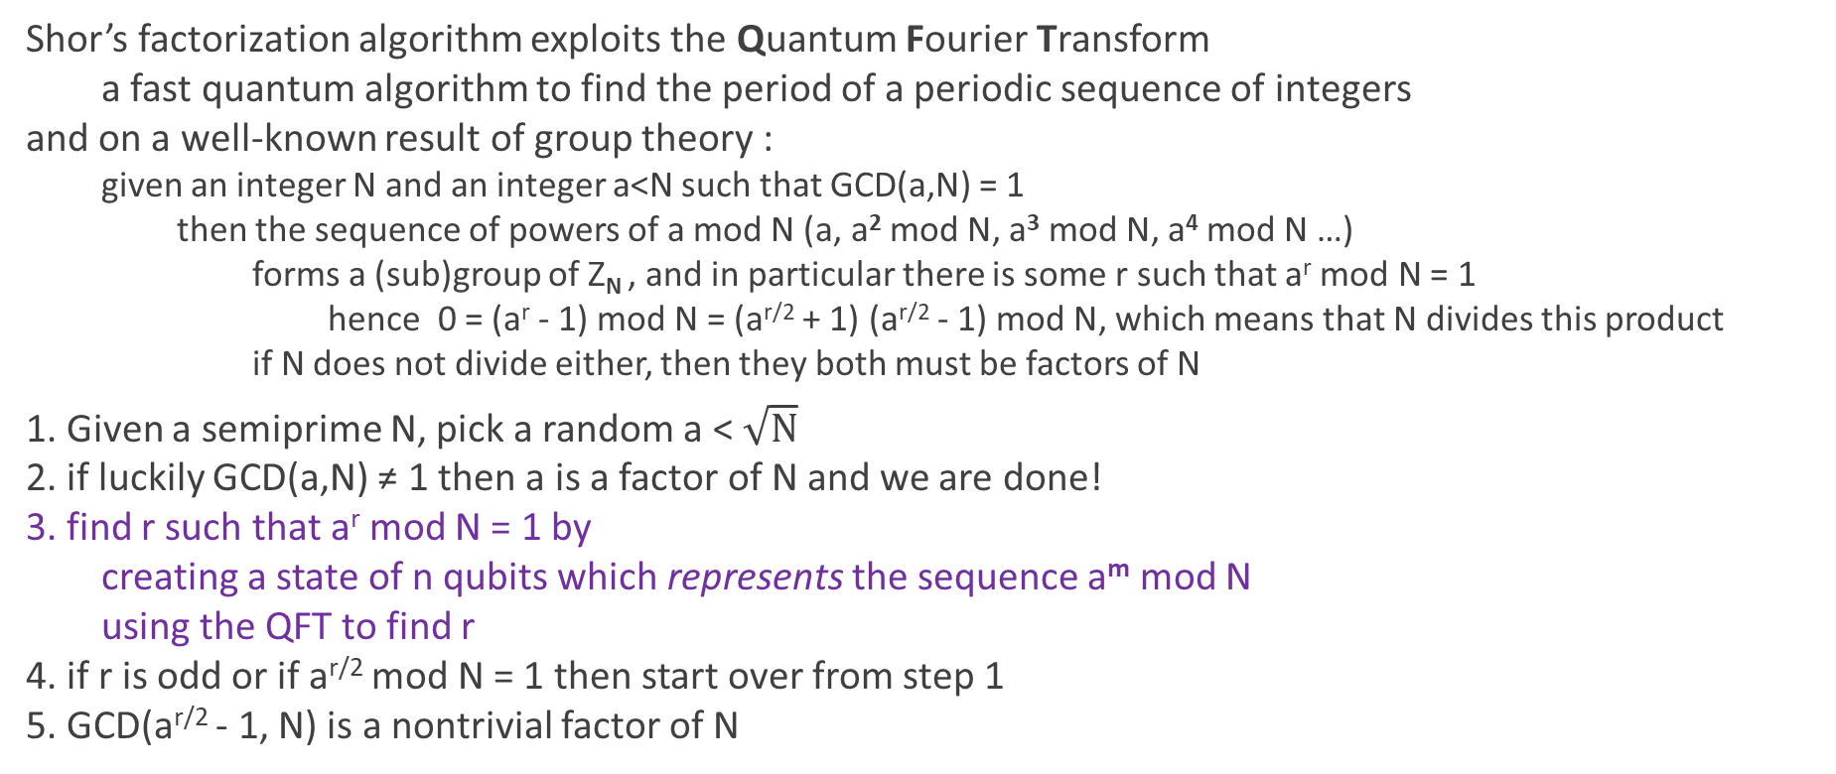
How does Shor’s factorization algorithm work?
Shor’s factorization algorithm exploits the Quantum Fourier Transform
a fast quantum algorithm to find the period of a periodic sequence of integers
and on a well-known result of group theory :
given an integer N and an integer a<N such that GCD(a,N) = 1
then the sequence of powers of a mod N (a, a² mod N, a³ mod N, a⁴ mod N …)
forms a (sub)group of Z_{N} , and in particular there is some r such that a^{r} mod N = 1
hence 0 = (a^{r} - 1) mod N = (a^{r/2} + 1) (a^{r/2} - 1) mod N, which means that N divides this product
if N does not divide either, then they both must be factors of N
1. Given a semiprime N, pick a random a < $\sqrt{N}$
2. if luckily GCD(a,N) ≠ 1 then a is a factor of N and we are done!
3. find r such that a^{r} mod N = 1 by
creating a state of n qubits which represents the sequence a^{m} mod N
using the QFT to find r
4. if r is odd or if a^{r/2} mod N = 1 then start over from step 1
5. GCD(a^{r/2} - 1, N) is a nontrivial factor of N
for the mathematically inclined
Quantum Computer

Slide 15
Why do we care?
In Allot we don’t really care about chemistry, logistics, or pure mathematics
so, why we should be interested in QCs?
In my November 2022 talk I discussed
the 4 main requirements of communications security
authorization – verifying a party’s claimed identify
source authentication – confirming that a message was indeed from the claimed party
integrity – preventing tampering with messages in flight
confidentiality – preventing eavesdropping
key distribution/exchange – sharing an initial secret
encryption
All the highlighted requirements are satisfied using 1-way problems

Slide 16

1-way problems
A 1-way problem is a mathematical problem such that
computing the forward problem b = f(a) is easy (fast)
computing the reverse (inverse) problem a = f⁻¹(b) is hard (slow)
Factoring semiprimes is a pre-quantum 1-way problem
multiplying two primes is easy
finding the prime factors of a large semiprime is hard on a classical computer
Computing a discrete logarithm is a pre-quantum 1-way problem
raising an element to a power is easy
finding the power of an element that gives a given result is hard on a classical computer
The hardness of the reverse problems is challenged by Shor’s algorithm!!
A QC which is sufficiently strong (large and reliable) to endanger security
is called a Cryptographically Relevant Quantum Computer (CRQC)

Slide 17

NISQ
A CRQC using Shor’s algorithm can break RSA and DH
but we are still far (years?, decades? Centuries?) from a CRQC
A CRQC would require thousands of logical qubits and billions of gates
We are still in the Noisy Intermediate-Scale Quantum era
unreliable short-lived qubits
few (up to 1,000) qubits per computer
It has been claimed that NISQ computers
have attained Quantum Supremacy for some specific problems
The largest number actually factored using Shor’s algorithm is 21

Slide 18

QKD and PQC
So, our communications are still safe, but they may not be so forever
People are already concerned due to the Harvest Now Decrypt Later scenario
As it will take many years to migrate to alternative security methods
we need to start now!
There are two main ways to restore quantum-safe communications
Quantum Key Distribution
Post Quantum Cryptography

Slide 19

QKD - fight QM with QM
QKD enables Alice and Bob to perform key exchange
with a physical (not a mathematical) proof that it has not been intercepted
This key may then be used as a symmetric encryption key
QKD systems are commercially available from several sources
and have been successfully deployed for extended periods of time
QKD is slow, typically 10 kbps over fiber, 100 bps for free-space
Fiber-based QKD system typically work over tens of kilometers
but have been demonstrated to operate over 100s of kms
An experimental satellite-based system has operated over 7,500 km
between China and Vienna

Slide 20
QKD exploiting entanglement
source of entangled photons
Great in principle
but hard to implement in practice
fiber
fiber
Alice
Bob
011100010010110
011100010010110

Slide 21
BB84 (exploiting collapsing of the wavefunction)
In 1984 Charles Bennett and Gilles Brassard proposed the 1st practical QKD protocol
The protocol uses photons polarized in 2 different bases (e.g., 0°/90° and ±45°)
measuring a qubit in one basis destroys its value in the other
measuring in the wrong basis returns a random 50/50 value
Alice sends a stream of photonic qubits to Bob
for each bit she chooses the basis (0°/90° or ±45°) and the value (0 or 1)
Alice and Bob publicly compare the sequence of bases, but not the values
keeping only qubits measurements where the bases agreed (the sifted key)
Alice and Bob compare values of a small subset of these qubits (test bits)
if Eve measured qubits on the fly, the error rate will be high (> 11%)
and the protocol aborts
if the error rate is low, error correction is applied to the remaining qubits
these are now the key
0
1
0
1

Slide 22
Why does BB84 work?
Alice encodes bits in one of two possible mutually exclusive bases
but neither Eve not Bob know which basis was used
Eve wants to measure the state and so must pick a basis
half the time it will be wrong one
collapsing the wavefunction and randomizing state in the right one
Because of the no-cloning theorem
Eve can’t clone the photon and measure both ways!
Any attempt to learn the key will lead to 25% QBER in the test bits, since
half of the time Eve picked the wrong basis
on these, half of the time the random answer Bob obtains is wrong

Slide 23
QKD pros and cons
pro
QKD is provably safe (aside from implementation issues)
con
QKD is expensive - dedicated hardware, often dedicated fiber
QKD is slow and limited in distance
QKD doesn’t scale well - for a network of N nodes you need O(N²) QKD links
QKD can be subject to DoS attacks
QKD performs only key exchange, not e.g., authorization
there are numerous attacks on QKD implementations

Slide 24
PQC
Find a new classical (all software) 1-way function
which no quantum algorithm is known to break
Note that we don’t (yet) have single-path PQC algorithms
that are provably quantum (or even classically) safe
But we don’t have any proof that conventional (ECC) non-PQC crypto
won’t one day be broken by a classical algorithm either!
In fact, the only provably-safe message encryption algorithms are
one-time pad
Shamir’s secret sharing (which requires >1 non-overlapping paths)
QKD

Slide 25
PQC pros and cons
pro
PQC is classical software, and hence scalable and inexpensive
PQC can be used for both key exchange
and digital signatures (and hence authentication)
cons
PQC has no proof of correctness
numerous proposed PQC algorithms have been broken and discarded
many PQC algorithms have much higher overhead (key-size, signature size)
than legacy ones

Slide 26
NIST PQC standards
2017-19 (round 1) 69 submissions 2019-20 (round 2) 26 candidates 2020-22 (round 3) 7 finalists July 2022 announced 4 winners 2024 released 3 FIPS standards | 2023-25 (round 4) new ML-KEMs Mar 2025 selected HQC as alternate KEM
Following a 6-year competition
NIST has endorsed 5 PQC (quantum-resistant) algorithms
For general encryption
FIPS 203 ML-KEM CRYSTALS-Kyber (lattice method, LWE ML based)
Hamming Quasi-Cyclic (based on Error Correcting Codes)
For digital signatures
FIPS 204 ML-DSA CRYSTALS-Dilithium (lattice method, Fiat-Shamir based)
FIPS 205 SLH-DSA SPHINCS+ (hash function based)
FALCON (Fast-Fourier Lattice-based Compact Signatures over NTRU)
ML-KEM-512, 768, 1024
ML-DSA-44, 65, 87
SLH-DSA-128s, 128f, 192s, 192f, 245s, 256f
Notes:
ML-KEM is base, HQC selected as backup in case Kyber is broken.
ML-DSA is base, other 2 are backups.

Slide 27
Lattice problems
A 1-way problem, not broken by any known quantum algorithm,
is the Closest (lattice) Vector Problem (CVP)
This problem is thought to be hard in high dimensions

Slide 28
Learning with Errors (LWE)
In 2005 Oded Regev found a practical way
of using the CVP to create a 1-way function
It is based on solving a set of linear equations (under modulus) with errors
and is called Learning With Errors
The error-free solutions of these equations form a lattice
but with errors we observe a non-lattice point
and it is difficult to find the closest lattice point
This creates a public key encryption system
the private key is the true solution
the public key are the coefficients of the equations

Slide 29
LWE example (1)
for the mathematically inclined
Alice picks a modulus m=101 and a private key (x=13, y=21, z=88)
Alice creates an overdetermined linear system modulo m=101
8 x + 43 y + 50 z = 45 mod 101
25 x + 6 y + 35 z = 97 mod 101
13 x + 92 y + 91 z = 9 mod 101
19 x + 96 y + 38 z = 52 mod 101
25 x + 50 y + 12 z = 7 mod 101
And adds random errors to the RHS
8 x + 43 y + 50 z ≈ 50 mod 101
25 x + 6 y + 35 z ≈ 96 mod 101
13 x + 92 y + 91 z ≈ 6 mod 101
19 x + 96 y + 38 z ≈ 51 mod 101
25 x + 50 y + 12 z ≈ 3 mod 101

Slide 30
LWE example (2)
for the mathematically inclined
Bob creates a new equation by adding together 3 random equations
25 x + 6 y + 35 z ≈ 96 mod 101
13 x + 92 y + 91 z ≈ 6 mod 101
+ 25 x + 50 y + 12 z ≈ 3 mod 101
63 x + 47 y + 37 z ≈ 4 mod 101
To encode a zero, he sends this equation
to encode a one, he adds 50 (half the modulus) to the RHS
63 x + 47 y + 37 z ≈ 54 mod 101
Alice inserts her private key (x=13, y=21, z=88) and finds without errors:
63*13 + 47*21 + 37*88 = 12 mod 101
Since 12 is closer to 4 then it is to 54
if Bob sent 4 the bit encoded was 0, if Bob sent 54 the bit encoded was 1
101=0
50

Slide 31

Hybrid KEMs
Half of the NIST PQC candidate algorithms
were subsequently classically broken
A quarter of the next stage algorithms were later broken
One of the finalists (SIKE) was found to be broken (< 1 min on a PC!)
In 2022, IDF’s MATZOV published an attack on Kyber
So, can we really trust LWE and other relatively new PQC algorithms?
The present trend is to concatenate a PQC key with an ECC one
(e.g., Kyber768+X25519)
to ensure that we at least don’t make a (classically) weaker system!
NSA is doing its best to discourage use of hybrids

Slide 32
Long TLS
PQC mechanisms are being inserted into TLS, IPsec, COSE/JOSE, etc.
The TLS Client Hello often contains key-shares for each proposed cyber suite
group code (e.g., X25519 or Kyber768 or the hybrid X25519MLKEM768)
public key
For X25519 - 32 bytes in length
For Kyber768 - 1,184 bytes
For X25519MLKEM768 - 1,216 bytes
So, the CH that once fit easily into a single packet (< 1500 bytes)
now requires 2 or 3 packets
distrupting middleboxes that assume a single-packet CH!
Notes:
CBOR (Concise Binary Object Representation)/JSON Object Signing and Encryption
CH key-shares avoid 1 RTT of delay (else server sends HelloRetryRequest (HRR) before can proceed).

Slide 33

PQC digital signature mechanisms
Quantum computers also break Digital Signature Algorithms
used in X.509 certificates to verify identify
thus enabling masquerading attacks
This threat is not as imminent as for key exchange
since Harvest Now Decrypt Later does not apply
NIST has selected 3 quantum DSAs (and standardized 2)
Dilithium (Modular Lattice)
SPHINCS+ (StateLess Hash)
Falcon (Fast-Fourier Lattice-based Compact Signatures over NTRU)
All have much larger footprints than conventional DSAs
Notes:
Dilithium is base, others are backups.

Slide 34
Comparison of legacy and PQC DSAs
DSA | Security | Public Key Size | Signature Size | Remarks
ECDSA P-256 | 128b | ~65 B (uncompressed) | ~72 B (DER-encoded) | Widely used in TLS certificates
Ed25519 | 128b | 32 B | 64 B | EdDSA using Curve25519
ML-DSA-44 | 128b | 1,312 B | 2,420 B | Dilithium “lightweight”
SLH-DSA-128s | 128b | 32 B | 7,856 B | 128-bit small SPHINCS+
SLH-DSA-128f | 128b | 32 B | 17,088 B | 128-bit fast SPHINCS+
ECDSA P-384 | 192b | ~97 B | ~104 B | Higher assurance certificates
ML-DSA-65 | 192b | 1,952 B | 3,309 B | Medium security Dilithium
SLH-DSA-192s | 192b | 48 B | 16,224 B | 192-bit small SPHINCS+
SLH-DSA-192f | 192b | 48 B | 35,664 B | 192-bit fast SPHINCS+
ECDSA P-521 | 256b | ~133 B | ~141 B | Largest NIST standard curve
Ed448 | 224b | 57 B | 114 B | EdDSA using Curve448
ML-DSA-87 | 256b | 2,592 B | 4,627 B | Strongest Dilithium
SLH-DSA-256s | 256b | 64 B | 29,792 B | 256-bit small SPHINCS+
SLH-DSA-256f | 256b | 64 B | 49,856 B | 256-bit fast SPHINCS+
basic security
medium security
high security
Notes:
Most often certificate “chain of trust” has 2 or 3 digital signatures (leaf cert, intermediate cert(s), trust anchor (not sent)).
So, SLH-DSA-256f requires another 3*50KB = 100 packets!

Slide 35
Lamport’s hash
for the mathematically inclined
Digital signatures can be implemented via hash-based schemes
all of which are based on Lamport’s 1976 one-time signature scheme
Lamport’s original scheme (let’s use the crypto-hash SHA-256)
Alice creates a one-time set of 2 256-bit secrets for every bit in the message to be signed
S00, S01, S10, S11, … one for if the message bit is 0 and one for if the bit is 1
Alice publishes the (huge!) public key consisting of the hashes of these bits
H(S00), H(S01), H(S10), H(S11), … (each 256 bits long, so public key is 512L bits long)
Alice signs by revealing the secret corresponding to the message bit
for example, for a message 01… the signature is S00, S11, …
(each 256 bits, so signature is 256L bits long)
Bob verifies the correctness
for the message 01… S00 is given and H(S00) must match the public key H(S00), etc.
In practice we first hash the message itself down to L= 256 bits
so Alice needs to send (512+256)*256 bits = 24.6 kB
Notes:
SPHINS is an extension of Lamport’s method.

Slide 36


Combining QKD and PQC
Can we combine QKD to achieve the best of all possible worlds?
QKD for KEM and PQC for Authentication
Hybrid (concatenated) keys - worst of all possible worlds!
(still requires hardware and doesn’t scale)
PQC end-to-end, QKD on links
Hub-based architecture
QKD
HUB
PQC
QKD
Notes:
Trusted hub. If infiltrated still PQC.

Slide 37
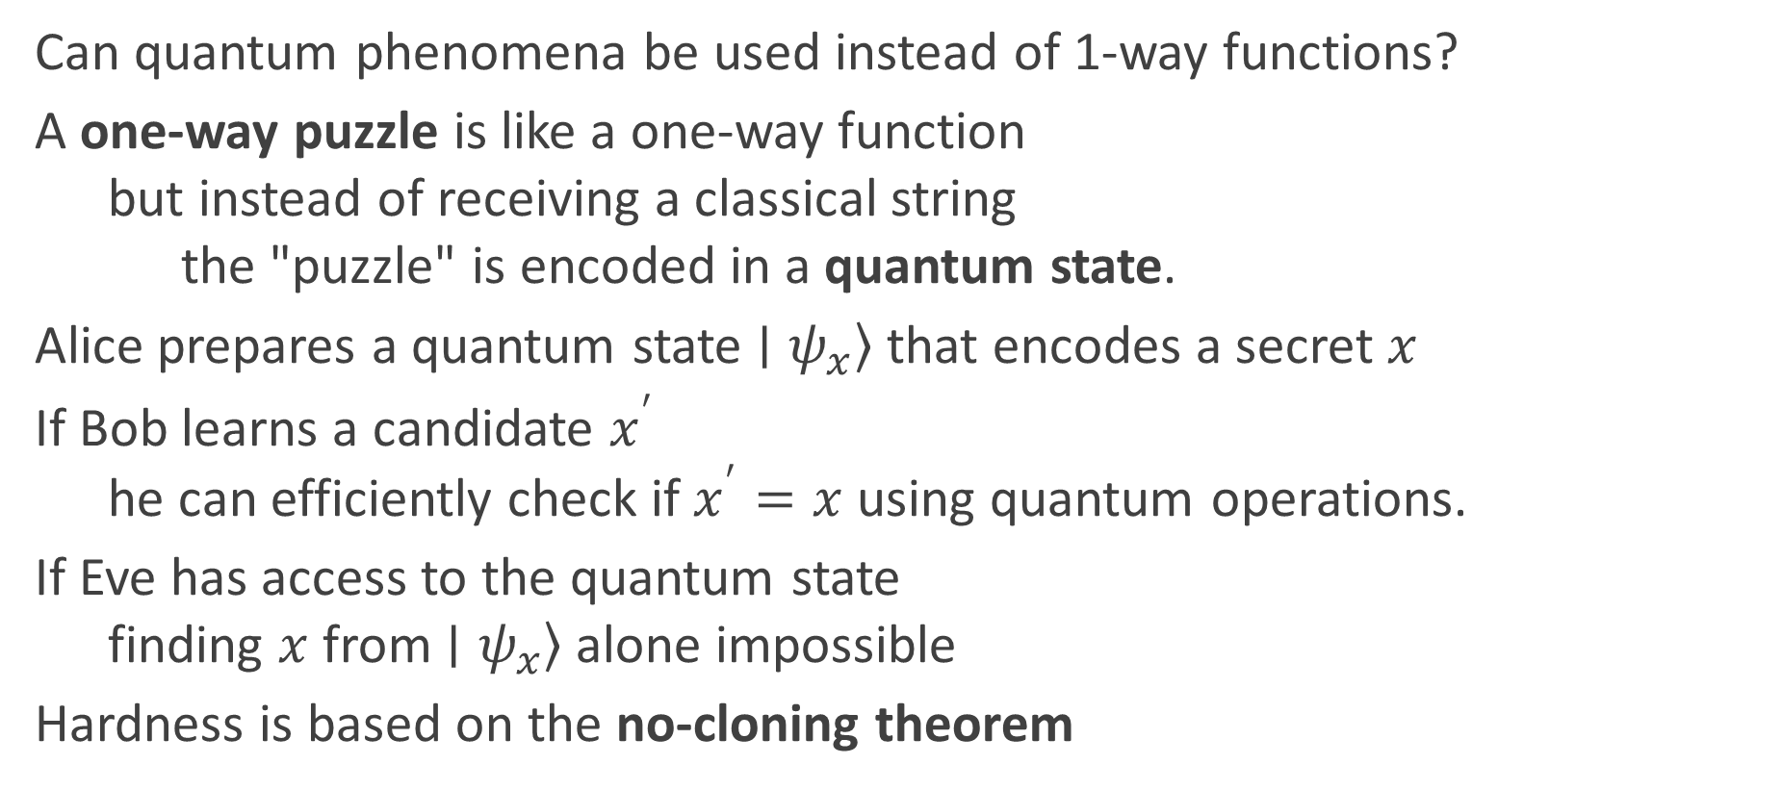
Future directions
Can quantum phenomena be used instead of 1-way functions?
A one-way puzzle is like a one-way function
but instead of receiving a classical string
the "puzzle" is encoded in a quantum state.
Alice prepares a quantum state $\left.∣ψ_{x}\right\rangle$that encodes a secret $x$
If Bob learns a candidate $x^{′}$
he can efficiently check if $x^{′}=x$ using quantum operations.
If Eve has access to the quantum state
finding $x$from $\left.∣ψ_{x}\right\rangle$ alone impossible
Hardness is based on the no-cloning theorem

Slide 38
Take-aways
For now, there aren’t any CRQCs
but we don’t know (if and) when there will be
CRQCs break conventional key exchange and digital signature algorithms
but not symmetric encryption (like AES)
There are two ways to mitigate this break : QKD and PQC
QKD is expensive and hard to do right
PQC is cheap but has large overhead and may yet be broken
For now, hybrid PQC/traditional key exchange methods are recommended

Slide 39
