Slide 1
Optical Transport Network
OTN
Yaakov Stein
CTO

Slide 2
OTN
In the beginning there was the DS0
a 64 kbps serial bit stream
Multiple (24 or 32) DS0s could be synchronously combined to form TDM – T1 or E1
at up to 2 Mbps
Multiple TDM streams could be combined plesiochronously to form PDH
with rates up to 45 Mbps (defined up to T4 at 275 Mbps)
Multiple PDH streams could be synchronously combined to form SDH (SONET)
with rates up to 10 Gbps (defined up to STM256 at 40 Gbps)
For higher rates over fiber Optical Transport Network technology was developed
and it can transport SDH and Ethernet signals
with rates from 2.66G to 420G (and higher rates too!)

Slide 3
This is only a short introduction
OTN is a rich ecosystem, and can not be fully covered in this short introduction
We will concentrate on :
OTN equipment types
capabilities
traditional rates and frame formats
We will only mention :
GMPLS management
physical layer optics
synchronization aspects
newer rates and features

Slide 4
Where to look for more information?
v1
v2
v3
G.709 Interfaces for the optical transport network (note that there are 2001, 2003, 2009, 2012, 2016, 2020 editions)
G.709.1 Flexible OTN short-reach interfaces
G.709.2 OTU4 long-reach interface
G.709.3 Flexible OTN long-reach interfaces
G.709.4 OTU25 and OTU50 short-reach interfaces
G.7041 Generic framing procedure
G.872 Architecture of optical transport networks
G.873.1 Optical transport network: Linear protection
G.873.2 ODUk shared ring protection
G.873.3 Optical transport network - Shared mesh protection
G.874 Management aspects of optical transport network elements
G.875 Optical transport network: Protocol-neutral management information model for the network element view
G.959.1 Optical transport network physical layer interfaces
G.975 Forward error correction
G.7044 Hitless adjustment of ODUflex(GFP)
G.7702 Architecture for SDN control of transport networks
G.8251 The control of jitter and wander within the optical transport network (OTN)

Slide 5
Why replace SDH?
SONET and SDH were originally developed for voice services
and don’t elegantly handle Ethernet and other modern services
GFP was introduced to partially solve this problem
SONET and SDH have constant frame rates (8000 fps)
and so their frame sizes become unwieldly at high data rates
hence so SDH maxes out at 40G (OC768) [or OC1920 (100G)]
SONET/SDH do not efficiently pack client signals
SONET/SDH do not provide a standardized Forward Error Correction scheme
and thus require many 3R (Reamplify, Reshape, Retime) regenerators
SONET/SDH do not integrally support WDM or ROADMs
SONET/SDH do not provide sufficient Tandem Connection Monitoring

Slide 6
OTN transponders
OTN was originally a point-to-point protocol
designed just to facilitate transparent wrapping of all clients (including λ services)
The OTN device that maps a client into the optical domain is called an transponder
Transparency means any client protocol can be transported with guaranteed bit rate
without any payload format modification
or timing degradation (OTN does not enforce its own clock!)
OTN adds overhead for OAM - similar to SDH, but enhanced
and can support multiple service provider models
including service independent NNI for transiting the multiple domains
Hence OTN is now considered the standard high-speed optical transport handoff format

Slide 7
OTN muxponders
But OTN is no longer just about wrapping a single client signal
In addition to assigning different clients to different wavelengths (WDM)
OTN can multiplex multiple clients on a single wavelength
For example, a single 10Gbps OTU2 or 40Gbps OTU3 can simultaneously carry multiple
  2.5Gbps OC-48, 10Gbps OC192
  1Gbps/10Gbps Ethernet
  1, 2, 4, 8 Gbps Fiber Channel signals
An OTN transponder that can mux different signals is called a muxponder
OTN muxponders are extremely popular
because grooming multiple low-rate signals onto a single high-rate wavelength
reduces the number of required wavelengths
thus shrinking cost, power, rack space, and management overhead

Slide 8
Partial OTN muxponder hierarchy
100G Ethernet
OPU4
ODU4
OTU4
100G OC1920
*2
40G Ethernet
*80
OPU3
ODU3
OTU3
40G OC768
*10
*40
*4
_{*32}
10G Ethernet
_{*16}
OPU2(e)
ODU2(e)
OTU2(e)
10G OC192
*4
*8
2.5G OC-48
OPU1
ODU1
OTU1
*2
1G Ethernet
OPU0
ODU0
and continue recursively!
arbitrary rate
CPRI, Eth, MPLS, ...
OPUflex2
ODUflex2

Slide 9
OTN switches
Muxponders are great for point-to-point connections
but building OTN networks requires placing them back to back
and manually stitching them together with fibers
This approach does not scale well to large OTN networks
and is certainly not optimal for dynamic networks
An OTN cross-connect contains a central switching fabric
that electrically combines and separates ODUks
mapping and remapping client signals from one interface to another

Slide 10
OTN + ROADM
A Reconfigurable Optical Add/Drop Multiplexer
switches optical signals potentially changing wavelength
and is completely programmable (via GMPLS)
ROADMs are the building blocks of the Wavelength Switched Optical Network
But a ROADM only switches wavelengths
and cannot switch, add, or drop, clients muxed in that wavelength
Thus, ROADMs by themselves can’t efficiently exploit wavelengths
A combined OTN muxponder + ROADM solves all problems
allowing optimal routing of even low-rate clients over complex optical networks

Slide 11
GMPLS (RFC 3945)
Generalized Multi-Protocol Label Switching (GMPLS)
is a control protocol suite based on :
RSVP-TE RFC 3209
OSPF-TE routing protocol RFC 4203
Link Management Protocol (LMP) RFC 4204
GMPLS extends MPLS switching to other cases
such as TDM, wavelength and fiber switching
GMPLS for the Wavelength Switched Optical Network (ROADMs)
uses the fiber number and lambda instead of an MPLS label
GMPLS for OTN (RFC 4328, 7062) uses the ODUk identifier

Slide 12
OTN alternatives
OTN may not be for everyone – so what are the alternatives?
SDH + ROADM
  GFP to convert packets into serial streams
  SDH low and high level cross connects for sub-wavelength switching
  ROADM for wavelength switching
  disadvantages: all the SDH drawbacks previously mentioned
MPLS + ROADM
  MPLS for all sub-wavelength multiplexing
  ROADM for wavelength switching
  optionally GMPLS control plane for both MPLS and ROADM
  optionally MPLS-TP for sub-wavelength OAM
  (note that Packet-OTN combines MPLS and OTN)
  disadvantages: MPLS switches is more expensive

Slide 13
G.8312 (G.mtn)
A brand new alternative is Metro Transport Network technology
targeted for 5G RAN transport (China Mobile)
and the Slicing Packet Network (slicing an Ethernet core)
promises high bandwidth, low latency, ultra-high-precision timing at low cost
runs over 50G, 100G, 200G, and 400G Ethernet
uses 802.3 64B/66B ordered set blocks for OAM
reuses FlexE calendaring and bonding technologies

Slide 14
Reminder SONET/SDH architecture
ADM
regenerator
ADM
Path
Termination
Line
Termination
Section
Termination
Line
Termination
Path
Termination
path
path section
line
line
line
multiplex section
section
section
section
section
regenerator section
SONET terms
SDH terms
SONET/SDH has at 3 layers:
path – end-to-end data connection, muxes tributary signals
  there are STS paths + Virtual Tributary (VT) paths
line – protected multiplexed SONET payload
section – physical link between adjacent elements
Each layer has its own overhead to support needed functionality

Slide 15
OTN hierarchy
OTN has more layers (only some are shown here)
Fiber Channel
CPRI
Infiniband, etc.
SDH
OTN
Ethernet
OPUk
OPU0, OPU1, OPU2, OPU2e, OPU3, OPU3e2, OPU4, ...
path
roughly comparable to:
line
ODUk
ODU0, ODU1, ODU2, OTU2e, ODU3, ODU3e2, ODU4, ODUflex, ...
digital
section
OTUk
OTU1, OTU2, OTU3, OTU4,
OUTC2, OTUC4, OTU25, OTU50
WDM
OCh
Optical Channel
OMS
Optical Multiplex Section
optical
OTS
Optical Transport Section

Slide 16
The (full functionality) optical layers
ODU
OCh
OMS
OMS
muxponder
ROADM
fiber
OLA
fiber
ROADM
fiber
OLA
fiber
ROADM
muxponder
OTS
OTS
OTS
OTS
Optical Transport Section functionality monitors optics between optical devices
including Optical Line Amplifiers (which are not full 3R)
Optical Multiplex Section functionality monitors connections between optical ADMs
Och transports signals between 3R regeneration points (NNIs) or transponders
ODU functionality monitors end to end client services

Slide 17
Multi-domain case
ODU
OCh
OCh
OMS
OMS
muxponder
ROADM
fiber
OLA
fiber
fiber
OLA
fiber
ROADM
muxponder
3R
OTS
OTS
OTS
OTS
The OCh layer does not terminate at plain optical amplifiers
only on full 3R regenerators

Slide 18
Reminder: STM-1 frame structure
270 columns
RSOH
Framing Alignment Signal (2B)
pointer OH
…
9 rows
MSOH
SOH
9 columns
Synchronous Payload Envelope
261 columns
Synchronous Transport Modules are the basic SDH structure
An STM-1 frame is 270 columns * 9 rows = 2430 bytes (STM-N has N times as many columns!)
There are always 8000 STM frames per second
so the basic STM-1 rate is 155.520 Mbps

Slide 19
Overall frame structure for OTUk (k=1,2,3,4)
4080 columns
Framing Alignment Signal (7B)
4 rows
Forward Error Correction (1024B)
16
columns
3808
columns
256
columns
The frame is 16,320 Bytes (130,560 bits) for all k (but different frame rates)
divided into 4 rows of 4080 columns
The first 16 columns contain various overhead fields, including the FAS
The last 256 columns contain Forward Error Correction
The middle 3808 columns (15,232 Bytes) are for payload

Slide 20
Note the magic
4080 columns? Where did that come from?
The numbers at first seem very strange – but are really very special!
In each row there are 16+3808 = 3824 overhead + payload columns
3824 = 16*239
so we can consider each row as 16 interleaved sub-rows of 239 bytes
A Reed Solomon RS(255,239) code
protects 239 data bytes by adding 255-239=16 FEC bytes
Altogether for 16 sub-rows we obtain 16*16=256 bits of FEC for each row
So with the FEC area we have 3824+256=4080 columns
But not all OTN frames have the FEC area!

Slide 21
OTUk rates
OTUk (k=1,2,3,4) frames have 130,560 bits
The different OTUk rates are due to different frame per second rates
Note that later versions of G.709 introduce
OTU2e at ≈11G and OTU3e2 at ≈44.6G
OTUk | frame duration (μsec) | frame rate (fps) | bit rate (Gbps)
OTU1 | 48.971 | 20,420.249 | 2.666
OTU2 | 12.191 | 82,027.725 | 10.710
OTU3 | 3.035 | 329,489.292 | 43.018
OTU4 | 1.168 | 856,387.668 | 111.810

Slide 22
Note the magic
OK, but where do the frame rates come from?
The OPU1 is defined to exactly hold the OC-48/STM-16 payload with no fixed stuffing
Since the OC-48 rate is 2488.32 Mbps
the payload of 3808 columns * 4 rows * 8 bit/Byte = 121,856 bits
requires 48.971 μsec which means 20,420 frames per second
which determines the frame rate for OTU1
The other OPUk have some fixed stuffing columns
For example, OPU2 carries a OC-192 /STM-64
but there are 16 columns (64 bytes) of fixed stuffing (columns 1905-1920)
leaving for payload only (3808-16) * 4 rows * 8 bit/Byte = 121,344 bits
which at the OC-192 rate of 9953.28 Mbps
requires 12.191 μsec

Slide 23
Summary of traditional rates
To summarize, the traditional rates in Mb/s
 | OPU | ODU | OTU
0 | 1,238.954 | 1,244.160
1 | 2,488.320 | 2,498.775 | 2,666.057
2 | 9,995.277 | 10,037.274 | 10,709.225
3 | 40,150.519 | 40,319.219 | 43,018.414
4 | 104,355.975 | 104,794.446 | 111,809.974

Slide 24
0?
Where did OPU0 and ODU0 come from?
The original G.709 did not support sub-2.5 Gbps (STM-16) client signals
and thus was not suitable for GbE clients
This meant that most end users needed to maintain their SDH equipment
OPU0 is designed to transparently transport GbE
but its rate was chosen so that 2 ODU0s map into an ODU1
This 1.239G OPU0 rate is not high enough for transparent Ethernet (1.25 Gbps + GFP overhead)
so a special Timing Transparent Transcoding mechanism is used
that translates 8B10B into 64B66B yielding about 1.18Gb/s
(this is actually too low for a standard AMP mapping, and thus a new mapping technique is used)

Slide 25
Some nonstandard (overclocked) rates
k | OPUk | ODUk | OTUk | client
1e | 10.312 | 10.355 | 11.049 | 10GbE
1f | 10.519 | 10.563 | 11.270 | 10GFC
2e | 10.356 | 10.399 | 11.096 | 10GbE
2f | 10.563 | 10.608 | 11.318 | 10GFC
3e1 | 41.600 | 41.774 | 44.571 | 4*ODU2e AMP
3e2 | 41.611 | 41.786 | 44.583 | 4*ODU2e GMP
Other rates have been invented for special cases (e for Ethernet, f for Fiber Channel)
1e, 1f, 2e, and 2f are overclocked OTN
i.e., transparently carry client but add OTN wrapper and FEC
(and thus have the client’s ±100 ppm frequency tolerance, instead of OTN’s ±20 ppm)

Slide 26
New rates
Newer versions of OTN (e.g., G.709-2020, G.709.x) introduce new rates
OTU25, OTU50
OTU25-RS, OTU-50-RS (short reach)
The B100G rates
OTUCn n*100G (C stands for 100), e.g.,
  OTUC2
  OTUC4
Note that the OTUCn
is built by bonding n instances of an OPUC1 (100G) signal
has all components traverse the same fibers and switches
to enable management as a single entity
is exclusively point-to-point (not digitally switched)
has no directly mapped clients

Slide 27
Frame structure for OTU25, OTU50, OTUCn
3824 columns
Framing Alignment Signal (7B)
4 rows
No Forward Error Correction
16
columns
3808
columns
The frame is 15,296 Bytes (122,368 bits)
divided into 4 rows of 3824 columns
It is identical to the OTUk frame
but without the 256 columns of FEC
(a stronger FEC is added elsewhere!)

Slide 28
Scrambling
OTN, like SDH and PDH, needs to recover the bit clock from the incoming signal
The normal frequency tolerance is ± 20 ppm
In order to ensure sufficient bit alternations
the entire OTUk frame except the first 7 bytes (the FAS) are bit scrambled
The scrambler is implemented by a 16-bit shift register
defined by the generating polynomial 1 + x + x³ + x¹² + x¹⁶
The shift register contents is reset to all ones every frame

Slide 29
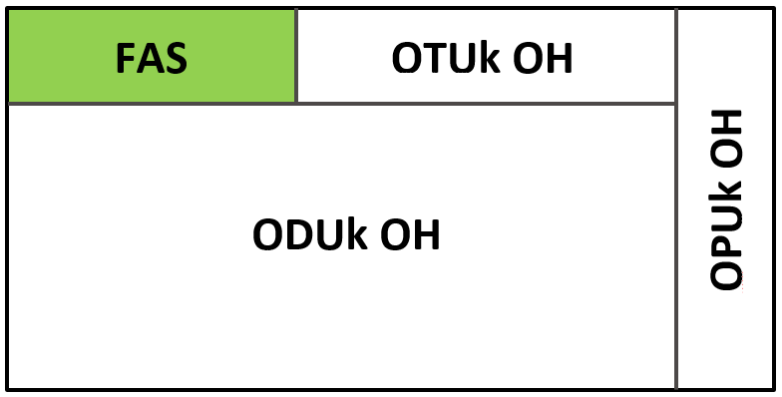
Overhead
The first 7 bytes of every OTN frame are the Frame Alignment Signal
F6 F6 F6 28 28 28 counter
where the counter cycles through 0-255, creating a 256-frame OTU multiframe
The rest of the first 16 columns are divided between OTU, ODU, and OPU overhead
1 row
3 rows
1
byte
14
columns
2
columns

Slide 30
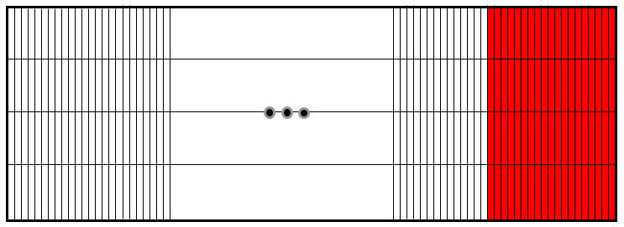
FEC
OTUk uses the G.975 RS(255,239) FEC
that adds 16 bytes to each 239 bytes it protects (6.7% overhead)
and can correct any 8 byte errors (and detect any 16 byte errors)
This gives 6.2 dB improvement in SNR
or allows extending reach with the same SNR
Assuming fiber loss of 0.5 dB per km this gives over 15 km more reach
Other FEC schemes (e.g., those of G.975.1) are explicitly allowed and widely used
SuperFEC RS(1023,1007) )/BCH(2047,1952) has 8.5 dB coding gain, but higher latency
Even stronger FECs require larger overhead (11% and higher)
OTU25-RS and OTU50-RS for short range 25G and 50G
use a lower overhead 10-bit RS(544,514) code (derived from IEEE 802.3 clause 108)
to save over 5% line rate and still correct 15 errors

Slide 31
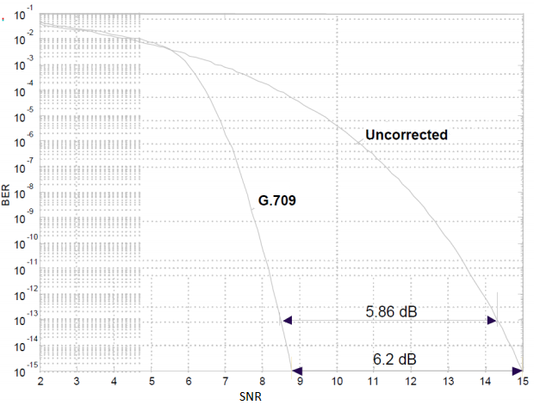
Performance of the standard G.709 FEC

Slide 32
Byte interleaving
Reed Solomon RS(n,k) codes can only correct (n-k)/2 symbol errors
but error bursts might be longer than this
So it is common practice to interleaving data before coding
so that the burst errors are shared among different code words
In OTUk the byte interleaving is simply performed for each row as follows
RS | 1st byte | 2nd byte | 3rd byte |  | 239th byte |  | 1st byte of RS | 16th byte of RS
1 | 1 | 17 | 33 | ... | 3809 |  | 3825 | 3840
2 | 2 | 18 | 34 | ... | 3810 |  | 3841 | 3856
3 | 3 | 19 | 35 | ... | 3811 |  | 3857 | 3872
4 | 4 | 20 | 36 | ... | 3812 |  | 3873 | 3888
5 | 5 | 21 | 37 | ... | 3813 |  | 3889 | 3904
6 | 6 | 22 | 38 | ... | 3814 |  | 3905 | 3920
7 | 7 | 23 | 39 | ... | 3815 |  | 3921 | 3936
8 | 8 | 24 | 40 | ... | 3816 |  | 3937 | 3952
9 | 9 | 25 | 41 | ... | 3817 |  | 3953 | 3968
10 | 10 | 26 | 42 | ... | 3818 |  | 3969 | 3984
11 | 11 | 27 | 43 | ... | 3819 |  | 3985 | 4000
12 | 12 | 28 | 44 | ... | 3820 |  | 4001 | 4016
13 | 13 | 29 | 45 | ... | 3821 |  | 4017 | 4032
14 | 14 | 30 | 46 | ... | 3822 |  | 4033 | 4048
15 | 15 | 31 | 47 | ... | 3823 |  | 4049 | 4064
16 | 16 | 32 | 48 | ... | 3824 |  | 4065 | 4080

Slide 33
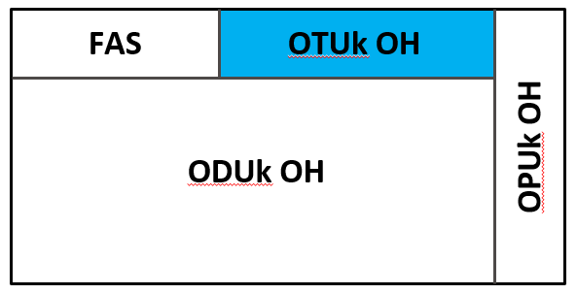
OTUk overhead
The OTUk overhead consists of 7 bytes per frame
(row 1 columns 8 through 14)
Section Monitoring (3 bytes)
  used for OTU layer OAM and contains
    Trail Trace Identifier (64 bytes, sent 4 times in every multiframe)
    BIP-8 parity check
    Backward Defect Indicator
    Backward Error counter (4 bits, based on BIP-8)
    Incoming Alignment Error indicator
General Communication Channel (2 bytes) called GCC0
  use not standardized
OTN Synchronization Message Channel 1 byte (see next slide)
RES 1 byte
SM
GCC0
OSMC
RES

Slide 34
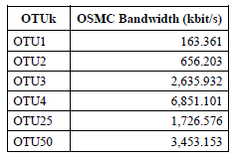
OSMC
OTN was not originally intended to transport client timing information
this being delegated to the client’s themselves
However, the latest version of OTN introduced 1 byte in the OTUk overhead
for the OTN Synchronization Message Channel
This capability is still optional
It transports (encapsulated in GFP)
Synchronization Status Messages
enhanced Synchronization Status Messages
1588
OF course 1 byte per frame is not really a lot of bandwidth

Slide 35
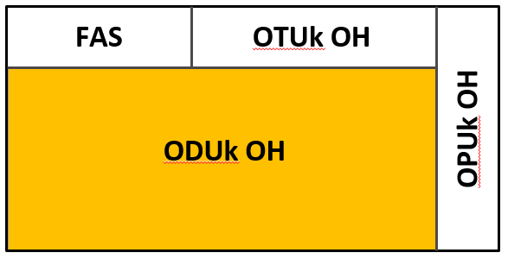
ODUk overhead
The ODUk overhead is 3 rows of 14 bytes = 42 bytes
and is used for monitoring the ODUk path
This monitoring includes many of the same elements
that are in the OTUk layer, but also
  Tandem Connection Monitoring
  Automatic Protection Switching
  fault localization
The format of the ODUk overhead is complex
and we will only specify the basic components

Slide 36
ODUk overhead
Trail Trace Identifier (64 bytes, sent 4 times in every multiframe)
BIP-8 parity check
Backward Defect Indicator
Backward Error counter (4 bits, based on BIP-8)
STATus (3 bits) to indicate presence of maintenance signals (LCK, OCI, AIS)
6 TCM fields TCM1, ... TCM6 (3 bytes each) each with TTI, BIP-8, BDI, BEI, and STAT
  TCM1 for users
  TCM2 for SP between UNIs
  TCM3-TCM6 for network operators
2 General Communications Channels (2 bytes each) called GCC1, GCC2
APS signaling channel (4 bytes)
Fault Type and Fault Location reporting channel (2 bytes / frame, 256 bytes / multiframe)
EXP (2 bytes) and RES (9 bytes)
LoCK, Open Connection Indication

Slide 37
Tandem Connection Monitoring
SDH monitors path, line, and section layers
but limits tandem connections (carrier’s carrier or peering)
where the end-to-end path bridges several carrier domains
Tandem connections require layers between the line and the path layers
SDH allows a single tandem layer
G.709 OTN allows 6 tandem layers
TCM1 belongs to the user to monitor end-to-end QoS
TCM2 belongs to the service provider to monitor end-to-end QoS between UNIs
TCM3, TCM4, TCM , and TCM6 are used by hierarchies of network operators
to monitor their segments in order to localize faults and performance degradations
TCM levels are analogous to the MEL in Y.1731

Slide 38
OPUk
The OPUk portion of the OTN frame contains
the payload bytes
fixed stuffing bytes (except for OPU1)
OPUk overhead in columns 15 and 16 (exact placement mapping dependent)
sometimes a positive justification byte in row 4 column 17

Slide 39
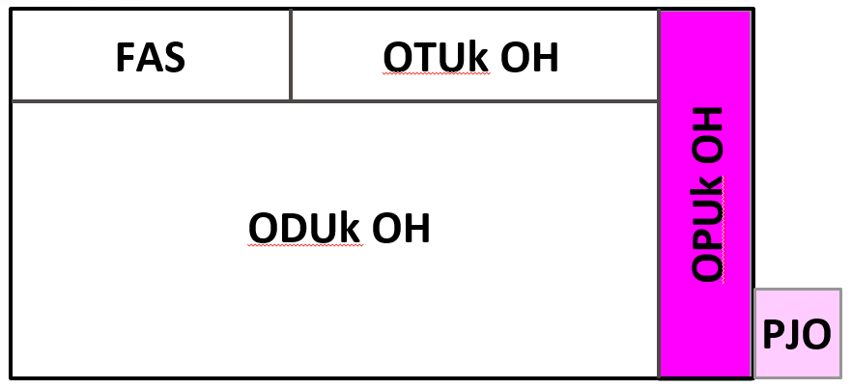
OPUk overhead
The OPUk overhead occupies columns 15 and 16
and thus contains 8 bytes
Payload Structure Identifier (1 byte/frame, 256 bytes/multiframe)
identifies mapping type (async CBR, sync CBR, GFP, etc.)
Maintenance signals (AIS, OCI, LCK, PMI)
Depending on OPU type and PSI
Justification Control bytes
Negative Justification Opportunity (1 byte per frame)
If positive justification is required then it takes the first payload byte in the 4th row
Payload Missing Indication

Slide 40
OTN timing
Unlike SDH, OTN transponders use free-running clocks
This allows different SDH tributaries to be transparently transported
each carrying its own clock
Hence OTN is actually an asynchronous network like Ethernet
When one OTN signal is mapped into another
their clocks are synchronized
When a client’s clocks is synchronized to the OTN’s
mapping it into the OPUk is simple
When it isn’t, compensation mechanisms are utilized
PDH-like byte justification
Ethernet-like idle insertion between frames

Slide 41
Mappings
Transporting any client service requires mapping the client signal into the OPUk
OTN defines three kinds of mapping for non-OTN clients
Bit synchronous Mapping Procedure (TDM-like)
requires client to be phase synchronized to OTN
rate differences may be compensated using fixed stuffing
Asynchronous Mapping Procedure (PDH-like)
  requires client rate to be within ± 65 ppm of OPUk rate (higher or lower)
  and uses negative/positive justification
Generic Mapping Procedure (in newer versions of OTN)
client rate must be less than or equal to OPUk rate (frequency ± 100 ppm)
a new algorithm is used to distribute data and variable stuffing
Fixed stuffing of BMP mandates a small jitter buffer, AMP and GMP demappings add jitter

Slide 42
Example mapping types
The new G.709 standard informs us how to best map clients into OTN
For example:
STM1/4 are mapped into OPU0 using GMP
STM16/64/256 are mapped into OPU1/2/3 with 0/16/32 columns of fixed stuffing using
  BMP if clocks synchronized
  AMP if not synchronized
10GbE is mapped into OPU2e using BMP with 16 columns of fixed stuffing
40GbE is mapped into OPU3 using GMP
100GbE is mapped into OPU4 using GMP

Slide 43
Mapping principles
With BMP client bits (not necessarily byte aligned)
are directly mapped into OPUk bytes, skipping the fixed stuffing areas
With AMP
if the client rate is faster than the OPUk rate then the buffer starts filling up
and negative justification is used to prevent buffer overflow
that is, an extra byte is pulled from the buffer and placed in the OPUk overhead
if the client rate is slower than the OPUk rate then the buffer starts emptying out
and positive justification is used to prevent buffer depletion
that is, a byte of the payload is not filled
With GMP an algorithm determines if a given OPUk payload byte contains data or stuffing
in order to reduce jitter
...

Slide 44
ODUflex
Up to now we have seen how to map well-known signals
such as STM-16/64/256, 1/10/100 GbE, and lower ODUk to higher ODUk
Rather than build special ODU formats for every signal
the new OTN standard defines ODUflex as an ODU with flexible rate
It comes in several flavors:
ODUflex(CBR) for constant bit rate services (e.g., video, Fiber Channel, InfiniBand)
with ODU rate 239/238 of the client rate
ODUflex(GFP) for packet services
    using GFP to convert packets into serial streams
    ODUflex(IMP) [Idle-insertion Mapping Procedure] for B100G rates
    maps stream of 64B/66B symbols into OPUCn
    non-Ethernet packets need to be encapsulated in Ethernet first

Slide 45
Arbitrary CBR clients
We saw that many nonstandard rates have been defined for CBR clients
but it is cumbersome to specify a new encapsulation for every special case
New versions of G.709 define a more generic method
CBR clients with rate less than 1.244G are mapped into ODU0 using GMP
CBR clients between 1.244G and 2.488G are mapped into ODU1 using GMP
CBR clients with rate greater than 2.488G use ODUflex(CBR)
ODUflex(CBR) uses BMP mapping
every payload byte holds 8 bits of client data
fixed stuffing is used to match rates
the OPUflex rate is exactly the client rate
the ODUflex rate is exactly equal to 239/238 times the client rate (like ODU1)

Slide 46
ODUflex GFP
GFP is defined by the ITU for SDH (and PDH)
and converts a flow of packets into a CBR bit stream
ODUflex(GFP) is used to map arbitrary rate Ethernet or MPLS packet flows to OTN
ODUflex (GFP) rates are integer multiples of the ODU0 rate (1.244Gbit/s)
ODUflex(GFP) works as follows:
an integer number of ODU0s are allocated to obtain a rate equal or higher than needed
these ODU0s are mapped into the required higher rate ODUk (k = 1,2,2e,3,3e2,4)
the packet stream is mapped by GFP into the fixed rate ODUk

Slide 47
Hitless Adjustment of ODUflex
The ODUflex(GFP) rate is chosen when the ODU0s are allocated
However, it is possible to dynamically change the rate of an ODUflex (GFP)
as the traffic rate increases or decreases
similar to the LCAS protocol for VCAT SDH/PDH
G.7044 defines Hitless Adjustment of ODUflex (HAO) [invented by Ciena]
that allows increasing/decreasing ODUflex (GFP) rates
HAO involves 2 protocols
Link Connection Resize (LCR) – updating the number of ODU0s
BandWidth Resize (BWR) – change the data rate of the path
In order for the change to be hitless
for increase: LCR happens before BWR
for decrease: BWR happens before LCR

Slide 48
B100G
We have mentioned Beyond 100G features several times
The B100G effort was required since DWDM with 50 GHz lambda spacing
can not transport in excess of 100G rates for required distances
due to Shannon capacity theorem limits
This limitation leads inexorably to
multi-lane solutions
removing the FEC from the frame structure and using a FEC per interface
using a larger basic size (5G like FlexE instead of 1.25G)
The basic OTUC rate was designed based on 2 requirements:
OPUC1 must be capable of carrying an ODU4
OPUC4 must be capable of carrying a 400GbE
which led to an OPUC1 rate of about 104.818 Gb/s
and an ODUC1 rate of about 105.258 Gb/s

Slide 49
ODUflex(IMP)
A new ODUflex mode was created for B100G OTN
based on a new Idle Mapping Procedure (IMP)
ODUflex(IMP) carries L1 Ethernet with rate 10G and above
all other protocols (e.g., MPLS) must first be encapsulated in Ethernet
ODUflex(IMP) transports the CBR stream of 64B/66B symbols
the OPU rate must be higher than the Ethernet rate,
Timing adjustment is realized by inserting 64B/66B Idle characters
between Ethernet frames (increasing the IFG)
Hence the ODUflex(IMP) mapper and demapper
must be aware of the packet boundaries
although they don’t process L2 MAC packets

Slide 50
FlexO
FlexO provides a flexible way of supporting different rates for B100G
and is specified in G.709.1 for short-reach OTN interfaces
FlexO was inspired by FlexE, and reuses many 100G Ethernet features
  lane architecture (including lane alignment markers and distribution of data over lanes)
  10 bit RS(544,514) FEC
FlexO implements an OTUCn for any value of n (not just n = 2 or 4)
by bonding together n 100GbE/OTU4 optical signals
(and in the future 200G and 400G signals will be used)
each OTUCn is mapped into n FlexO signals, each containing an OTUC instance
a RS(544,514) FEC is used

Slide 51
Thanks for your attention

