Slide 1

Life (cycle) Assurance from vCPE
Yaakov (J) Stein
CTO

Slide 2
Advanced communications services
Once communications services were pure connectivity services, defined by :
endpoints
bandwidth (or equivalent)
delay (and possibly delay variation)
priorities, access permissions, etc.
Today, communications services have non-trivial network functionalities, e.g.,
firewall, IDS
authentication, integrity, encryption
performance acceleration,
caching, CDN
performance monitoring, application visibility
This talk discusses such constructs in a service theoretic context

Slide 3

Services
What is a service ?
In economics a commodity is a marketable good, i.e., an item
that provides utility
that someone wishes to sell
that someone else wishes to buy
Historically commodities were classified as either products or services
In order to provide communications we need both
products (e.g., switches, routers, middleboxes, transceivers, etc.)
and
services (e.g., telephone/cellular, VPN, Internet access, etc.)
We call entities that sell products communications equipment vendors
and those who sell services communications service providers
We call entities that buy products customers or consumers
and those who buy services users or subscribers

Slide 4
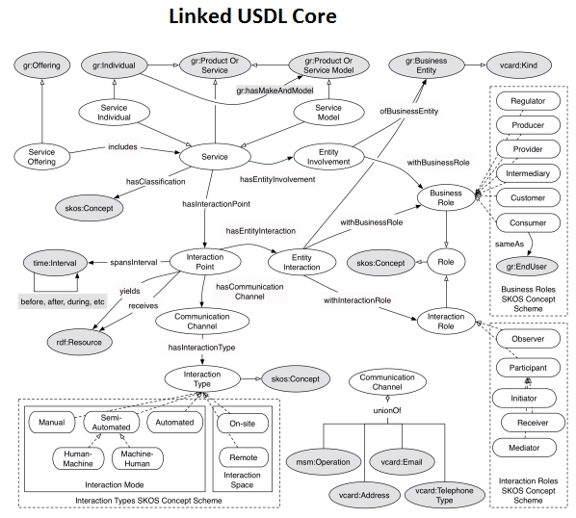
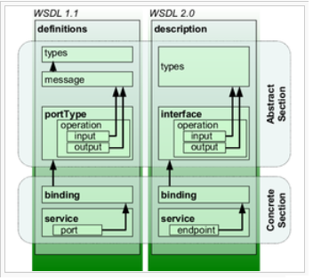
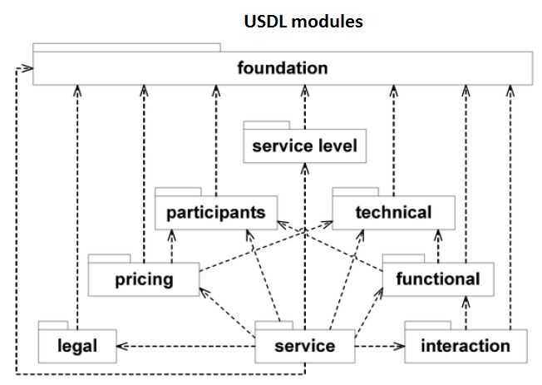
Service description
Products may be formally described, e.g., in brochures and datasheets
but importantly potential customers can see and feel products
Formal description is more important for services
since they can’t be seen
and it is not always practical to try out a service before ordering
Formal languages, such as
Web Services Description Language (W3C)
Unified Service Description Language (W3C, Theseus-Texo, SAP)
Linked UDSL (W3C, KMI, SAP)
are advantageous for many service types
and enable delivery and trading of services over the Internet

Slide 5
Multi-provider services
Often no single service provider can deliver the entire service
In such cases service providers form partnerships
For example, international mail requires multiple postal services
In telecommunications we often speak of an end-to-end service
provided by multiple service providers
This can be accomplished in two distinct fashions
One service provider is the lead service provider, who :
takes responsibility for the end-to-end service
interfaces with the customer (service monitoring, billing, customer support)
contracts out portions of the service to other service providers
The customer deals directly with multiple service providers

Slide 6
The product–service spectrum
It was once popular to emphasize the dichotomy
between products (such as routers) and services (such as a VPN)
Selling a tangible product was mostly a prompt one-time event
On the other hand, delivering a service involves a life-cycle
negotiating service terms
service planning, creation, provisioning, testing
service monitoring, assurance and customer support
billing
service termination
The period from initial request to service fulfillment could take weeks
Today the distinction between a product and a service has blurred
and economists talk about a product-service spectrum
Services often require deployment of products
and product delivery generally involves service delivery

Slide 7
Consequences of product-service blurring
With the blurring of the product/service distinction
customers start expecting service attributes to be similar to product ones
Customers expect :
service description to be as understandable as a product name
if it did everything I wanted last time, it should this time
service delivery to be as fast as product delivery
click a button and instantly receive service
service reliability to be similar to product quality
perfect out-of-the-box, or return it
Unfortunately, these expectations are hard to meet with present technologies
In fact they are largely contradictory
advanced services require longer commissioning times
fast set-up may lead to low reliability or performance
simple services are usually more reliable than complex ones

Slide 8

Slow service delivery paradox
Let’s consider service delivery (fulfilment) times
There seems to be an paradox :
customers want instant gratification
Service Providers desire faster order-to-cash cycles
If both sides want speedy delivery
why is new service delivery still slow ?
The paradox can not be explained away by physical constraints
since even services without installation (truck rolls) requirements
are characterized by slow delivery
This paradox has recently become painfully evident
as software products are now quickly developed
while new communications service types take months or years to deploy

Slide 9

Poor service in general
There are basically 4 reasons for poor service
all of which derive from the very nature of services
(in contradistinction to products)
services are intangible
services are abstract
services are nonexclusive
services are commitments

Slide 10
Services are intangible
Due to intangibility :
Services can not be manufactured and stored
they must be created on-demand one-at-a-time
Services tend to have many free parameters
there may be 5 kinds of coffee available in a café
but even a simple existing communications service template
can have 5 fields each with >10 values each
new service types require description of completely new constructs
Intangibility translates into lengthy set-up times, since :
service parameters must be negotiated between customer and service provider
service parameters must be translated into technical parameters
technical parameters feed complex optimization procedures (planning)
the network then needs to be configured accordingly
the configuration must be meticulously tested

Slide 11
Services are abstract
Due to abstractness :
Services can be implemented in many different ways
the only restriction being physical localities
Variant implementations needs to be considered
some sort of optimization carried out
Different vendors usually have slightly different implementations
and even different equipment from the same vendor
may have different characteristics (CLI, state database, etc.)
Abstractness translates into lengthy set-up/modification and erratic service :
scripts need to be written and maintained for all equipment types
functionalities may not be available where needed
functionality idiosyncrasies vary
functionalities can not be readily migrated between equipment types

Slide 12
Services are nonexclusive
Once a product is delivered to a customer, no other customer can use it
but services share common infrastructures
and frequently compete for collectively exhaustive resources
Due to non-exclusivity :
mutual interference needs to be carefully handled
so as not to impair existing services
and enable new services to conform to guarantees
services need exhaustive joint activation testing
Non-exclusivity translates into lengthy set-up/modification and erratic service :
existing service loads need to be tracked
new services need to be verified and resource optimized
momentary load peaks can cause nonconformance and information loss
services are often prioritized (differentiated) rather than guaranteed
network failures can lead to resource starvation of fully protected services

Slide 13
Services are commitments
Unlike products which are delivered in one-time events
services create obligations over protracted periods of time
For this reason
customers and providers negotiate binding Service Level Agreements that
define Quality of Service KPIs that need to be monitored and maintained
customers pay according to SLA level (paying for QoS)
service providers incur penalties for SLA nonconformance
Before service delivery a service provider needs to ensure
that conformance is not only possible, but economically feasible
Thus, lengthy service activation testing is performed
ITU-T M.2110 mandates 15 minutes, 2 hours or 24 hours of testing
Y.1564 recommends
2 hour test duration for single provider services
24 hour test duration for multiple provider services
In addition, OAM must be continually run
in order to monitor SLA commitments throughout the service life-cycle

Slide 14

Living on the fast track
Migration to orchestrated SDN/NFV networks
requires rethinking of existing procedures
which in many cases can be made faster and more efficient
For example, why do we need to run activation testing for 2 or 24 hours ?
The main reason is to be 100% sure
that the planned service has been correctly implemented
that all the various equipment is correctly configured
These are not self-evident, because real networks
are composed of a bewildering variety of equipment from different vendors
change over time (in topology, in customer loads)
Were there to be full equipment uniformity and full network omniscience
service providers could rely on proper implementation and configuration
and activation testing could be reduced to a quick go/no-go sanity check

Slide 15
SDN service assistance
It is now clear how Software Defined Networking
can assist in fulfillment of advanced communications services
SDN-based networks
maintain a central omniscient controller with a global view
homogenize equipment to uniform whiteboxes (in pure SDN models)
harmonize heterogeneous equipment (in overlay SDN models)
reduce the need for lengthy activation testing
replace complex idiosyncratic protocols and configuration languages
with well-defined interfaces (e.g., OpenFlow)

Slide 16
SDN services are more like products
Thus, SDN-enabled networks
can support fast delivery of template services, due to
minimizing activation testing
regularizing configuration
can support fast definition of completely new service topologies
can reduce SLA non-conformance by
explicitly handling resource sharing (from omniscient controller)
eliminating forwarding functionality idiosyncrasies
reduce negative provider-user interaction, by
accelerating deployment and service modification
minimizing idiosyncratic behavior
So SDN-based communications services seem more like products

Slide 17
NFV service assistance
It is now clear how Network Function Virtualization
can assist in fulfillment of advanced communications services
NFV-enabled networks
accelerate development of new service functionalities
enabling rapid deployment of completely new service type
deploy the same functionality no matter where function is placed
combine multiple functionalities on a single platform
enable smooth functionality migration
for example, a firewall function can be
single-tenant at customer premises or multi-tenant at PoP
but run the same software and retain the same rule-base
Virtual Network Functions can also be deployed to
monitor performance or provide application visibility
enhance security functionality

Slide 18
NFV services are more like products
Thus, NFV-enabled networks
can support fast delivery of new service types, due to
developing service in pure software
deploying service on COTS hardware
can reduce negative provider-user interaction by
simplifying service description
minimizing idiosyncratic behavior
can reduce service charges because of
reduction in equipment CAPEX
reduction in provider OPEX
So NFV-enabled communications services seem more like products

Slide 19

vCPE
SDN and NFV are communications service facilitators
The virtualized CPE is a communications product is a key enabler
for SDN and NFV operation and thus for the new generation of flexible life-cycle management
The vCPE is composed of two components :
the physical product situated at the customer location
that both provides physical demarcation
and hosts arbitrary Virtual Network Functions
the virtual functionalities that can be situated where-ever most suitable
and provides all the needed networking functions
Having a component close to the user
anchors the SDN service assistance
and means that end-to-end QoS can be reliably monitored and assured
Virtualization of the functionalities
instantiates the NFV service assistance
and means that new services can be deployed at the speed of software

Slide 20
The vCPE is the product
The vCPE :
provides the user with access to the advanced communications service
monitors and assures that service
enables the SDN control of the service
implements the user sensitive part of the NFV functionalities
Being tangible, and exclusive to the customer
from the user’s point of view
the vCPE is the communications product
just as the residential WiFi router is the Internet product

Slide 21
Wrap-up
Although the distinction between products and services has become blurred
there is still a disconnect between communications products and services
Products services are
developed quickly slowly
delivered quickly slowly
require no further lasting interactions
between vendor provider and customer user
Most service quality failures result from fundamental characteristics of services
services are intangible, abstract, nonexclusive, commitments
SDN and NFV make services seem more like products
The vCPE provides access and anchors SDN and NFV
and from the user point of view is the communications product

Slide 22
Yaakov (J) Stein
CTO
Yaakov_S@RAD.com

