Slide 1
Introduction to 5G
Yaakov (J) Stein
CTO

Slide 2
Agenda
Generations of cellular technologies
5G? Why?
5G goals
NR air interface
RAN and Functional splits
5G NG core
Network slicing
Timing
RAD directions

Slide 3
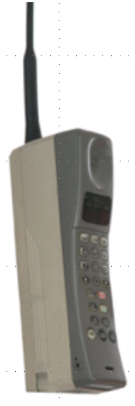



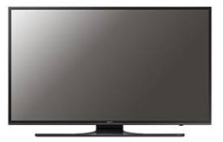
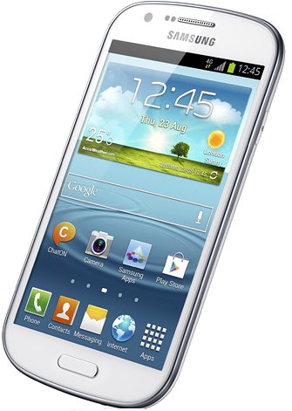


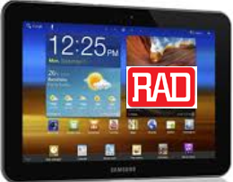
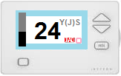
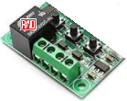
Generations of cellular technologies
 | 1G | 2G | 3G | 4G | 5G
3GPP releases |  |  | 4 - 7 | 8-9, 10-14 | 15, 16
era | 1980s | 1990s | 2000s | 2010s | 2020s
services | analog voice | digital voice messages | WB voice packet data | voice, video Internet, apps | everything
devices
data rate | 0 | 100 kbps (GPRS) | 10 Mbps (HSPA) | 100+ Mbps (LTE/LTE-A) | 10 Gbps (NR)
delay |  | 500 ms | 100 ms | 10s ms | 5 ms
Notes:
5G is not about “phones” – that’s so old fashioned!
Everything is going to be connected all the time!

Slide 4
What’s wrong with 4G?
4G made possible:
fast Internet access
video reception and creation
apps relying on location and identity
always-on behavior
but suffers from numerous limitations:
for some applications: data-rate too low
for some applications: delay too high
too few simultaneous connections (insufficient density)
coverage too low / drop rate too high
weak (if any) QoS guarantees
price per bit too high (inefficient spectral use)
power consumption too high (and thus battery life too low)
poor support for new applications/markets (e.g., IoT, AR/VR, connected cars)
no support for new mobility requirements (mobile hot spots, high speed)
insufficient security/privacy
5G is being developed to address 4G limitations
Notes:
data rate too low for immersive VR/AR, multiple HDTV, ..
delay too high for gaming, distributed orchestra, some IoT, ...
simultaneous connections – IoT!
high speed – trains, LEO satellites

Slide 5
5G importance
5G will enable entirely new market segments
ubiquitous wireless broadband (eMBB)
Wireless-to-the-Premises
broadband on high-speed trains, at events and in crowds
massive IoT (20 B IoT devices connected by 2020)
V2X (vehicle to vehicle, vehicle to infrastructure)
Virtual Reality / Augmented Reality
A study led by Qualcomm finds that by 2035
$3.5 trillion in 5G direct yearly revenues
$12.3 trillion worth of goods and services will be enabled by 5G
22 million jobs will be attributable to 5G
5G will boost global GDP growth by $3 trillion (compared to 2020)
about the GDP of India
Notes:
lead-in: So what? Isn’t 4G good enough?
But – 5G won’t arrive due to use cases, only due to business case!

Slide 6
5G is coming fast!
You may think that 5G is futuristic, but it is coming fast
In June 2016, 3GPP accelerated the standardization work-plan
5G phase 1 (release 15) finished by June 2018 for trials in 2019
5G phase 2 (release 16) finished by March 2020
and SPs/vendors are not even waiting for 2019!
AT&T (Ericsson, Samsung, Nokia, Intel) are in trials in 5 cities
and hope to roll out nationwide by late 2018
Verizon (Nokia, Ericsson) conducting WTTP trials (10G connectivity!)
Telus (Huawei) demoed Wireless-to-the-Premises with Huawei
Orange (Ericsson) announced testing of selected use cases
Softbank and China Mobile installing thousands of massive MIMO towers
NTT DOCOMO (Ericsson, Intel) trial environment in central Tokyo
KT promised 5G coverage along Highway 50 ahead of 2018 Olympic games
AirtelBSE, Vodafone India, Reliance Jio (ZTE) have conducted trials
You’ll see 5G in 2019 for sure Qualcomm CEO Steve Mollenkopf
Notes:
Release 15 uses NR in both sub-6 GHz and mmW bands.
It includes Non-Standalone 5G NR which adds NR
but utilizes LTE EPC in order to enable certain 5G use cases starting in 2019.
Full 5G core will arrive in 2020 and afterwards.
These are select 2017 trials – many more have been publicized since.

Slide 7
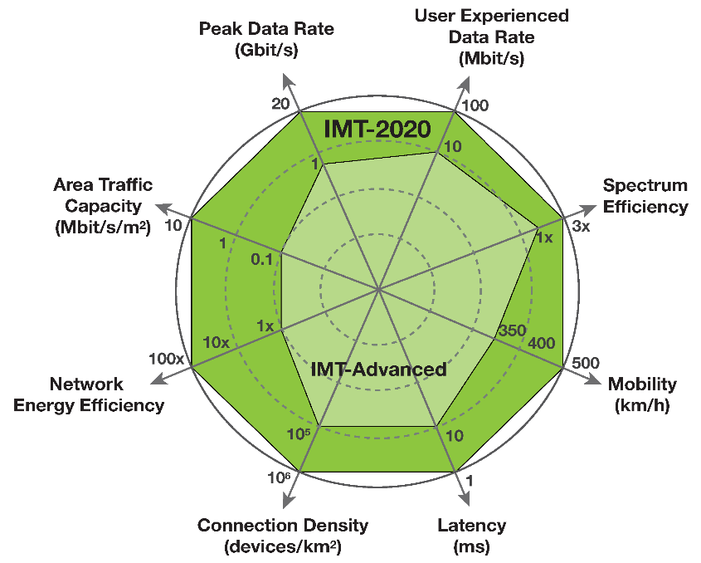
IMT-2020 goals
The ITU is defining performance targets for 5G
that are 10 to 100 times more than 4G* :
Peak data rate (20 Gbps/device)
User experienced data rate (100 Mbps)
Latency (1 ms)
Mobility (500 km/h and seamless transfer)
Connection density (10⁶ devices/km²)
Energy efficiency (1/100 Joule/bit for both air interface and network)
Spectrum efficiency (3 times the bps/Hz of LTE-A)
Area traffic capacity (10 Mbps/m²)
However, it is not possible to attain all of these at the same time
so 5G recognizes usage scenarios
and includes mechanisms to separate traffic types (slicing)
* ITU-R M.2083-0
Notes:
actually some goals are 1000* the presently available
distance UE-BS is a non-goal, so 5G is urban-directed
(but projects such as OneWeb envision 5G-compatible LEO satellites for universal coverage)
latency is for V2x, AR/VR, and some IoT
energy efficiency may be reduced to 1 pJ/bit
500 km/h is for high-speed trains
connection density is for IoT and sensor networks
area traffic is separate from density since IoT are usually low rate

Slide 8



5G changes all cellular segments
FDMA, TDMA, CDMA, NR
Radio Access Network
(backhauling)
GRAN, GERAN, UTRAN, E-UTRAN,
NextGen (R)AN
Air Interface
User Equipment
Base Station
BTS, NB, eNB, gNB
core network
NSS, UMTS core, EPC, NGCN
Multiple 4G/5G co-existence options have been proposed
Standalone (e.g., eNB-EPC and gNB-NGCN)
Non-Standalone (gNB-LTE-EPC, gNB-EPC, eNB-NR, eNB-NGCN, ...)
Initial 5G will be Non-Standalone gNB connecting to LTE RAN and EPC
Notes:
In order to explain the differences between 4G and 5G need to understand the architecture
NextGen Core Network
Did not show interfaces – 4G’s S1 and X2 will be replaced by new interfaces

Slide 9
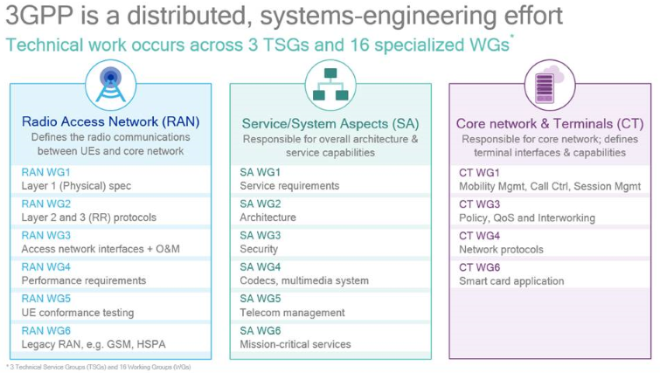
3GPP organization

Slide 10
Some important 3GPP documents
consult http://www.3gpp.org/specifications/specification-numbering
NR
38.101-1 Range 1 (< 6GHz) spectrum
38.101-2 Range 2 (> 6GHz) spectrum
38.201 Physical layer; General description
38.202 Services provided by the physical layer
38.211 Physical channels and modulation
38.212 Multiplexing and channel coding
38.213 Physical layer procedures for control
38.214 Physical layer procedures for data
38.215 Physical layer measurements
38.801 Report (including migration options)
38.806 Functional splits report
38.816 Lower layer split
Requirements
22.261 General
22.861 IoT
22.862 Critical communications
22.863 eMBB
22.886 V2V
38.913 Access Technologies
Architecture
23.799 Study
23.501 System Architecture
23.502 System Flows
Security
33.899 Study
33.501 normative doc

Slide 11
Upgrading the air interface
How can we improve the radio link from the gNb to UE ?
more efficient modulation (New Radio)
wider spectral bands (100 Mhz, 1GHz), which requires
new RF bands (sub-1GHz, 24/28 GHz mmWave, 30-90GHz ?)
use of licensed/unlicensed unshared/shared spectrum
higher cell density (i.e., many more antennas)
small cells
HetNets
massive MIMO
massive is defined as 16 or more antennas (4-by-4 array)
5G envisages up to 256 antennas
LTE: 4UL/8DL 802.11n: 4, 802.11ac: 8
in LTE’s CoMP UE connects to multiple cells to reduce intercell interference
< 6 GHz use multipath for spatial mux and multiuser MIMO
> 6 GHz use coherent beamforming (i.e., personal cells)
Notes:
Remember Shannon C  BW
Previous generation networks operated in licensed spectrum bands below 3 GHz
5G defines low-bands below 1 GHz, mid-bands 1-6 GHz, high-bands above 24 GHz (mmW)
>24G called mmW but actually 1 cm = 30 GHz
28 GHz mmW open up vast BW amount of bandwidth

Slide 12
NR evolved from LTE
Gen | Modulation | Duplexing | MA | MIMO
1G | analog FM | FDD | FDMA | −
2G | QPSK/MSK | FDD | TD/FD/CD-MA | −
3G | xPSK | FDD/TDD | WCDMA | −
4G - DL | OFDM QPSK/16QAM/64QAM | FDD/TDD | OFDMA | 1x1/2x2/4x4
4G - UL | SC-OFDM QPSK/16QAM/64QAM |  | SC-FDMA
Unlike previous generations, 5G physical layer builds on the 4G one
However, it frees up many of the constraints in order to
enable higher data rates
enable lower latencies
reduce power consumption per bit
enable co-existence of multiple application requirements

Slide 13
LTE OFDM scheme (1)
LTE defined 1.4, 3, 5, 10, 15, and 20 MHz channel bandwidths
Subcarrier spacing is always 15 kHz
and thus OFDM requires the symbol rate to be 15 ksps (30, 60, or 90 kbps)
and the symbol duration to be 1/15kHz = 66.7 μsec
The total number of subcarriers is constrained to be a multiple of 12
(subcarriers are allocated in blocks of 12 subcarriers each)
Channel BW | subcarriers | RBs | useable BW (- guard)
1.4 MHz | 72 | 6 | 1.08 MHz
3 MHz | 180 | 15 | 2.7 MHz
5 MHz | 300 | 25 | 4.5 MHz
10 MHz | 600 | 50 | 9 MHz
15 MHz | 900 | 75 | 13.5 MHz
20 MHz | 1200 | 100 | 18 MHz

Slide 14
LTE OFDM scheme (2)
The time/frequency plane is naturally divided into Resource Elements
of 66.7 μsec by 15 kHz (i.e., 1 symbol on 1 subcarrier)
Each symbol is divided into 2048 times Ts, so the sampling rate is 30.720 MHz
Due to several μsec of multipath
we need to add a Cyclic Prefix to each symbol
An LTE slot is 0.5 ms in duration
and contains 6 or 7 symbols with their Cyclic Prefix (CP)
normal mode: 1 long CP of 160 Ts = 5.2 μs + 6 regular CP of 144 Ts = 4.7 μs
extended mode: 6 CP of 512 Ts = 16.7 μs
frequency
RE
1 subcarrier
1 symbol
time

Slide 15
LTE OFDM scheme (3)
The smallest unit that can be allocated to a user is a
Resource Block = 12 subcarriers (180 kHz) * 1 slot (0.5 ms)
1 RB = 12*7 REs = 84 REs
While allocation is per RB, scheduling is per subframe
An LTE frame is always 10 ms and subframe 1 ms
FDD frames have ten 1 ms subframes of 2 slots each
TDD frames have two 5 ms half-frames of 5 subframes each
subframe = 2 slots
12
11
10
9
8
7
6
5
RE
4
3
2
1
1
2
3
4
5
6
7

Slide 16
5G OFDM scheme
Channel BW can be 5, 10, 15, 20, 25, 30, 40, 50, 60, 80, 100, 200, 400 MHz
<6GHz 5 ... 100 MHz >6GHz 50, 100, 200, 400 MHz
5G has subcarrier spacing of 2^{n} * 15 kHz where n=0...5 (0 ... 2 for sub 6 GHz)
i.e., 15, 30, 60 (optional), 120, 240, 480 kHz
All cases use normal CP except n=2 (60 kHz) which can use an extended CP
Each subcarrier can use higher order modulation (up to 256 QAM)
Each slot is 14 symbols for normal CP (and 12 symbols for extended CP)
Thus a slot lasts 1 ms (15 kHz), 500 μsec (30 kHz), 250 μsec (60 kHz), ...
So, for 15 kHz 1 1 ms subframe is 1 slot, for 30 KHz it is 2 slots, ...
A slot can be DL, UL, or flexible (mixed)
Slots can be aggregated for higher data rates
For low latency, allocation can also be per minislot (2, 4, or 7 OFDM symbols)
to achieve low latency (LTE now has sTTI for similar reasons)
REs are grouped into Physical Resource Blocks of 12 subcarriers

Slide 17
Basic time unit
In LTE that subcarrier size is 15 kHz and the FFT is 2048
so the basic time unit is based on Fs = 15KHz * 2048 = 30.720 MHz
so that Ts = 32.552 ns
For 5G the maximum subcarrier spacing is 480 kHz, and the FFT is 4096
so we define Fc = 480 kHz * 4096 = 1.9 GHz 64 times higher!
and 1 / Tc = 0.509 ns

Slide 18
Self contained integrated subframe
Another innovation enables transmission of both directions in one subframe
This enables for
URLLC: quick acknowledgements
unlicensed spectrum: blank subframes and messaging for Listen Before Talk
device-device communications: link direction and scheduling messaging
massive MIMO: UL control and sounding
DL-centric subframe
DL
CTRL
DL
DATA
UL
CTRL
GUARD
DL
CTRL
UL DATA 1
UL
CTRL
UL-centric subframe
GUARD
UL DATA 2

Slide 19
New FEC
5G needs support for
higher reliability
lower SNRs
higher rates (lower complexity)
LTE used
Turbo codes for data channels
Reed Muller or tail-biting convolutional codes for control channels
5G uses
Low Density Parity Check codes for data channels
Polar codes for control channels
LTE has HARQ feedback for fast retransmission
5G has enhanced

Slide 20
Carrier Aggregation
CA was introduced in LTE-A Release 10 and enhanced Release 11
We saw that LTE spectrum is allocated in units of 20MHz
A mobile operator may have 2 contiguous units
but more probably has noncontiguous units – even in different RF ranges
CA enables a network operator to combine radio channels (FDD or TDD)
contiguous
noncontiguous within the same frequency band
across different bands
between licensed and unlicensed bands
across cells (e.g., to support HetNets)
Note that 4G/5G dual connectivity is not CA

Slide 21
Spectrum
Before 5G, cellular traffic was limited to 300 MHz – 3 GHz licensed bands
5G needs bandwidth, and can use anything it can get
This includes licensed, unlicensed, and shared spectrum
RF ranges include:
low and mid frequencies for macro cells
mm waves for small and ultra-small cells (LoS 300m, urban multipath 150m)
ITU-R is working on allocation, for now, bands being considered:
Note: WiFi 802.11ad already operates in the 60 GHz band
 | low (MHz) | mid (GHz) | high (GHz)
US | 600 | 3.5 | 28, 37-40, 64-71
EU | 700 | 3.4-3.8 | 24.25-27.5
China |  | 3.4-3.6 | 24.25-27.5
Japan |  | 3.6-4.2, 4.4-4.9 | 27.25-29.5
South Korea |  |  | 28, 37.5-40

Slide 22
MIMO
LTE defined 2x2 (2 transmit antennas + 2 receive antennas) and 4x4 MIMO
MIMO was used for
single user – to exploit spatial diversity
multiple user (MU-MIMO) – to conserve bandwidth
5G allows more advanced MIMO
spectral reuse and cell edge improvement
massive MIMO – up to 256 antennas
>6GHz
smaller antennas so higher order MIMO
beamforming and beam-tracking
2D antenna arrays for 3D beamforming

Slide 23
Device centric mobility
LTE uses network-centric mobility
Nbs periodically transmit reference signals
UE receives reference signals from all cells in its neighborhood
UE sends measurements to network
network triggers handover
5G uses device-centric mobility
UE periodically transmits reference signals
gNbs measure strength and trigger handover
Since gNbs don’t need to transmit reference signals
they transmit only initial discovery beacon
full information transmitted on-demand

Slide 24
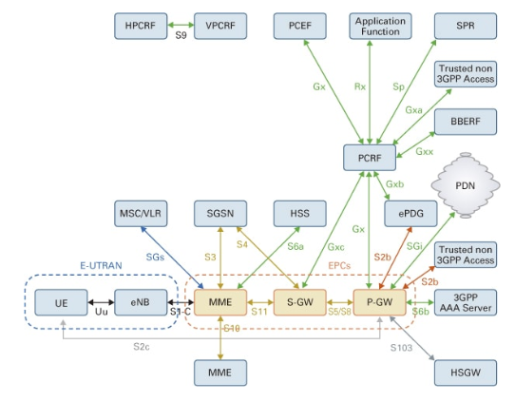
LTE Architecture and Interfaces
Policy & Charging Rules Function P&C Enforcement Function Subscriber Profile Repository
Serving GPRS Support Node Home Subscriber Server Packet Data Gateway / Network
Evolved UMTS Terrestrial Radio Access Network Bearer Binding & Event Reporting Function
User Equipment Mobility Management Entity Serving – GateWay PDN - GateWay

Slide 25
5G Architecture Principles
Modular Function design based on Network Functions – not boxes
NF can be hardware or (virtual) software – even in cloud
reference points between NFs
function separation for scaling (e.g., AMF/SMF, AUSF/PCF)
Service based architecture
define procedures as services (enable reuse)
NFs in Control Plane enable authorized functions to directly access services
Minimize dependencies between Access Network and Core Network
Multiple access technologies (multi-RAT)
interwork with previous 3GPP generations
interwork with non-3GPP networks
Support diverging architectures and new services
Automation and programmability designed into architecture

Slide 26
5G Architecture and Interfaces
non-roaming case
Network Slice Selection Function Network Exposure Function NF Repository Function
Policy Control Function Unified Data Management
Authentication Server Function Access & Mobility Mngment Function Session Mngment Function
User Equipment (Radio) Access Network User Plane Function Data Network
Notes:
Warning – 2 different reference point nomenclatures
control functions connected via bus

Slide 27
Another way to look at it

Slide 28
What the NFs do
AMF provides authentication, authorization, mobility management of UE
UE (even with multiple access technologies) connected to single AMF
SMF provides session management, IP address allocation, selects/controls UPF
UE with multiple sessions may connect to multiple SMFs
UPF provide data transfer functionalities, e.g., routing, NAT, DPI, firewall
AF provides packet flow information to PCF to support QoS
PCF determines (mobility, session) policies so AMF and SMF work properly
AUSF stores UE authentication data
UDM stores UE subscription data (replaces HLR/HSS)
DN provides Internet access.
NEF expose capabilities to partners
NSSF Network Slice Selection Function
NRF Network repository function for subscribe to/for service

Slide 29
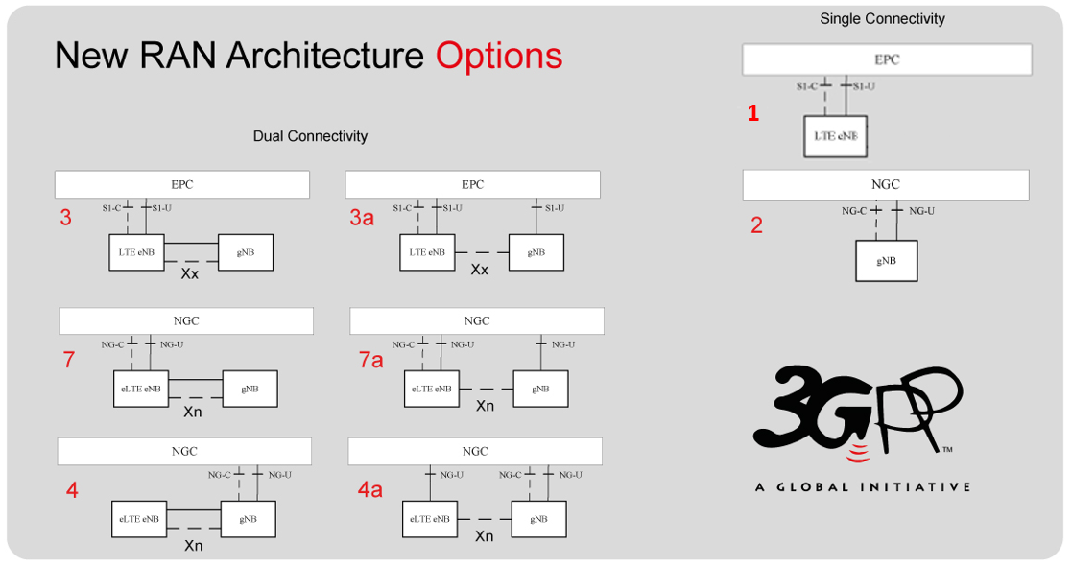
Migration options for core
The 5G NGC core will only be defined in Release 16
so in the meantime 5G is based on non-standalone (NSA) mode
where the gNb connects to a 4G EPC
Once the 5G core is introduced, multiple options have been defined
PURE 4G
PURE 5G

Slide 30




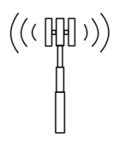

Splitting up the RAN (1)
In 3G the RAN was a pure backhaul network
In 4G this changed in 2 ways
the X2 interface interconnected eNBs (at least logically)
fronthaul (CPRI)
In 5G this must change more drastically
NB
NB
MSC/SGSN
RNC
NB
NB
S1
eNB
eNB
eNB
CORE
backhaul
fronthaul
X2
RH
eNB
BBU
Notes:
What’s the problem?

Slide 31
Splitting up the RAN (2)
Fronthaul originated as a digital interface
to connect the antenna to the BBU at the foot of the tower
But then it was realized that is advantageous to fronthaul further
share processing resources
reduce effective delay for CoMP
This led to new cost/energy-saving network architectures:
cRAN / cloud-RAN (BBU pooling, BBU hosteling)
vRAN / virtualized RAN (software BBU)
Unfortunately, there is a problem with 5G fronthaul ...
The sampling theorem tells us that we need to sample at least twice the BW
so a single 100 MHz signal requires 200 Msps or 3.2 Gbps (without overhead)
Assuming 3 sectors each with 16 MIMO antennas : > 150 Gbps
Assuming 3 sectors each with 256 MIMO antennas : > 2.5 Tbps
Assuming 1 GHz bandwidth, 3 sectors, 256 MIMO antennas : > 25 Tbps
So, we need a new kind of fronthaul
Notes:
BBU hosteling is pooling + X2 local interfaces
Assumed 16 bits per sample
IQ sampling still requires twice the BW in sample/sec
For comparison, EoY 2016 the entire Internet was 100 PB/month = 300 Tbps

Slide 32
5G RAN Functional Splits
Bandwidth increases with user traffic
Bandwidth PHY dependent
Latency tolerance increases
Option
1
Option
2
Option
3
Option
4
Option
5
Option
6
Options
7.x
Option
8
RRC
L3
L2
L1
PDCP
High-
RLC
Low-RLC
High-
MAC
Low-
MAC
High-
PHY
Low-
PHY
↓
A/D
RU
Data
CoMP
HARQ
conventional
backhauling
xHauling
conventional
fronthauling
Decomposed base station transceiver
PHY – Physical layer processing
MAC – Medium Access Control
RLC – Radio Link Control
PDCP – Packet Data Convergence Protocol
Network based control functionality
RRC – Radio Resource Control
LTE uses splits 1 and 8
3GPP is working on split 2
xRAN (ORAN) is working on split 7.2
Notes:
To enable resource sharing and delay reduction
we can do some portion of the L1/L2/L3 processing locally
For example, after the FFT we only need active subcarriers, < 50%

Slide 33
Potential RAN transport technologies
What transport functionality is required for the Radio Access Network* ?
XG-PON/XGS-PON/NG-PON2
but 10 Gbps will only be satisfactory for initial 5G deployments
25 GbE (802.3by), 1-lane 50 GbE (802.3cd), NG 100/200/400 GbE (802.3bs)
FlexE (bonding, sub-rating, channelization, TDM calendar)
eCPRI and IEEE 1914 Radio over Ethernet
Time Sensitive Networking
IEEE 802.1CM for Ethernet fronthaul
IEEE 802.1Qbv scheduled traffic enhancements
IEEE 802.1Qbu frame pre-emption
IETF DetNet (Deterministic Networking) for IP
* we’ll mention upgrading the core later on in the context of slicing/SDN/NFV
Notes:
XG-PON G.987 (X=10) 10G DS 2.5G US
XGS-PON G.989.2-1 symmetric 10G US and DS 20km
NG-PON2 G.989.x TDM and WDM, talk about extending to 25G-PON
802.3by approved June 2016
OIF approved FlexE Implementation Agreement in March 2016
bonding alternative to LAG - e.g., n*25G
sub-rating - e.g., 50G MAC inside 100GB PHY.
channelization e.g., support 150G + 2*25G MACs over 2*bonded 100G PHY
All modes supported by TDM allocation in a “calendar”

Slide 34
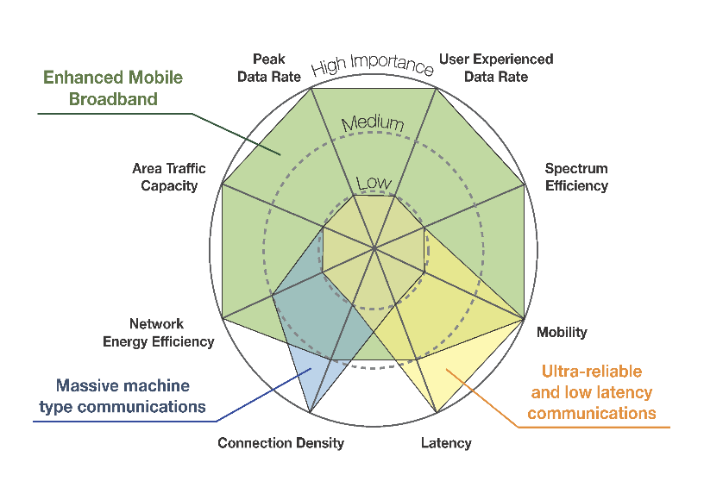
Network slicing
We already said that 5G can’t reach all of its goals simultaneously
but it doesn’t have to
For example:
enhanced mobile broadband
needs high data rates
doesn’t need very low latency
massive IoT
needs high connection density
doesn’t need high data rates
So, 5G using network slicing to satisfy needs of different devices/apps
Network slicing means:
on-demand assignment of networking/computational resources
resources: bandwidth, forwarding tables, processing capacity, etc.
resources can be physical or virtual, but
each slices acts as a strongly isolated network or cloud
isolation of performance, security, and management aspects
Notes:
dynamic “on-demand” is what differentiates a slice from a VPN
performance isolation means each slice meets service KPIs
regardless of congestion and performance levels of other slices
each slice has independent security functions, so authorization to one slice does not apply to another
control and management of each slice is totally independent

Slide 35
Why slicing in 5G?
Different network slices cater to different service needs
latency (1 ms – 10 ms – non-delay sensitive)
data rate (kbps – Mbps – Gbps)
QoS parameters (or Best Effort)
battery usage
mobility (stationary – mobile – high speed)
range (150m – 1 km – long range)
service pricing
23.501: S-NSSAI identifies a slice, and is composed of:
Slice/Service type (SST) expected slice behaviour (features and services)
Slice Differentiator (SD) optional information to differentiate
between slices of the same Slice/Service type
Slice/Service type | SST value | Characteristics.
eMBB | 1 | slice suitable for the handling of 5G enhanced Mobile Broadband.
URLLC | 2 | slice suitable for the handling of ultra- reliable low latency communications.
MIoT | 3 | slice suitable for the handling of massive IoT.

Slide 36
Implementing slicing
In 5G, slicing is end-to-end, i.e., both RAN and core network must support slicing
Slicing requires programmability, flexibility, and modularity
in order to create multiple virtual networks, each tailored for a given use case
on top of a common network
Different slices can be labeled using VLAN ID, VXLAN, IPv6 flow label, DSCP
but a slice is different from a separate physical network or a VPN
because of dynamic set-up / release requirement
SDN techniques (AKA network softwarization) will be used to achieve slicing
APIs provided to specify requirements
rich service includes NFV/MEC elements
low latency apps benefit from server allocation close to UE
parts of mobile L1/L2/L3 stack itself can be virtualized and optimally located
global orchestrator
has universal knowledge of network allocations and loads
enables rapid yet highly optimized slice creation
Notes:
We all know VLANs – why is slicing new ?

Slide 37
Timing for 5G (1)
RAN timing requirements are becoming stricter from generation to generation
Frequency and Time requirements are defined
to assure efficient and proper functioning of the air interface
Base stations require more and more accurate timing in order to
maximize data-rates
minimize guard frequencies/times in order to maximize spectral efficiency
utilize BW boosting technologies like Carrier Aggregation (CA) and MIMO
optimize user experience
smooth handover
reduced delay
Location Based Services (LBS)
Base stations (including NodeB, eNodeB, gNodeB) obtain timing from the RAN
(unless they have a local source of timing, e.g., GNSS)
So the RAN must deliver ever more accurate timing!
Notes:
RAD is known as a timing expert – how can we leverage this in the world of 5G?

Slide 38

Timing for 5G (2)
5G requirements will be at least as strict as 4G
and some experts are speaking of them becoming significantly stricter
CPRI interfaces require very strict transport delay accuracy of 16 nanoseconds
Even if this requirement will be relaxed for some 5G splits
it is still likely to be a few dozens of nanoseconds
So 5G xhaul will need to support extremely accurate time distribution
The centralized GrandMaster model will require on-path support
The Distributed GM (MiCLK) approach is advantageous if GNSS can be secured
< 50 nsec accuracy guaranteed for gNBs served by same MiCLK
±125 nsec accuracy guaranteed for gNBs served by different MiCLK
Note that GNSS at every site
only guarantees ± 100 nsec accuracy between neighboring eNBs!
Notes:
Note that MiCLK is actually better than GPS per site

Slide 39


RAD 5G directions
Backhaul Cell Site Gateway (splits 1 and 2)
Backhaul Aggregator (splits 1 and 2) for multiple sites and/or cross-generation/RAT
Optional NFVI for MEC and other functionality
xHaul Gateway straddles splits 1 and 2 with embedded PDCP functionality (for LTE and 5G)
Optional NFVI for MEC and other functionality
xHaul [Fronthaul] Transport Node for splits 2-7
fronthaul CPRI - FlexE Gateway
C
xHaul Gateway
Option
1
Option
2
Option
3
Option
4
Option
5
Option
6
Option
7
Option
8
RRC
PDCP
High-
RLC
Low-RLC
High-
MAC
Low-
MAC
High-
PHY
Low-
PHY
RF
Data
E
A
B
D
Backhaul Cell Site Gateway
frontHaul Gateway
Backhaul Aggregator
xHaul Transport Node
Notes:
Boxes support 25G interfaces, FlexE, TSN
A, B, D are upgrades of present units
B can host NFV, e.g., for low latency IoT aggregation
C includes nontrivial functionality, e.g., PDCP (mobile operator – not transport operator)
E in near-term 10*10G CPRI to 100G FlexE, and later 8*25G CPRI to 200G FlexE
Don’t include this slide in handouts

Slide 40
Presenter Name
Title
E-mail

