Slide 1
Part 3 Signal Processing Algorithms
0368.3464
עיבוד ספרתי של אותות
Digital Signal Processing for Computer Science
AKA
Digital Signal Processing – Algorithms and Applications

Slide 2
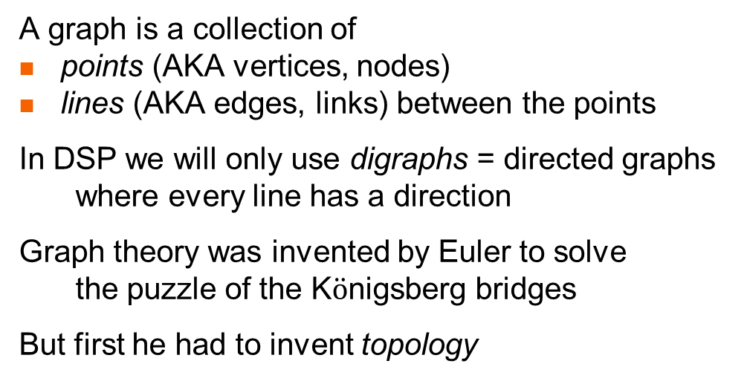
What is a graph?
A graph is a collection of
points (AKA vertices, nodes)
lines (AKA edges, links) between the points
In DSP we will only use digraphs = directed graphs
where every line has a direction
Graph theory was invented by Euler to solve
the puzzle of the K$\ddot{o}$nigsberg bridges
But first he had to invent topology
Is it possible to leave your home for a walk, cross all the bridges exactly once,
and return home? (an Euler cycle)
There is an Euler cycle
iff every point has even degree
Pregel river
graph
map
topologically equivalent map

Slide 3

Topology?
Topology is a generalization of geometry
in geometry congruence allows translation and rotation
in affine geometry we also allow scale changes (zoom)
in projective geometry we allow
any transformation from lines to lines (maintains collinearity)
here all triangles are equivalent, but squares are different
in topology we allow any transformation
that doesn’t tear or glue together space
(think of drawing on a rubber sheet)
Side Side Side
Side Angle Side
Angle Side Angle
but not
Angle Angle Angle
Side Side Side
Side Angle Side
Angle Side Angle
Angle Angle Angle

Slide 4
Some more topology
Topology’s equivalence relationship is called homeomorphism
A homeomorphism is a continuous function from space to space
with a continuous inverse function
In topology distance, angle, and linearity are meaningless
triangle = square = polygon = circle
all curves that don’t cross themselves are equivalent
a figure 8 is not the same as a circle (would require a tear)
(the number of holes is preserved)
in 3D topology a sphere is equivalent to a cube
but not to a donut
What Euler realized is that the existence of a Euler cycle
is independent of the bridge location and orientation
The bridge puzzle is truly a topological problem

Slide 5




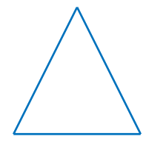



Continuous transformations
Continuously morph a square into a circle (and back again)
Continuously triangle into a square (and back again)

Slide 6
Topology and graph theory
In graph theory all we care about is connectivity
which point is connected to which point
We don’t care about the length or angle of the line
or even if it is a line
The meaning of a graph is purely topological
So all the following digraphs are equivalent:
But not or
y
x
y
x
y
x
y
x
x
y
y
x
x
w
y

Slide 7
Graph theory in CS
In the early days of computer science
programs were represented by block diagrams
which are a kind of graph
This representation has been mostly abandoned
for several reasons:
block diagrams are actually a programming language
so using them in addition to code
means maintaining 2 code different sets
block diagrams are tightly coupled to
imperative program with goto statements
which has been disparaged
block diagrams are purely documentation
and add nothing positive to the programming process
block diagrams only describe algorithms
Wirth’s Law
programs = algorithms + data structures
But in DSP we still use signal flow graphs!
processing
false
if
true
Goto A

Slide 8
Signal flow graphs
Shannon introduced signal flow graphs in which
the points represent signals
the lines (and things on lines) represent signal processing functions
These graphs capture both
algorithms and
data structures
In addition to their purely documentary function
signal flow graphs are useful because of graphical mechanisms
for simplifying graphs
lowering computational power or memory requirements

Slide 9
The simplest graph
The simplest signal flow graph has 1 point and represents a signal
When we write a letter next to a point (below, left, right, above)
it represents the name of the signal (here: x !)
When interpreting signal flow graphs
it is often useful to ask – what is the value of the signals at time n ?
So we sometime draw
But don’t be confused!
The point represents the signal x_{n} Ɐn= -∞ … +∞
not a particular value
x
x_{n}

Slide 10
The next simplest graph
The simplest nontrivial signal flow graph has 2 points and one line
and it represents signal identity (y = x, i.e., Ɐn= -∞ … +∞ y_{n} = x_{n})
Of course, due to the topological nature of graphs
we could have drawn this graph in many other ways
And in this case only we can also reverse the line direction
Note that we will often neglect to draw the point when it is obvious
(i.e., at the end of a line)
(we will later only draw points in specific places …)
identity = assignment
x
y
y = x
x
y
y
x
x
y
y
x
x
y

Slide 11
What does this mean?
y
x
z
y
x
We can figure this out by naming the unlabeled point w
and breaking the graph down into three parts
So w = x and y = w = x and also z = w = x
WARNING! Do not think of this as electrical currents
in which case y=x/2 and z=x/2 !
This graph is called the splitter
Note that the splitter always has
1 signal going in and 2 signals coming out
w
z
x
w
w
y
w
z
y
y = x
and
z = x
x
splitter = tee connector
z

Slide 12
Gain
The simplest signal processing is the gain y = g x (Ɐn= -∞ … +∞ y_{n} = g x_{n})
We draw this by putting the letter g next to the arrow
Note that (for g ≠1) this is very different from
but the same as
Be careful!
A letter near a point tells you the signal’s name
but a letter near an arrow represents a gain
g
x
y
y = g x
gain
g
y
x
x = g y
x
y
g
g
g
g
etc.
y
x
x
y
y
x

Slide 13

Delay
We have seen that the unit delay is very important in DSP
and so it deserves its own graphical symbol
and as usual we can draw this in various orientations, such as
is the same as ?
x
z⁻¹
y
$y= {\hat{z}}^{−1} x$ (Ɐn= -∞ … +∞ y_{n} = x_{n-1} )
unit delay
x
y
z⁻¹
x
z⁻¹
y
g
g
x
z⁻¹
y
x
z⁻¹
y

Slide 14
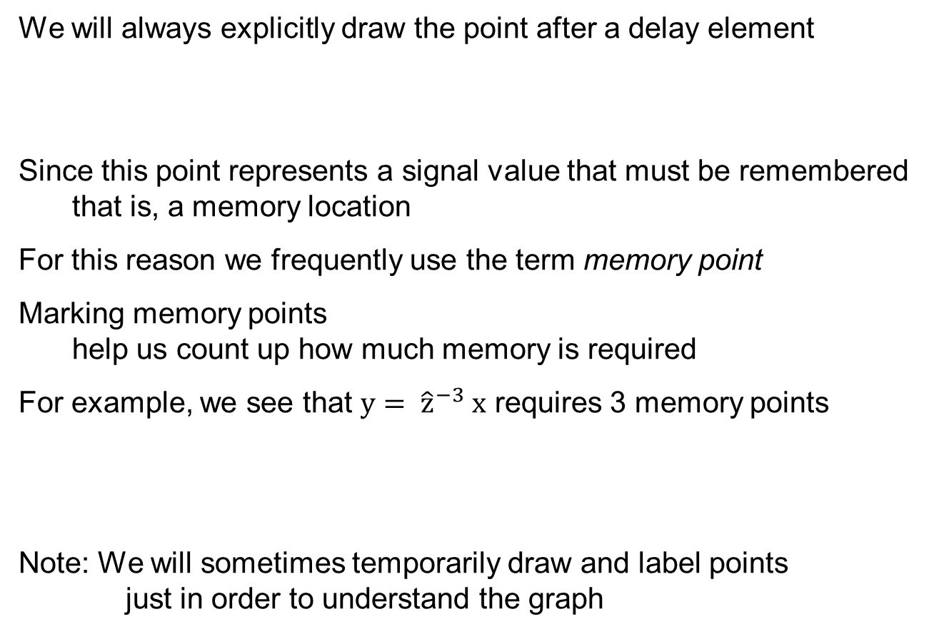
Drawing points
We will always explicitly draw the point after a delay element
Since this point represents a signal value that must be remembered
that is, a memory location
For this reason we frequently use the term memory point
Marking memory points
help us count up how much memory is required
For example, we see that $y= {\hat{z}}^{−3} x$ requires 3 memory points
Note: We will sometimes temporarily draw and label points
just in order to understand the graph
z⁻¹
x
z⁻¹
z⁻¹
z⁻¹
y

Slide 15
Adder
Signal addition is very important as well!
We define the two-signal adder
which of course means
Ɐn= -∞ … +∞ z_{n} = x_{n} + y_{n}
Note that the adder always has
2 signals going in and 1 signal coming out
As usual, we could draw the adder in many ways!
x
z
adder
z = x + y
y
y
y
y
z
x
z
x
z
x

Slide 16
Subtractor
For convenience we also define the 2-signal subtractor
Although we could have used instead
x
z
-
z = x - y
y
Note the position of the minus sign
It can be at either (or both) of the adder’s inputs!
x
z
-1
y

Slide 17
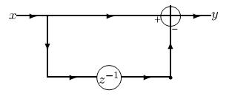

The finite difference
We can now use what we have learned so far to draw a useful graph
the finite difference y = $\hat{Δ}$ x ( i.e., y_{n} = x_{n} - x_{n-1} )
To see that this is correct label needed points (not just the memory points)
with their value at time n
y_{n} = x_{n} - x_{n-1}
x_{n}
y_{n}
splitter
x_{n-1}
x_{n}

Slide 18
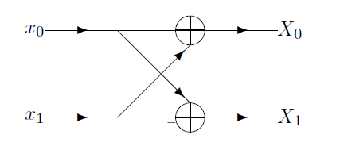

The butterfly
Remember the DFT for N=2 ?
X₀ = x₀ + x₁
X₁ = x₀ – x₁
We can draw this as a DSP graph
(it is not really a signal flow graph!)
Rotating this 90 degrees and using a lot of imagination
one can understand why this is called a butterfly

Slide 19
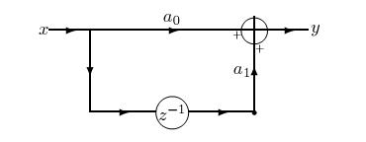
The basic MA filter
Let’s draw something even more interesting
To see that this is indeed the MA filter label all these points
y_{n} = a₀ x_{n} + a₁ x_{n-1}
x_{n}
a₀ x_{n}
y_{n}
a₁ x_{n-1}
x_{n}
x_{n-1}

Slide 20
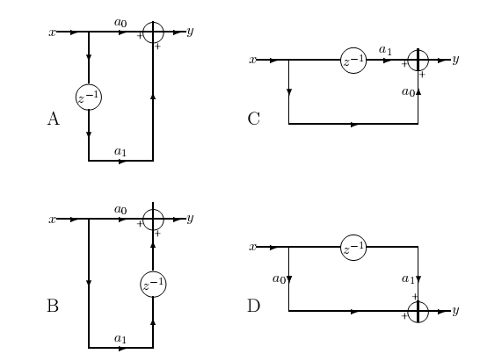
Basic MA blocks
Here are 4 interesting ways to draw this same simple MA filter
What transformations brings us from one to the other?
topological
commute
topological
topological
y_{n} = a₀ x_{n} + a₁ x_{n-1}
commute

Slide 21
Why do we need 4 blocks?
Products next to adder –
can make memoryless chip
Products all parallel –
easy to iterate (we’ll see later)
Products all parallel –
easy to iterate (we’ll see later)
y line is different height from x line
Delay element adjacent to adder

Slide 22
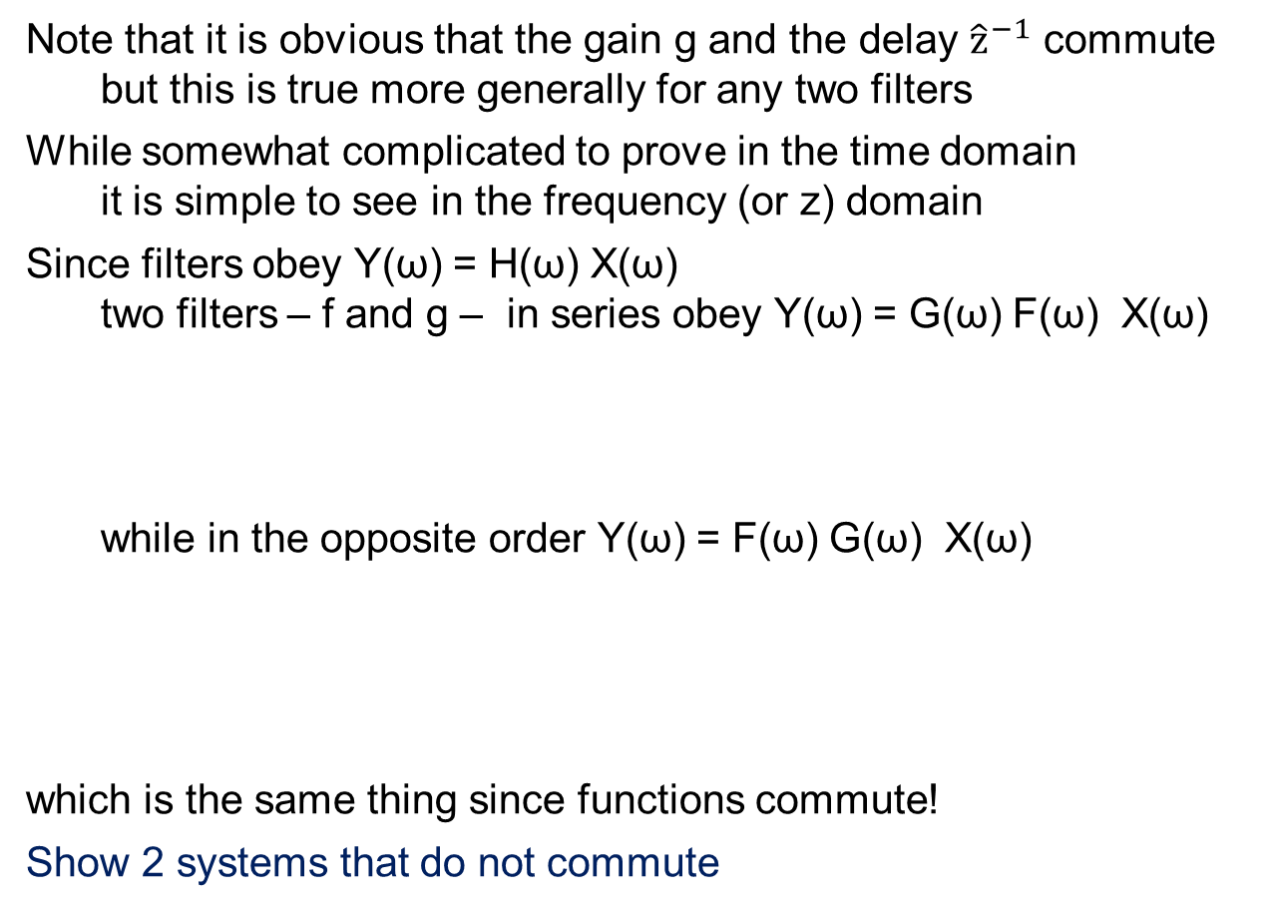
Commutativity
Note that it is obvious that the gain g and the delay ${\hat{z}}^{−1}$ commute
but this is true more generally for any two filters
While somewhat complicated to prove in the time domain
it is simple to see in the frequency (or z) domain
Since filters obey Y(ω) = H(ω) X(ω)
two filters – f and g – in series obey Y(ω) = G(ω) F(ω) X(ω)
while in the opposite order Y(ω) = F(ω) G(ω) X(ω)
which is the same thing since functions commute!
Show 2 systems that do not commute
F(ω) X(ω)
G(ω) F(ω) X(ω)
X(ω)
f
g
Y(ω)
G(ω) X(ω)
F(ω) G(ω) X(ω)
X(ω)
g
f
Y(ω)

Slide 23
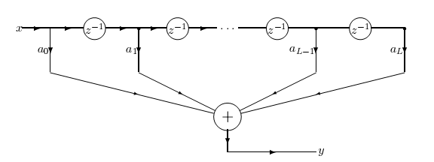
General MA
Now we consider the general MA filter with L coefficients
We would like to draw
but we only defined 2-input adders !

Slide 24
Tapped delay line
Before correcting this, note that top of this diagram
has an interesting analog interpretations
Engineers think of this as a tapped delay line
similar to a length of cable with finite transmission velocity
But since information travels in (copper or optical) cables
at 2/3 the speed of light (200 meters per μsec)
you need a long cable for significant delay !
tapped delay line

Slide 25
A data structure!
We will think of this differently (and find a data structure in addition to the algorithm)
Considering the memory points from some time
we find a data structure (assume L=8)
with the following time varying contents
We see that values that enter first from the left
exit (are discarded) first to the right
so this is a FIFO buffer
x
z⁻¹
z⁻¹
z⁻¹
z⁻¹
z⁻¹
z⁻¹
z⁻¹
y
x₈
x₇
x₆
x₅
x₄
x₃
x₂
x₁
x₉
x₈
x₇
x₆
x₅
x₄
x₃
x₂
x₁₀
x₉
x₈
x₇
x₆
x₅
x₄
x₃
x₁₁
x₁₀
x₉
x₈
x₇
x₆
x₅
x₄

Slide 26
How do we fix the adders
So, were we to use an N-input adder
we would have a FIFO, multiplications, and an adder
Let’s perform the additions one at a time!
FIFO

Slide 27
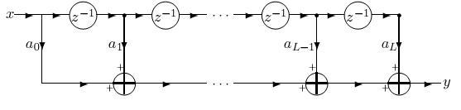
General MA – 1st way
We still have the tapped delay line = FIFO as a data structure
but now we perform Multiplication + Accumulations (MACs)
We have previously mentioned how important MACs are in DSP
Another way of looking at this is iteration on one of our basic MA blocks
Which one ?
MACs

Slide 28
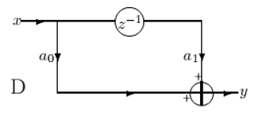
Iteration – 1st way
We iterate on basic block D
So this graph tells us
Data structure = FIFO
Algorithm = iteration over MA block D
MACs

Slide 29
The signal’s point of view
We saw how to look at this from the processing point of view
Sometimes it is useful to look at graphs from the signal’s point of view!
the signal enters the filter and is split into 2 replicas : A and B
gain is applied to replica A, replica B is delayed
replica B is split in two : C and D
gain is applied to replica C, which then is added to replica A
etc.

Slide 30
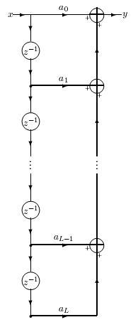
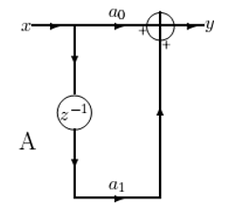
General MA – 2nd way
This isn’t the only way to compute a general MA
Here we see an alternative
It still uses a FIFO data structure
(which is now vertical – but who cares?)
Which basic MA block is used here?
So this graph tells us
Data structure = FIFO
Algorithm = iteration over MA block A
FIFO
MACs

Slide 31
Two ways to MA
Is there any difference between these two ways?
the 1st way MACs from the new x backward
a₀ x_{n} + a₁ x_{n-1} + … + a_{L} x_{n-L}
the 2nd way MACs from the earliest x forward
a_{L} x_{n-L} + … + a₁ x_{n-1} + a₀ x_{n}
Theoretically there is no difference
(addition is commutative)
but in practice there may be
Given a list of numbers sorted from smallest to largest
which way is most accurate to sum?

Slide 32
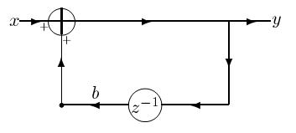
Basic AR block
What is the graph for the basic AR filter ?
Here is one way:
Note that for the first time we see a loop in the graph
in none of the MA filters was there a loop!
Whenever there is a loop, there is recursion (AR)
Put another way – loops correspond to poles

Slide 33
How does it work?
As usual – let’s label points to see why this works
We don’t worry about signals from the past influencing the output now
but non-causal loops can be paradoxical (like time travel)
This is just one way the draw the simple AR
there are 4 basic blocks here too
Can you find them?
x_{n}
x_{n} + b y_{n-1}
y_{n}
y_{n}
b y_{n-1}
y_{n-1}

Slide 34
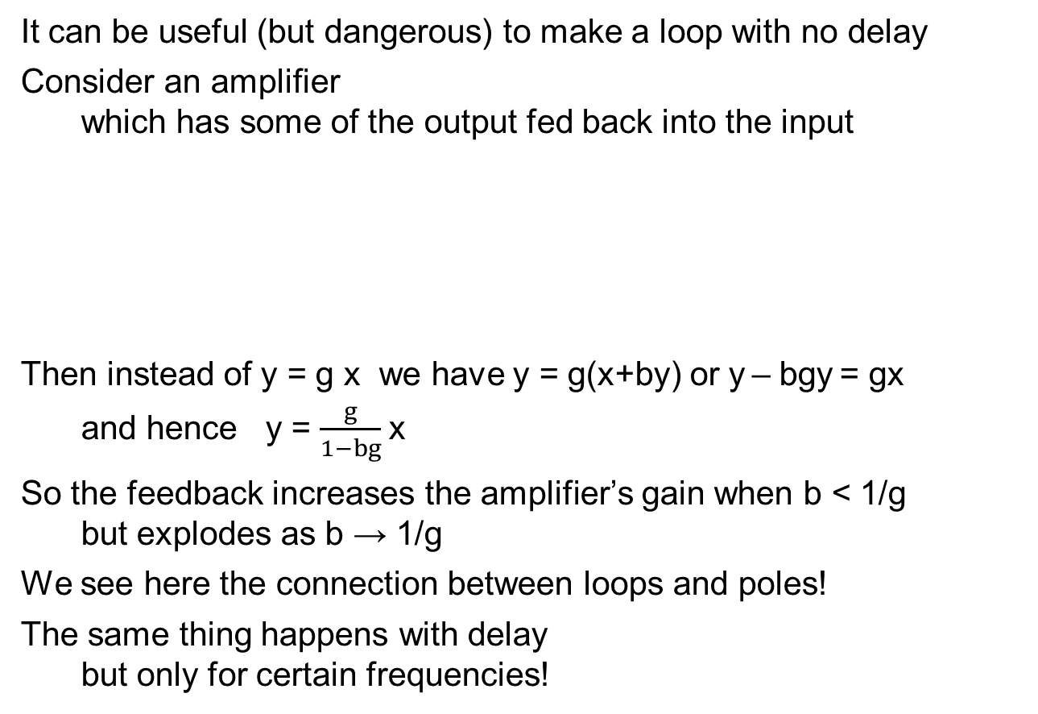
A loop with no delay
It can be useful (but dangerous) to make a loop with no delay
Consider an amplifier
which has some of the output fed back into the input
Then instead of y = g x we have y = g(x+by) or y – bgy = gx
and hence y = $\frac{g}{1−bg}$x
So the feedback increases the amplifier’s gain when b < 1/g
but explodes as b → 1/g
We see here the connection between loops and poles!
The same thing happens with delay
but only for certain frequencies!
g
x
y
g
x
y
b

Slide 35
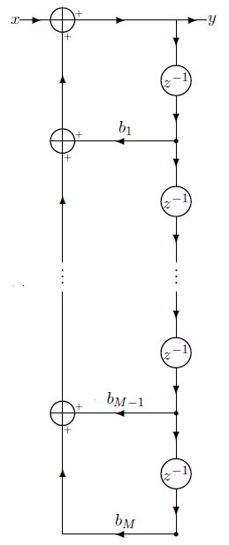
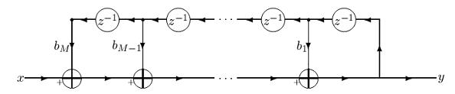
General AR filters
Here are two ways to implement the general AR filter
Explain why these indeed implement the AR
Is there any difference between these two ways?

Slide 36
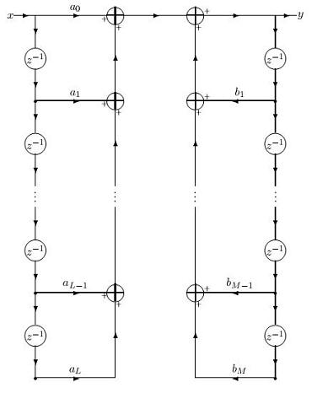
ARMA filters – stage 1
What do we do about ARMA filters?
The straightforward implementation would be
perform the MA portion using one of our MA implementations
perform the AR portion using one of our AR implementations
add the two together
MA
AR
MA
+
AR

Slide 37
How much memory?
u
By observing the graph we see
that L+M memory points are used
Without limiting generality
we can say 2L memory points
and assume L=M
Why? Take max(L,M)
and pad the other with zeros
We will now use graph theory
to reduce the number
of needed memory points

Slide 38
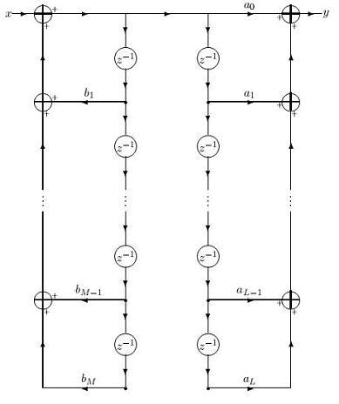
ARMA filters – stage 2
w
The graph has two filters in series
1 MA and 1 AR
Since any 2 filters commute
we can exchange their order
We obtain this new graph
Note that the signal w
between the 2 filters
is different from the signal u !

Slide 39
ARMA filters – stage 3
w_{n}
w_{n-1}
We see that there are points
representing the same signal !
All of these are
So we can combine the memory locations
and remove un-needed delays
This is a new graph transformation
w_{n-2}

Slide 40
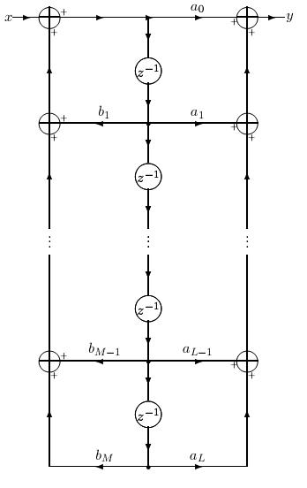
ARMA filters stage 3
We now require only L memory points
instead of 2L memory points
A reduction to 50% !

Slide 41
The transposition theorem
Another transformation that creates a new graph
that is equivalent in functionality to the original one
is given by the Transposition theorem
This transformation is more complex
since multiple operations are carried out at the same time
exchange input(s) and output(s)
reverse direction of all arrows
replace adders with splitters (since now 1 in - 2 out)
replace splitters with adders (since now 2 in - 1 out)

Slide 42
2 simple cases
a₀
a₀
x
y
y
x
Simple
MA
z⁻¹
z⁻¹
a₁
a₁
a₀
x
y
y
x
Simple
AR
z⁻¹
z⁻¹
b₁
b₁

Slide 43
Summary – the 4 transformations
We have learned 4 basic transformations
that create equivalent signal flow graphs
transformations that do not change topology
changing order of filters
identification of identical signal points
and removal of redundant branches
the transposition theorem
These transformations can be carried out mechanically
and are used to
reduce the amount of memory needed (we saw such a case!)
reduce the amount of computation needed (we’ll see next time)
This is why graphs are still used in DSP !

Slide 44
Real-time
DSP processing is almost always real-time
Some exceptions:
work on recordings
systems with outputs that are not signals (e.g., detections)
What is real-time ?
For a signal processing system
which inputs an input signal one value at a time
hard real-time: ALWAYS finish computing output before next input
soft real-time: finish computing output on average before next input
store input points that arrive before output ready
exploit some additional delay to output
x_{n}
memory
y_{n}
CPU
XTAL

Slide 45
Example
Assume samples arrive 1000 times per second f_{s} = 1000 Hz
then the time between samples is t_{s} = 1 millisecond
So, for hard real-time
all of the processing of a single input sample x_{n}
in order to produce the output sample y_{n}
must take place in less than 1 millisecond
(before the next sample x_{n+1} arrives)
For soft real-time
sometimes the processing of a single input sample x_{n}
can take longer than 1 millisecond
in which case we store the next sample x_{n+1}
until we output the output sample y_{n}
and then start processing x_{n+1}

Slide 46
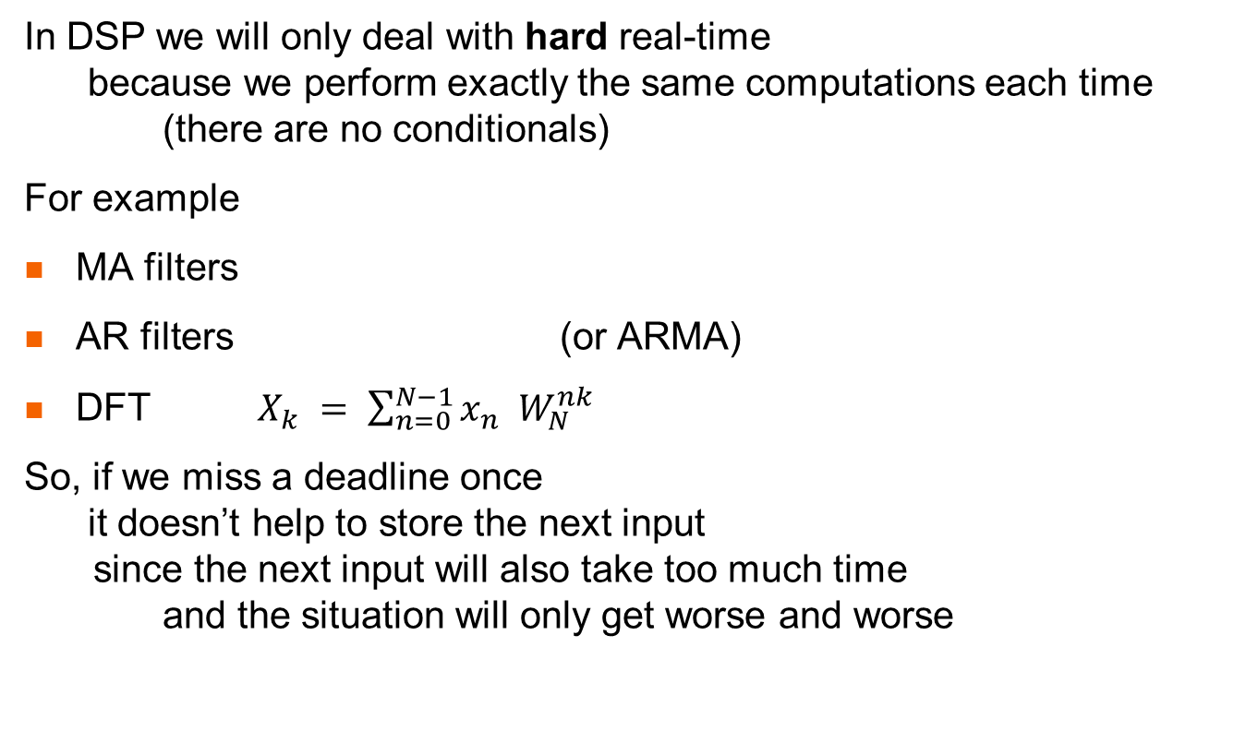
DSP = Hard real-time
In DSP we will only deal with hard real-time
because we perform exactly the same computations each time
(there are no conditionals)
For example
MA filters
AR filters (or ARMA)
DFT $X_{k} = \sum_{n=0}^{N−1}{x_{n} W_{N}^{nk} }$
So, if we miss a deadline once
it doesn’t help to store the next input
since the next input will also take too much time
and the situation will only get worse and worse

Slide 47
Real-time for multi-input
What about the DFT? We can’t perform a DFT on one sample x_{n}
it only makes sense to perform on N samples x_{0,} x_{1,} x_{2,} … x_{N-1} !
For a system which performs calculation on N inputs
hard real-time means that
we must finish processing all N samples x_{0,} x_{1,} x_{2,} … x_{N-1}
before the next N samples x_{N,} x_{N+1,} x_{N+2,} … x_{2N-1} arrive!
The requirement is the same as before, but on average
That is, finishing processing of N old samples
during the time N new samples appear
means on average processing a sample in a sampling time
However, in general the processing of N samples
need not reduce to N processing stages each on 1 sample!

Slide 48
Wrong way to process N samples
You might think that we do the following:
time 0: input x₀, store in buffer, but don’t perform any processing
time 1: input x₁, store in buffer, but don’t perform any processing
…
time N-1: input x_{N-1}, store in buffer
and perform all processing of N samples
before the next sample x_{N} arrives
time N: input x_{N} but don’t perform any processing
etc.
but that would be really hard!
We would need to process N samples in 1 sampling time
although on average we need to process 1 sample per sample time
So, what do we do instead?

Slide 49
Double buffering
double buffer
What we do is the following:
time 0: input x₀ into buffer 1
time 1: input x₁ into buffer 1
…
time N-1: input x_{N-1} into buffer 1 (filling buffer)
and start performing all processing of N samples in buffer 1
time N: input x_{N} into buffer 2 and continue processing buffer 1
time N+1: input x_{N+1} into buffer 2 and continue processing buffer 1)
some time before time 2N-1: finish processing buffer 1 and output
time 2N-1: input x_{2N-1} into buffer 1
and start performing all processing of N samples in buffer 2
Trick:
Instead of having to swap write pointers
between buffer 1 and buffer 2
we can use a cyclic buffer
1
2
1
cyclic
buffer
2

Slide 50

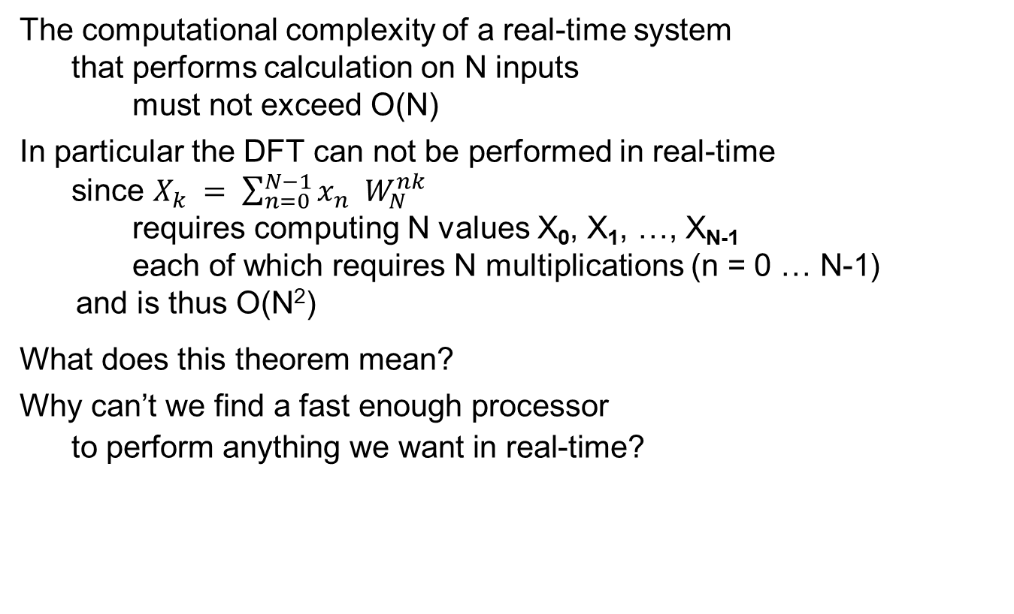
Theorem for real-time
The computational complexity of a real-time system
that performs calculation on N inputs
must not exceed O(N)
In particular the DFT can not be performed in real-time
since $X_{k} = \sum_{n=0}^{N−1}{x_{n} W_{N}^{nk} }$
requires computing N values X₀, X₁, …, X_{N-1}
each of which requires N multiplications (n = 0 … N-1)
and is thus O(N²)
What does this theorem mean?
Why can’t we find a fast enough processor
to perform anything we want in real-time?

Slide 51
The meaning of the theorem
Imagine that you need to program some O(N²) process
and as before samples arrive every millisecond
Let’s assume that you are told that N=1024
and that you manage to program you CPU
to finish the processing in less than 1024 milliseconds
But then it turns out that N=2048 is really needed
You now have twice the time to perform the computation – 2048 ms
but because of O(N²) you require 4 times the time – 4096 ms!
So you buy a faster processor and manage to run in real-time
but then if it turns out that N=4096 is needed
no strong enough CPU is available!
But if the complexity is O(N)
then when N is increased from 1024 to 2048
you have twice the time to perform the computation
but only need twice the time!

Slide 52
and the solution is …
DFT and iDFT are so critical in DSP
that without a real-time implementation DSP won’t work!
The Fast Fourier Transform
reduces the O(N²) complexity of the straightforward DFT
to O(N log N)
Note we don’t need to specify the base of the log
since changing base only inserts a multiplicative constant
but we will always assume log₂
But O(N log N) is higher than O(N)
and so violates the theorem that real-time requires O(N) !
O(N log N) is not low enough to guarantee real-time for all N
but is sufficiently low to enable even extremely large Ns
DSP processors are rated by
how large an FFT they can perform in real-time!

Slide 53
Warm-up problem #1
Find minimum and maximum of N numbers x₀ x₁ x₂ x₃ ... x_{N-2} x_{N-1}
minimum alone takes N comparisons prove this
maximum alone takes N comparisons prove this
So we can certainly find both with 2N comparisons
But there is a way to find both in 1½ N comparisons
x₀ x₁ x₂ x₃ ... x_{N-2} x_{N-1}
smaller x₀ x₃ ... x_{N-1}
larger x₁ x₂ ... x_{N-2}
run over at pairs, separating into larger and smaller
– this takes ½ N comparisons
the minimum must be in the smaller list (why?)
– find it in ½ N comparisons
the maximum must be in the larger list
– find it in ½ N comparisons
altogether 3/2 N comparisons – 25% savings
Can we improve this by further decimation? Why not?
for example

Slide 54
2 remarks
this method uses decimation
that is separating a sequence of N elements
into two subsequences of N/2 elements
based on even and odd elements
although we reserved 2 buffers
smaller x₀ x₃ ... x_{N-1}
larger x₁ x₂ ... x_{N-2}
the calculation can be performed in-place
that is, without additional memory !
x₀ x₁ x₂ x₃ x₄ x₅ ... x_{N-2} x_{N-1}
x₀ x₁ x₃ x₂ x₅ x₄ ... x_{N-2} x_{N-1}
But to swap two values x₀ x₁ we do need an additional memory
y←x₀ , x₀←x_{1 ,} x₁←y
why don’t we count this?

Slide 55
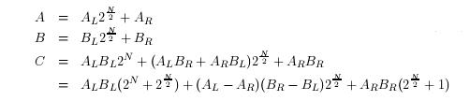
Warm-up problem #2
Multiply two N digit numbers A and B (w.o.l.g. N binary digits)
we saw that long multiplication is a convolution
and thus takes 2N² 1-digit multiplications
But there is a faster way!
Partition the binary representation of A and B into 2 parts
A7 A6 A5 A4 A3 A2 A1 A0 = A_{L} A_{R}
B7 B6 B5 A4 B3 B2 B1 B0 = B_{L} B_{R}
Now
So partitioning factors reduces to 3/4 N² saving 25% !
There’s a small problem here – the subtractions might add a bit!
But O(3/4 N²) = O(N²) so we haven’t change the O complexity!

Slide 56
Continued …
But this time we can continue
Now, 3^{log}2^{(N)} = N^{log}2³ Why is a^{log}k^{(b)} = b^{log}kª ?
So, the complexity is O(N^{log}2 ³) ≈ O(N^{1.585})
and O(N^{1.585}) < O(N²) -- the O complexity has been reduced!
This is the Toom-Cook (Karatsuba) algorithm
which was thought to be the fastest way to multiply
until the FFT way was discovered
0
1
1
3
3 multiplications, each N/2 bits
2
9
3² multiplications, each N/4 bits
log2(N)
27
3 ^{log}2^{(N)} multiplications, each 1 bit

Slide 57
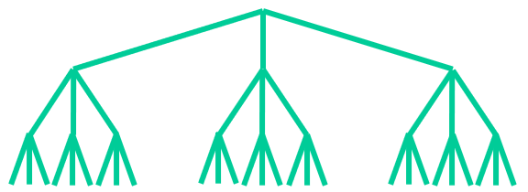
Toom-Cook example
Let’s multiply A=83 times B=122 using Toom Cook
(the answer is 10,126)
A = 0 1 0 1 0 0 1 1 B = 0 1 1 1 1 0 1 0
A_{L} = 0 1 0 1 = 5 B_{L} = 0 1 1 1 = 7
A_{R} = 0 0 1 1 = 3 B_{R} = 1 0 1 0 = 10
AR =
= 5*7 *(256+16) + (5-3) * (10-7) *16 + 3*10*(16+1)
= 35 * 272 + 6 * 16 + 30 * 17
= 35 shl 8 + (35 + 6 + 30) shl 4 + 30 [3 N/2-bit products + 2 shifts + 4 adds]
Now we repeat the process for A_{L}B_{L}
A_{L} = 0 1 0 1 B_{L} = 0 1 1 1
A_{LL} = 0 1 = 1 B_{LL} = 0 1 = 1
A_{LR} = 0 1 = 1 B_{LR} = 1 1 = 3
A_{L} B_{L} = 1*1*(16+4) + (1-1)*(3-1)*4 + 1*3*(4+1) = 20 + 0 + 15 = 35
and the same for the other 2 multiplications

Slide 58
Toom-Cook example (cont.)
(A_{L}-A_{R}) (B_{R}-B_{L}) = 2 * 3 = 0010 * 0011 =
0*0*(16+4) + (0-2)*(3-0)*4 + 2*3*(4+1) = 0 + -24 + 30 = 6
A_{R}B_{R} = 3 * 10 = 0011 * 1010 =
0*2*(16+4) + (0-3)*(2-2)*4 + 3*2*(4+1) = 0 + 0 + 30 = 30
Finally, we go one step further to 9 individual bit multiplications, e.g.,
A_{LR}*B_{LR} = 1 * 3 = 3
A_{LRL}= 0 A_{LRR} = 1 B_{LRL}= 1 B_{LRR} = 1
A_{LR} B_{LR} = A_{LRL} B_{LRL} (4+2) + (A_{LRL} - A_{LRR} )(B_{LRR} -B_{LRL}) + A_{LRR} B_{LRR} (2+1)
= 0 * 1 * 6 + -1 * 0 + 1 * 1 * 3
and similarly for all the others

Slide 59
Decimation and Partition
The two warm-up problems had a strategy in common
If the complexity is C=cN²
then it is worthwhile to divide the input sequence into 2 subsequences
Since performing the operation on each part costs c(N/2)² = C/4
so the two together cost C/2
If we can glue the two parts back together in less than C/2
then we have a more efficient algorithm!
But the two problems used two different methods of dividing the sequence
x₀ x₁ x₂ x₃ x₄ x₅ x₆ x₇
Decimation
x₀ x₂ x₄ x₆ EVEN
x₁ x₃ x₅ x₇ ODD
LSB sort
Partition
x₀ x₁ x₂ x₃ LEFT
x₄ x₅ x₆ x₇ RIGHT
MSB sort

Slide 60
Radix 2
In both warm-up problems, and in the FFT algorithm we will derive
we divide up the sequence into 2 sub-sequences of length N/2
In fact we will require that N be a power of 2
so that we can continue to divide by 2 until we get to units
Such algorithms are called radix-2 FFT algorithms
We could also chose to divide it up into 3 subsequences
or 4 or 5 or any other integer into which N factors
There are special FFT algorithms for powers of other primes
and for semi-primes like N=15=5*3
In fact, only for prime N is no possibility of reducing complexity
Shmuel Winograd discovered FFTs with few multiplications
for various values of N = N₁ * N₂ where N₁ and N₂ are coprime

Slide 61
Decimation in Time ⇔ Partition in Frequency
What does decimating a signal in the time domain
do to the frequency domain representation ?
Assume that the original signal x₀ x₁ x₂ … x_{N-1}
was sampled at f_{s}
and thus by the sampling theorem
have maximum frequency f_{N} = f_{s}/2
Then the decimated signals, x₀ x₂ x₄ … and x₁ x₃ x₅ …
are sampled at f_{s}/2
and thus have maximum frequency f_{s}/4
So we obtain only the lower ½ of the original spectral width
in other words the LEFT partition of the spectrum
Thus DIT = PIF
We’ll see later the exact relationship between
the lower and upper partitions of the spectrum

Slide 62
Partition in Time ⇔ Decimation in Frequency
What does partitioning a signal in the time domain
do to the frequency domain representation ?
Assume that the original signal x₀ x₁ x₂ … x_{N-1}
was sampled at f_{s} and thus has duration T = N t_{s} = N / f_{s}
Then the partitioned signals, x₀ x₁ … x_{N/2-1} and x_{N/2} x_{N/2+2} … x_{N-1} have duration N/2 t_{s} = T/2
According to the uncertainty principle
if the time duration Δt is reduced by ½
then the frequency uncertainty Δω is increased by 2
(the frequency resolution is blurred)
So, we can effectively observe only every other spectral line!
Thus PIT = DIF

Slide 63
FFT history
The FFT has been discovered many times
perhaps as early as unpublished 1805 work by Gauss
which predates Fourier!
In 1903 Runge discovered an FFT for N a power of 2
and in 1942 Danielson and Lanczos discovered a O(N log N) DFT
However, credit is now usually given to
John Wilder Tukey – American mathematician/statistician (Princeton)
who coined the words bit = binary digit and software
James William Cooley – American mathematician / programmer (IBM)
who published in 1965 (in order to avoid patenting)
The Cooley-Tukey algorithm is Decimation In Time
that is, it decimates the signal in the time domain
performing DFTs separately of the evens and the odds
The Sande-Tukey algorithm is Decimation in Frequency
that is, it partitions the signal in the time domain
performing DFTs separately of the 1st half and 2nd half

Slide 64
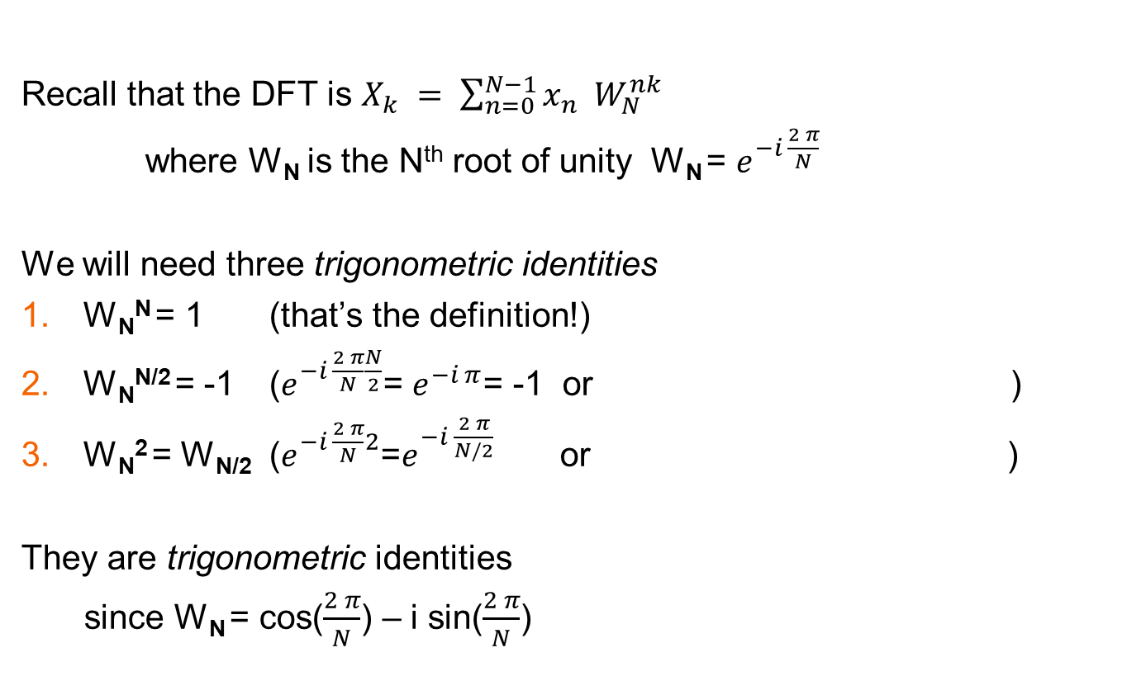
Before starting
Recall that the DFT is $X_{k} = \sum_{n=0}^{N−1}{x_{n} W_{N}^{nk} }$
where W_{N} is the N^{th} root of unity W_{N} = $e^{−i \frac{2 π}{N}}$
We will need three trigonometric identities
W_{N}^{N} = 1 (that’s the definition!)
W_{N}^{N/2} = -1 ($e^{−i \frac{2 π}{N}\frac{N}{2}}$= $e^{−i π}$= -1 or )
W_{N}² = W_{N/2} ($e^{−i \frac{2 π}{N}2}$=$e^{−i \frac{2 π}{N/2}}$ or )
They are trigonometric identities
since W_{N} = cos($\frac{2 π}{N}$) – i sin($\frac{2 π}{N}$)
W_{N}
W_{N}^{N/2}
W_{N}
W_{N}² = W_{N/2}

Slide 65
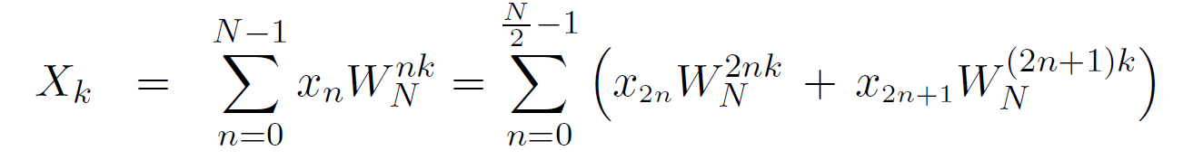
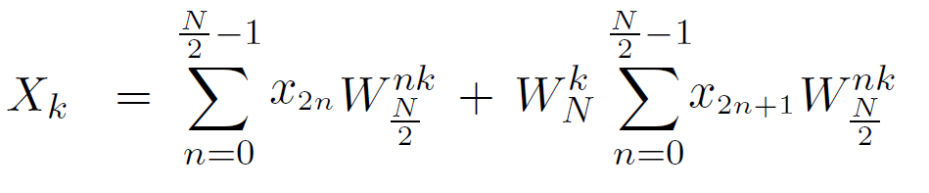

DIT (Cooley-Tukey) FFT
Let’s derive the radix-2 DIT FFT algorithm!
We start by decimating the formula for the DFT
that is, we separate the even terms 2n from the odd terms 2n+1
Now, ${{ W}_{N }^{2nk}\text{ = }{ W}_{N/2 }^{nk} \text{and} W}_{N}^{\left(2n+1\right)k}= W_{N }^{k}{ W}_{N }^{2nk}$ and so we can rewrite:
3rd identity
DFT of evens
DFT of odds

Slide 66
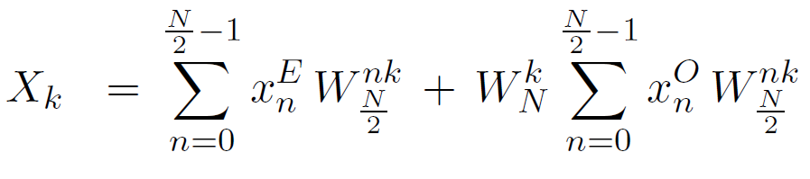
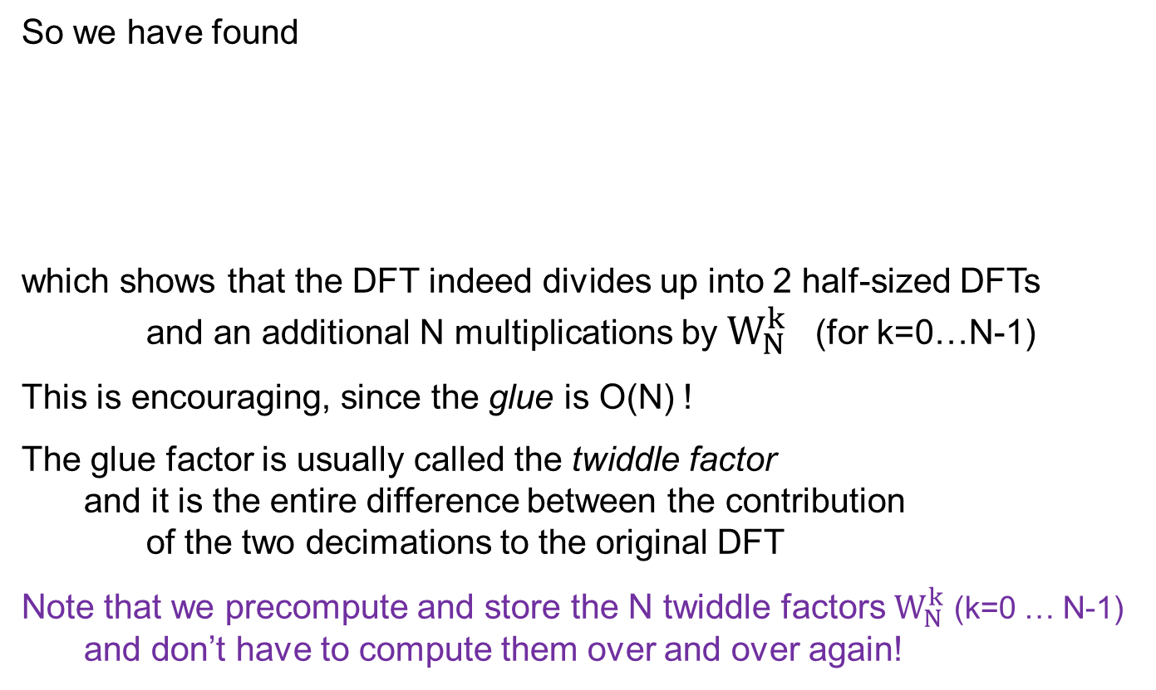
DIT – the first step
So we have found
which shows that the DFT indeed divides up into 2 half-sized DFTs
and an additional N multiplications by $W_{N}^{k}$ (for k=0…N-1)
This is encouraging, since the glue is O(N) !
The glue factor is usually called the twiddle factor
and it is the entire difference between the contribution
of the two decimations to the original DFT
Note that we precompute and store the N twiddle factors $W_{N}^{k}$ (k=0 … N-1)
and don’t have to compute them over and over again!
Even
Odd

Slide 67
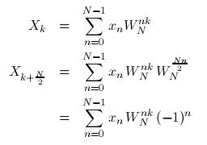
PIF
The next step is to exploit the relationship between
Decimation In Time and Partition In Frequency
What is the connection between
Xk in the left partition : 0 ≤ k ≤ N/2 – 1
and the corresponding component in the right partition
Xk in the right partition : N/2 ≤ k ≤ N – 1
Note that we compute exactly the same products
but add them with different signs + − + − + − + −
2nd identity
W_{N}^{N/2} = -1

Slide 68


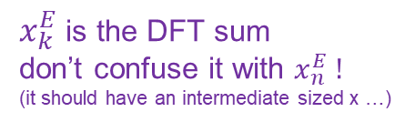
DIT is PIF
So, we have already reduced the number of multiplications by ½
Now, the products for which (-1)^{n} is negative are odd n
i.e., exactly those terms in the odd decimation!
So
We can draw this as a DSP diagram in a nice in-place way !
This reminds us of the N=2 butterfly
but has a twiddle factor before the butterfly
The DIF algorithm/s butterfly
has a twiddle factor after the butterfly
$x_{k}^{E}$ is the DFT sum
don’t confuse it with $x_{n}^{E} !$
(it should have an intermediate sized x …)

Slide 69

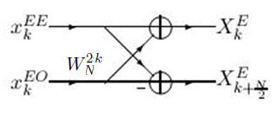
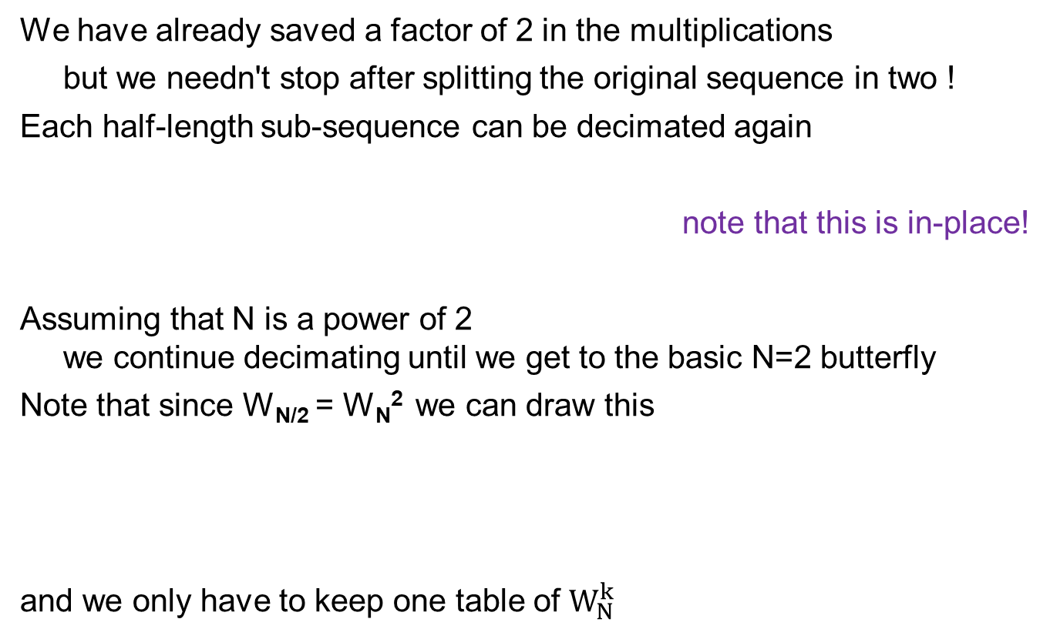
DIT all the way
We have already saved a factor of 2 in the multiplications
but we needn't stop after splitting the original sequence in two !
Each half-length sub-sequence can be decimated again
note that this is in-place!
Assuming that N is a power of 2
we continue decimating until we get to the basic N=2 butterfly
Note that since W_{N/2} = W_{N}² we can draw this
and we only have to keep one table of $W_{N}^{k}$

Slide 70
Let’s continue!
Instead of explicitly writing equations for the next step
it is easier to do everything graphically
In order to make things simple, we’ll assume N=8
and explicitly draw out all the steps
decimate the N=8 sequence into two subsequences of length 4
decimate each of the sub-sequences of length 4
into two sub-sub-sequences of length 2 (4 altogether)
perform four basic N=2 butterflies
Let’s see this happen!

Slide 71
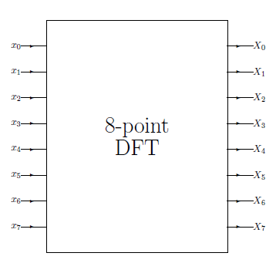
DIT N=8 - step 0

Slide 72
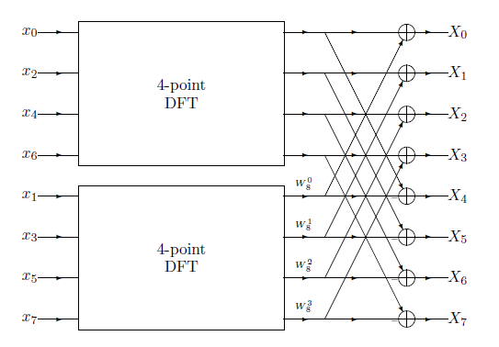
DIT N=8 - step 1
in-place!

Slide 73
DIT N=8 - step 1 : 4 butterflies
The butterflies are all entangled – do you see them?

Slide 74
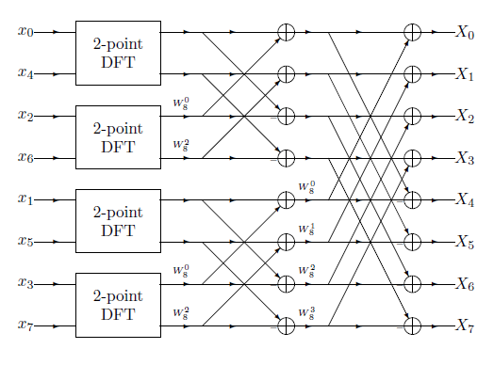
DIT N=8 - step 2
W₄⁰ = W₈⁰
W₄¹ = W₈²

Slide 75
DIT N=8 - step 2
Note that the second stage butterflies are less entangled!

Slide 76
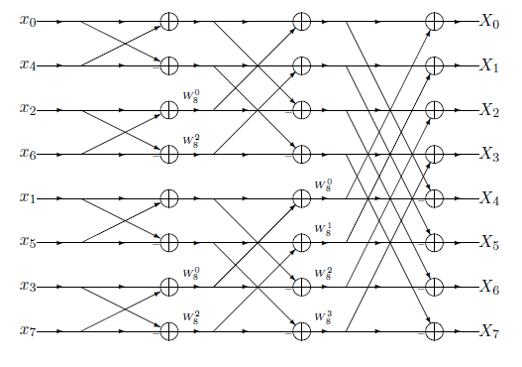
DIT N=8 - step 3

Slide 77
Complexity
An FFT of length N has
log₂(N) stages of butterflies
there are ½N butterflies in each stage, each with
1 complex multiply
2 complex adds (1 add and 1 subtract)
So there are :
½ N log₂(N) complex multiplications
N log₂(N) complex additions
Which is why we say that the complexity is O(N log N)
for N=8 there are 3 stages
Stage 1: 4 butterflies
Stage 2: 2*2 butterflies
Stage 3: 4*1 butterflies
stage 3 stage 2 stage 1

Slide 78
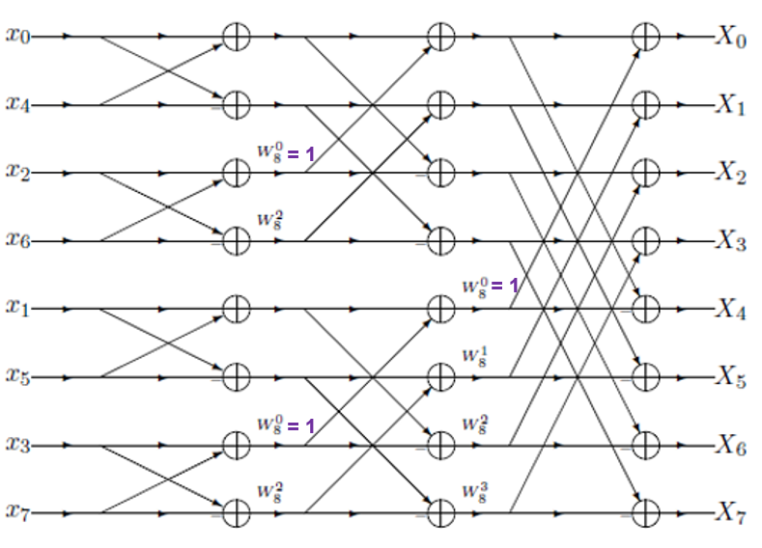

Well, its even a bit less
Actually, some of the multiplications are trivial!
the first stage has one trivial multiplication ($W_{N}^{0}$=1)
the 2nd stage has 2 trivial multiplications
…
the last stage has no true multiplications (it has N=2 butterflies!)
So for N=8 there are really only 5 multiplications instead of 8log₂(8) = 24 !
This is mostly important for small N!

Slide 79
Real complexity
So far we have counted complex multiplications and additions
Each complex add entails 2 real adds
Each complex multiply is either:
4 real multiplies and 2 real adds
(a + i b) (c + i d) = (a*c – b*d) + i (a*d + b*c)
or 3 real multiplies and 5 real adds
M1 = a*c M2 = b*d M3 = (a+b)*(c+d)
(a + i b) (c + i d) = (M1 – M2) + i (M3 – M2 – M1)
So
N log₂(N) complex additions = 2N log₂(N) real additions
½ N log₂(N) complex multiplications =
2N log₂(N) real multiplications
and another N log₂(N) real additions
or
3/2 N log₂(N) real multiplications
and another 5/2 N log₂(N) real additions

Slide 80
What’s going on?
The order of the input values is very strange!
Our time domain signal is not arranged x₀, x₁, x₂, … !

Slide 81
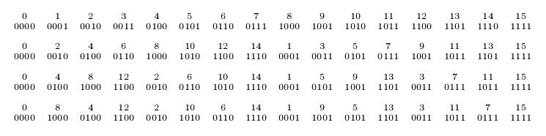
Bit reversal
Let’s see if we can figure it out! Here for N=16 IN-PLACE!
1st transition is cyclic left shift
2nd transition freezes the LSB and cyclic left shifts the rest
3rd transition freezes the 2 LSBs and cyclic left shifts (swaps) the rest
Altogether we find abcd → bcda → cdba → dcba
The bits of the index have been reversed !
This is called bit-reversal
and DSP processors have a special addressing mode for it

Slide 82
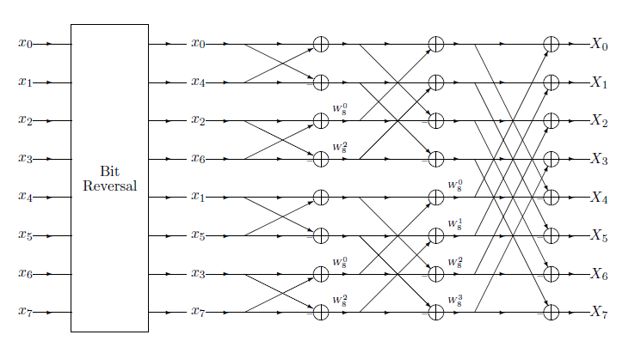
DIT N=8 with bit reversal

Slide 83
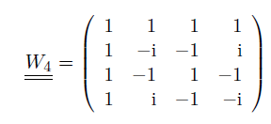
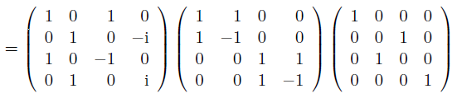
The matrix interpretation
The FFT can be understood as a matrix decomposition
that reduces the number of operations to multiply by it
For example, when N=4
The right matrix is a permutation matrix
which carries out the bit reversal
The middle matrix comprises the butterflies
(note the block matrix form)
The left matrix is the twiddle factors

Slide 84
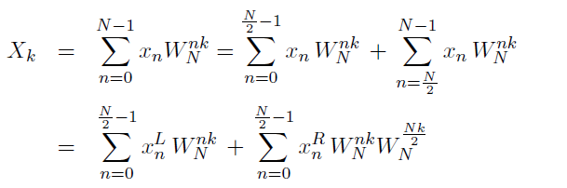
What about the DIF algorithm?
The other radix-2 FFT algorithm could be called Partition in Time
but is always called Decimation In Frequency
To derive it algebraically we need to return to the DFT formula
and partition the sum into high and low halves
We then exploit that DIF to relate X_{k} (even k) with X_{k+1}
resulting in butterflies
But instead of working hard we’ll use a trick!
Performing the transposition theorem on the N=8 DIT (and a mirror reflection)
gives us the n=8 DIF!

Slide 85
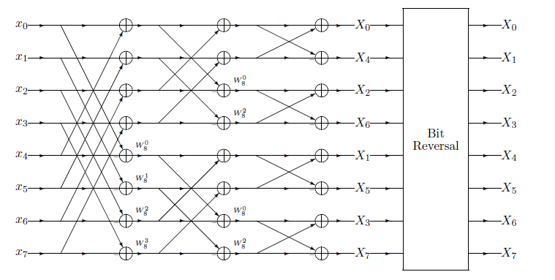
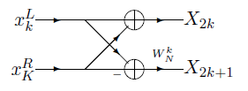
DIF N=8
DIF butterfly

Slide 86
FIFO FFT
There are many other Fast Fourier Transform algorithms!
What if we need to update the DFT every sample?
In other words, [x_{0,} x_{1,} x_{2,} … x_{N-1}], [x_{1,} x_{2,} x_{3,} … x_{N}], [x_{2,} x_{3,} x_{4,} … x_{N+1}], …
You might already know the trick
on how to update a simple moving average
A₁ = x₀ + x₁ + x₂ + … + x_{N-1}
A₂ = x₁ + x₂ + x₃ + … + x_{N} = A₁ – x₀ + x_{N}
A₃ = x₂ + x₃ + x₄ + … + x_{N+1} = A₂ – x₁ + x_{N+1}
This is implemented by maintaining a FIFO of length N
adding the new input and subtracting the one to be discarded
A similar trick works for weighted MA
if the weights form a geometric progression
A₁ = x₀ + q x₁ + q² x₂ + … + q^{N-1} x_{N-1}
A₂ = x₁ + q x₂ + q² x₃ + … + q^{N-1} x_{N} = (A₁ – x₀)/q + q^{N-1} x_{N}
A₃ = x₂ + q x₃ + q² x₄ + … + q^{N-1} x_{N+1} = (A₂ – x₁)/q + q^{N-1} x_{N+1}

Slide 87
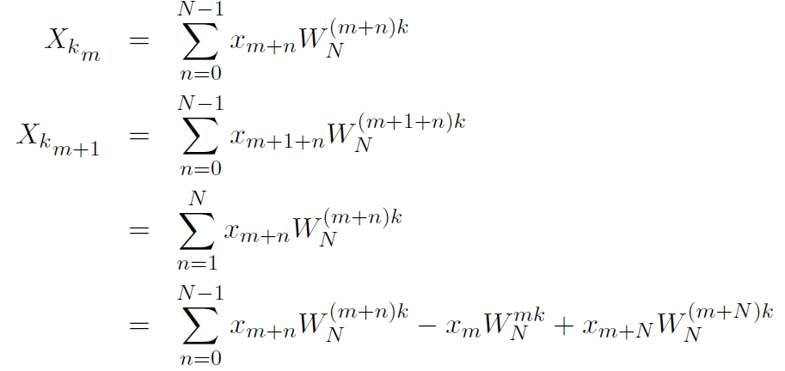

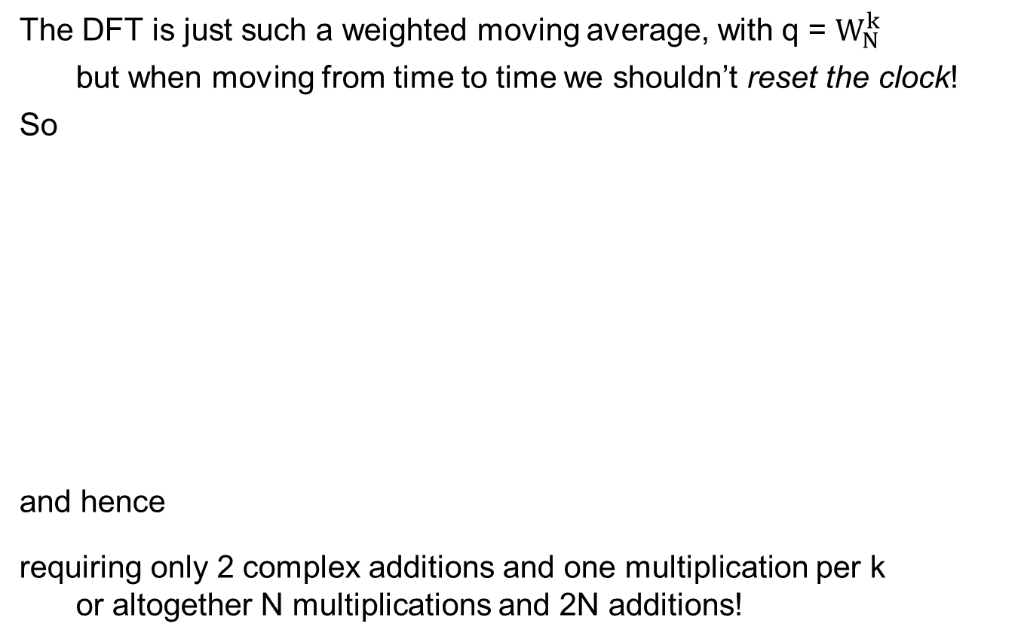
FIFO FFT (cont)
The DFT is just such a weighted moving average, with q = $W_{N}^{k}$
but when moving from time to time we shouldn’t reset the clock!
So
and hence
requiring only 2 complex additions and one multiplication per k
or altogether N multiplications and 2N additions!

Slide 88


Goertzel’s algorithm
Sometimes we are only interested in
the energy |X_{k}|² of a few of the frequencies k
and computing all N spectral values would be wasteful
For example, when looking for energy at a few discrete frequencies
as in a DTMF detector
For such cases there is an algorithm due to Goertzel (Herzl in Russian)
which is less expensive that running many bandpass filters
The idea is to compute only the X_{k} needed
by using Horner’s rule for evaluating polynomials (simplify $W_{N}^{k}$ to W)
This can be further simplified to get a noncomplex recursion

Slide 89



Goertzel 1
To make the recursion look like a convolution we use V = W⁻¹
Changing the overall phase doesn’t change the power spectrum
which using Horner’s rule is coded like this :
Since all the x_{n} are real, at each step P_{n} – P_{n-1}V is real
So we implicitly define a new real sequence Q_{n} by P_{n} = Q_{n} - Q_{n-1}W

Slide 90



Goertzel 2
After a little algebra we find the following recursion:
And the desired energy is given by
where

Slide 91
Using Goertzel
To use Goertzel first decide on how many points N you want to use
Since Goertzel’s algorithm only works for integer digital frequencies
(that is, for analog frequencies f = k/N fs)
larger N allows finer resolution and narrower bandwidth
but also longer computation time and delay
For each frequency that is needed
compute W and A
initialize
iterate N-1 times using A
compute X using W
compute the desired squared power using A

Slide 92


Other radixes
While radix-2 is popular, sometimes other radixes are better
The radix 4 DFT is
which corresponds to radix-4 butterflies
which is more expensive than radix-2
12 complex additions
0 true multiplications
8 complex additions
0 true multiplications

Slide 93
FFT842
But this is only the case for N=4 itself
For powers of 4 there are only log₄N = 1/2 log₂N stages of butterflies
and each has ¾ N complex multiplications
and so only 3/8 log₂N multiplications altogether
which is slightly less than ½ log₂N !
But only half of the powers of 2 are also powers of 4
so the algorithm is less applicable …
Similarly, for N=8^{m} there are even fewer stages
but only a quarter of the powers of 2 are powers of 8
So, the FFT842 algorithm performs as many radix-8 stages that it can
it then performs either a radix-4 or a radix-2 stage as needed
It beats out pure radix-2 algorithms on general purpose CPUs
but highly optimized radix-2 are preferable on DSPs

Slide 94
Multiplication by FFT
When learning the Toom-Cook algorithm
we said that for large N the FFT will multiply even faster
That is because O(N log N) < O(N^{log}2³)
We saw that long multiplication c = a*b is actually 2N convolutions
Hence convolution in the time domain takes O(N²) multiplications
but in the frequency domain it only takes O(N)
So the strategy is instead of convolution c = a * b
use the FFT to convert from the time to the frequency domain
a→A and b→B [ O(N log N) ]
multiply point by point in the frequency domain C=AB [ O(N) ]
convert back from the frequency to the frequency domain
C → c [ O(N log N) ]
Altogether O(N log N) !

Slide 95

Example multiplication (1)
Let’s see how this works for N=4 !
We want to multiply a = a₃ a₂ a₁ a₀ by b = b₃ b₂ b₁ b₀
We convert the numbers into time domain signals
a₀ a₁ a₂ a₃ and b₀ b₁ b₂ b₃

Slide 96


Example multiplication (2)
For this simple case we can simply convert all 16 signals
into the frequency domain
To do this we multiply by the DFT matrix
and we find:
Of course, using the W matrix for conversion is O(N²)
But we would get the same answers with the FFT

Slide 97


Example multiplication (3)
For example, let’s multiply 2*3
Looking this up we find is indeed S^{[6]}
And similarly for almost all other multiplications that fit into 4 bits
0 * s = 0
1 * s = s
2 * 4 = 8
2 * 5 = 10
2 * 6 = 12
2 * 7 = 14
3 * 4 = 12
3 * 5 = 15

Slide 98

Example multiplication (4)
All products that fit into 4 bits work correctly - except 3*3
What’s going on?
Converting back using the iDFT we find (1, 2, 1, 0)
which has a meaningless 2 bit !!!
So, we convert back into binary digits 0121
and perform the carries to get 1001 which is indeed 9
For all products that exceed 4 bits
we can use 8 bits
i.e., signals with 8 time values

Slide 99
Spectral Estimation
Sometimes we only need to know which frequencies are in a signal
For this task the FFT is almost always not the best solution
for unknown frequencies you need to compute the entire spectrum
it does not give accurate frequencies - only bins (depending on N)
There are better ways, for example:
If you know that the signal is a single sinusoid in white noise
or N sinusoids in white noise
then use the Pisarenko Harmonic Distribution
If the signal can be assumed to be generated by an AR filter
solve the Yule-Walker equations
and the pole angles give the frequencies!

Slide 100
Why do we need DSPs?
In this part of the course DSP = Digital Signal Processor
A DSP is a CPU that is used in signal processing applications
Why do we need a DSP? Why not use a regular CPU?
DSPs are optimized for DSP, and thus :
DSPs are physically small
several millimeters as compared to several centimeters
DSPs are much more energy efficient
a DSP may consumes milliwatts
as compared to standard CPUs tens of watts or more
DSPs are less expensive
a DSP may cost several dollars or less
as compared to a CPUs 10s – 100s of dollars or more

Slide 101
Other special processors
DSPs are not the only species of special CPUs
Array Processors specialize in matrix multiplication
FFT chips compute FFT even faster than DSPs
by parallelizing the butterflies (up to a given size)
Systolic Arrays have arrays of simple processors to perform
matrix operations
convolutions
image processing
Graphics Processing Units were designed for graphics displays
but are now used for many parallelizable tasks
such as deep learning
AI processors, to accelerate neutral network training
Network processors are optimal for packet forwarding

Slide 102
DSP Processors
We have seen that the Multiply and Accumulate (MAC) operation
is very prevalent in DSP computation
computation of energy
MA filters
AR filters
correlation of two signals
DFT
A Digital Signal Processor (DSP) is a CPU
that can compute MACs very efficiently
In fact, a DSP computes each individual MAC in 1 CPU clock cycle
Thus an L coefficient MA takes (about) L clock cycles in a DSP
and to perform it in real-time
L must be less than the sample interval (time between 2 inputs)

Slide 103
CPU architecture
The term architecture in CS originated
when IBM designed a series of computers
and desired to use the same (assembly) code on all of them
Like in buildings, architecture means the overall design
without quantitative details
A DSP is a CPU with a specific architecture
designed to be efficient in computation of MACs
The idea is to remove all architectural elements not needed for MACs
(e.g., cache memory) in order to keep size and power minimal
and add new architectural elements that support MACs
We will start with a simple generic CPU architecture
and see what elements we need to add

Slide 104
A simple CPU
We will assume a simplistic model of CPU architecture
the CPU is driven by a crystal (clock)
faster CPUs can use higher frequency clocks
the CPU connects to external memory
over a bus
the CPU has an ALU with
the usual arithmetic operations
the CPU has registers
which are internal memory locations
upon which the ALU can operate
CPU
x
y
XTAL
t
ALU with
ADD, MULT, etc
bus
memory
registers
PC
a
x
y
z

Slide 105
What is the XTAL for?
All CPUs are driven by an oscillator (usually a piezoelectric crystal)
that supplies periodic pulses (we often say clocks or cycles or ticks)
We quantify efficiency of an operation by the number of ticks it requires
CPUs are rated according to the maximum frequency of the crystal
So, a 3 GHz CPU can compute 3 times as fast as a 1 GHZ CPU
if it is fed by a 3 GHZ crystal (but will be the same if fed by 1 GHz xtal!)
To increase yield, fabricated CPUs dies are tested for speed
and the CPUs rated according to the speed attained
Modern CPUs use microcode
their op-codes do not directly translate into hardware operations
but are actually subroutines in a lower level language
Each individual microcode instruction takes place in on pulse time
Most op-codes require multiple microcode instructions
(e.g., the multiplication op-code might be microcoded Toom-Cook)

Slide 106
Why registers?
CPUs are classified based on the number of addresses in an op-code
3 address CPUs: A1 = A2 op A3
2 address CPUs: A1 = A1 op A2
0 address CPUs (stack machines): op
Early computers allowed arithmetic operations on memory locations
but this severely limits memory space
So a full 3-address architecture
needs an opcode that contains 3 addresses in memory
For example, a computer with 1 MB of memory
requires 3*20bits = 60 bits just to specify memory
and more bits to describe the operation
The alternative is to enable arithmetic only on registers
which are special memory locations internal to the CPU
So, if we have 16 registers
a full 3-address architecture only requires 3*4=12 bits + operation
The cost is the need to load from and store to external memory

Slide 107
Special registers
Not all registers are created equal!
In addition to general purpose registers all CPUs have special ones
There is one special register called the Program Counter
that always holds the address of the next op-code to be performed
It is auto-incremented each operation
but can be overwritten by goto and conditional branch op-codes
In DSPs some registers are accumulators
Accumulators hold larger numbers than regular registers
(e.g., a regular register may be 16 bits in length
and an accumulator 24 bits – 8 guard bits)
Accumulators are used for accumulating
and need the longer length in order not to overflow!
Many CPUs have other special registers
such as stack pointers, loop counters, pointer registers, etc.

Slide 108
High-level MAC loop
The basic MAC loop in high level languages is
(assuming that a and x are in static buffers)
loop over all times n
initialize y_{n} ← 0
loop over i from 1 to number of coefficients (L)
y_{n} ← y_{n} + a_{i} * x_{j} (j somehow related to i)
output y_{n}
Efficient low level programming always uses (read) pointers
since array indexing requires wasteful offset calculations
ADDR(a[i]) = ADDR(a[0]) + i * word-length
To explicitly increment the pointers
ADDR(a[i+1]) = ADDR(a[i]) + word-length
For energy and correlation i and j increase together
For convolution i increases and j decreases

Slide 109
Intermediate level MAC loop
So, in some imaginary assembly level language
our MAC loop looks like this:
loop over all times n
clear y
set number-of-iterations to L
loop
decrement number-of-iterations
if number-of-iterations = 0 then terminate loop
update a pointer
update x pointer
multiply z ← a * x (3-address addressing)
increment y ← y + z (2-address addressing)
output y

Slide 110
Low level MAC loop
Now let’s use registers! (remember we have a, x, and y registers)
loop over all times n
clear y register
set number-of-iterations to L
loop
decrement number-of-iterations
if number-of-iterations = 0 then terminate loop
update a pointer
load contents of memory addressed by a into register a
update x pointer
load contents of memory addressed by x into register x
multiply z ← a * x (register operation!)
increment y ← y + z (register operation!)
store y

Slide 111
Zero-overhead loops
DSPs, like many CPUs, have a zero-overhead loop
This means that we can configure a special loop counter register
that auto-decrements and is tested implicitly
loop over all times n
clear y register
loop number-of-iterations times (zero overhead loop)
update a pointer
load contents of memory addressed by a into register a
update x pointer
load contents of memory addressed by x into register x
multiply z ← a * x (register operation!)
increment y ← y + z (register operation!)
store y
Why do we no longer care about the decrement and testing?
Since additional hardware (silicon) takes care of this task
in parallel to other operations!

Slide 112
Cycle counting
We still can’t count clock ticks
since really low level (hardware) operations
need to take the op-code fetch and decode into account
So the clocks operations inside the outer loop look something like this:
Update pointer to a_{i}
Update pointer to x_{j}
LOAD contents of a_{i} into register a
LOAD contents of x_{j} into register x
Fetch operation (MULT)
Decode operation (MULT)
MULT a*x with result in register z (MULT really takes >1 clock!)
Fetch operation (INC)
Decode operation (INC)
INC register y by contents of register z
So, it takes at least 10 cycles to perform each MAC using a regular CPU
Our mission (and we have decided to accept it!)
is to reduce this to 1 clock cycle by adding new silicon

Slide 113
This really isn’t right!
We ridiculously assumed each operation takes only 1 cycle
we know multiplication takes many more
addition frequently takes a few cycles
even fetch really requires at least 2 cycles
1 to send an address to external memory
1 to retrieve the value from the memory
So we are radically underestimating
the number of cycles a regular CPU needs
But we don’t care since this will happen in any CPU
even a DSP!

Slide 114
Step 1 - new opcode
To build a DSP (a 1-cycle MAC CPU)
we need to enhance the basic CPU with new hardware (silicon)
The easiest step is to define a new opcode called MAC
which is what Intel did in the MMX extensions
The upgraded code now looks like this:
Update pointer to a_{i}
Update pointer to x_{j}
LOAD contents of a_{i} into register a
LOAD contents of x_{j} into register x
Fetch operation (MAC)
Decode operation (MAC)
MAC a*x with incremented to accumulator y
However 7 > 1, so this is still NOT a DSP !
ALU with
ADD, MULT, MAC, etc
bus
memory
p-registers
PC
pa
px
accumulator
registers
y
a
x

Slide 115
Step 2 - register arithmetic
The two operations
Update pointer to a_{i}
Update pointer to x_{j}
could be performed in parallel
but both are performed by the ALU
So we add pointer arithmetic units
one for each pointer register
Special sign || used in DSP assembler
to mean operations in parallel
ALU with
ADD, MULT, MAC, etc
bus
memory
p-registers
PC
pa
px
INC/DEC
accumulator
registers
y
a
x
z
Update pointer to a_{i} || Update pointer to x_{j}
LOAD contents of a_{i} into register a
LOAD contents of x_{j} into register x
Fetch operation (MAC)
Decode operation (MAC)
MAC a*x with incremented to accumulator y
However 6 > 1, so this is still NOT a DSP !

Slide 116
Step 3 - memory banks and buses
We would like to perform the loads in parallel
but we can't since they both have to go over the same bus
So we add another bus
and segment into memory banks
so that there is no contention !
There is dual-port memory
but it has an arbitrator which adds delay
Update pointer to a_{i} || Update pointer to x_{j}
LOAD a_{i} into a || LOAD x_{j} into x
Fetch operation (MAC)
Decode operation (MAC)
MAC a*x with incremented to accumulator y
However 5 > 1, so this is still NOT a DSP !
ALU with
ADD, MULT, MAC, etc
bus
p-registers
bank 1
PC
pa
px
INC/DEC
bus
bank 2
accumulator
registers
y
a
x

Slide 117
Harvard architecture
One of the first digital computers
was the Automatic Sequence Controlled Calculator (the Mark I)
that was designed in Harvard by Howard Aiken (and built by IBM)
and employed >750,000 electromechanical components
It was funded by the US Navy
and later enhanced to become the Harvard Mark II, III, and IV
The Harvard computers were used by John von Neumann
for calculations related to the Manhattan project
and was programmed by Grace Hopper (the originator of the word bug)
The overall architecture of the Harvard computers included
a central processing unit
program memory (that is immutable during run-time)
data memory (that can be read and written during run-time)

Slide 118
Von Neumann architecture
The Electronic Numerical Integrator and Computer is often called the 1st
fully programmable, general-purpose, digital computer
It was designed by John Mauchly and J. Presper Eckert
at the University of Pennsylvania, funded by the US army
based on principles described in 1945 by John von Neumann
The overall architecture of the ENIAC included
a central processing unit
a single memory that holds both program op-codes and data
Von Neumann merged program and data memory not only to simplify
but to enable changing the program during run-time (learning)
Turing, after reading von Neumann’s paper,
abstracted these principles into what is called the Turing machine
The von Neumann architecture is used in all modern computers
except DSPs!

Slide 119
Step 4 - Harvard architecture
By adopting Harvard architecture with yet another bus to another memory
we needn't count fetch since it is performed in parallel
We can remove the decode cycle as well
(we’ll see why later)
ALU with
ADD, MULT, MAC, etc
bus
data 1
p-registers
bus
PC
pa
px
data 2
INC/DEC
accumulator
registers
bus
program
y
a
x
Update pointer to a_{i} || Update pointer to x_{j}
LOAD a_{i} into a || LOAD x_{j} into x
MAC a*x with incremented to accumulator y
However 3 > 1, so this is still NOT a DSP !

Slide 120
Step 5 - pipelines
We seem to be stuck
Update MUST be before Load
Load MUST be before MAC
But we can use a pipelined approach
It takes 1 tick per tap as long as the pipeline is full
altogether it takes n+2 clocks (which is n for large n!)
More generally, a pipeline of depth D takes n+D-1 ticks
op
U1 | U2 | U3 | U4 | U5
 | L1 | L2 | L3 | L4 | L5
 |  | M1 | M2 | M3 | M4 | M5
t
1
2
3
4
5
6
7

Slide 121
Why do we need longer pipelines?
Why would we want D>3 ?
Remember that we said
that we don’t have to count ticks for fetch and decode?
These are actually performed in parallel using a pipeline
Doesn’t a MAC op-code have to multiply before adding?
Yes, but the DSP chip pipelines them
Remember we said that multiplication
really takes many more than 1 cycle?
We can pipeline these cycles to reduce overall execution time
Of course, adding to the pipeline’s depth
increases the delay
makes filling the pipeline more challenging
is subject to diminishing returns (Amdahl’s law)

Slide 122
Pipelines in other CPUs
Many modern CPUs employ pipelines – how are DSPs different?
DSPs employ pipelining as a last resort (when logically stuck)
other CPUs use pipelining as the main (only) parallelization
Thus, non-DSP CPUs can pipeline all stages of a MAC
resulting in lower ticks/tap
but more delay and less determinism
Advanced non-DSP CPUs even employ speculative lookahead
to attempt to keep the pipeline full with conditional branches
DSPs allow programmers to monitor and manipulate the pipeline
for other CPUs pipelining is basically transparent
DSPs actually get more from pipelining
due to memory banks and Harvard architecture

Slide 123
DSP programming
DSP programming is harder than regular programming
(which is why it is today mostly done in India and eastern Europe)
For maximal efficiency :
one needs to program in assembly
one needs to know the DSP’s architecture
one needs to program in parallel assembly
one needs to place data in the correct memory banks
one needs to keep the pipeline full
The last portion often requires painstakingly rewriting and reordering
The usual technique is to start with many NOPs
and iteratively improve the program eliminating pipeline holes

Slide 124
DSP programmers
There are three types of DSP programmers
1. algorithm designers
use floating point
care more about theory than real-time
usually code in MATLAB, Python, C++
2. low-level coders
structure code for real-time
convert algorithms from floating point to fixed point
usually code in C
3. DSP coders
convert real-time oriented C to parallel assembly
work directly on the silicon
program critical routines in DSP assembly language
program non-critical routines in C with pragmas

Slide 125
Zero-overhead interrupts
How do the input sample values get into the buffers?
All CPUs have (serial or parallel) I/O ports
with memory for one value (bit or byte or whatever)
There are two methods for transferring from an input port to the buffer:
1. Polling – the CPU repeatedly checks if something is in port memory
this is very inefficient since we need to check overly frequently
2. Interrupts – when the input port is ready it raises an interrupt
causing the CPU to perform a context switch
Context switches are very expensive on regular CPUs
since all registers need to be saved and later restored
Most DSPs have a limited zero-overhead interrupt mechanism
where certain registers are copied into shadow registers in 1 cycle
and restored when returning form the interrupt handler
Such handlers are usually limited to a small number of instructions
(just enough to copy and increment the buffer length)
and are themselves non-interruptable

Slide 126
Fixed point
In the real world signal values are real numbers
that can be well approximated by rational numbers
but not usually by integers
Fixed point representation represents a rational number as a integer
by fixing the (binary) decimal point, described as Qm.n notation
We often take m=0 and use Qn (scientific) notation
in which the integer value I represents the rational Q = I / 2^{n}
In each part of the program
all values are represented in the same Qn
but in different parts different Qn are used
sign
bit
m
n

Slide 127
Q representation examples
On a machine with 16 bit registers
since
0.100000000000000 = 0.5
01000000.00000000 = 64.0
010000000000.0000 = 1024.0
binary | integer | Q15 value | Q8 value | Q4 value
0100000000000000 | 16384 | 0.5 | 64.0 | 1024.0
0010000000000000 | 8192 | 0.25 | 32.0 | 512.0
0001000000000000 | 4096 | 0.125 | 16.0 | 256.0
1100000000000000 | -16384 | -0.5 | -64.0 | -1024.0
1010000000000000 | -8192 | -0.25 | -32.0 | -512.0
1001000000000000 | -4096 | -0.125 | -16.0 | -256.0

Slide 128
Saturation Arithmetic
Many DSPs are fixed point, i.e. handle (2s complement) integers only
Floating point is more expensive and slower
(because of the need to renormalize after calculation)
Floating point numbers can underflow
Fixed point numbers can overflow
We saw that accumulators have guard bits to protect against overflow
When regular fixed point CPUs overflow
numbers greater than MAXINT become negative
numbers smaller than -MAXINT become positive
Fixed point DSPs have a saturation arithmetic mode
numbers larger than MAXINT become MAXINT
numbers smaller than -MAXINT become -MAXINT
this is still an error, but a smaller error
There is a tradeoff between safety from overflow and SNR

Slide 129
What else is special?
We have already mentioned that DSPs support bit-reversed addressing
which speeds calculation of FFTs
However, it is important to consider what DSPs don’t have:
most DSPs run at modest clock rates compared to modern CPUs
(50MHz, 100 MHz, 200 MHz)
many DSPs are fixed point
many DSPs have modest word sizes (16/24 bits, 32/40 bits)
DSPs do not have program or data cache memory
DSPs do not use modern accelerations, e.g., speculative execution
most DSPs do not have a division op-code
DSPs do not have a square-root op-code
That’s why DSPs are amazing at DSP tasks ( but miserable at others)
but can be small and require little power

Slide 130
What – no division?
Most DSPs do not have an op-code for division, which is often needed
For example, Automatic Gain Control divides by the RMS
If time is not critical one can use a library routine
but for real-time we need something better
It is enough to know how to invert y = 1/x
for which there are many iterations
that converges to the right answer
The simplest one is
Start with a reasonable guess for y
Loop
y ← y * (2 – y*x)
If you start with a good guess*, this will converge in a few iterations
For AGC, initializing with the previous value, 3 iterations is often enough
* many DSPs have an inverse-seed opcode

Slide 131

Example : how much is ½?
attractor
wrong!

Slide 132
Full division
If you need to divide y = N/D
and don’t want to invert and multiply
then Goldschmidt division uses a similar trick
N’ ← N
D’ ← D
Loop
y ← 2 – D’
N’ ← N’ * y
D’ ← D’ * y
More generally
many operations can be carried out by finding a recursion
for which the answer is an attractive fixed point

Slide 133

Square root
Square roots are often needed in DSP
and some DSPs have a square-root-seed op-code
but none have a full square-root
The most common non-DSP iteration for square root y = $\sqrt{x}$
is the Newton-Raphson iteration which converges quadratically
(and is great for finding square roots in your head!)
y ← square-root-seed(x)
Loop
y ← ½ (y + x/y)
but this requires a division!
Sometimes one can use the fact that log($\sqrt{x}$) = ½ log(x)
along with algorithms for log and power
For small intervals one can use polynomial approximations
such as y ≈ −0.5973x² + 1.4043x + 0.1628
But there is often an alternative

Slide 134

Example : how much is √4 ?

Slide 135

Pythagorean addition
In DSP applications square root is mostly required as part of
Pythagorean addition
for which there are approximations such as
where 0.25 < k < 0.31
k=0.267304 gives the exact mean
k=0.300585 gives minimum variance
More importantly the Moler-Morrison algorithm
which requires 2 divisions
and the CORDIC algorithm requires only shift and add
and converges exponentially, gaining 1 bit per iteration

Slide 136

Moler Morrison
p ← max(|x|, |y|)
q ← min(|x|, |y|)
while q > ε
r ← (q/p)²
s ← r / (4 + r)
p ← p + 2sp
q ← sq
return p
Note that in each iteration
sum of squares
remains the same
s decreases

Slide 137

Sine and Cosine
Of course, we need sin and cos all the time!
Non-DSP libraries use Taylor expansions, which are inefficient
However, we most often need to generate both sin(ωn) and cos(ωn)
for increasing n = 0, 1, 2, 3, 4 ...
1. We know how to update sin(ωn) using a difference equation
sin(ω(n+1)) = 2cos(ω) sin(ωn) – sin(ω(n-1))
which requires 2 initial values
2. Both sin and cos together is easy since $e^{iω(n+1)}=e^{iω }e^{iωn}$
which is the same as the trig identities:
sin(ω(n+1)) = cos(ω) sin(ωn) + sin(ω) cos(ωn)
cos(ω(n+1)) = cos(ω) cos(ωn) - sin(ω) sin(ωn)
So from a single pair we can continue
However, both methods may suffer from error accumulation

Slide 138

CORDIC
The COordinate Rotation for DIgital Computers (CORDIC) algorithm
is an iteration for calculating elementary functions
using only addition and binary shift
It was described in 1959 by Volder (and refined Walther)
and was used in the first scientific hand-held calculator (HP-35)
It computes 1 bit / iteration
and so is great for hardware implementations
but has a conditional and so breaks pipelines
CORDIC can simultaneously compute these pairs of functions
sin(θ) and cos(θ)
sinh(θ) and cosh(θ)
$\sqrt{x^{2}+ y^{2}}$ and $\tan^{−1}(\frac{y}{x})$
$\sqrt{x^{2}− y^{2}}$ and $\tanh^{−1}(\frac{y}{x})$
$\sqrt{x}$ and ln(x)
$e^{x}$ (alone)

Slide 139

The main idea behind CORDIC for sin/cos
An arbitrary angle θ in the 1st quadrant [0,π/2] can always be written
as a sum of angles ${±α}_{i}$ where tan($α_{i}$) = 2^{-i}
For example,
90º = $α_{0}$ + $α_{1}$ + $α_{2}$+ $α_{3}$- $α_{4}$+ $α_{5}$ + ...
60º = $α_{0}$ + $α_{1}$ - $α_{2}$+ $α_{3}$- $α_{4}$- $α_{5}$ + ...
30º = $α_{0}$ - $α_{1}$+ $α_{2}$- $α_{3}$+ $α_{4}$+ $α_{5}$ + ...
15º = $α_{0}$ - $α_{1}$ - $α_{2}$+ $α_{3}$+ $α_{4}$- $α_{5}$ + ...
Note that multiplication by tan($α_{i}$) is actually a right shift
k | tan⁻¹ 2^{-k}
0 | 45º
1 | 26.566º
2 | 14.036º
3 | 7.125º
4 | 3.576º
5 | 1.790º
... | ...
∞
θ = ∑(± tan⁻¹ 2^{-k} )
k=0

Slide 140




CORDIC for sin/cos
Recall that coordinate rotations in the plane are performed by
We can reach an arbitrary point on the unit circle (cos(θ), sin(θ))
by starting from the point (1,0) [θ=0]
and performing a coordinate rotation
The coordinate rotation can be decomposed
into the sum of angles ${±α}_{i}$ = $±$tan⁻¹ 2^{-k}
So the R(θ) can be written as
the product of matrices of the form
(cosθ, sinθ)
θ
(1,0)

Slide 141


No multiplications!
Multiplying by the M matrices
only requires addition/subtractions and left shifts
All that is needed is to finish off is to multiply once by all the cos($α_{i}$)
but since cos is an even function we can precompute the product
And instead of multiplying by K at the end
we can simply start with the vector (K,0) instead of (1,0) !
Note that since the multiplicands are all inverse powers of 2
each iteration gives us another bit of accuracy
(exponentially fast convergence!)
We can now give the full CORDIC algorithm
to simultaneously calculate the cos and sin
of any angle in the 1st quadrant
What do we do for the other quadrants?

Slide 142

The CORDIC algorithm
The full derivation is in the course text!
depends on sgn(z)

