Slide 1
5G – what’s it all about?
Yaakov (J) Stein

Slide 2
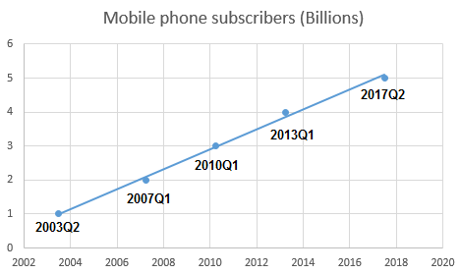
Importance of mobile communications
Mobile communications is consistently ranked
as one of mankind’s breakthrough technologies
Annual worldwide mobile service provider revenue exceeds 1 trillion USD
and mobile services generate about 5% of global GDP
5 billion people (2/3 of the world) own at least 1 mobile phone (> 8B devices)
with over ½ of these smartphones
and over ½ of all Internet usage
is from smartphones

Slide 3
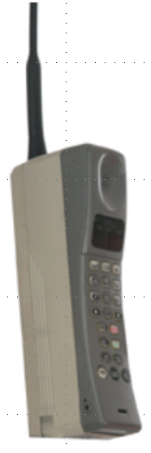
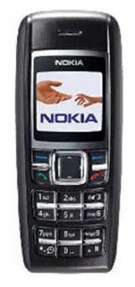
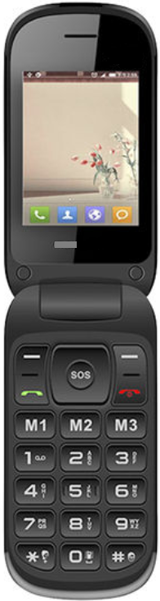

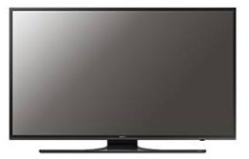
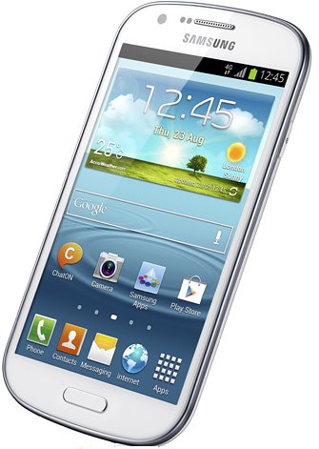
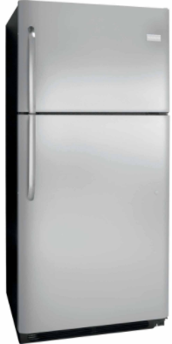
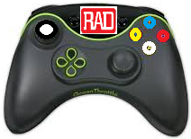
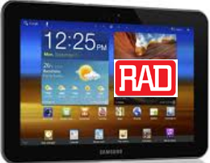
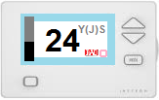
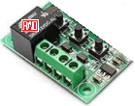
Generations of cellular technologies
 | 1G | 2G | 3G | 4G | 5G
3GPP releases |  |  | 4 - 7 | 8-9, 10-14 | 15, 16
era | 1980s | 1990s | 2000s | 2010s | 2020s
services | analog voice | digital voice messages | WB voice packet data | voice, video always on Internet | everything
devices
data rate | 0 | 100 kbps (GPRS) | 10 Mbps (HSPA) | 100+ Mbps (LTE/LTE-A) | 10 Gbps (NR)
delay |  | 500 ms | 100 ms | 10s ms | 5 ms

Slide 4





The 5G refrigerator

Slide 5
What’s wrong with 4G?
4G made possible:
fast Internet access
video reception and creation
apps relying on location and identity
always-on behavior
but suffers from numerous limitations:
for some applications: data-rate too low
for some applications: delay too high
too few simultaneous connections (insufficient density)
coverage too low / drop rate too high
weak (if any) QoS guarantees
price per bit too high (inefficient spectral use)
power consumption too high (and thus battery life too low)
poor support for new applications/markets (e.g., IoT, AR/VR, connected cars)
no support for new mobility requirements (mobile hot spots, high speed)
insufficient security/privacy
5G is designed to address 4G limitations

Slide 6
5G importance
5G will enable entirely new market segments
enhanced wireless broadband (eMBB)
Wireless-to-the-Premises
broadband on high-speed trains, at events and in crowds
massive IoT (20 B IoT devices connected by 2020)
Smart X (home, city, utilities)
V2X (vehicle to vehicle, vehicle to infrastructure, vehicle to pedestrians)
Virtual Reality / Augmented Reality
A study led by Qualcomm finds that by 2035
$3.5 trillion in 5G direct yearly revenues
$12.3 trillion worth of goods and services will be enabled by 5G
22 million jobs will be attributable to 5G
5G will boost global GDP growth by $3 trillion (compared to 2020)
about the GDP of India

Slide 7
5G is coming fast!
You may think that 5G is futuristic, but it is coming fast
3GPP accelerated the standardization work-plan
5G phase 1 (release 15) finished by June 2018 for trials in 2019
5G phase 2 (release 16) finished by March 2020
WRC-19 approved 17.25 GHz of new spectrum in November 2019
and the ongoing FCC auction has already surpassed $8B
SPs/vendors did not even wait for 2019!
Verizon deployed its own pre-standard 5G (using Samsung and LG phones)
AT&T is deployed in about 20 cities
see next slide for European situation
Analysts predict that by 2025
50% of US 30% of European 25% of Chinese
mobile connections will be 5G
I want 5G, and even 6G, technology in the United States as soon as possible
Donald Trump

Slide 8
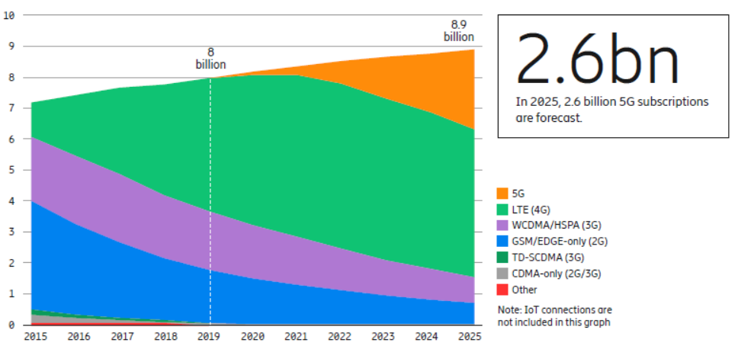
5G is coming fast!
Source: Ericsson Mobility Report, Nov 2019

Slide 9
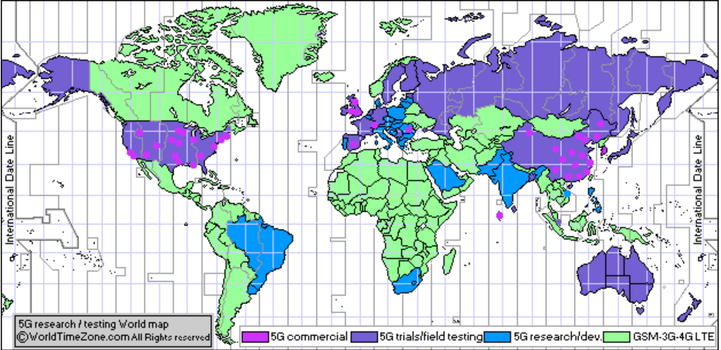
5G is already here!
>7000 deployments >100 operators
WorldTimeZone Dec 12, 2019

Slide 10
Verticals
All earlier generations were designed for general purpose connectivity
without considering requirements for specific use cases
5G focused on several vertical markets of interest
general Internet (broadband) ● entertainment and gaming
AR/VR ● wearables
first responders ● critical infrastructure
smart city ● smart utilities
automotive (V2X) ● mass transit
e-health ● e-government
manufacturing (incl. industrial robots) ● agriculture
and collected specific requirements for each
Requirements naturally fell into 3 main categories
eMBB enhanced mobile broadband
URLLC ultra-reliable and low latency communications
mMTC (AKA mIoT) massive machine type communications
These categories were the basis of ITU-R’s framework

Slide 11
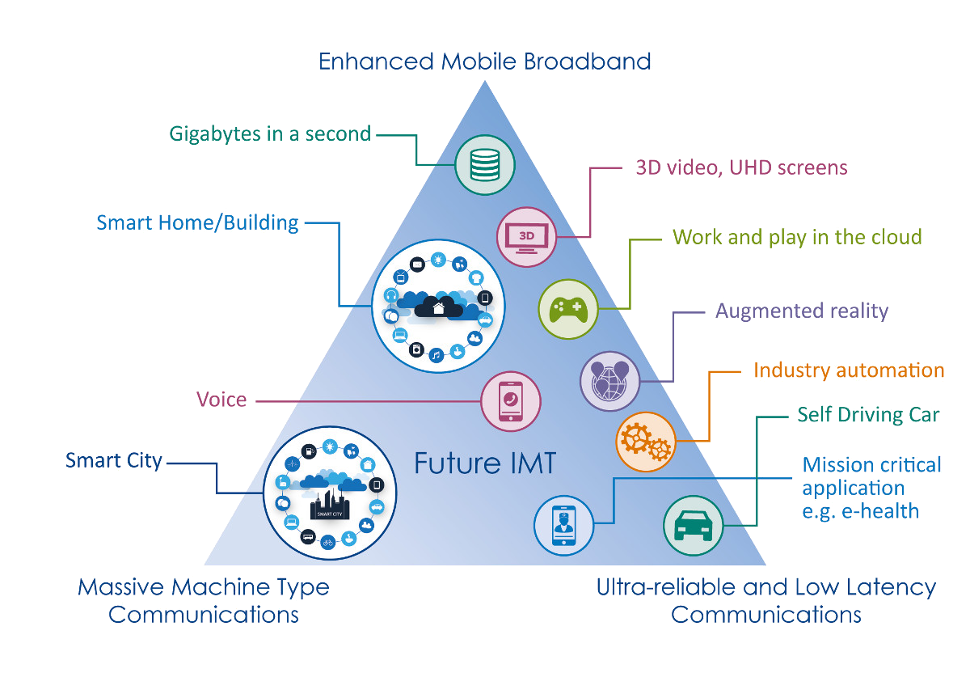
3 Categories
eMBB
10 Gbps, 10 Mbps/m²
from M.2083.0
1 Million / km²
1 ms, 5 nines
mMTC
(MIoT)
URLLC

Slide 12
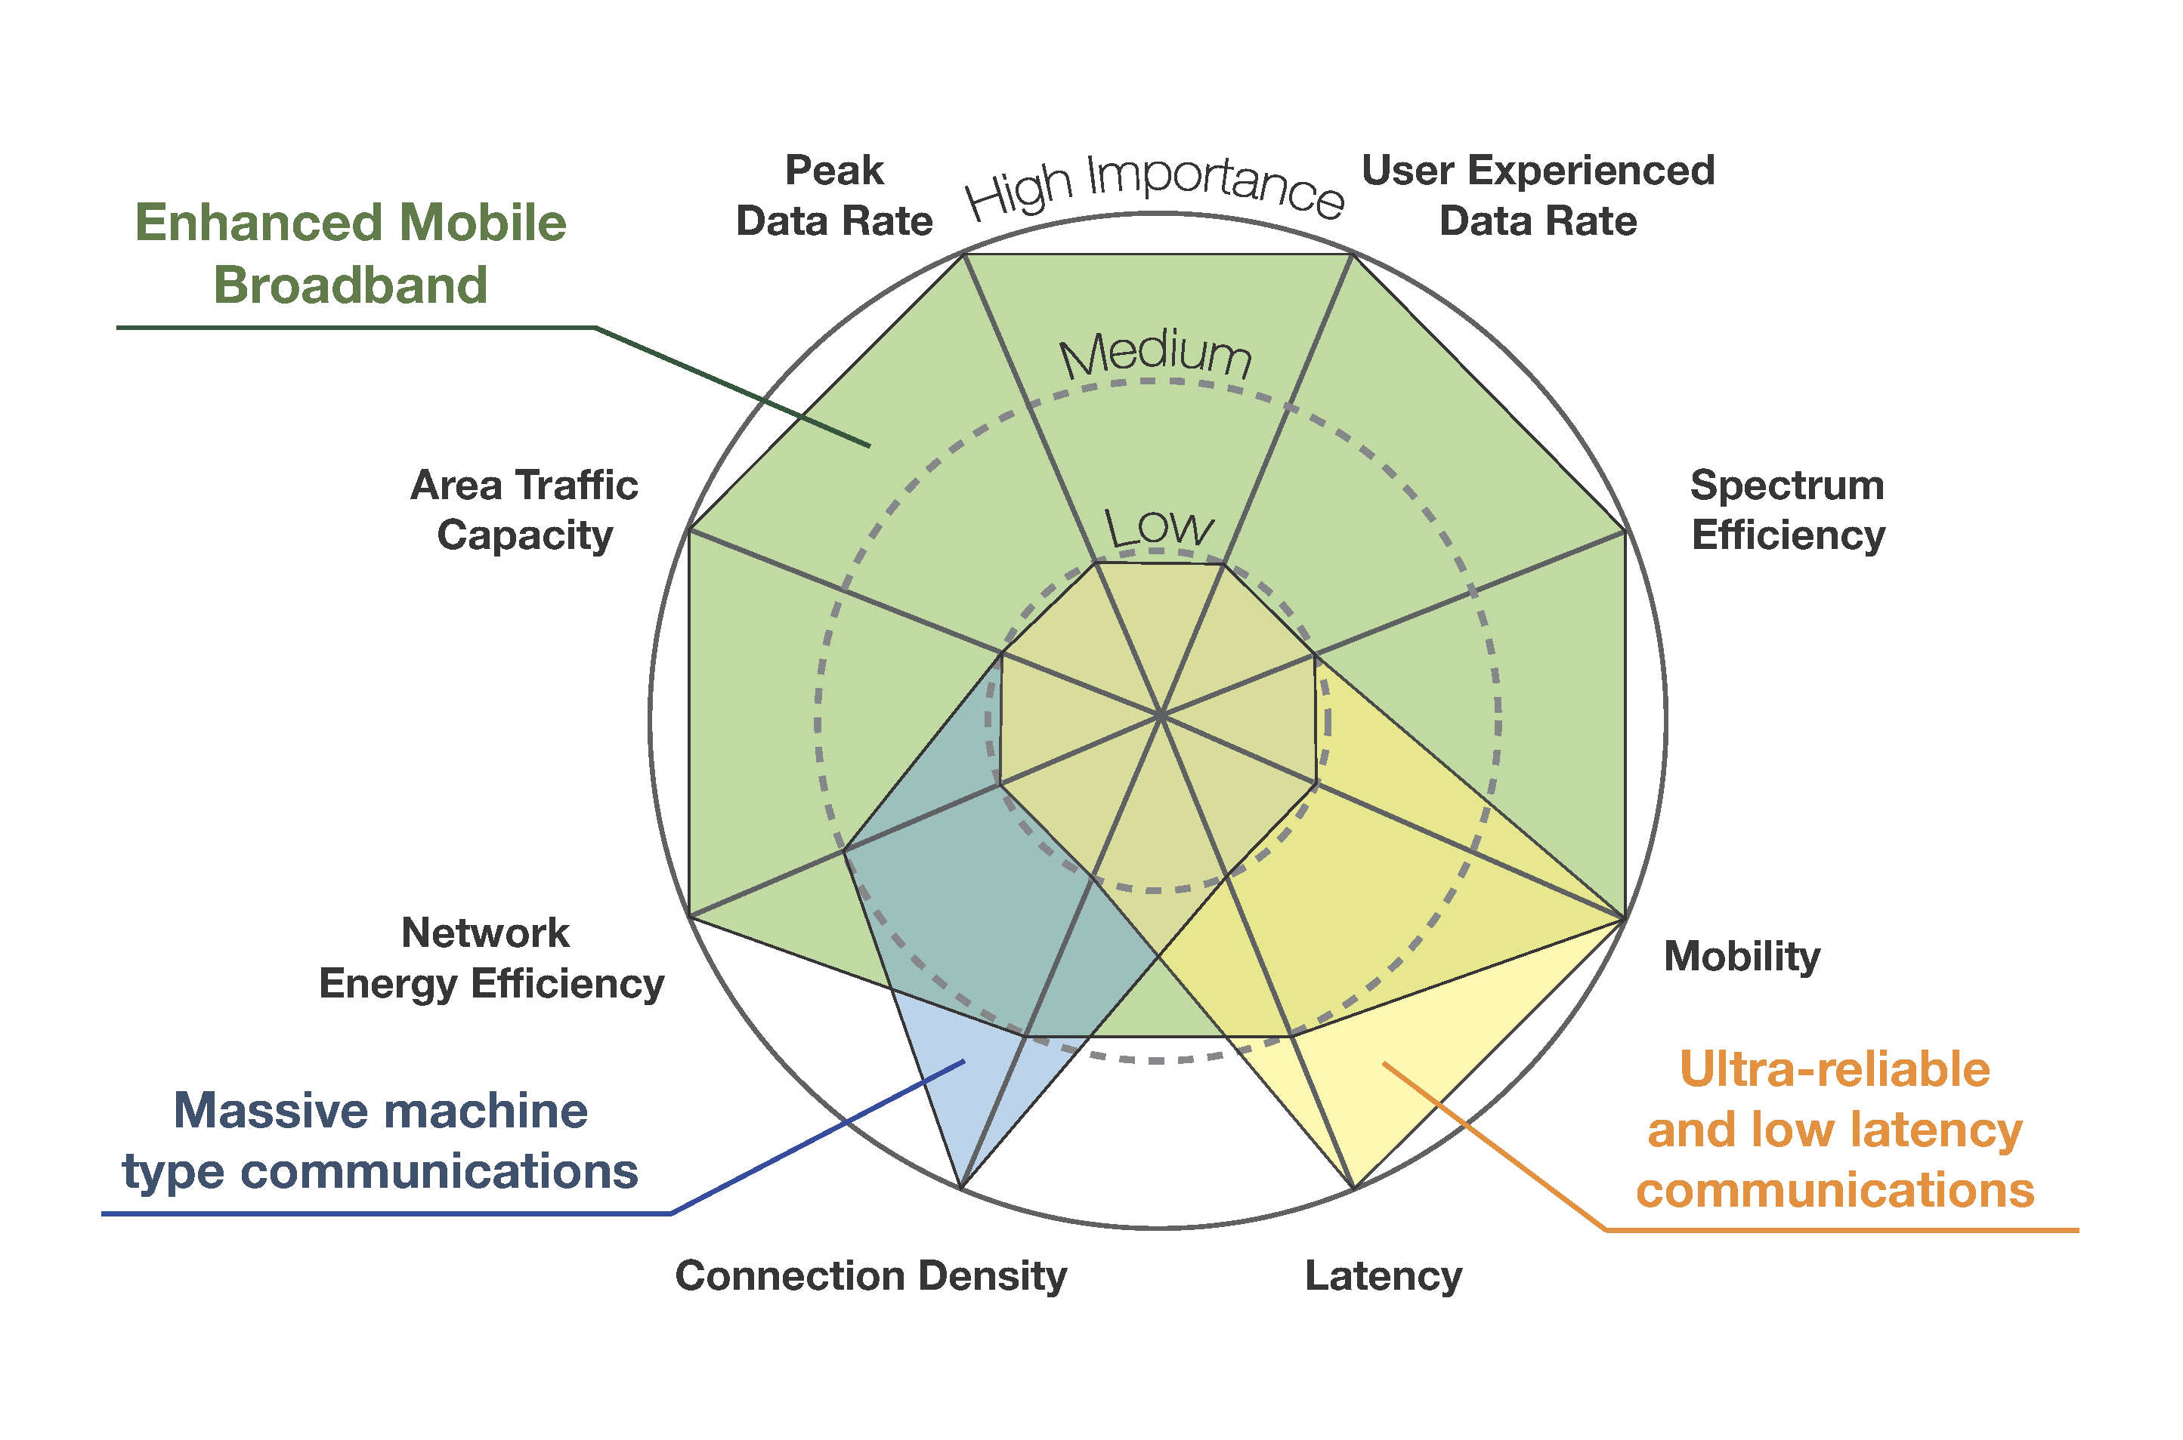
Requirements for categories

Slide 13
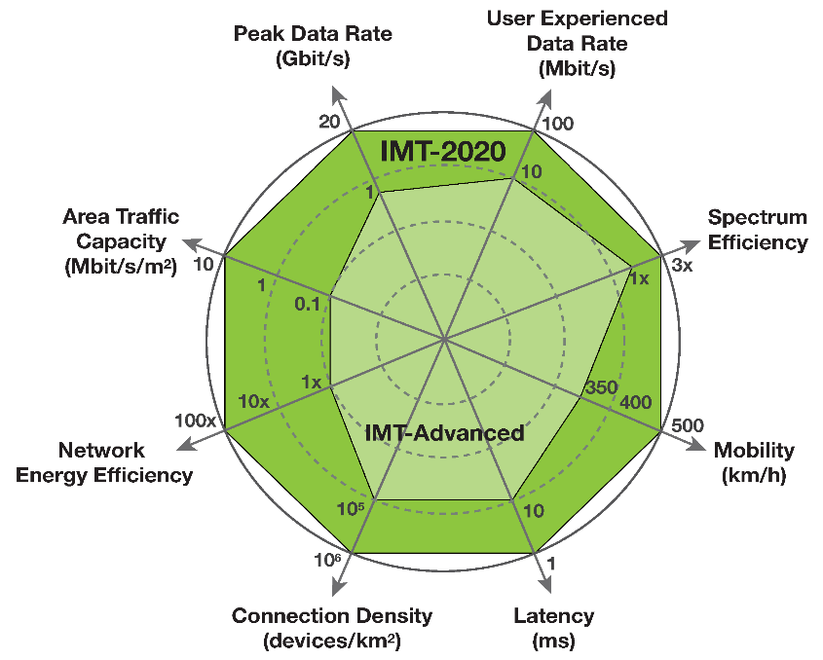
IMT-2020 goals
ITU-R published M.2083.0
IMT Vision – Framework and overall objectives
of the future development of IMT
for 2020 and beyond
which defined performance targets for 5G
that are 10 to 100 times more than 4G* :
Peak data rate (up to 20 Gbps/device)
User experienced data rate (100 Mbps/device)
Latency (as low as 1 ms)
Mobility (500 km/h and seamless transfer)
Connection density (1 million devices/km²)
Energy efficiency (1/100 Joule/bit for both air interface and network)
Spectrum efficiency (3 times the bps/Hz of LTE-A)
Area traffic capacity (10 Mbps/m²)
However, it is recognized that it may not be possible
to attain all of these at the same time

Slide 14
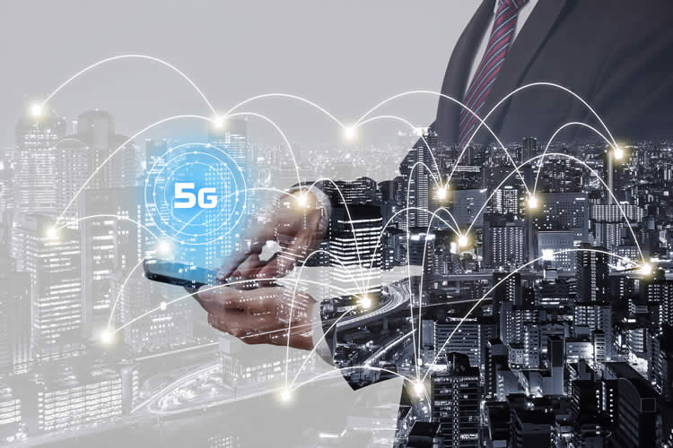
eMBB
The focus of the current 5G deployments
is enhanced (Mobile) BroadBand
eMBB traffic is the same as 4G’s broadband service
but with 10+ times higher data rates
eMBB can be subdivided into numerous sub-use-cases, for example
Fixed Wireless Access
hotspot backhauling
downstream video
video upstream
misc. media and entertainment
Note that some entertainment might be URLLC (e.g., gaming, RT jamming)

Slide 15




FWA
5G is expected to deliver much higher data rates than average consumer rates
(500 Mbps as compared to 50 Mbps)
so 5G opens the prospect of cellular Internet access to homes / small offices
thus replacing HFC-DOCSIS/CATV, ADSL/VDSL, PON access technologies
End-user installation will involve mounting an antenna on a roof or window
However, coverage will be limited to 1 km from a gNb site
and the very high rates to within 150 meters
This will initially limit penetration to
dense urban environments
to a small percentage of potential customers in such environments

Slide 16

Downstream video
Major mobile operators expect 90% of 5G traffic to be mobile video
based on current growth trends of 50% year-on-year
From 2010-2015 mobile video growth was due to increased watch times
since 2015 mobile video growth is mostly due to migration to HD
Much of this consumer video is from 3rd party sources and encrypted
for this traffic the mobile operator is a dumb-pipe provider
5G data rates are much higher than needed for HD television RT streaming
standard MP4 TV requires about 3 Mbps
4K resolution requires 25-50 Mbps
8K 50-100 Mbps
So, 5G has the potential to replace cable TV and Digital Terrestrial Television
but present data caps will need to be significantly increased
(25 Mbps is 11.25 GB per hour)
There may also be regulatory issues regarding free live TV

Slide 17

Upstream video
5G data rates may enable numerous use cases
for User Generated Content video, e.g.,
event broadcast
social streaming (e.g., Korea dance scene)
Youtube upload
e-learning / remote learning
VR conference calls
surveillance backhauling
drone video
multi-vantage point video
This may be the main difference between 5G and 4G

Slide 18
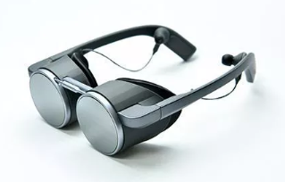
VR/AR/MR
Beyond eMBB we have new use cases, such as VR/AR
Virtual Reality is the ability to be virtually present in a (real/artificial) scene
requires high accuracy rendering of natural/synthetic image and sound
correlates image and sound to movements of immersed user
responds to user actions enabling realistic interaction with the scene
Immersive VR provides full 360 degree views
Augmented Reality overlays information or artificial content
onto true real-time environment
Spatial Augmented Reality (SAR) is AR without displays
using projection onto physical objects
Industrial Augmented Reality enables industrial designers
to visual products before they are manufactured
Mixed Reality is an advanced form of AR
where virtual elements are inserted into the true scene
to provide the illusion that these elements are part of it

Slide 19
IoT
Analysts predict 25-100 Billion Internet-connected devices by 2020, such as:
thermostats and temperature control
home automation (smart lighting, smart temperature control)
meters (electric, water, gas)
household appliances (refrigerators, microwaves, water heaters, ...)
RFID
wearable health devices
robots
The Internet of Things will enable such devices to communicate
enabling new applications and increased value to people (non-devices)
5G differentiates between two kinds of connected devices:
URLLC where the major issues are
very low delay
very high reliability
mMTC where the major issues are
device density
low power
URLLC and mMTC mostly require R16
Commercial URLLC services
are not expected before early 2021
mMTC in late 2021 to early 2022

Slide 20
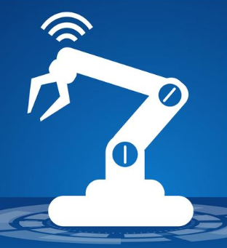
Industrial IoT
Industrial Internet of Things refers to various
Programmable Logic Controllers
sensors / measurement equipment
relays/actuators / regulators
supervisory controllers (microcomputers)
networked together for industrial applications, such as
manufacturing
quality control
material processing
energy management
The messaging is called Supervisory Control And Data Acquisition
Example applications:
smart factories (Industry 4.0)
construction
Cyber-Physical Systems
industrial robots
smart dust

Slide 21
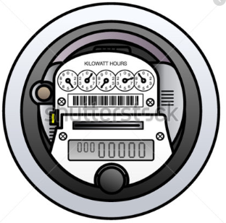
Smart metering
Utilities (electric, water, gas) conventionally read meters manually
There are better ways:
Automatic Meter Reading (e.g., hand-held reader)
Smart meters
Smart meters can record usage frequently (hourly, or at least daily)
Unlike AMR, smart meters usually employ bidirectional communication
Wireless communication options:
cellular
Wi-Fi or ZigBee and wired backhaul
wireless ad hoc, wireless mesh
LoRa and LoRaWAN Long Range (spread-spectrum in unlicensed bands)
Wi-SUN (Smart Utility Networks) Field Area Network

Slide 22

V2X
Vehicle-to-everything (V2X) means communications between a vehicle
and other vehicles or anything that may affect the vehicle, including
V2V (vehicle-to-vehicle)
V2I (vehicle-to-infrastructure)
V2N (vehicle-to-network – includes broadcasts and Application Servers)
V2P (vehicle-to-pedestrian)
V2D (vehicle-to-device, for keyless vehicles, car sharing, etc.)
V2G (vehicle-to-grid for plug-in electric vehicles)
V2X can be useful for are road safety, traffic efficiency, and energy savings
Specific applications of V2X include
forward collision warning
lane change warning
blind spot warning
emergency brake warning
emergency vehicle approaching
roadworks warning
platooning (flocking)

Slide 23

eHealth / telemedicine
5G will improve/enable new use cases, including
remote monitoring of health or wellness data
cloud connected pacemakers
telepharmacy and smart medication
micro-hospitals
hospital asset and intervention management
remote EKG
remote surgery (first performed in Sept 2001 – the Lindbergh Operation)
telenursing and robotics for assisted living
tele-rehabilitation (remote audiology, occupational/physical therapy)

Slide 24
How is it done?
How does 5G achieve these amazing speeds?
It requires a lot of upgrading
but we have to explain some basics first

Slide 25
What is mobile communications?
When they hear mobile or cellular communications
most people think only about the radio link (air interface) between
a mobile phone (User Equipment) and
a cellular base station (BTS/nodeB)
But this is only a small part of the story
Air Interface
(radio link)
Base Station
User Equipment

Slide 26
Basic cellular segments
Radio Access Network
Air Interface
FDMA, TDMA, CDMA, NR
other networks
backhauling
GRAN, GERAN, UTRAN, E-UTRAN,
NextGen (R)AN
mobile
core network
NSS, UMTS core, EPC, NGCN
User Equipment
Base Station
BTS, NB, eNB, gNB

Slide 27
The need for backhaul
We can imagine connecting cellular base-stations directly to a core network
and modern cellular networks are indeed approaching this ideal
logically if not physically
However, such a simplistic approach suffers from drawbacks
due to the large number of base-stations
base-stations would require many physical ports (expense)
physical ports would need to support high rates
many fiber runs would be needed to interconnect
base-stations would need to be routers
base-stations would need to support redundancy for other base-stations
core network would extend to edge with security implications
Instead, base-station connectivity is supported by a backhaul network
that connects the base-stations to the core network
The air interface and the backhaul network together form
the Radio Access Network (RAN)

Slide 28




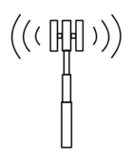

Splitting up the RAN
In 3G the RAN was a pure backhaul network
In 4G this changed in 2 ways
the X2 interface interconnected eNBs (at least logically)
fronthaul (CPRI)
In 5G this must change more drastically
NB
NB
MSC/SGSN
RNC
NB
NB
S1
eNB
eNB
eNB
CORE
backhaul
fronthaul
X2
RH
eNB
BBU
Notes:
What’s the problem?

Slide 29
5G RAN Functional Splits
Bandwidth increases with user traffic
Bandwidth PHY dependent
Latency tolerance increases
Option
1
Option
2
Option
3
Option
4
Option
5
Option
6
Options
7.x
Option
8
RRC
L3
L2
L1
PDCP
High-
RLC
Low-RLC
High-
MAC
Low-
MAC
High-
PHY
Low-
PHY
↓
A/D
Data
CU
CoMP
DU
HARQ
ORAN
split
RU
conventional
backhauling
3GPP
split
conventional
fronthauling
xHauling
LTE uses splits 1 and 8
3GPP has standardized split 2 (CU/DU split)
ORAN has developed split 7.2 (RU/DU split)
Decomposed base station transceiver
PHY – Physical layer processing
MAC – Medium Access Control
RLC – Radio Link Control
PDCP – Packet Data Convergence Protocol
Network based control functionality
RRC – Radio Resource Control
Notes:
To enable resource sharing and delay reduction
we can do some portion of the L1/L2/L3 processing locally
For example, after the FFT we only need active subcarriers, < 50%

Slide 30
5G interfaces
Using intermediate split options
decomposes the BBU into
Central Unit
Distributed Unit
Radio Unit
Possible decompositions:
RU+DU+CU
RU+DU – CU
RU – DU+CU
RU – DU – CU
RU
F2
fronthaul
DU
RU
F1
midhaul
NG
backhaul
RU
RU
5GC
F1
midhaul
CU
F2
fronthaul
DU
RU
RU

Slide 31
How does 5G attain higher speed?
Air interface
more efficient New Radio modultion (factor of 3 improvement)
wider spectral bands (100 MHz, 1GHz), which requires
new RF bands (sub-1GHz, 24/28 GHz mmWave, 30-90GHz)
use of licensed/unlicensed unshared/shared spectrum
smaller cells and higher cell density (i.e., many more antennas)
massive MIMO
in 5G massive is defined as 16 or more antennas (4-by-4 array)
5G envisages up to 256 antennas
< 6 GHz use multipath for spatial mux and multiuser MIMO
> 6 GHz use coherent beamforming (i.e., personal cells)
RAN
functional split options – split 2 and 7.2 standardized
upgrade from 1Gbps to 10Gbps to 100Gbps
25 GbE (802.3by), 1-lane 50 GbE (802.3cd), NG 100/200/400 GbE (802.3bs)
FlexE bonding

Slide 32

RF spectral bands
Cellular communications takes place in licensed spectral bands
most common at 400,450,700,750,800,900,1800,1900,2100,2600 MHz
and 5G will use higher mmWave bands
This differs from unlicensed spectral bands, such as used for WiFi
such as the Industrial, Scientific and Medical bands e.g., 2.4, 5, 24 GHz
The spectral bands available for licensing differ by:
different ITU regions (Americas, Europe, Africa, Asia)
cellular generation (2G, 3G, 4G)
modulation details (EVDO/GSM, FDD/TDD, for TDD up/down-link, etc.)
WRC-19 (Sharm El-Sheikh) approved 17.25 GHz of new spectrum in Nov ‘19
Spectrum is most often allocated to mobile SPs via auctions
initiated by the FCC in 1994
87 US auctions since 1994 assigned 1000s of licenses and raised >$60B
5G auctions have commenced worldwide
although alternatives (hearings, lotteries) exist
The ongoing FCC auction has already surpassed $8B

Slide 33
Spectrum
5G needs bandwidth, and can use anything it can get
This includes licensed, unlicensed, and shared spectrum
RF ranges include:
low and mid frequencies for macro cells
mm waves for small and ultra-small cells (LoS 300m, urban multipath 150m)
At WRC-2019 (Sharm El Sheikh, October 2019)
ITU's 193 member states allocated new frequency bands for 5G
 | low (MHz) | mid (GHz) | high (GHz)
US | 600 | 3.5 | 28, 37-40, 64-71
EU | 700 | 3.4-3.8 | 24.25-27.5
China |  | 3.4-3.6 | 24.25-27.5
Japan |  | 3.6-4.2, 4.4-4.9 | 27.25-29.5
South Korea |  |  | 28, 37.5-40

Slide 34
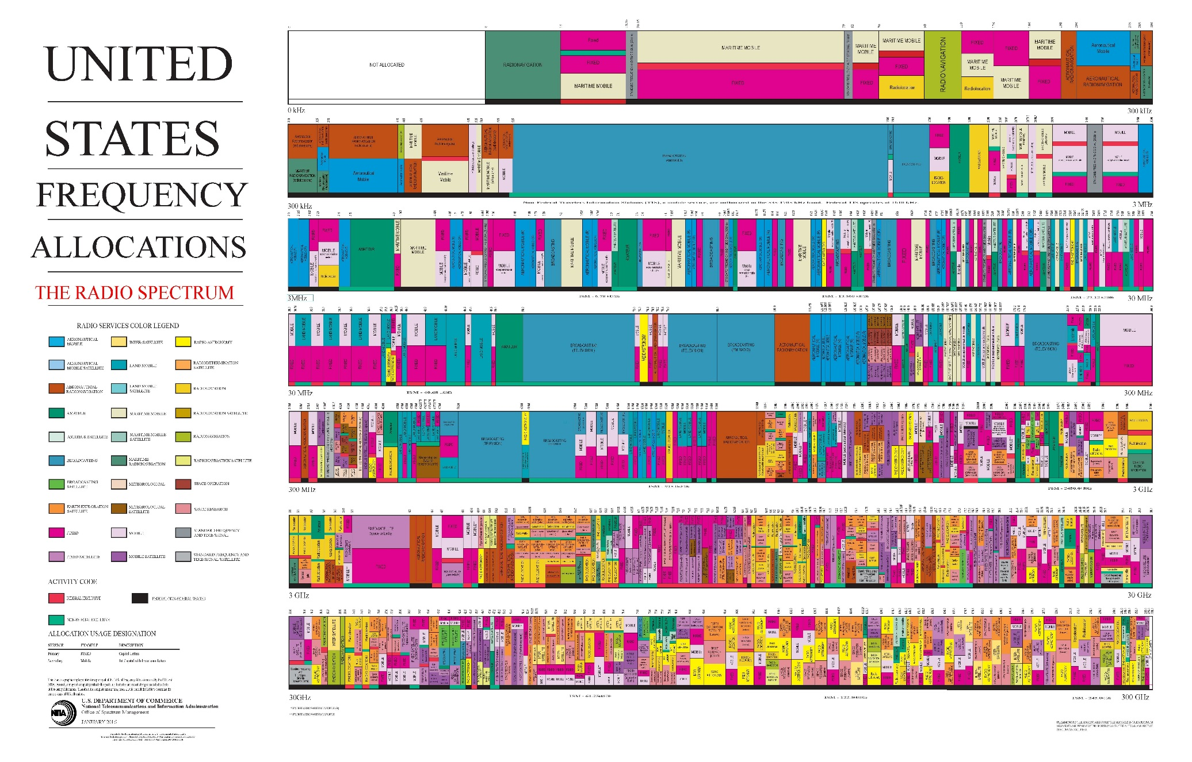
Spectrum is tight!

Slide 35
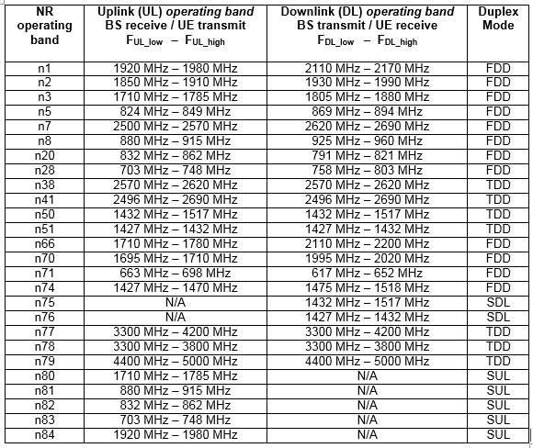
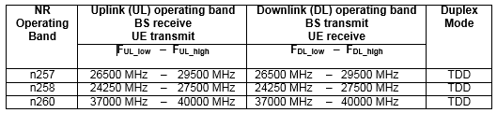
R15 operating bands
FR1 (< 6GHz)
FR2 (>6GHz)

Slide 36
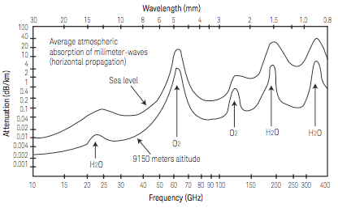
mmWave challenges (1)
30 GHz corresponds to 1 mm wavelength
so the 24, 27, 28 GHz bands are informally called mm waves
At these high RF frequencies there is plenty of real estate for 5G
but there are multiple challenges to exploiting these frequencies!
1. signal attenuation
free space signal attenuation scales like f² due to antenna aperture size
so increasing from 3 GHz to 30 GHz increases loss by 20 dB = factor of 100 !
dry oxygen, water vapor, etc. have absorption lines
SOLUTION: much smaller cell sizes – 150-200 m

Slide 37
mmWave challenges (2)
2. concrete and glass strongly absorb mm waves - so need clean line of sight
but 80% of expected usage is indoors
SOLUTION: indoor coverage
3. much shorter channel coherence time (time over which can assume channel stationarity)
for mobile user the coherence time scales like 1/f
increasing from 3 GHz to 30 GHz decreases the coherence time by a factor of 10!
SOLUTON: much more frequent channel probing
4. energy efficiency (and carbon footprint)
scaling BW by 10 usually equates to 10 times more power
and scaling data rate by 10-100 produces the same scaling in the backhaul
SOLUTION: more directive antennas, energy-efficient system design, sleep modes
5. implementation issues
power amplifiers are very inefficient at mmWaves (< 10% is common)
need low loss/low dielectric constant materials for multi-layer PCBs
copper traces have high resistance due to skin effect
need temperature stable high-Q dielectrics
various ceramics and polymers being investigated
need new magnetic materials for high-frequency oscillators
Yttrbium Iron garnet, Ni-Zn ferrites, Li-based spinels being investigated

Slide 38
mmWave (3) health issues
6. health issues
there is no data on the long-term safety of continuous mmwave exposure
direct effect will be on external 2 mm of skin or eyes
30-40% of power will be reflected
thermal effects known for radiation above 5 mW/cm²
so FCC guidelines limit public to 1 mW/cm² over 30 minutes fro 1.5-100GHz
non-thermal effects reported for mmWaves:
long term exposure may be carcinogenic
altering structural and functional properties of plasma membranes
by modifying ion channel activity or modifying the phospholipid bilayer
skin nerve ending damage
activation of the immune system and peripheral neural system
changes to blood and bone marrow composition
changes to activity of various enzymes
modification of microbes (growth depression and property alteration)
may lead to various effects including antibiotic resistance,
SOLUTION: none yet

Slide 39
MIMO
4G and WiFi have started deploying Multiple-Input Multiple-Output (MIMO)
where multiple transmit and receive antennas are used simultaneously
While LTE supports 4*2 MIMO (4 BS and 2 UE antennas)
R15 supports 32*4 MIMO (and this will increase significantly!)
MIMO is critical for both < 6 GHz and > 6 GHz operating bands
for < 6 GHz
cells are large
there will be rich multipath
many users in cell
users will be highly mobile
so MIMO will use spatial mux to help achieve spectral efficiency goals
for > 6 GHz
signal attenuation much higher (100 times higher?)
cells are small and little multipath
few users in cell
users are relatively static in the cell
so MIMO will use beamforming to overcome the high attenuation
4*2 MIMO

Slide 40

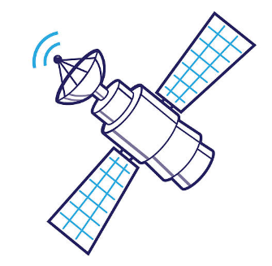


But what can we do about coverage?
5G macrocells will be much smaller than 4G ones (especially for mmWaves)
and so will mostly be deployed inside buildings and in cities
What can be done for everyone else?
AT&T’s AirGig uses power lines as waveguides for 5G distribution
to bring cellular broadband to rural areas (to be launched 2021)
LEO Satelites
OneWeb (Google) is a collection of 650-1972 satellites at 1,200 km
Samsung, Amazon (Kuiper), and SpaceX proposed larger constellations
Israel’s Genesis Consortium is researching an Israeli version
Drones
Facebook’s Aquila was a solar-powered pilotless airplane data repeater
which first flew in June 2016 but development ceased in June 2018
Its goal was to cover the 66% of Earth with no/poor Internet coverage
Baloons
Alphabet (Google) spun-off Loon in July 2018
to provide Internet access to remote areas using high-altitude balloons

Slide 41
How does 5G attain lower latencies?
Air interface
Lower one-way delay due to flexible frame structure
lower round-trip time due to self contained integrated subframe
RAN
Software Defined Networking and Network Functions Virtualization
we’ll discuss in the context of the core!
Time Sensitive Networking / Deterministic Networking
minimizes time packets wait in queues
Mobile Edge Computing
moves application close to end-user
network slicing allocates low-delay paths to express traffic
and placing applications in optimal places for each service

Slide 42
How does 5G support new applications?
5G service and network requirements
necessitate a fundamental change to the core architecture
Some 4G network cores presently support 10s of millions of subscribers
5GC will need to support many more subscribers and sessions
The only technology proven to scale up to such sizes is cloud computing
3GPP has defined a new 5G Core architecture
that uses a cloud-native Service Based Architecture (SBA)
with modular Network Functions instead of Network Elements (boxes)
NFs can be hardware or (virtual) software – even VMs in a cloud
core NFs can be located anywhere – even near the antenna!
to enable scaling, core NFs are designed as micro-services
connected using function chaining
single interface to NF rather than interface between every two NFs
use of Representational State Transfer principles

Slide 43




Computation and communications
Once there was no overlap
between communications (telephone, radio, TV)
and computation (computers)
Actually communications devices always ran complex algorithms
but these are hidden from the user
Most home computers
are not used for computation at all
rather for communications (email, chat, VoIP)
Smart cellular telephones have become computers
and are used more for running apps
than for telephone calls
We now have the single concept of computications

Slide 44


Software and development speed
There is a fundamental problem
with merging communications and computation
Communications is based on protocols
Standardizing new protocols is a slow process
that typically takes years
Computation is based on algorithms
Coding new algorithms is a fast process
that can take hours (or days)
This leads to a fundamental disconnect
between software and networking development timescales
Is there any way to develop communications
at the speed of software?

Slide 45
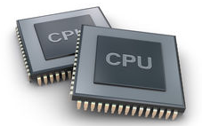
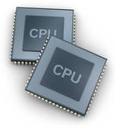
SDN and NFV
Two new approaches aim to resolve the disconnect
Software Defined Networking replaces protocols with algorithms
Network Functions Virtualization replaces hardware with software
So, communications has completely merged into computation
We are still left with CPUs, but these can be virtualized too!

Slide 46
Concretization vs. Virtualization
Concretization means moving a task to the left
CONCRETIZATION
dedicated hardware
special purpose processors
general
purpose
software
PHYSICS
ASIC
FPGA
firmware
LOGIC
VIRTUALIZATION
Virtualization means moving a task to the right
(although frequently reserved for the extreme case of HW → SW)

Slide 47
Why concretization?
Concretization (moving from software to hardware)
is what we have been doing for years
and is easy to understand
Justifications for concretization include :
cost savings for mass produced products
miniaturization/packaging constraints
need for high processing rates
energy savings / power limitation / heat dissipation
But why would one want to perform virtualization ?
Why take power/space optimized, efficient, inexpensive function
and replace it with a large, energy hungry, inefficient, costly one?

Slide 48


Virtualization
In the last few years
there has been a major trend towards virtualization
Virtualization here means the creation of a Virtual Machine (VM)
that acts like an independent physical computer
A VM is software that emulates hardware (e.g., an x86 CPU)
over which one can run software
as if it is running on a physical computer
So, a VM looks like a computer, but is really just software

Slide 49
Why virtualization?
Justification for such virtualization is initially hard to grasp
platform independence
which is the reason Java, Android and .NET use VMs
capability of running multiple CPU instances on one host CPU
which is the reason VMs are used in data centers
capability of running virtual CPUs of different flavors / OSes
vastly simplifying management
natural statistical multiplexing of resources
lowering cost when not all virtual CPUs maxed out
flexible spin-up / tear-down / migration of virtual CPUs

Slide 50
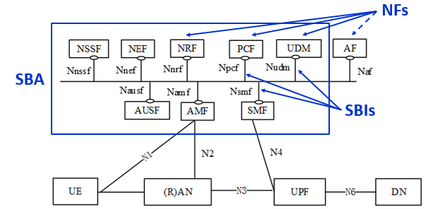
Service Based Architecture
The NFs are interconnected via a logical bus
i.e., every NF can communicate with every other NF

Slide 51
Micro-services
When building physical networks elements
there is pressure to put all functionality into a single box
Modern software systems are designed to be flexible
by using micro-services and function chaining
For example, many network functions may utilize (deep) packet inspection
so this function can be packaged separately as a micro-service
The 5G core is composed of microservices
and even the gNB itself is decomposed into them!
Option
1
Option
2
Option
3
Option
4
Option
5
Option
6
Options
7.x
Option
8
RRC
L3
L2
L1
PDCP
High-
RLC
Low-RLC
High-
MAC
Low-
MAC
High-
PHY
Low-
PHY
↓
A/D
Data
micro-services

Slide 52
CRAN, CRAN, and vRAN (before 5G)
Fronthaul decomposes the BS into RRHs and a BBU
but we needn’t locate the BBU at the foot of the tower
It may make sense to have one BBU serve several base-stations
using fronthaul links, that now need to be much longer
Baseband processing places strict limits on the round-trip delay
and thus on the fronthauling distance (e.g., 20 km for LTE)
This architecture is called Centralized RAN (CRAN)
and was first promoted by China Mobile in 2010
in order to improve scaling of the world’s largest mobile network
Using load-balancing/resilience techniques developed for cloud computing
may allow a central site to service 100s of RRHs
This is called BBU Hotelling or Cloud RAN (CRAN)
If we are already using cloud techniques
we may implement at least some of the BBU functionality in software
(e.g., packet processing, control functionality)
running as virtual machines inside a Data Center
This architecture is called Virtualized RAN

Slide 53

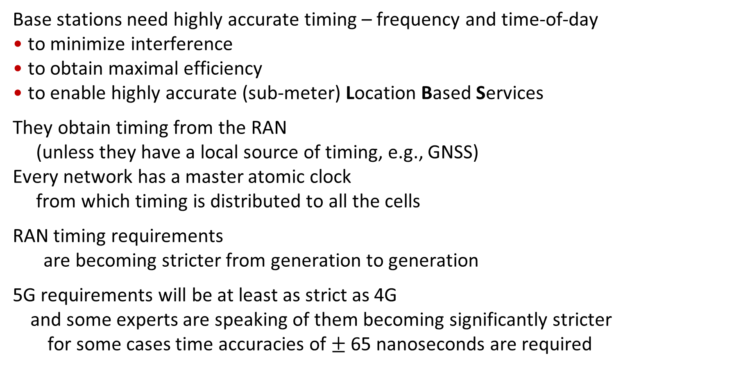
Timing for 5G
Base stations need highly accurate timing – frequency and time-of-day
to minimize interference
to obtain maximal efficiency
to enable highly accurate (sub-meter) Location Based Services
They obtain timing from the RAN
(unless they have a local source of timing, e.g., GNSS)
Every network has a master atomic clock
from which timing is distributed to all the cells
RAN timing requirements
are becoming stricter from generation to generation
5G requirements will be at least as strict as 4G
and some experts are speaking of them becoming significantly stricter
for some cases time accuracies of $±$ 65 nanoseconds are required

Slide 54
The End

