Slide 1
5G – a quick overview
Yaakov (J) Stein
February 2020
Notes:
When I say 5G what are the first things come to you mind ?

Slide 2
Why 5G ?

Slide 3
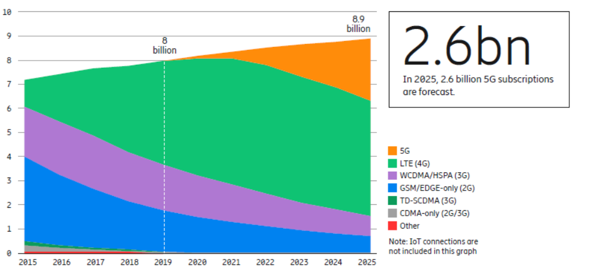
5G is coming fast!
5G standardization was accelerated and proceeded at an unprecedented pace
Release 15 had an early drop completed Dec 2017 (a year earlier than originally planned)
and the majority of the work was approved in June 2018
Release 16 will be frozen in March 2020 and completed by June 2020
WRC-19 approved 17.25 GHz of new spectrum in November 2019
and the ongoing FCC auction has already surpassed $8B
Source: Ericsson Mobility Report, Nov 2019

Slide 4
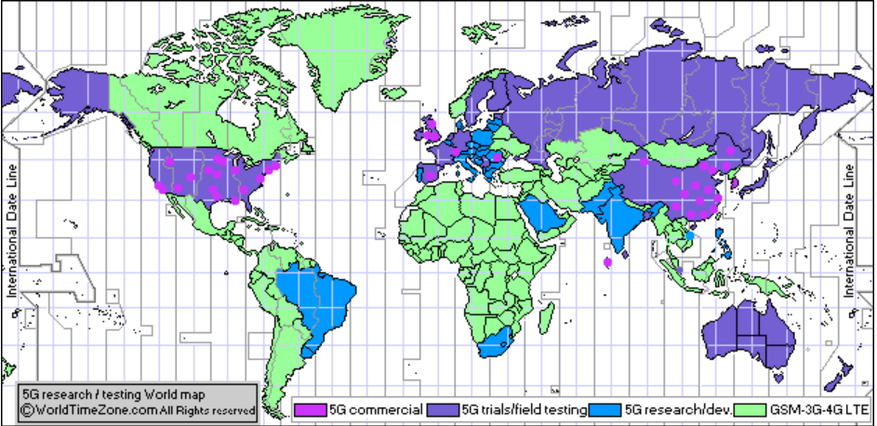
5G is already here!
>7000 deployments >100 operators
WorldTimeZone Dec 12, 2019

Slide 5
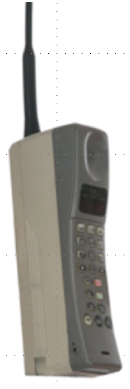




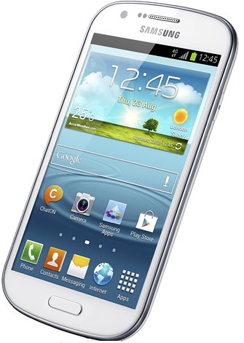


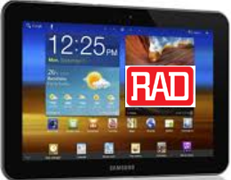
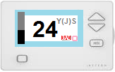
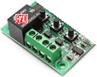
Generations of cellular technologies
 | 1G | 2G | 3G | 4G | 5G
3GPP releases |  |  | 4 - 7 | 8-9, 10-14 | 15, 16
era | 1980s | 1990s | 2000s | 2010s | 2020s
services | analog voice | digital voice messages | WB voice packet data | voice, video always on Internet | everything
devices
data rate | 0 | 100 kbps (GPRS) | 10 Mbps (HSPA) | 100+ Mbps (LTE/LTE-A) | 10 Gbps (NR)
delay |  | 500 ms | 100 ms | 10s ms | 5 ms

Slide 6
What’s wrong with 4G?
4G made possible:
fast Internet access
video reception and creation
apps relying on location and identity
always-on behavior
but suffers from numerous limitations:
for some applications: data-rate too low
for some applications: delay too high
too few simultaneous connections (insufficient density)
coverage too low / drop rate too high
weak (if any) QoS guarantees
price per bit too high (inefficient spectral use)
power consumption too high (and thus battery life too low)
poor support for new applications/markets (e.g., IoT, AR/VR, connected cars)
no support for new mobility requirements (mobile hot spots, high speed)
insufficient security/privacy
5G is designed to address 4G limitations

Slide 7
Verticals
Unlike earlier generations
which were designed for general purpose connectivity
without considering requirements for specific use cases
initial 5G work focused on vertical markets of interest, such as
● fixed and mobile broadband ● entertainment and gaming
● AR/VR ● wearables
● first responders ● critical infrastructure
● smart city ● smart utilities
● automotive (V2X) ● mass transit
● e-health ● e-government
Industry 4.0 (incl. industrial robots) ● agriculture
and collected specific requirements for each
Requirements were found to fall into 3 main categories
● eMBB enhanced mobile (or fixed wireless) broadband
● URLLC ultra-reliable and low latency communications
● mMTC (AKA mIoT) massive machine type communications

Slide 8
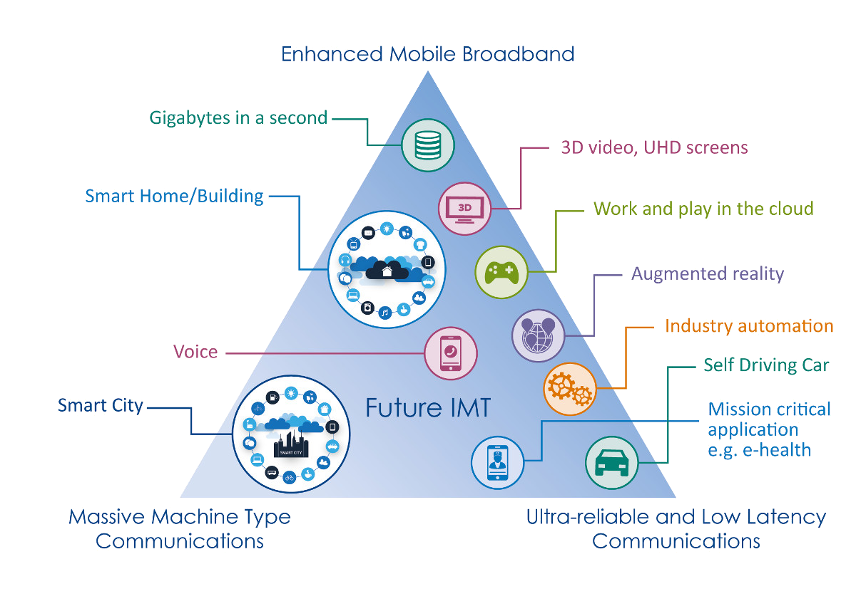
5G usage categories
eMBB
10 Gbps, 10 Mbps/m²
from M.2083.0
1 Million / km²
1 ms, 5 nines
mMTC
(MIoT)
URLLC

Slide 9
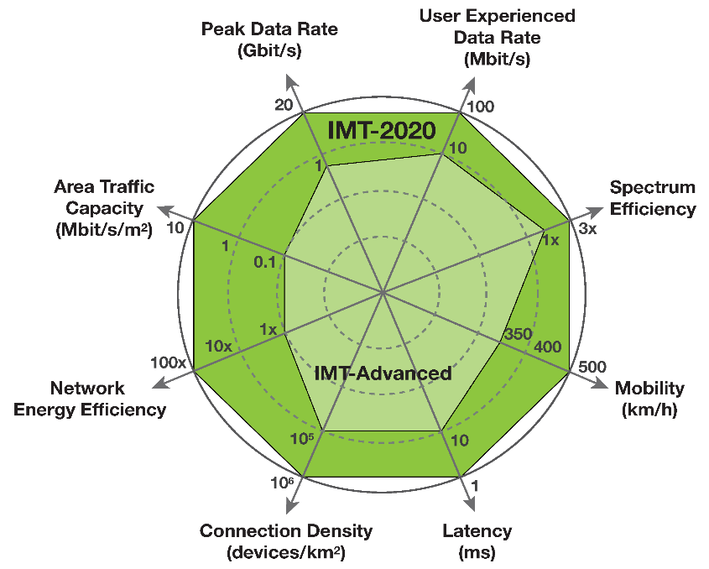
IMT-2020 goals
ITU-R published M.2083.0
IMT Vision – Framework and overall objectives
of the future development of IMT
for 2020 and beyond
which defined performance targets for 5G
that are 10 to 100 times more than 4G :
Peak data rate (up to 20 Gbps/device)
User experienced data rate (100 Mbps/device)
Latency (as low as 1 ms)
Mobility (500 km/h and seamless transfer)
Connection density (1 million devices/km²)
Energy efficiency (1/100 Joule/bit for both air interface and network)
Spectrum efficiency (3 times the bps/Hz of LTE-A)
Area traffic capacity (10 Mbps/m²)
However, it is recognized that it may not be possible (or needed)
to attain all of these at the same time

Slide 10








Business services
Due to LTE’s limited data-rates and availability
until now mobile-only operators could not provide profitable business services
which typically require fiber or symmetric DSL
With 5G, business sites can be connected to the feature-rich 5G core using
5G NR - Fixed Wireless Access (fixed, since CPE isn’t mobile!)
Fiber using the Access Gateway Function (being defined by 3GPP and BBF)
Core DC
LAN
Mobile Core
VNFs
FWA
AMF
5G Cellular CPE
UPF
Customer Sites
gNB
Content/Apps
Internet
Local
Network
Fiber
Data Network
AGF
5G Fiber CPE

Slide 11
From 4G to 5G

Slide 12


5G changes all cellular segments
FDMA, TDMA, CDMA, NR
Air Interface(s)
Radio Access Network
(backhauling)
GRAN, GERAN, UTRAN, E-UTRAN,
NextGen (R)AN
User Equipment
Base Station
BTS, NB, eNB, gNB
core network
NSS, UMTS core, EPC, 5GC
other networks

Slide 13
How does 5G attain higher speed?
Air interface
NR more efficient (factor of 3 improvement)
wider spectral bands (100 MHz, 1GHz), which requires
  new RF bands (sub-1GHz, mmWave: 24/28 GHz, 30-90GHz)
  use of licensed/unlicensed unshared/shared spectrum
smaller cells and densification
Massive (16 or more, up to 256) MIMO
    < 6 GHz use multipath for spatial mux and multiuser MIMO
    > 6 GHz use coherent beamforming (personal cells)
RAN
functional split options – split 2 and 7.2 standardized
upgrade backhauling from 1Gbps to 10Gbps to 100Gbps
25 GbE (802.3by), 1-lane 50 GbE (802.3cd), NG 100/200/400 GbE (802.3bs)
FlexE bonding

Slide 14
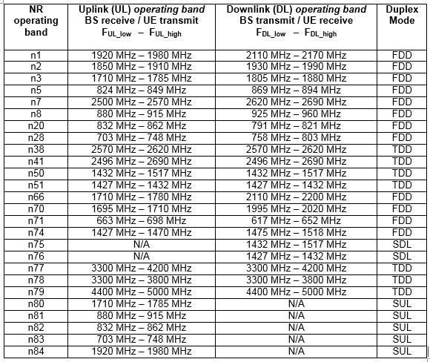
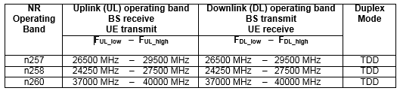
R15 operating bands
FR1 (< 6GHz)
FR2 (>6GHz)
WRC-19 Sharm El-Skeikh Nov 2019
expanded RF bands available for 5G from 1.9 GHz to 17.25 GHz
New bands:
24.25-27.5 GHz
37-43.5 GHz
45.5-47 GHz
47.2-48.2 GHz
66-71 GHz
Additional bands will be considered for WRC-23
including low and mid frequencies

Slide 15
How does 5G attain lower latencies?
Air interface
more flexible frame structure
self contained integrated subframe
RAN
Software Defined Networking or Segment Routing
Network Functions Virtualization
Mobile Edge Computing (moving functionality closer to UE)
Time Sensitive Networking / Deterministic Networking
  IEEE 802.1CM for Ethernet fronthaul
  IEEE 802.1Qbv scheduled traffic enhancements
  IEEE 802.1Qbu frame pre-emption
  IETF DetNet (Deterministic Networking) for IP
Network slicing

Slide 16
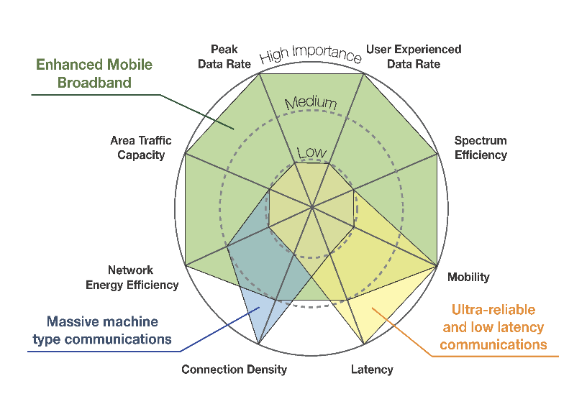
Network slicing
5G must support coexistence of traffic with wildly diverging requirements
It can’t necessarily reach all of its goals simultaneously, but it doesn’t have to
For example:
enhanced mobile broadband
  needs high data rates
  doesn’t need very low latency
massive IoT
  needs high connection density
  doesn’t need high data rates
5G uses network slicing to satisfy these widely divergent needs
Network slices are dynamically established strong-isolated networks

Slide 17
Network slicing
5G can support coexistence of traffic with wildly diverging requirements
by using network slicing in the air interface, xhaul, and core
on-demand (i.e., dynamic) assignment of networking/computational resources
  bandwidth, forwarding tables, processing capacity, etc.
each slice acts as an end-to-end independent network
resources can be physical or virtual, but
each slice acts as a strongly isolated network or cloud
  isolation of management, security, and performance
3GPP defines a slice by
Slice/Service type (SST) expected slice behaviour (features and services)
  3 types mandated, but many other types possible
    for example, MVNOs, specific enterprises, etc.
Slice Differentiator (SD) to differentiate between different slices of the same Slice/Service type
Slice/Service type | SST value
eMBB | 1
URLLC | 2
MIoT | 3

Slide 18
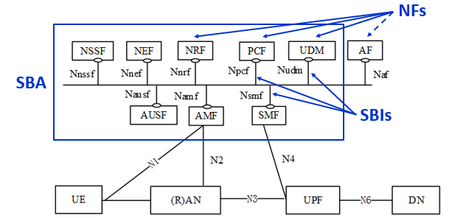
How does 5G support new applications?
New cloud-based Service Based Architecture core
SDN/SR, NFV and network slicing
Network Functions and exposure functions (NRF, NEF)
client/server with RESTful interfaces (CRUD operations)
Application Functions

Slide 19
How do we get there from here?
Initial 5G deployments focus on eMBB
and simply locate a gNB next to existing eNB (“deployment option 3”)
In order to facilitate this first stage 3GPP defined Non StandAlone (NSA)
i.e., 5G supported by the existing 4G infrastructure (E-UTRAN, EPC)
and thus not delivering all 5G’s potential
3GPP has also defined 3 StandAlone options
The obvious two are pure SA 4G (option 1) and 5G (option 2)
For the distant future there is option 5 for supporting legacy phones
with a 4G LTE air interface connecting to a 5G core
EPC
5GC
5GC
4G data
Option 1
Option 2
Option 5
4G ctrl
eNB
gNb
ng-eNB
5G data
LTE
NR
LTE
5G ctrl

Slide 20
Option(s) 3
The most important NSA option in the near term is called option 3
which assumes installation of a gNB (to gain the advantages of NR)
but does not (yet) upgrade the core to 5GC
and so provides higher data rates but not full 5G capabilities
This will enable fast deployment of gNBs for eMBB
In option 3 there is no direct connection between gNB and EPC
user and control data flow through the eNB via X2-U and X2-C interfaces
In option 3A there is an S1-U connection from gNB to EPC (but no X2-U)
Option 3X has both X2 and S1 to enable load balancing
EPC
EPC
Option 3A
EPC
Option 3X
4G data
Option 3
4G ctrl
eNB
gNB
eNB
gNB
eNB
gNB
5G data
LTE
NR
LTE
NR
LTE
NR
5G ctrl

Slide 21
Other options
For the distant future there are options 4 and 7
which only have a 5G core (no EPC)
but support 4G legacy UEs via upgraded ng-eNBs
In option 4 gNB is the master and ng-eNB connects via Xn interface
In option 7 ng-eNB is the master and gNB connects via Xn interface
These too have variations (4, 4A, 7, 7A, and 7X)
Options 4
5GC
5GC
Options 7
4A only
7A and 7X
4G data
4 only
7A,7X
ng-eNB
gNB
ng-eNB
gNB
4G ctrl
LTE
NR
LTE
NR
5G data
5G ctrl

Slide 22
5G Radio Access Network

Slide 23



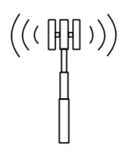

Splitting up the RAN
In 3G the RAN was a pure backhaul network
In 4G this changed in 2 ways
the X2 interface interconnected eNBs (at least logically)
fronthaul (CPRI)
In 5G this changes more drastically
NB
NB
MSC/SGSN
RNC
NB
NB
S1
eNB
eNB
eNB
CORE
backhaul
fronthaul
X2
RH
eNB
BBU
Notes:
What’s the problem?

Slide 24
5G RAN Functional Splits
Bandwidth increases with user traffic
Bandwidth PHY dependent
Latency tolerance increases
Option
1
Option
2
Option
3
Option
4
Option
5
Option
6
Options
7.x
Option
8
RRC
L3
L2
L1
PDCP
High-
RLC
Low-RLC
High-
MAC
Low-
MAC
High-
PHY
Low-
PHY
↓
A/D
Data
CU
DU
ORAN
split
RU
CoMP
HARQ
conventional
backhauling
3GPP
split
conventional
fronthauling
xHauling
Decomposed base station transceiver
PHY – Physical layer processing
MAC – Medium Access Control
RLC – Radio Link Control
PDCP – Packet Data Convergence Protocol
Network based control functionality
RRC – Radio Resource Control
LTE uses splits 1 and 8
3GPP has standardized split 2 (CU/DU split)
ORAN has developed split 7.2 (RU/DU split)
Notes:
To enable resource sharing and delay reduction
we can do some portion of the L1/L2/L3 processing locally
For example, after the FFT we only need active subcarriers, < 50%

Slide 25
Units and interfaces
Using intermediate split options decomposes the BBU into
Central Unit
Distributed Unit
Radio Unit
Possible decompositions:
RU+DU+CU (no splits)
RU+DU – CU (one split)
RU – DU+CU (one split)
RU – DU – CU (two splits!)
RU
F2
fronthaul
DU
RU
F1
midhaul
NG
backhaul
RU
RU
5GC
F1
midhaul
CU
F2
fronthaul
DU
RU
RU

Slide 26
Why split 2 and not 1?
Why did 3GPP prefer to standardize split 2 over conventional backhaul ?
DU close to antenna handles time critical functionalities
  scheduling
  retransmission
Many DUs but few CUs
  reduces cost
  facilitates densification
  simplifies management
  increases security
Centralized CU handles pool-able functionalities
  enables hoteling and use of resources in the cloud
  since PDCP and Xn interfaces are in the CU
    end-end encryption (terminated in PDCP in CU)
    minimal in-network connectivity
    optimized dual connectivity (delay-less CoMP) and handoff

Slide 27
Why 7.2 and not 8 (CPRI)?
Why did ORAN prefer 7.2 over conventional (CPRI) fronthaul ?
Split 7.2 is a packet interface
which can be transported using eCPRI over Ethernet links
Conventional fronthaul data rates become impractical for 5G
and while split 7.2 still represents the air interface (not user traffic)
its data-rate scales with actual usage, not only with system bandwidth!
  While 4G had system bandwidths up to 20MHz
  5G has more options
      for RF bands under 6 GHz
        5, 10, 15, 20, 25, 30, 40, 50, 60, 70, 80, 90, 100 MHz
      for RF bands above 6GHz
        50, 100, 200, 400 MHz (and higher rates will come later)
  Bit-rate > 2 BW N_{bits/sample} N_{sectors} N_{MIMO} (> due to overhead and coding)
    with 400 MHz, 16 bits, 3 sectors, 16 MIMO this exceeds 614 Gbps !
The Low-PHY functionality is amenable to hardware

Slide 28
eCPRI
Traditional fronthaul (split 8) utilizes a proprietary Constant Bit Rate physical layer
such as the Common Public Radio Interface
other splits use packet interfaces, in particular split 7.x uses the evolved CPRI protocol
eCPRI runs over UDP/IP or directly over Ethernet (EtherType AEFE)
between eCPRI Radio Equipment and an eCPRI Radio Equipment Controller
An eCPRI packet contains multiple eCPRI messages
each consisting of a 4-byte eCPRI Common Header and a payload of up to 64K bytes
The payload contains user plane, OAM, control, and synchronization data
8 message types are defined:
  0 IQ Data (for split 8)
  1 Bit Sequence (for split 7.x)
  2 Real-Time Control Data (information on how to process the following message)
  3 Generic Data Transfer
  4 Remote Memory Access (read/write specific peer memory location)
  5 One-way Delay Measurement
  6 Remote Reset
  7 Event Indication

Slide 29
CRAN, CRAN, and vRAN
Already in 4G it sometimes made sense
to have one (remote) BBU serve many base-stations
The fronthaul links now need to be much longer (not at the base of the tower!)
but processing mandates strict limits on the round-trip delay
and thus on the fronthauling distance (e.g., 20 km for LTE)
This architecture is called Centralized RAN (CRAN)
and was first promoted by China Mobile in 2010
in order to improve scaling of the world’s largest mobile network
Using load-balancing/resilience techniques developed for cloud computing
may allow a central site to service 100s of RRHs
This is called BBU Hoteling or Cloud RAN (also CRAN)
If we are already using cloud techniques
we may implement at least some of the BBU functionality in software
(e.g., packet processing, control functionality)
running as virtual machines inside a Data Center
This architecture is called Virtualized RAN
DU
DU
CU
DU

Slide 30
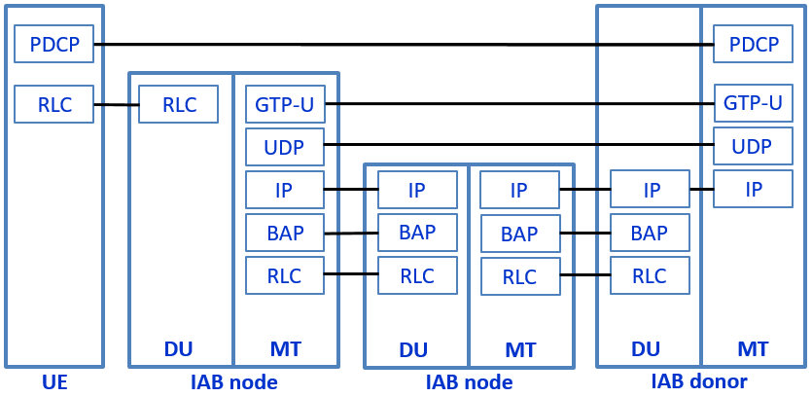
Integrated Access Backhaul
Due to cell densification, fiber xHaul will be prohibitively expensive
Use of cellular bands/techniques for xHaul was introduced in R10 (LTE relaying)
but becomes practical with 5G’s mmWave bands
IAB transports midhaul (F1) traffic over a QoS enabled, multi-hop IP network
Topology adaptation changes multi-hop path as needed
Starting with R16 DU and MT may use same band (in-band IAB)
  with time, frequency, or space (multi-beam MIMO) multiplexing
UE – IAB node – IAB node – … – IAB donor
  first IAB node terminates UE’s
    HARQ for fast ARQ
    RLC for optimal scheduling
  IAB donor terminates UE’s PDCP and RRC
    improved handoff decisions
    hiding Dus in network from core improves security
each IAB node consists of DU and Mobile Termination, while the IAB donor consists of DU and CU
Notes:
Fiber installation in metro areas estimated at 100 K$ per km
BAP = Backhaul Adaptation Protocol

Slide 31
Potential 5G RAN transport technologies
The 3 main challenges for the 5G transport segment are:
data-rate
latency
reliability (including very low Packet Loss Ratios)
Multiple transport innovations aid supporting 5G xHaul requirements
10GbE, XGS-PON, NG-PON2
  but 10 Gbps is only satisfactory for initial 5G deployments
25 GbE (802.3by), 1-lane 50 GbE (802.3cd)
100/200/400 GbE (802.3bs)
FlexE
Mobile (Multi-access) Edge Computing
Synchronization (SyncE, IEEE 1588, DGM)
Network slicing
Time Sensitive Networking (and Deterministic Networking)
Frame Replication and Elimination (IEEE 802.1CB)
high data rates
low latency
ultra high reliability

Slide 32

Slicing, again
Slicing is not only about dynamically separating transport flows
The decomposition of the gNB and virtualized functions
play an essential role in network slicing
A slice that requires a definitive response within a short time
needs edge computation which is only possible after the PDCP in the CU
and probably needs edge computation (MEC)
A slice that serves video can benefit from local breakout and CDN
voice + browsing
AMF
DU
CU
UPF
vFW
other
networks
video
MEC
DU+CU
CDN
Video server
transport
CORE
Massive IoT
DU
CU
UPF
cloud
V2X
DU+CU
V2X AF
V2X server

Slide 33
Implementing slicing
Slicing must be end-to-end - both RAN and core network must support slicing
Slicing requires programmability, flexibility, and modularity
in order to create multiple virtual networks over a common network
Different slices can be labeled using VLAN ID, VXLAN, IPv6 flow label, DSCP
but a slice is different from a separate physical network or a VPN
because of dynamic set-up / release requirements
and separate management
SDN techniques (network softwarization) are used to achieve slicing
APIs provided to specify requirements
service definition may include NFV/MEC elements
  particularly useful for ultra low latency cases
use of global orchestrator
  for rapid yet highly optimized slice creation

Slide 34
SDN and NFV for 5G
Software Defined Networking or Segment Routing
and
Network Functions Virtualization or
are widely considered to be essential technologies for 5G
Slicing depends on SDN to be dynamic, obey constraints, efficient, and end-to-end
Mobile (Multi-access) Edge Computing depends on NFV to dynamic place functionality where needed
SDN advocates replacing standardized networking protocols
with centralized software applications
that configure whitebox switches in the network
SR achieves SDN-like control over packet forwarding by adding routing information to packet headers
NFV advocates replacing hardware network elements
with software running on whitebox servers
that may be housed in data-centers or POPs or cell-sites

Slide 35
Source routing is evil
The IP suite (RFCs) provides a mechanism called Source Routing
IPv4 source routing options (Loose SR, Strict SR)
IPv6 type 0 routing header extension (Rh0)
which inserts sequences of router addresses into packet headers
Yet there are major problems with source routing
complicated processing for core routers
DoS attack – attacker forces packets to traverse selected routers, thus overloading them
amplified DoS attack – attacker forces packet to oscillate between 2 selected routers
infiltration attack – attacker bypasses ACLs by forwarding through a permitted waypoint
The IETF has not yet completely deprecated it
but highly recommends that it be disabled
Core Internet routers drop packets with options
(Linux kernels no longer process Source Routing)

Slide 36
Safe policy-based routing
But without Source Routing, how can we achieve policy based routing?
There are 2 alternatives
Software Defined Networking
SDN give the network administer full control over routing
particular flows can be configured to traverse arbitrary paths
But SDN
requires relatively large architectural changes
risks attacks (and plain bugs) at control plane level
Segment routing is similar to Source Routing, but
the path is specified by an ingress router, not by the source host
thus blocking Source Routing attacks (unless a router is compromised)

Slide 37
MPLS-based Segment Routing
MPLS forwards packets using a simple universal paradigm
read ToS Label
look up label in LFIB
perform label stack operation (swap, push, pop) in NHLFE
forward packet according to NHLFE
In regular MPLS networks
most of the time the label stack operation is swap
pop is used by egress LERs and FRR
MPLS segment routing reuses the standard MPLS mechanism
ingress LER inserts an entire stack of labels, one per hop
each LSR pops a label revealing the next hop
MPLS SR doesn’t require LDP or RSVP-TE (but extends the IGP)

Slide 38
MPLS Segment Routing example
B
C
C
2
egress LER
ingress LER
label = B
desired path
3
label = C
label = A
ToS
A
B
C
1
BoS
Ingress LER inserts label stack with 3 labels : A (ToS), B, C (BoS)
1st LSR reads A, pops label, forwards over link for A
2nd LSR reads B, pops label, forwards over link for B
3rd LSR reads C, pops label, forwards over link for C

Slide 39

Synchronization
Frequency and time accuracy requirements are defined
to assure efficient and proper functioning of the air interface
5G RAN timing requirements
are stricter, especially for fronthauling (which uses packet based eCPRI instead of CBR CPRI)
When distributing timing over packet networks for 5G using IEEE 1588, ITU defines
Enhanced Primary Reference (Time) Clock (ePRC, ePRTC)
Telecom Grand Master Clock (T-GM)
Telecom Boundary Clocks (T-BC)
Telecom Slave Clocks (T-TSC)
ITU introduced two new T-BC accuracy levels for 5G - classes C and D
  Class A (up to 10 clocks, ±1.5µs E2E) 100 ns Time Error
  Class B (up to 20 clocks, ±1.5µs E2E) 70 ns Time Error
  Class C (up to 20 clocks, ±130ns E2E) 30 ns filtered Time Error
  Class D (long chains, FlexE, FlexO) 5 ns filtered Time Error

Slide 40
5G Core Network

Slide 41
Mobile core networks
Like all core networks, the mobile core handles transport of user data, with
very high data rates
relatively small number of network elements and links
relatively stable environment
Mobile core networks were originally circuit switched (SDH)
but have migrated to packet switching
The mobile core network is more like a PSTN core than an Internet AS core since it supports:
voice traffic (at least until 4G)
user (not necessarily true end-user) management
  mobility management (tracking where users are)
  user profile, home location
  authentication and registration
  billing (charging)
session management (call establishment, management and termination)
lawful interception (CALEA)
QoS (network neutrality may not be relevant for mobile)

Slide 42

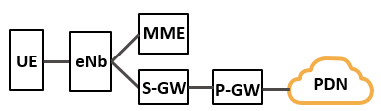
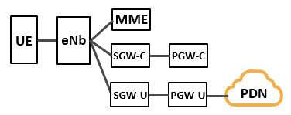
Architectures from 3G to 5G
3G data the Nb+RNC connect to the SGSN and GGSN
SGSN and GGSN handle both data and control
4G Nb+RNC were unified into the eNB
eNB connects to S-GW and P-GW
Mobility management was separated
4G CUPS (R14) separates into UPF and CPFs
S-GW-C and S-GW-U, P-GW-C, P-GW-U
5G
decomposes the MME into AMF and SMF
unifies all user plane functions (S-GW-U and P-GW-U) into the UPF
unifies S-GW-C, P-GW-U and MME session management into SMF
reorganizes functions as micro-services

Slide 43
Upgrading the core
5G service and network requirements
necessitate a fundamental change to the core architecture
Some 4G network cores presently support 10s of millions of subscribers
5GC will need to support many more subscribers and sessions
The only technology proven to scale up to such sizes is cloud computing
3GPP has defined a new 5G Core architecture
that uses a cloud-native Service Based Architecture (SBA)
with modular Network Functions instead of Network Elements (boxes)
NFs can be hardware or (virtual) software – even VMs in a cloud
NFs are more atomic for improved scaling
NFs in control plane enable authorized functions to directly access services
reference points are defined between NFs, not Network Elements
single interface to NF rather than interface between every two NFs
use of Representational State Transfer (stateless, client-server, with CRUD operations) principles

Slide 44
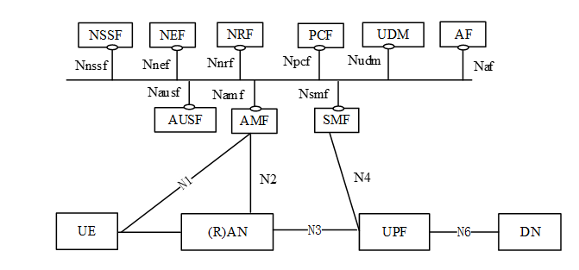
Simplified 5G core – SBA
The new core’s Service Based Architecture is based on Network Functions – not Network Elements (boxes)
NF can be hardware or (virtual) software – even software hosted in the cloud
core NFs can be located anywhere – even near the antenna
to enable scaling, core NFs are designed as micro-services connected using function chaining
the core utilizes a unified database and single authentication server
The core NFs are interconnected via a logical bus (every NF can communicate with every other NF)
and the Network Repository Function allows every NF to discover the services offered by other NFs
SBA
NFs
SBIs

Slide 45
UPF
The User Plane Function performs all the user plane functions
handled in 4G by S-GW, P-GW, and TDF, including:
anchor for mobility
connection to external data networks (e.g., Internet)
optionally Firewall and Network Address Translation (NAT) functions
packet queuing
packet routing and forwarding
packet inspection (optionally DPI), classification, QoS handling
policy enforcement
packet marking
lawful intercept
traffic usage statistics collection and reporting
IPv4 ARP and IPv6 neighbor solicitation

Slide 46
AMF and SMF
The 4G MME has 2 distinguishable functions
access/mobility management
session management
A single RRC message usually performs both access and session attaches!
But a single UE can simultaneously participate in multiple sessions
In 5G the access/mobility and session management are separated into micro-services
the AMF performs the access and mobility functions
that were handled by the 4G MME, S-GW-C and P-GW-C
the SMF performs the session management functions
that were handled by the 4G MME, SGW-C, and PGW-C
The AMF and SMF are stateless, but often need access to state information
For this purpose there is a secure and resilient Unified Data Management function
that provides data storage, e.g., the UE’s subscription data (like 3G HLR and 4G HSS)
The Authentication Server Function performs authentication based on keys stored in the UDM

Slide 47
Slicing, yet again
A single UE can participate in more than one slice
Each UE is served by a single AMF
but each slice from a UE has its own SMF and UPF
The AMF can use a Network Slice Selection Function to select the needed network slices
based on Network Slice Selection Assistance Information from the UE
AMF
SMF
UPF
DN
UE
UPF
DN
SMF

Slide 48
AFs and capability exposure
In order to enable new service types and integrate with vertical industries
5G core functionalities will be made available to 3rd parties, including
    application service providers
    value added service providers
    end-users (vehicles, factories, smart cities, etc.)
5G learned from MEC the importance of capability exposure
and defined the Network Exposure Function
which is similar to the core’s own NRF
The NEF, like MEC’s Mobile Edge Platform, can be queried via an API
to discover available services
Capability exposure is a very common feature of web-based services
and the modern way of providing such services is via RESTful APIs

Slide 49
The End

